Slide 1
Archaic Era(750-480 b.C.)
Culture and Art

Slide 2
Texts: poetry and litterature
Poetry: feelings, expression of personal experiences and sentiments
Λογογράφοι (writers): they try to tell their cities history, to talk about their everyday life and rituals
Hecateus from Miletos, Athis (Ατθίς),
POETRY
Expressing personal feelings
The time flied away so quickly, midnight is near,
the moon was hiding, the same did the Morning Star,
and here I am, alone, deserted.
Love, that only difficult times gives,
Love that makes fairy tales
seized my soul and burned it
same as the wind that comes from the mountains
and rushes through the trees
Sappho, woman poet

Slide 3
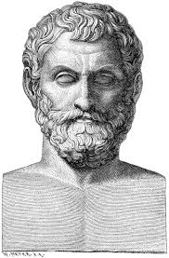
Litterature: philosophy
Philosophers try to explain the creation of the world (κοσμογονία),
and they are called natural philosophers
Thales of Miletos: he thinks that the beginning and the basis of the cosmos (the world) is the water.

Slide 4
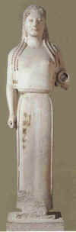
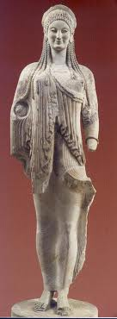
sculpture: “Anatolian”, from east, Daedalic is the form of statues (Daedalus was a mythic person
Woman figure
Κόρη

Slide 5
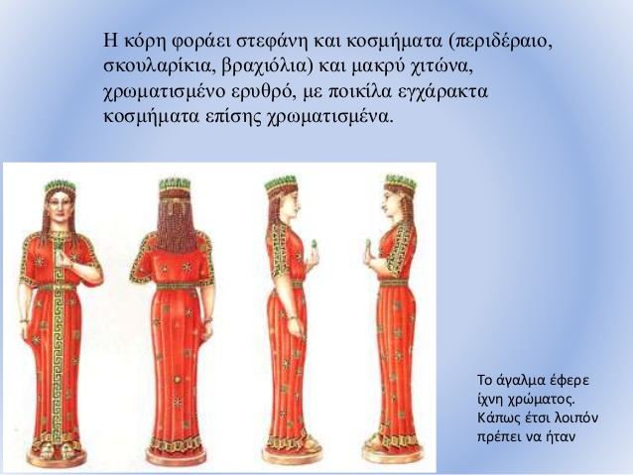
Woman in veil

Slide 6
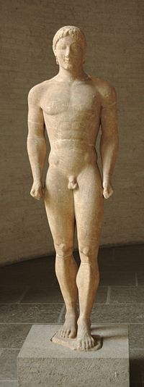
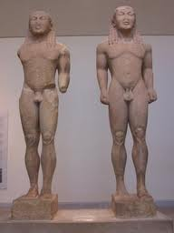
Sculpture
Kouros, man figure:
Kleovis and Viton
Κούρος of Anavyssos

Slide 7
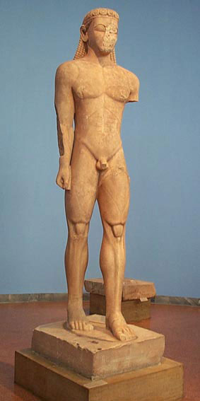
sculpture

Slide 8
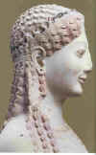
General characteristics
Archaic smile.
The figures are motionless.
Kouros and Kore are motionless but they try to make a step forward.
Details in hairdress and their clothes

Slide 9
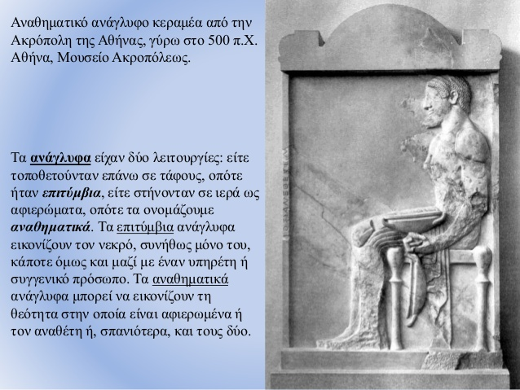
sculpture
More works in sculpture:
Details in temple pediments
Reliefs votive or tombstones

Slide 10
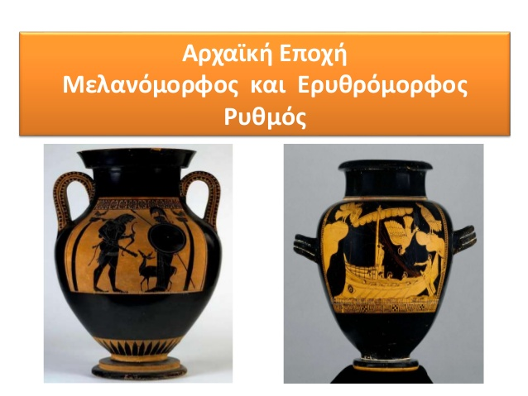
Vase Paintings
The figures are in black color (blackcolored vases)
or in red color (redcolored vases)

Slide 11
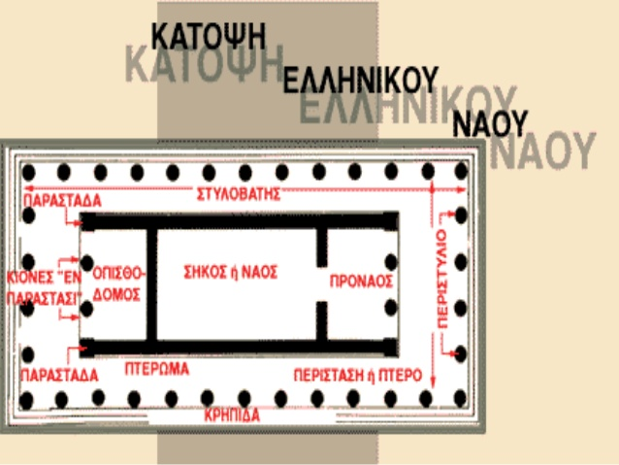
Architecture
The design of a peripteros (περίπτερος)
temple
You see the floor plan of a temple →

Slide 12
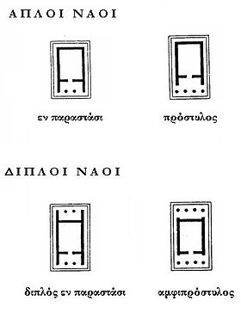
Temple building
The temple types are:
doric : it has triglyphs and metope over the molding
ionic : it has frieze with sculpture presentations from Greek mythology
Columns and sculpture presentations.

Slide 13
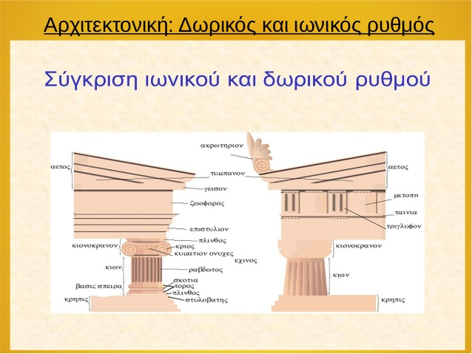
Comparing Doric and Ionic type

Slide 14
Persian Wars
When?
During the first decades of 5th cent.BC
What was the motivation?
Ionic Revolution 499-494 BC
When was the first Persian organized attempt to expand?
492 BC: Persians with their fleet came against Greek cities. They conquered Thrace and Macedonia, but their fleet destroyed by a tempest near Athos peninsula

Slide 15
Persian Wars
Second expendition against Greek cities 490 BC
A naval operation
Persians wanted to punish Eretria and Athens because they helped the Greek colonies during the Ionic Revolution.
490 BC Marathon Battle, disaster for the Persian army from Athenians and Plateians (Miltiades was the Athenian general)

Slide 16
Third Expedition 480-479 BC
Persian leader, Xerxes the King of Persia
He wanted to conquer all Greek cities
Corinth Congress 481 BC: all Greek cities united under the common goal: freedom
480 Thermopylae Battle, Leonidas was the leader
480 Artemision Naval Battle
480 Salamis Naval Battle, Themistocles was the leader
479 Plataies Battle, Pausanias was the leader
479 Mycale Naval Battle

