Slide 1
The cradle of civilization
Ancient people of Anatolia

Slide 2
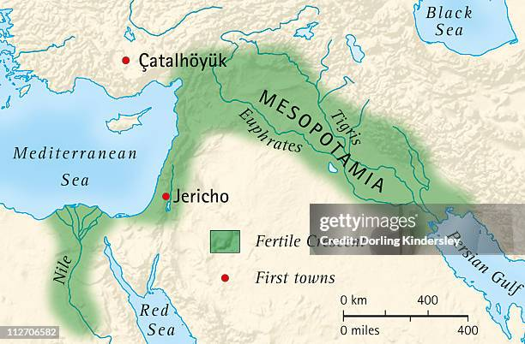
Mesopotamia
The region between two rivers, Tigris and Euphrates make the fields fertile .
The ancient name of the region is Assur.

Slide 3
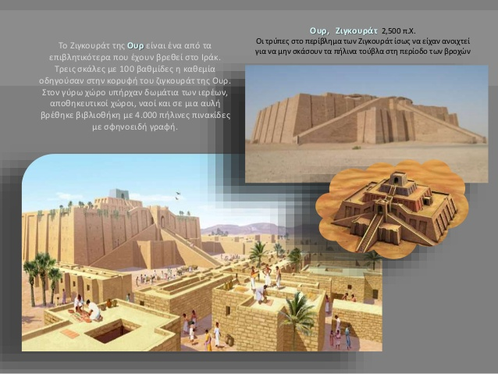
Religion-temples (ziggurat)

Slide 4
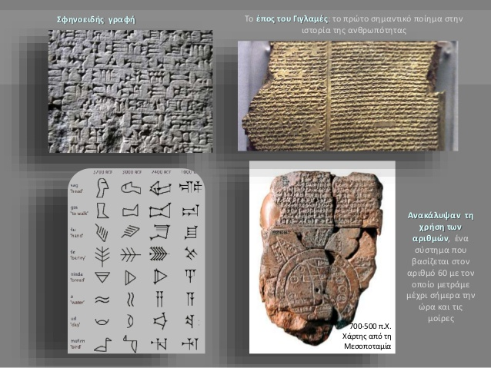
Scripture, cuniform letters, texts in clay

Slide 5
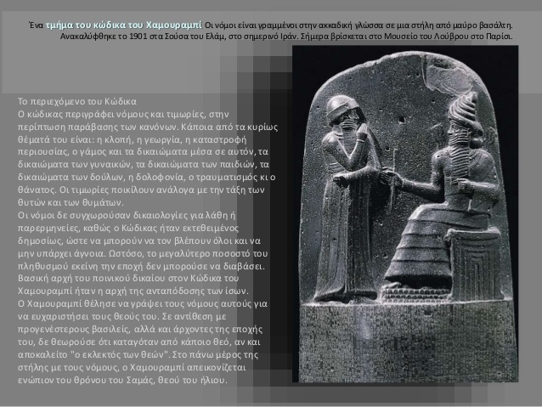
Law: Hammurabi, the righteous king and his law.

Slide 6
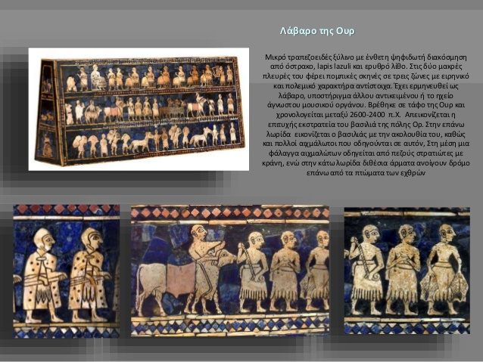
The warriors

Slide 7
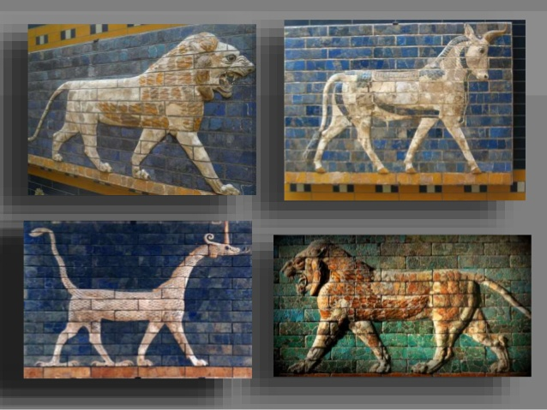
Decorating the palaces…

Slide 8
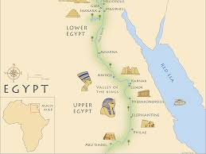
The historian Herodotus called Egypt, “the gift of Nile” because the fields were fertile. Once a year the river floods and leaves the mud, a natural fertilizer, over the fields. In first place there were 2 kingdoms, Lower and Upper Egypt, but later they became into one.

Slide 9
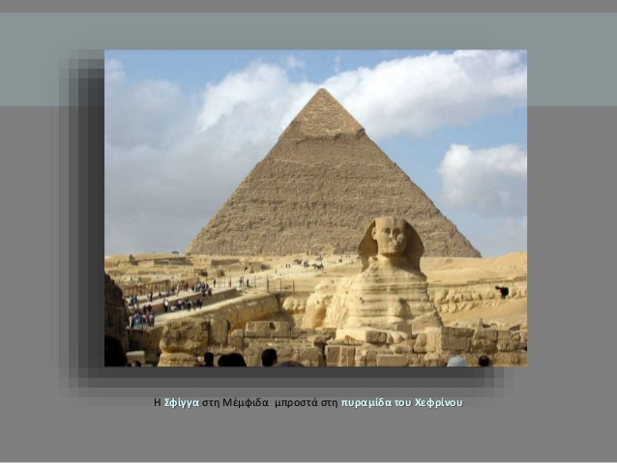
Pyramids, temple and monuments

Slide 10
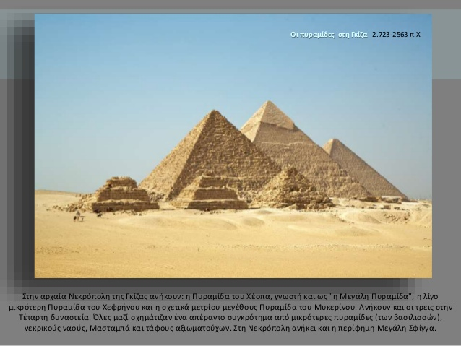
Giza, Cheops pyramid

Slide 11
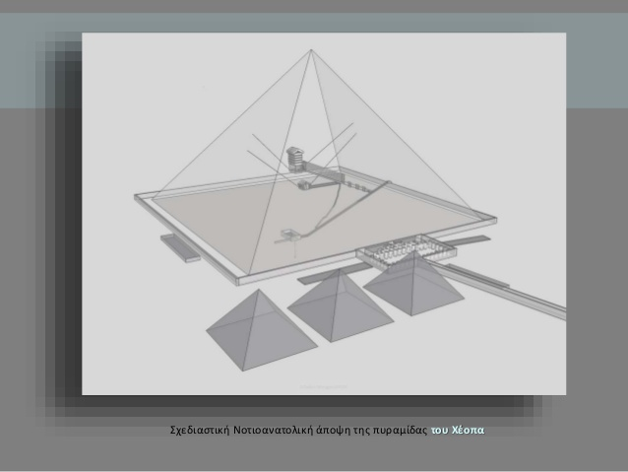
The interior of a pyramid

Slide 12
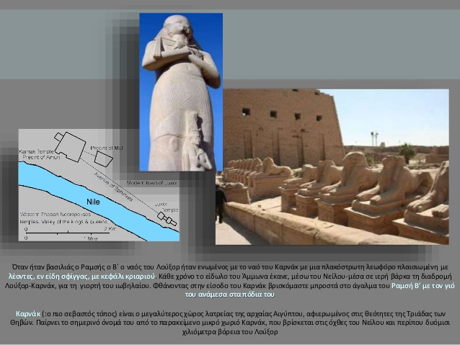
Temples, Carnak

Slide 13
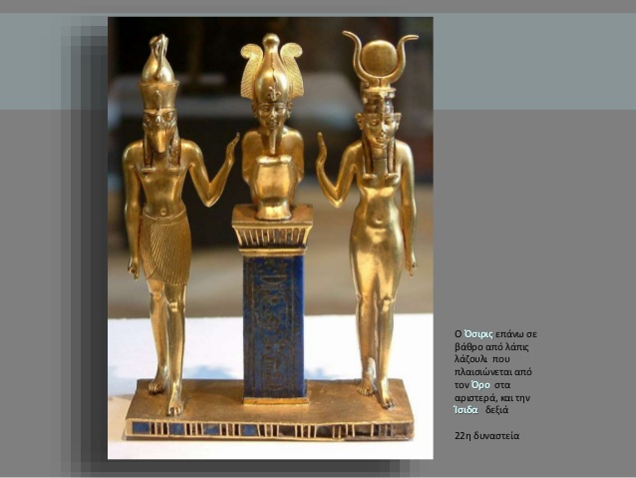
Creation Gods: Oriris, Isis, Horus

Slide 14
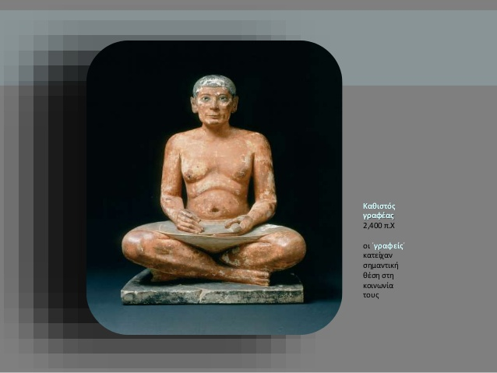
Hieroglyphs: the sacred craft

Slide 15
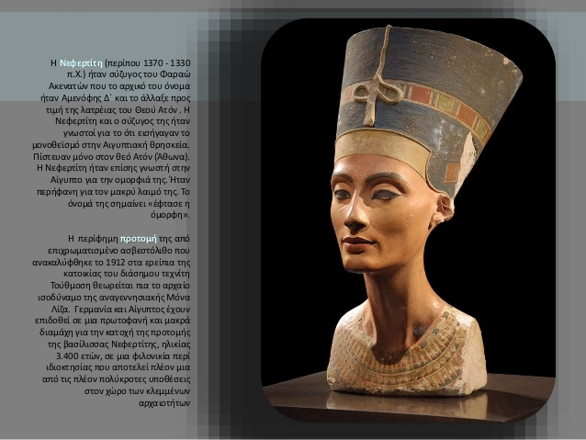
Nefertiti, Acenaton’s wife

Slide 16
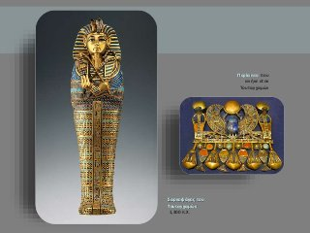
Pharaoh Tutachamon

Slide 17
Mesopotamia-Egypt: the oldest civilizations
Studying the cultures of Mesopotamia and Egypt, what common items you find?
How important was the geography for these civilizations?

Slide 18
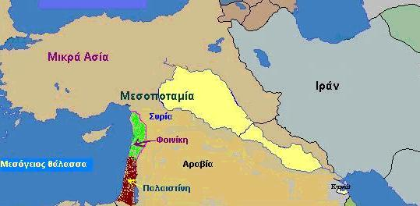
Phoenicians: a maritime people

Slide 19
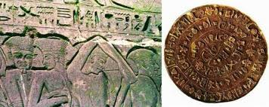
Merchants, they found the alphabet

Slide 20
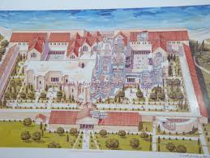
Carthago, Phoenicians colony in north Africa

Slide 21
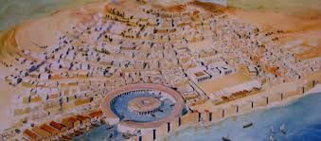
The city with the biggest naval station

Slide 22
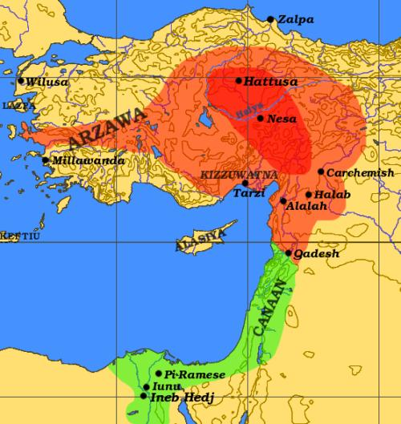
Chitites: in the heart of Anatolia

Slide 23
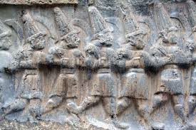
Warriors

Slide 24
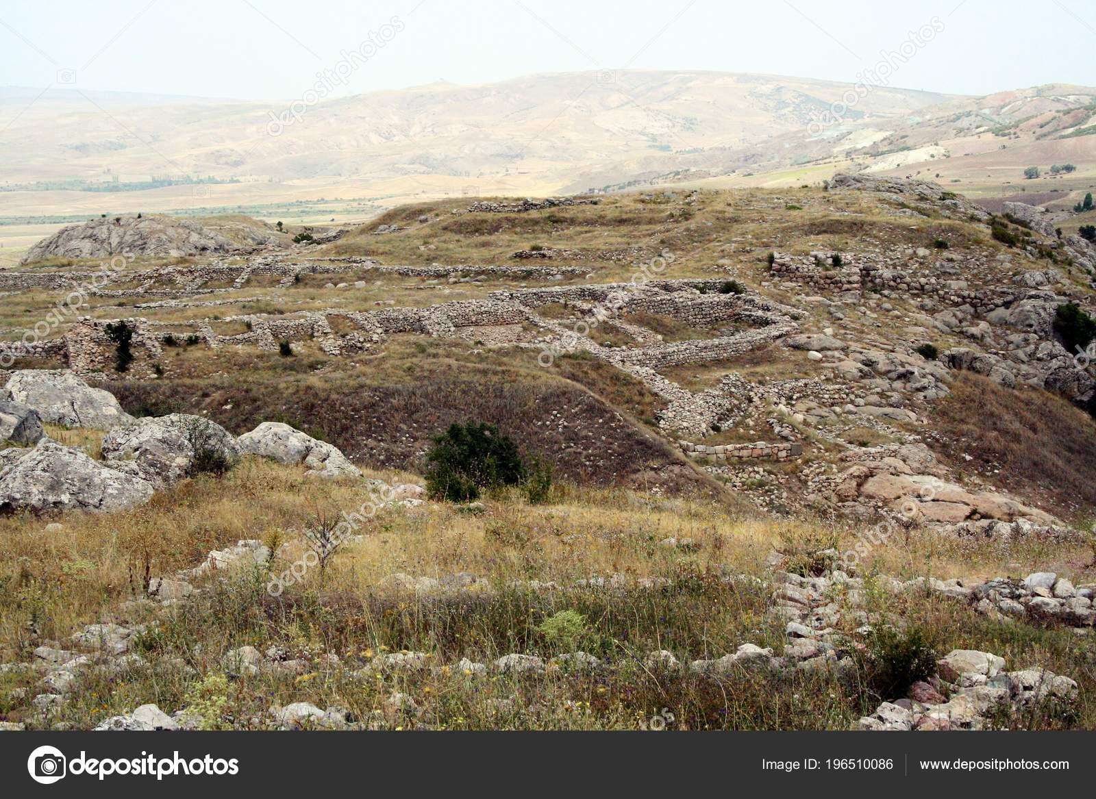
Chatoussa, their main city

Slide 25
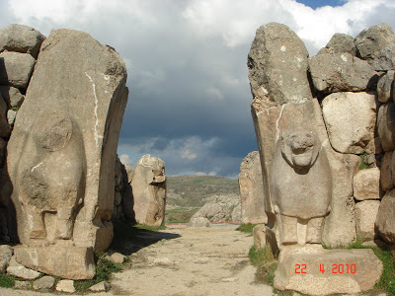
The gates of the city Chatoussa

Slide 26
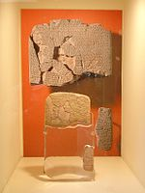
In the battle of Cantesh, Chitites fought against the Egyptians.

Slide 27
Let us recapitulate…
We saw two other civilizations, which was peaceful and which was martial?
Chitites expanded in Anatolia but from 11th century BC their traces are lost. What do you think happened to them?

