Slide 1
Talking about Environmental Issues and Concerns
An engaging lesson for Year 7 students

Slide 2
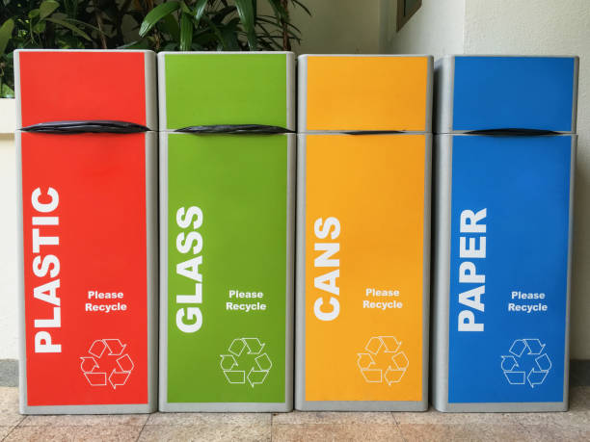
Project Summary - How can we save the environment?
Discuss the importance of saving the environment
Explore different ways to contribute towards protecting the environment
Develop strategies to reduce environmental damage

Slide 3
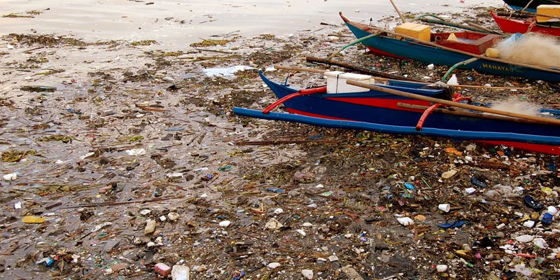
Project Launch - Impact of human activities on natural resources
Understand how human activities affect the environment
Identify the impact of deforestation, pollution, and waste on natural resources
Discuss the consequences of these activities on wildlife and ecosystems

Slide 4
True or False
True or False: Human activities have no impact on the environment

Slide 5
Milestone 1 - Identify environmental issues in the local community
Research and identify environmental problems in your local community
Understand the causes and effects of these issues
Discuss potential solutions to address the identified problems

Slide 6
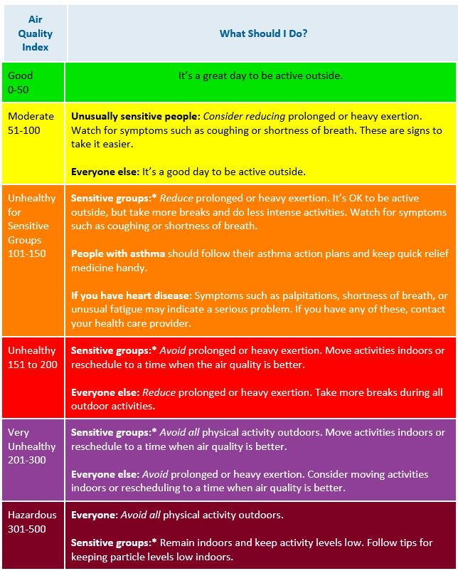
Milestone 1 - Research and discuss global environmental issues
Explore global environmental issues such as climate change, deforestation, and pollution
Discuss the causes and consequences of these problems
Investigate initiatives and organizations working towards solving these issues

Slide 7
Fun Facts
Fun Fact: Recycling one aluminum can save enough energy to power a TV for three hours

Slide 8
Milestone 2 - Brainstorm and develop strategies
Brainstorm ideas to reduce environmental damage in your community
Develop strategies for conserving energy, reducing waste, and promoting sustainable living
Discuss the feasibility and potential impact of these strategies

Slide 9
Milestone 2 - Individual reflection on personal environmental habits
Reflect on your personal environmental habits
Identify areas for improvement and set goals for sustainable living
Share your reflections with your classmates

Slide 10
Would you rather
Would you rather: Use a plastic bag or bring your own reusable bag?

Slide 11
Milestone 3 - Peer feedback on personal habits and strategies
Provide constructive feedback to your peers based on their personal habits and strategies
Offer suggestions for improvement and commend effective approaches
Engage in discussions to enhance understanding and collaboration

Slide 12
Milestone 3 - Group discussion on effectiveness
Discuss the effectiveness of the strategies developed by your group
Analyze the potential impact of these strategies on the environment
Consider challenges and improvements for future implementation

Slide 13
Multiple Choice Question
Which of the following is a benefit of recycling?
A) Reducing pollution
B) Increasing waste
C) Depleting natural resources
D) Contributing to climate change

Slide 14
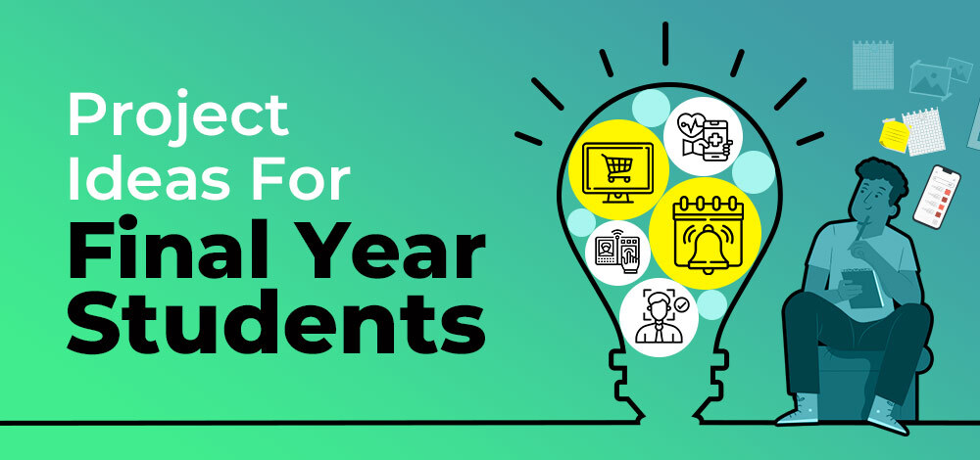
Milestone 4 - Create a final product
Create a final product to showcase your learning
Choose a medium such as a poster, video, or presentation
Include information about environmental issues and strategies to save the environment

Slide 15
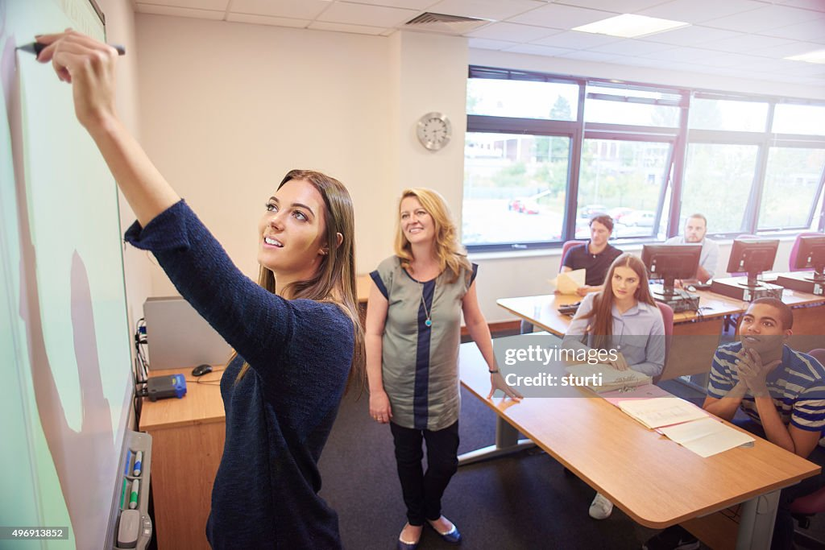
Milestone 4 - Class presentation of final products
Present your final products to the class
Share your knowledge and insights about environmental issues
Inspire others to take action and make positive changes

Slide 16
Discussion question
Why is it important to share ideas and collaborate to save the environment?

Slide 17
Scaffolds - Graphic organizers and modeling effective language use
Provide students with graphic organizers to plan their ideas
Model effective language use for discussing environmental issues
Offer support and guidance in developing clear and persuasive arguments

Slide 18
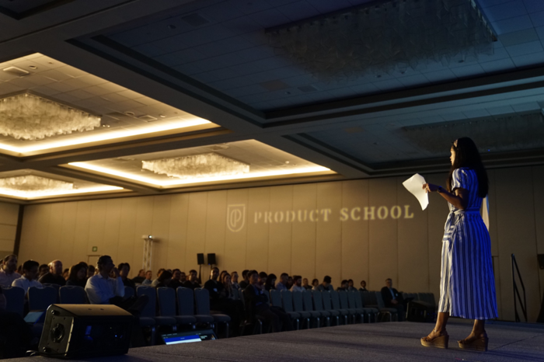
Public Presentation of Learning - Presenting to an authentic audience
Present your final products to an authentic audience
Invite parents, community members, or environmental experts
Receive feedback and recognition for your efforts

Slide 19
Reflection - Strengths and areas for improvement
Reflect on the strengths of your project and presentation
Identify areas for improvement in your understanding and communication
Set goals for future learning and engagement with environmental issues

