Slide 1
The History of the Freedom Riders of 1961

Slide 2
Who Were The Freedom Riders?
Notes:
They were a group of black and white people, young and old, who were inspired to change the attitudes of discrimination and bigotry in the deep South in 1961 by riding together on interstate buses. They sat together peacefully, ignoring segregated white only seating on the buses, bus station waiting rooms, bathrooms and cafeterias at the bus stations.
They volunteered to put themselves at great personal risk in order to bring about change in our democracy. They knew that they would be arrested; beaten and that they may even die for the cause.

Slide 3
Non-Violent Protesters of Segregated Transportation
Segregated buses, with “Colored Only” and “White Only” seating had already been declared illegal in Federal court cases.
Southern states still had segregation laws on the books.
No one was enforcing desegregation in the South.

Slide 4
The Civil Rights Movement
The Civil Rights Movement started in the 1950’s and reached its height in the 1960’s. It involved non-violent demonstrations by Black and White Activists to stop discrimination and bigotry that existed throughout the United States.
Although the Civil War Amendments to the U.S. Constitution (the 13^{th (1865)}, 14^{th (1868)} and 15th (1870) Amendments outlawed slavery and mandated equal protection of the law to all citizens in all states, Blacks in the South did not have equal rights.
In the South, every aspect of public life was segregated including, schools, libraries, parks, movie theatres, bathrooms, restaurants and all types of Public Transportation.
Notes:
State laws allowed segregation. The system of segregation was upheld by local government officials and reinforced by vigilantes.
The state laws were humiliating to Blacks. Further, Black only facilities were inferior to white facilities or often non-existent.
**Now, let’s look at pictures of what the South was alike for minorities in the 1960’s.

Slide 5
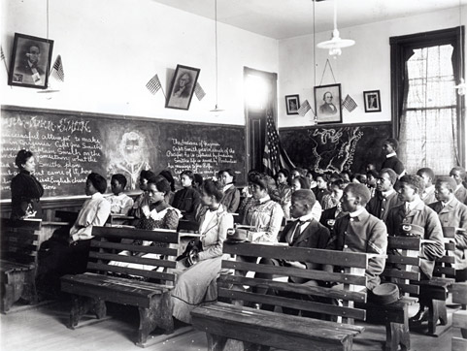
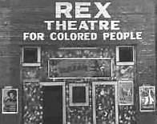
Segregation Permeated all Aspects of Life in the South
Segregated Schools
Segregated Movie Theatres

Slide 6
Notes:
Drinking fountains were always labeled Colored Only or White Only. Most of the time the facilities designated for Blacks were inferior or non-existent.

Slide 7
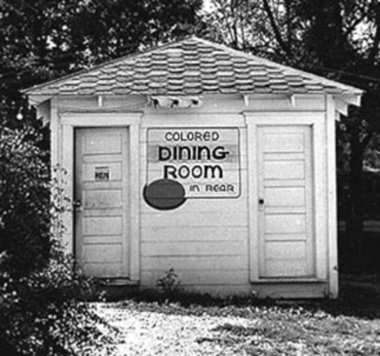

Slide 8
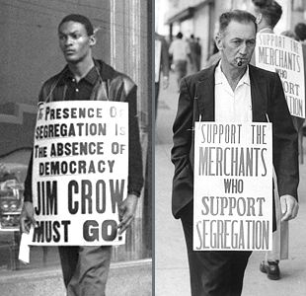
Notes:
There were many “Jim Crow” or State laws in the South discriminating against Black people.

Slide 9
1951- Students Protested Segregated Lunch Counters in Greensboro, North Carolina.
Notes:
Students inspired by the non-violence techniques of Mohandas Gandhi in the revolution in India against Great Britain and by Dr. Martin Luther King, Jr. began to demonstrate
against these Segregation Laws. Students and others, such as CORE (Congress of Racial Equality) began to use such techniques to gain equal treatment for Blacks in the
United States.

Slide 10
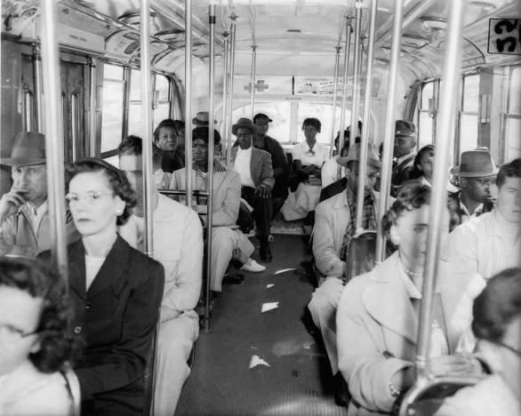
Notes:
In 1946, the U.S. Supreme Court outlawed segregated seating on interstate buses (Irene Morgan vs. Virginia). Yet, the segregated seating continued, no one was enforcing the law.
Then, in 1960 the U.S. Supreme Court in Boynton v. Virginia, banned segregation in bus depot bathrooms, cafeterias and waiting rooms.
However, if no one was going to enforce those laws they had little effect.

Slide 11
The Freedom Riders were trained Civil Rights Activists
Notes:
In 1961, CORE (Congress of Racial Equality) planned a “Freedom Ride” from Washington, D.C. through the Deep South, including Georgia, Alabama, Mississippi and Louisiana to
deliberately violate the illegal Segregation Laws in those States and call public attention to the continued plight of Blacks in these states. **Here is an example of how they were
trained to withstand having smoke blown on them, being called names, having eggs, and fruit thrown at them. They were expecting to be harassed as they tried to meet their objectives.

Slide 12
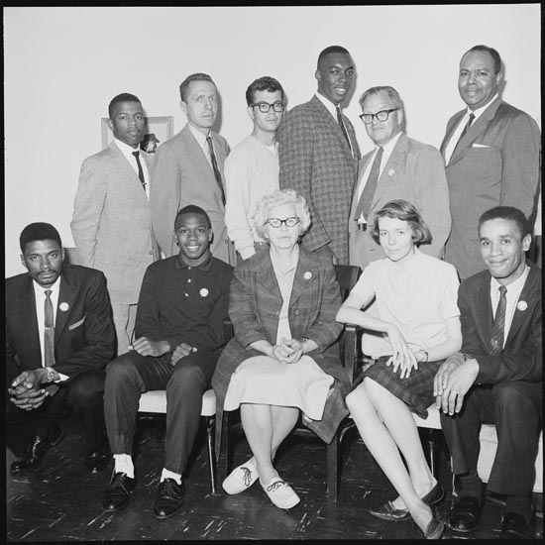
The Original Group –May 4, 1961
Notes:
The original Freedom Riders: Front, left to right: Joe Perkins, Charles Person, Frances Bergman, Genevieve Hughes, and Jimmy MacDonald; Back, left to right: John Lewis, Jim Peck, Ed Blankenheim, Hank Thomas, Walter Bergman, James Farmer. Not pictured: Rev. Benjamin Elton Cox, and Albert Bigelow. Credit: Johnson Publishing Company Their Goals: 1) to overcome the humiliation of dual facilities; 2) to dare the Kennedy Administration to enforce the U.S. Supreme Court Decisions; and 3) to confront segregation head on. **The Young Man in the back row on the left (John Lewis) was a student at Nashville’s American Baptist Theological Seminary training to become a minister. Later Lewis would become the best-known among the youthful Freedom Riders, serving as chairman of the Student Nonviolent Coordinating Committee (SNCC), speaking at the 1963 March on Washington, and playing a pivotal role in the 1965 Selma — Montgomery March. In 1986, John Lewis was elected to represent Georgia in the U.S. House of Representatives where he currently is serving his 12th term.
They realized that they might be thrown in jail, subjected to violence and even killed. Due to their belief in the cause some of them left college right before final exams, not knowing if they would be reinstated to participate in the Freedom Rides.

Slide 13
The Planned Bus Route
Notes:
The planned route was to travel on interstate buses from Washington, D. C. through South Carolina, Georgia, Alabama and Mississippi to Louisiana. At first, the riders encountered no violence or resistance to their protest. But things changed when the bus reached Anniston, Alabama.

Slide 14
Anniston, Alabama- Riders are beaten; bus engulfed in flames.
Notes:
On May 14, 1961 in Anniston, Alabama a mob of around 200 people, including Klu Klux Klan Members, met the bus and broke windows, pulled riders off the bus and beat them.
The bus was fire bombed. In many instances the mob broke television crew cameras and beat up journalists before they attacked the Riders, so there would be no record of their crimes.

Slide 15
Original Freedom Riders are Flown out of Birmingham, Alabama
Asst. Administrator, John Seigenthaler is sent by Robert F. Kennedy (Attorney General ) to help the Freedom Riders and prevent further violence.
Notes:
On May 8, 1961 the first Freedom came to an end because no Greyhound Bus Drivers will drive the group. President Kennedy sent National Guards out to
rescue the Riders taking them out of Alabama by Plane to New Orleans, Louisiana. Attorney General Robert F. Kennedy’s Asst. John Seigenthaler was sent by
The Kennedy’s to try to prevent further violence in the South and stop the Freedom Riders.
Unbelievably, a group of students from Fiske University in Nashville, Tennessee organized by the Student Nonviolent Coordinating Committee (SNCC)
Decided to take over where the CORE group had failed. They took two buses from Nashville, Tennessee to Birmingham, Alabama. Mr. Seigenthaler
Tried to convince their coordinator, Dane Nash, to stop the Riders before someone got killed. She refused.

Slide 16
SNCC takes over Freedom Rides
Diane Nash, Coordinator of SNCC
Attorney General, Robert F. Kennedy was deeply troubled when he heard that Diane Nash and the SNCC was sending another group of Freedom Riders to Alabama.
They were told that they might get killed? Diane Nash said, “ We have signed our Last Wills & Testaments. We will not let violence win against non-violence.”
Notes:
Unbelievably, a group of students from Fiske University in Nashville, Tennessee organized by the Student Nonviolent Coordinating Committee (SNCC)
Decided to take over where the CORE group had failed. They took two buses from Nashville, Tennessee to Birmingham, Alabama. Mr. Seigenthaler
Tried to convince their coordinator, Dane Nash, to stop the Riders before someone got killed. She refused. Now, we will hear from
The Freedom Riders in some short video clips.

Slide 17
Resolution of the Freedom Rides
Hundreds of people around the country were inspired by the Freedom Riders and joined them.
In September 1961, the Interstate Commerce Commission issued a sweeping desegregation order that included orders that all Jim Crow signs be removed.
The Justice Dept. prosecuted local officials who resisted desegregation.

Slide 18
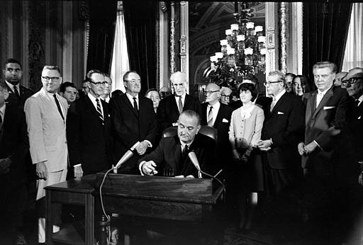
President Lyndon B. Johnson signs the Civil Rights Act of 1964
Notes:
Earlier Civil Rights Legislation was signed by President Eisenhower in 1960. However, this was the first Civil Rights law that called for enforcement of the Federal laws outlawing unequal treatment of Blacks and segregation.

Slide 19
Resources:
1.http://www.pbs.org/wgbh/americanexperience/freedomriders/index.php/tag/media/13
2.Bausman, Ann, “Freedom Riders: Congressman John Lewis and Jim Zwerg on the Front Lines of the Civil Rights Movement,” 2006, Natl. Geographic Society.
DVD: “Freedom Riders: Could You Get On The Bus?,” PBS, American Experience, 2011.

