Slide 1

Important Legal Vocabulary for
Twelve Angry Men

Slide 2
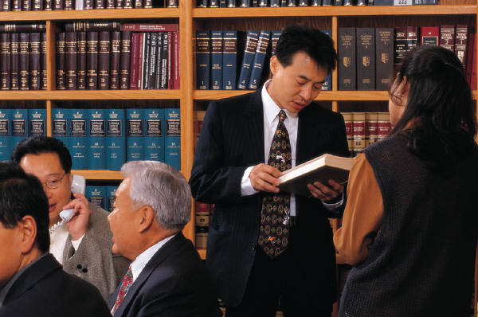
Counsel
A lawyer or attorney

Slide 3
Defendant
A person, company, etc., who is accused of something and taken to court.

Slide 4
Prosecution
The legal team who presents the case in a criminal trial against an individual suspected of breaking the law (the defendant).

Slide 5
Testimony
The statement or declaration of a witness under oath.

Slide 6
Burden of Proof
The obligation to establish a fact by proof.
(This is the prosecutor’s responsibility . )
the obligation to offer evidence that the court or jury could reasonably believe.

Slide 7
Motive
Something that causes a person to act in a certain way or do a certain thing.
Example of motives: revenge, jealousy, anger
My motive in going to Florida was
a wish to travel somewhere warm.

Slide 8
Alibi
An excuse, defense, or explanation for the defendant’s whereabouts at the time of the crime.
“Where were you on the night of January 11, 2012?” asked the prosecutor.
“I was at my grandmother’s house,” said the defendant.
(this is the alibi)

Slide 9
Circumstantial Evidence
Evidence in which an inference is required to connect it to a conclusion or fact
Example: a witness testifying that he/she saw the defendant stab the victim is direct evidence. However, a witness who says that he/she saw the defendant enter a house, that he/she heard screaming, and that he/she saw the defendant leave with a bloody knife gives circumstantial evidence

Slide 10

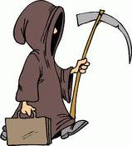
Premeditated Homicide/Murder
A murder that was done on purpose (not accidental) or one that was planned in advance.

Slide 11
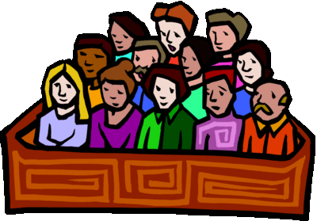
Foreman
Head juror
The role of the foreman is to ask questions on behalf of the jury, facilitate jury discussions, and sometimes to read the verdict of the jury

Slide 12
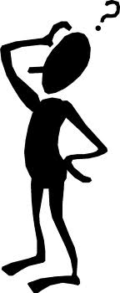
Reasonable Doubt
Reasonable means sensible; not foolish
Reasonable doubt is the level of certainty
a juror must have to find a defendant guilty of a crime
There must be no "reasonable doubt" in the mind of a juror that the defendant is guilty.

Slide 13
Deliberate
To consider carefully

Slide 14
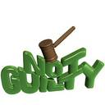
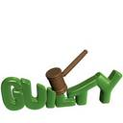
Verdict
The jury’s final decision
The verdict is either “not guilty” or “guilty”

Slide 15
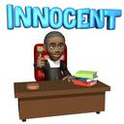
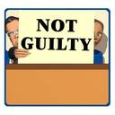
Acquitted
Declared NOT GUILTY
Example: He was acquitted of the murder charge because there wasn’t enough evidence against him.

Slide 16
Hung Jury
A jury that can’t come to an agreement on a verdict.

Slide 17
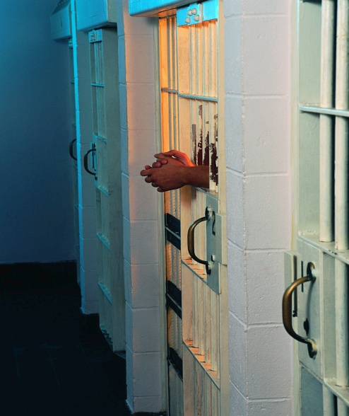
Double Jeopardy
The Fifth Amendment to the Constitution states that no person shall “be subject for the same offense to be twice put in jeopardy of life or limb.”
This means that no one can be punished more than once for the same crime.

