Slide 1
Nuclear Fusion
Our Solar System

Slide 2
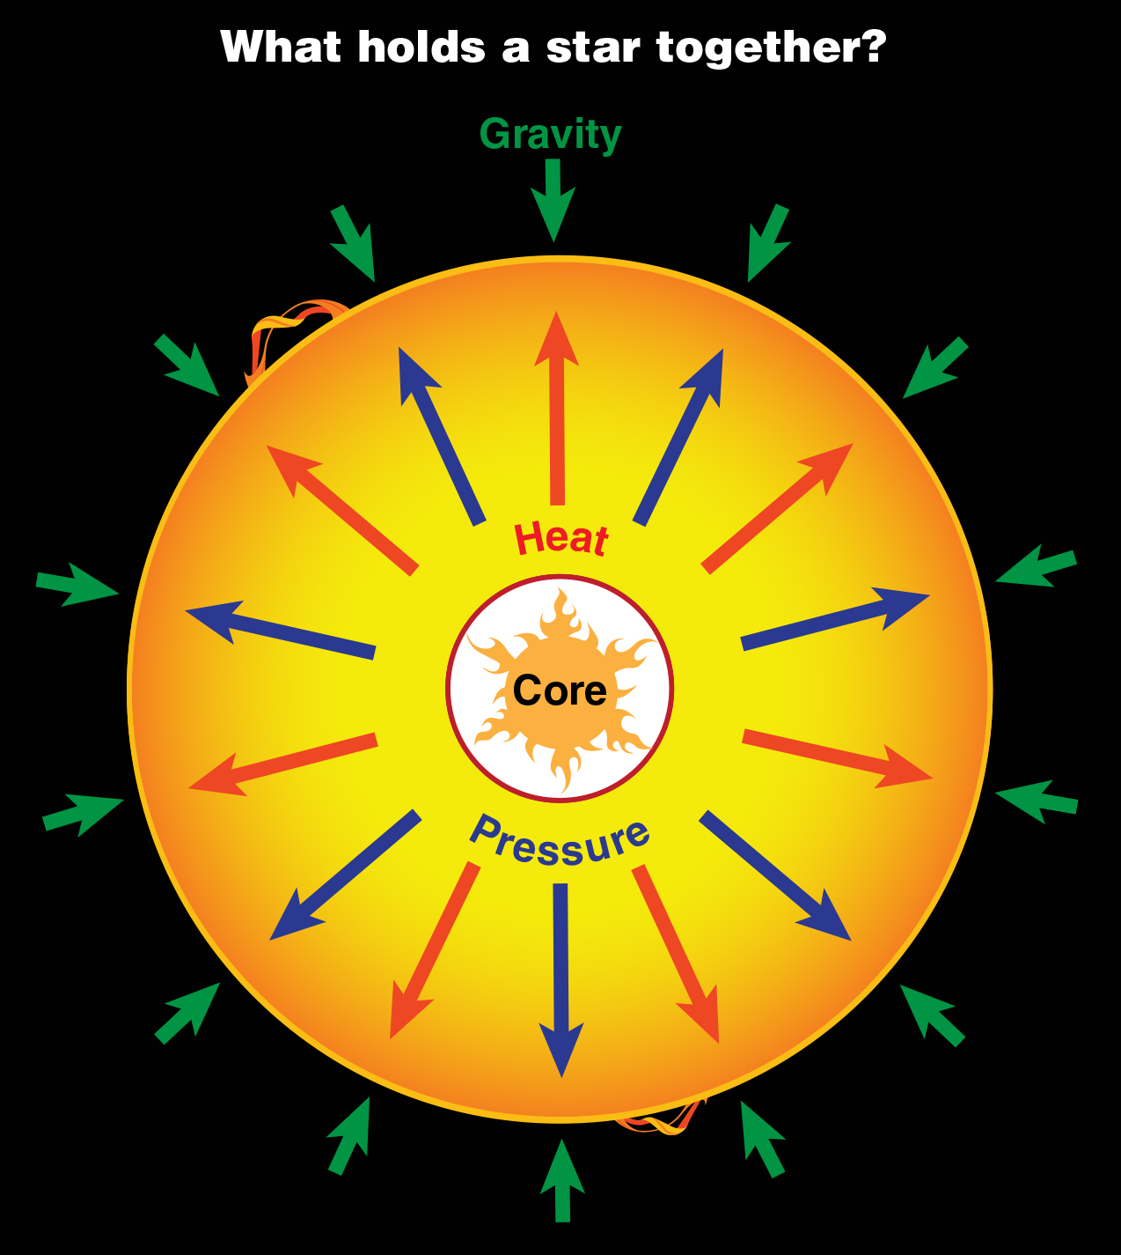

NUCLEAR FUSION

Slide 3
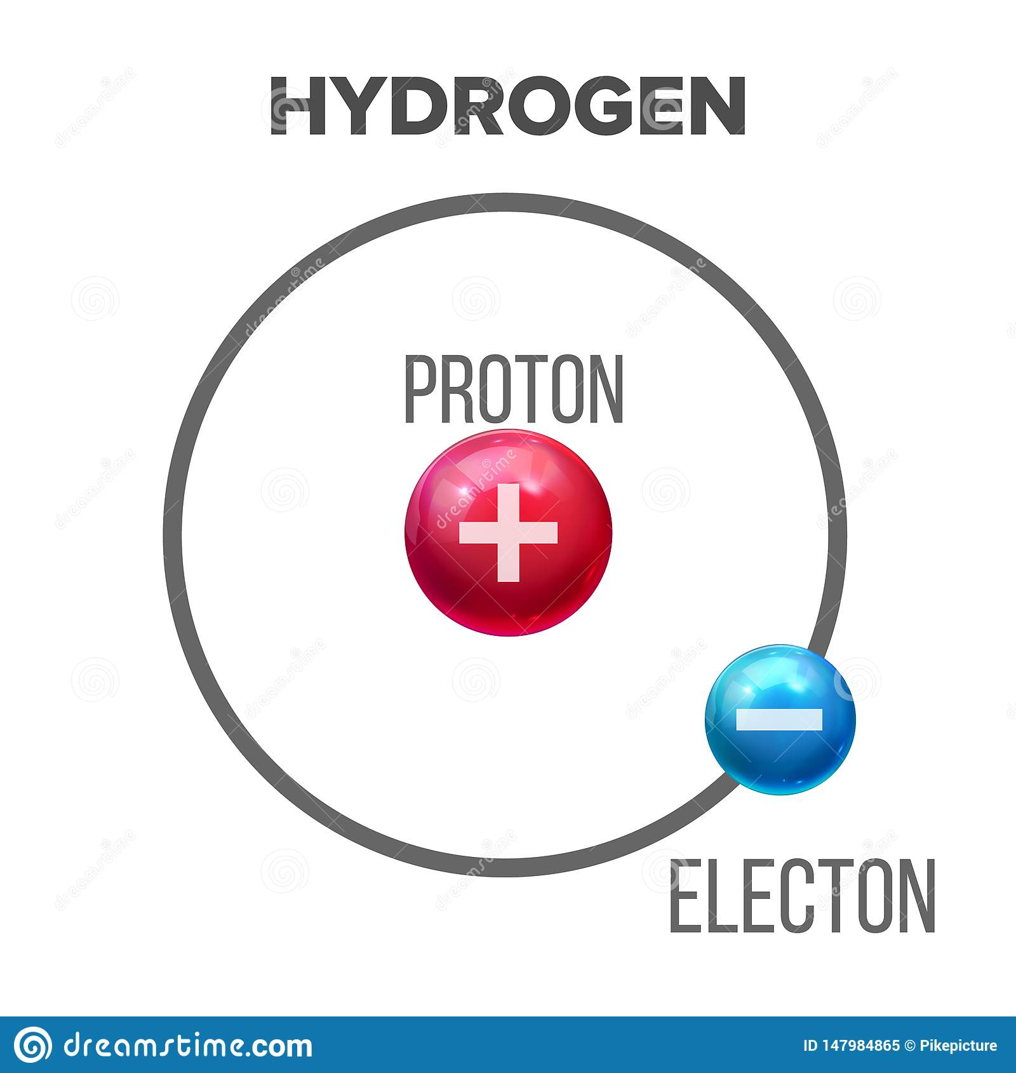
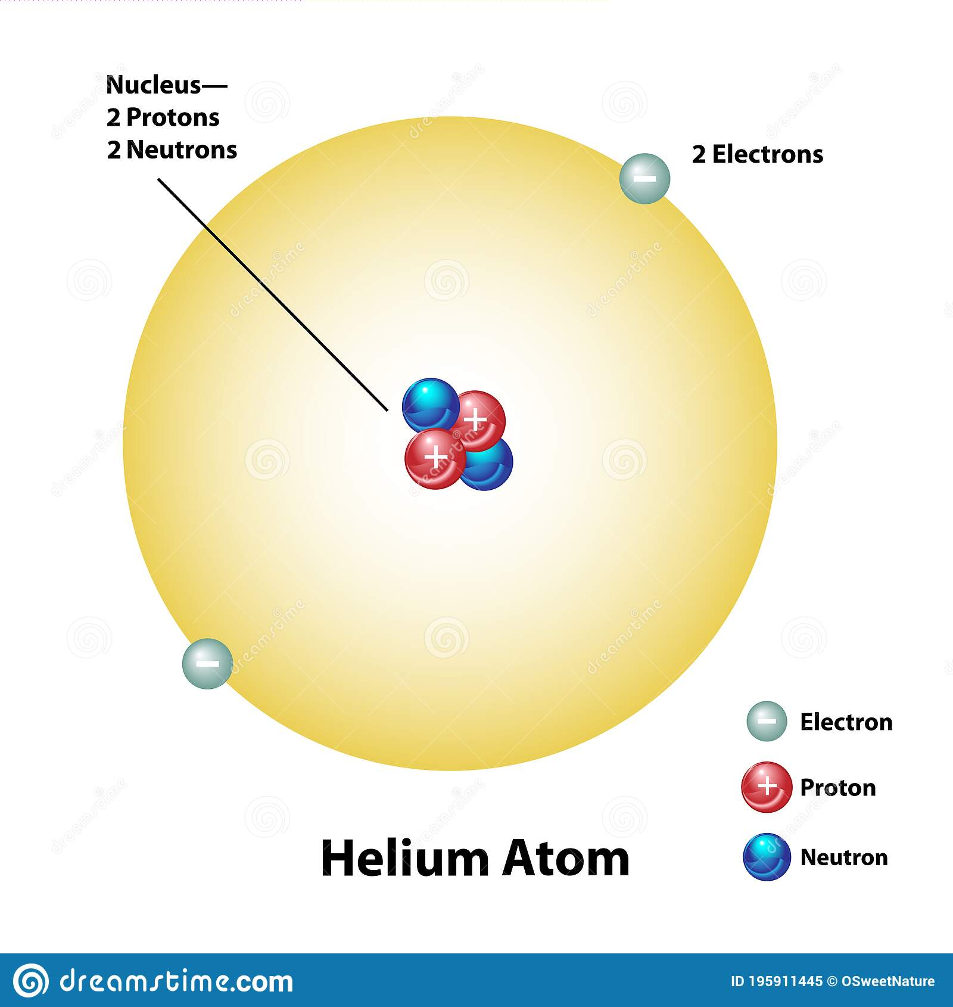
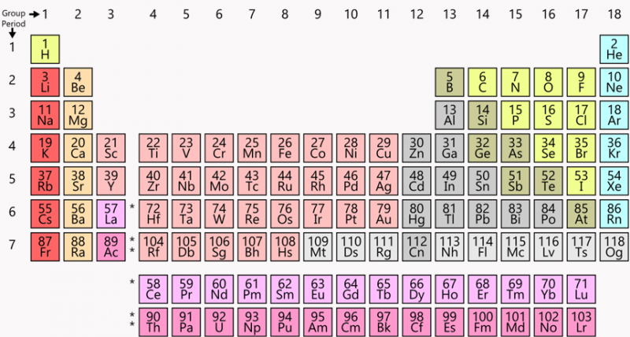

Slide 5
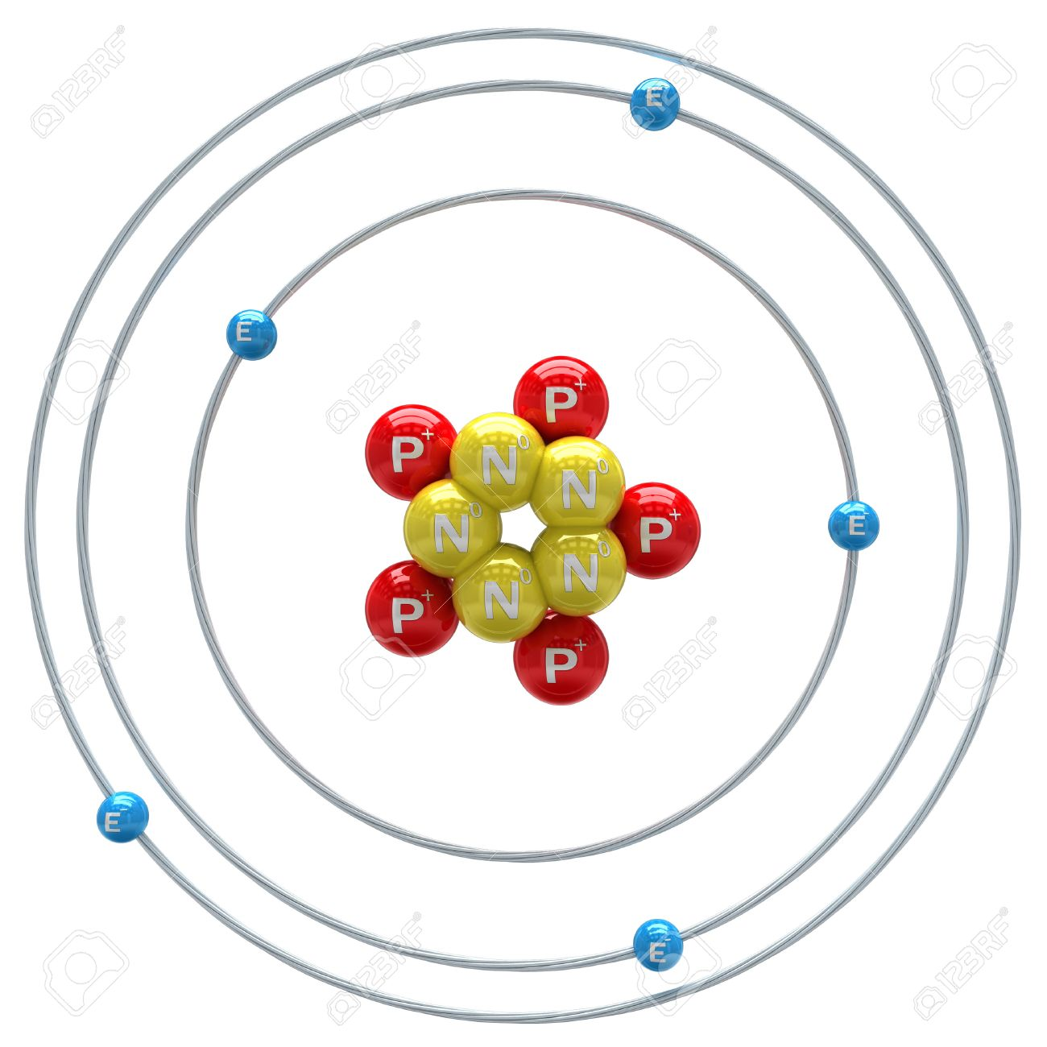
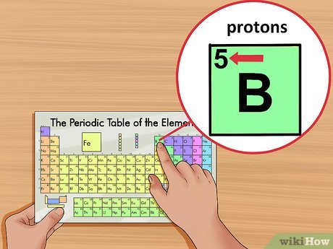

Slide 6

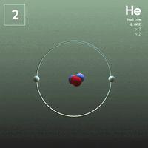
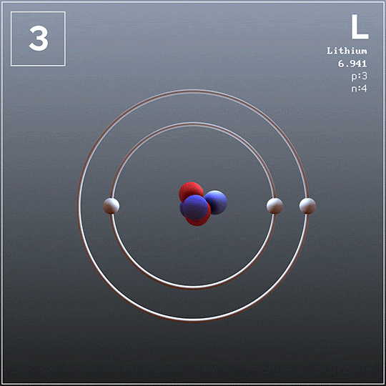
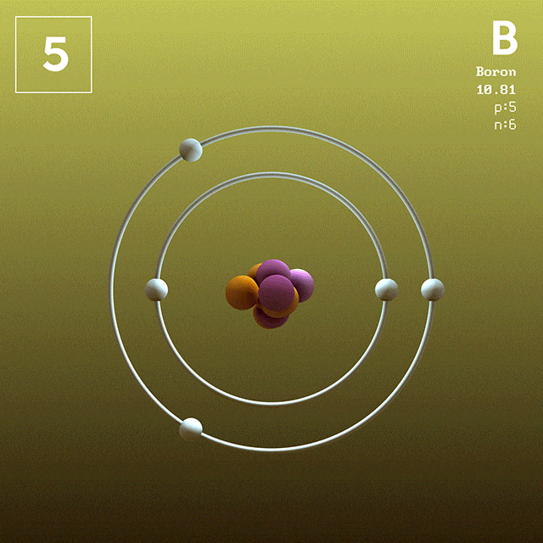
ELEMENTS DIFFER BY THE NUMBER OF???????
What is missing?
How many protons?
What element?

Slide 7

pressure - asl

Slide 8

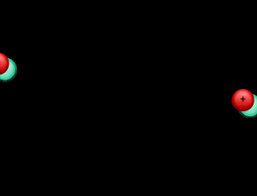

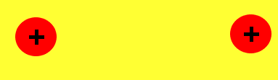
GRAVITY PROVIDES THE PRESSURE
atoms usually repel
gravity’s pressure can force atoms together

Slide 9
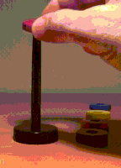
GRAVITY PROVIDES THE PRESSURE
gravity’s pressure can force atoms together

Slide 10

More Pressure Higher Temperature

Slide 11
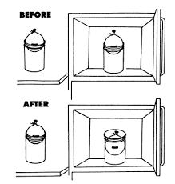
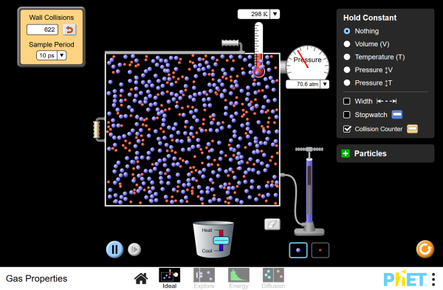
TEMPERATURE/PRESSURE LAB
PHET

Slide 12
GAME: NUCLEAR FUSION

Slide 13
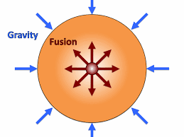

NUCLEAR FUSION

Slide 14
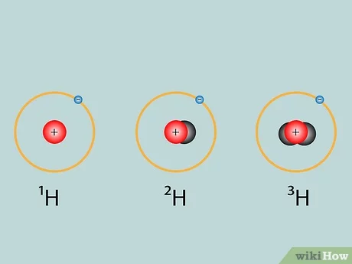
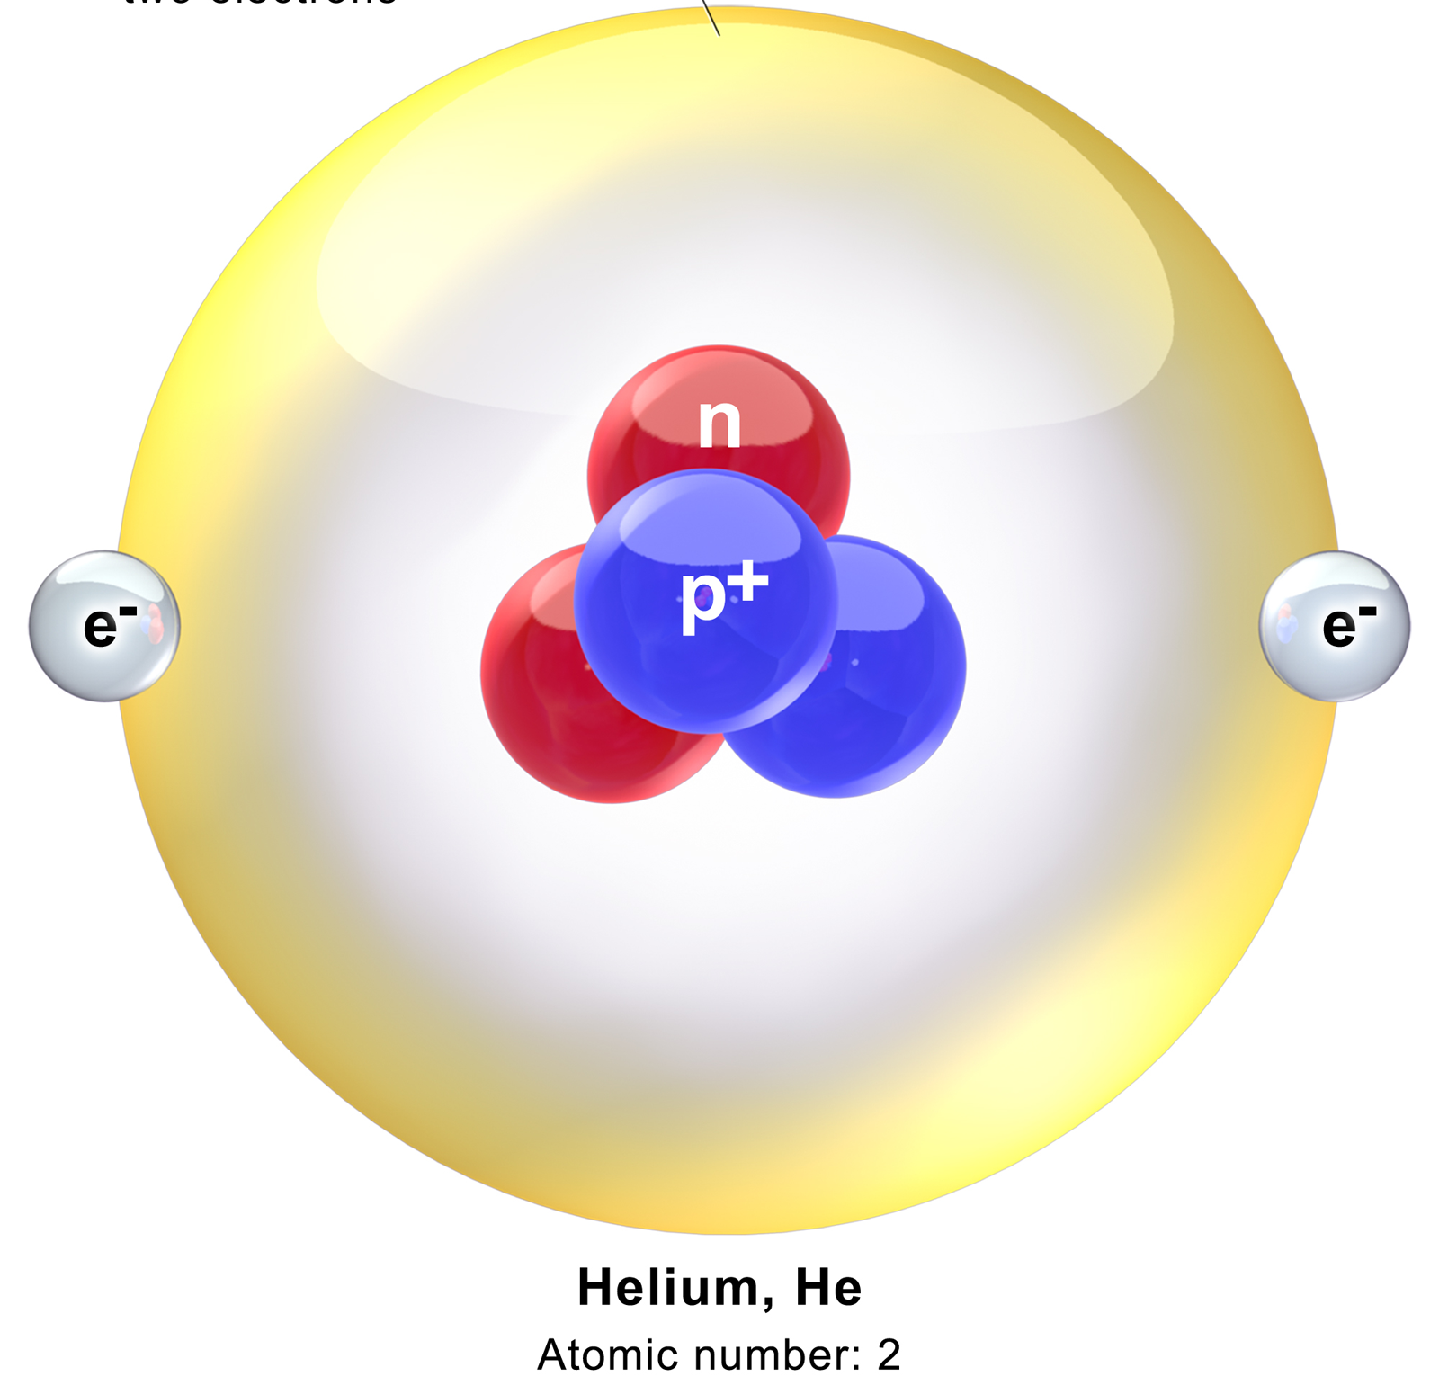
NUCLEAR FUSION

Slide 15
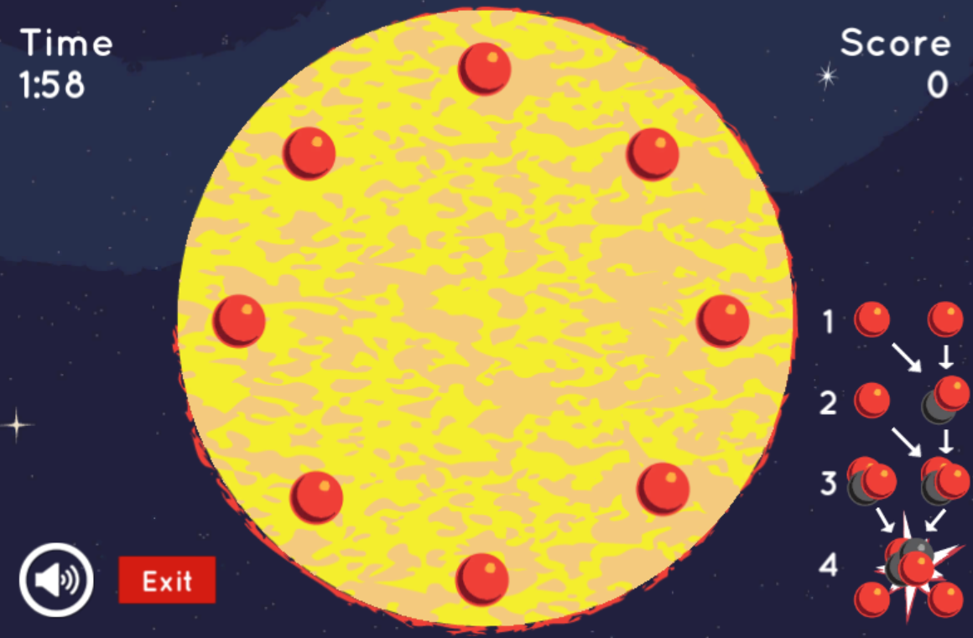
GAME: CREATE FUSION IN THE SUN

Slide 16
LAB: FUSION MARSHMALLOW

Slide 17


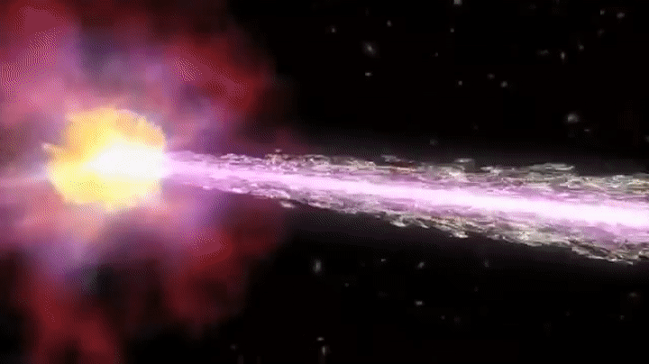
NUCLEAR FUSION LAB

Slide 18
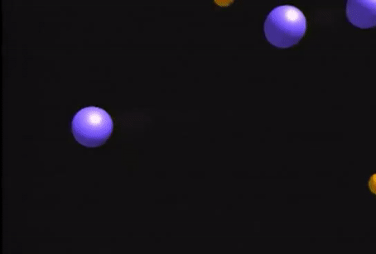

Slide 20
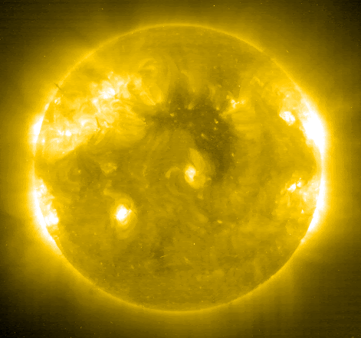
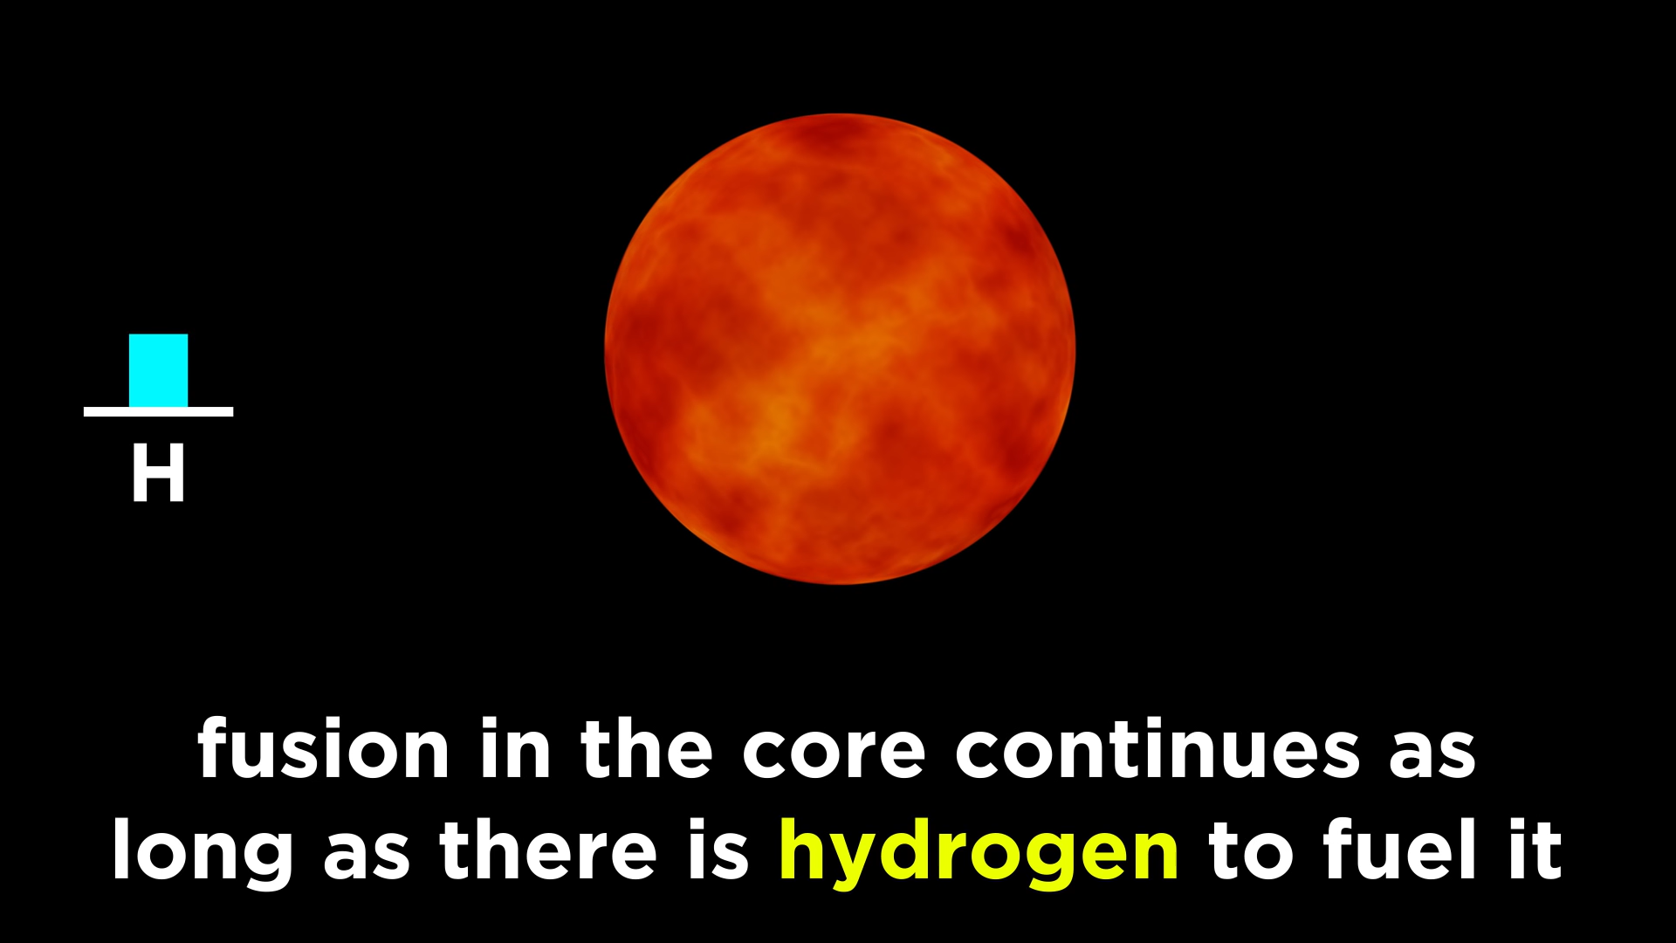
FUSION CONTINUES

Slide 21
RED GIANT

Slide 22
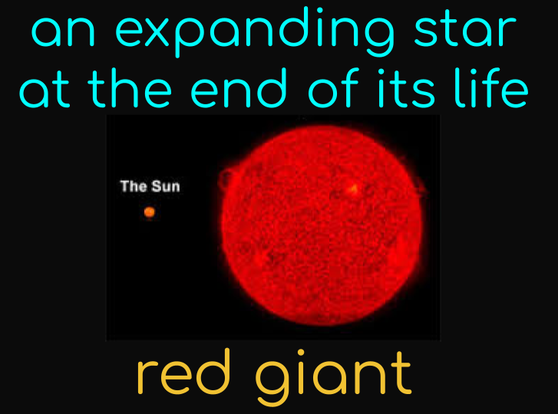
RED GIANT

Slide 23
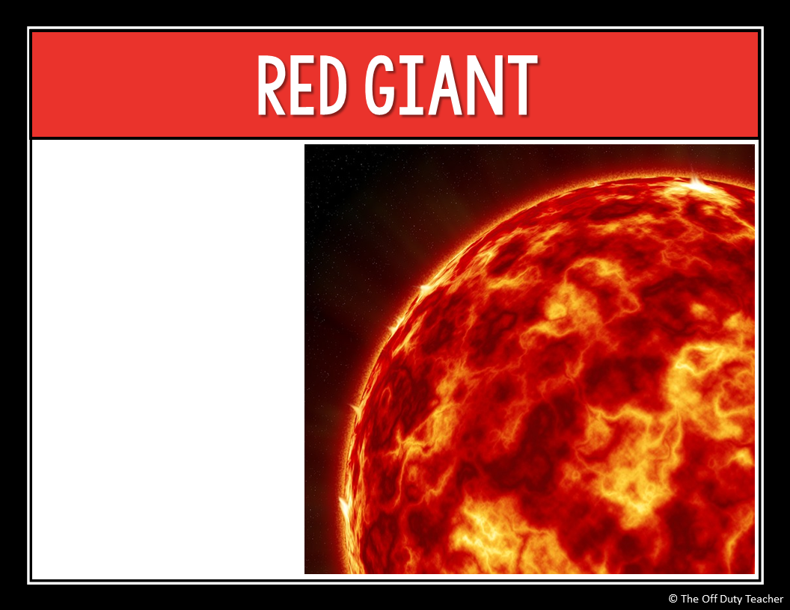
Eventually, the heat forces the hydrogen on the edge of the star to expand into space
It cools and turns red
A red giant may expand to 100 times its former size

Slide 24
ACTIVITY

Slide 25
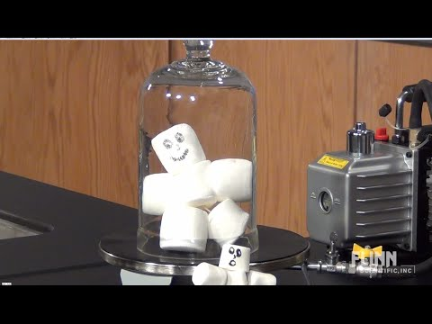

Slide 27
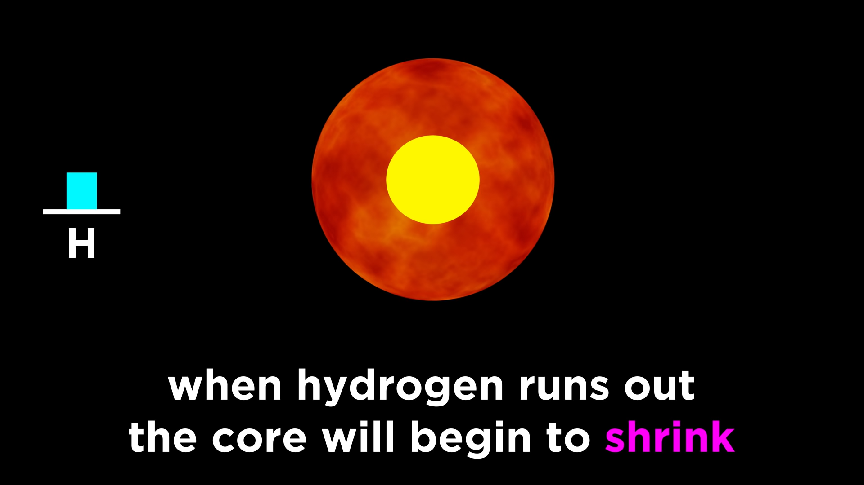
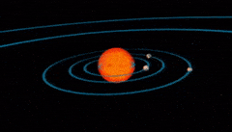
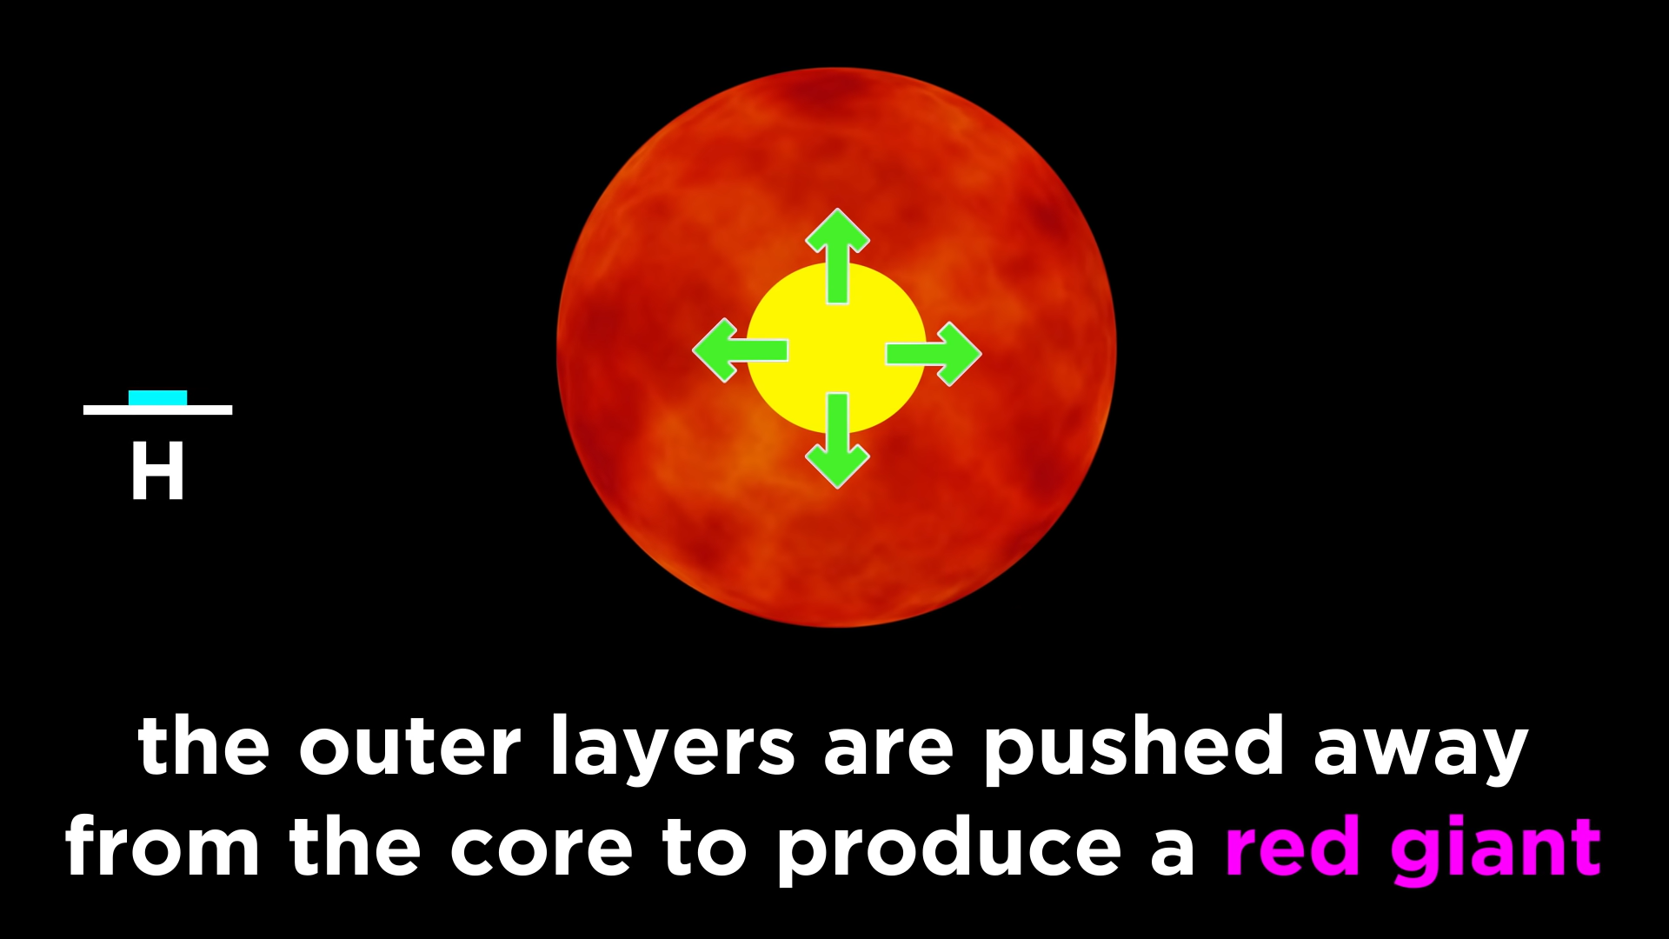

Slide 28
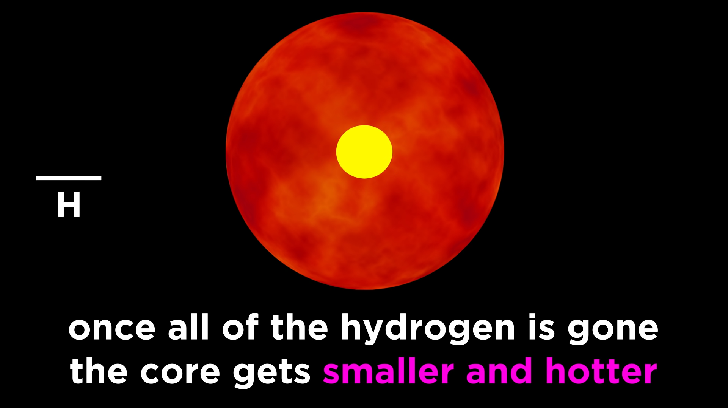

Slide 29
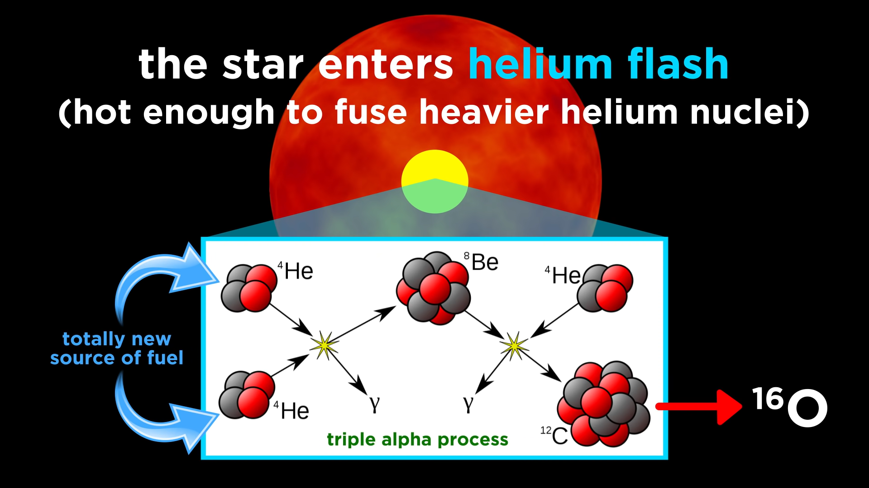

Slide 30
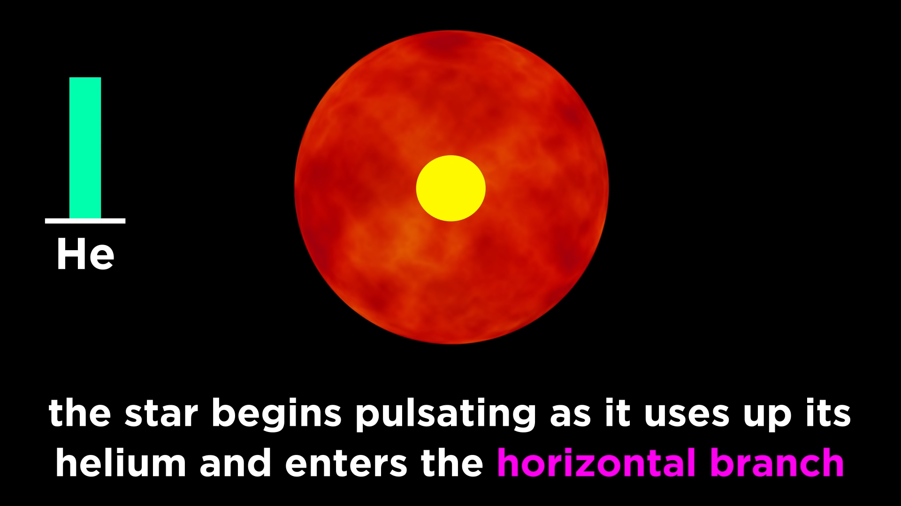

Slide 31
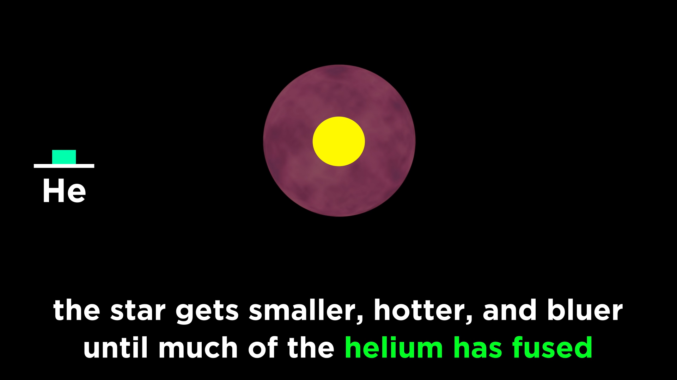

Slide 32
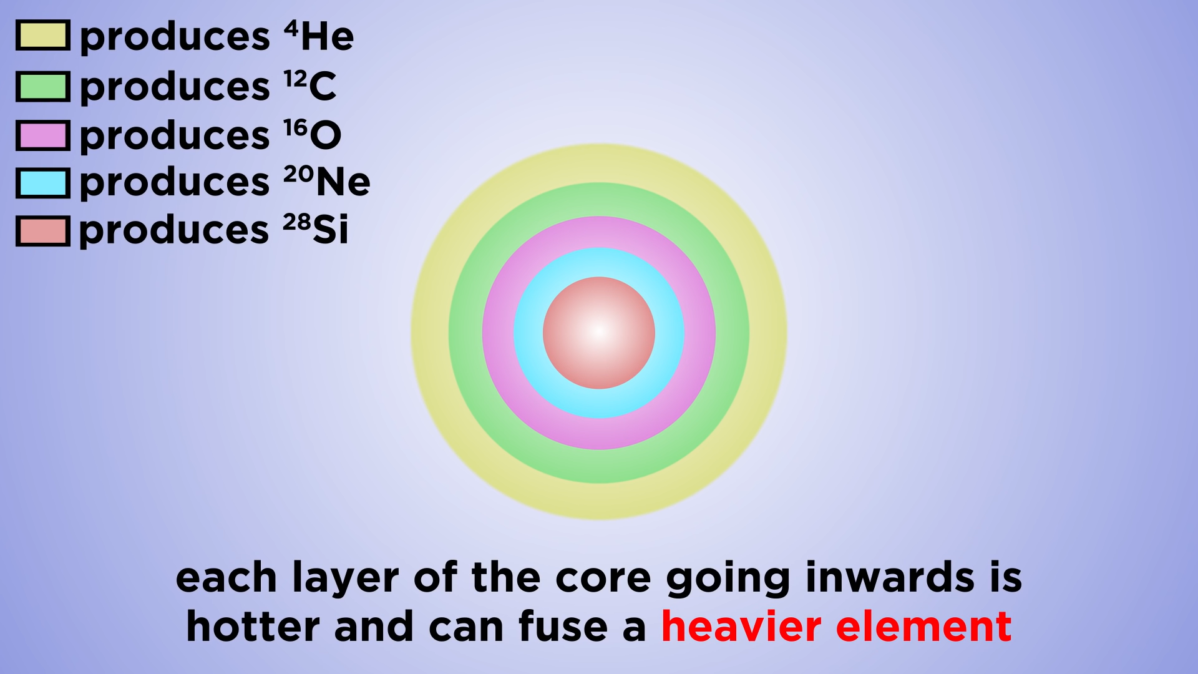

Slide 33
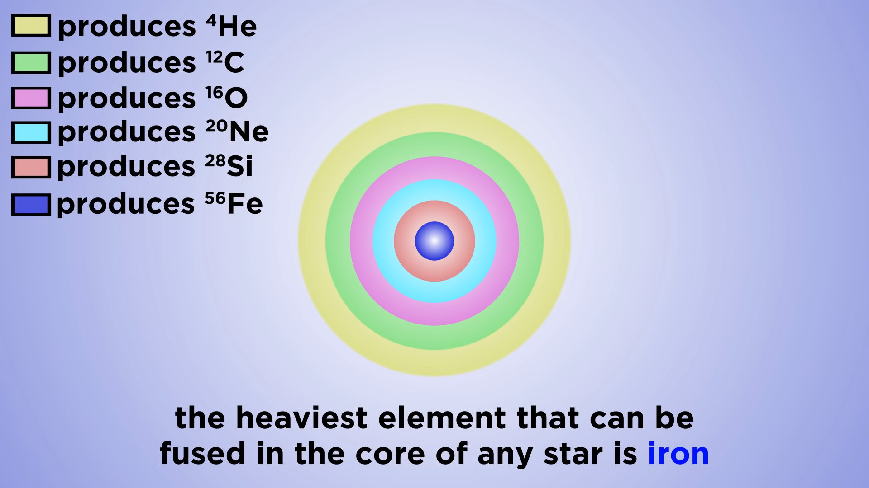
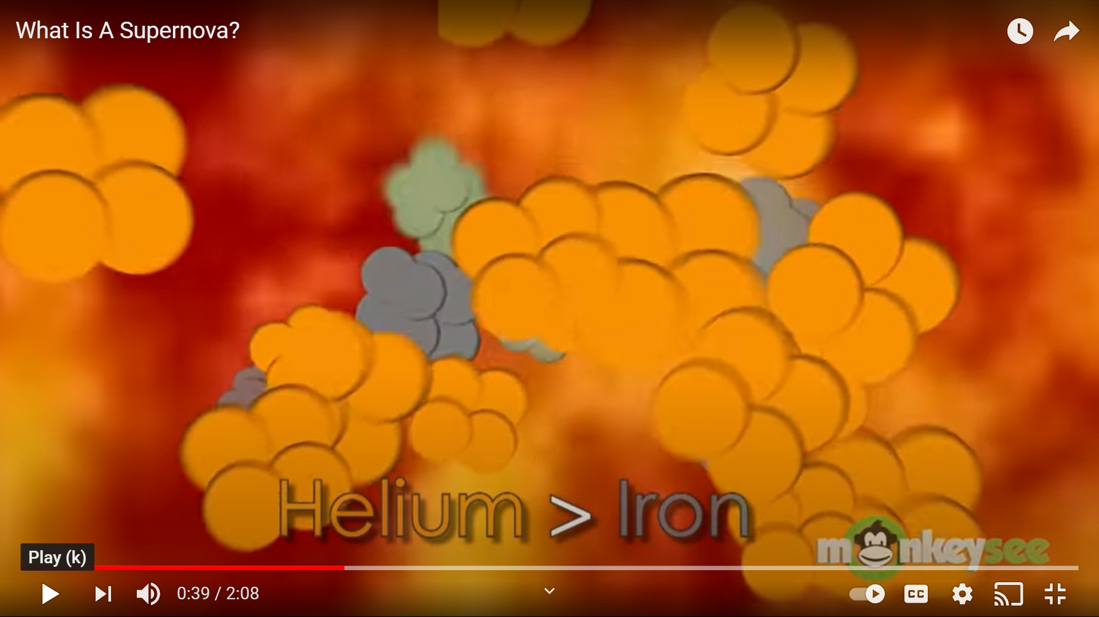

Slide 34
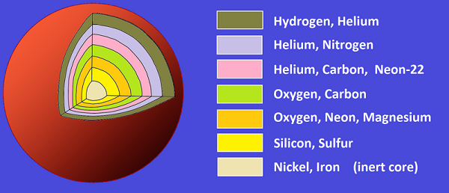

Slide 35
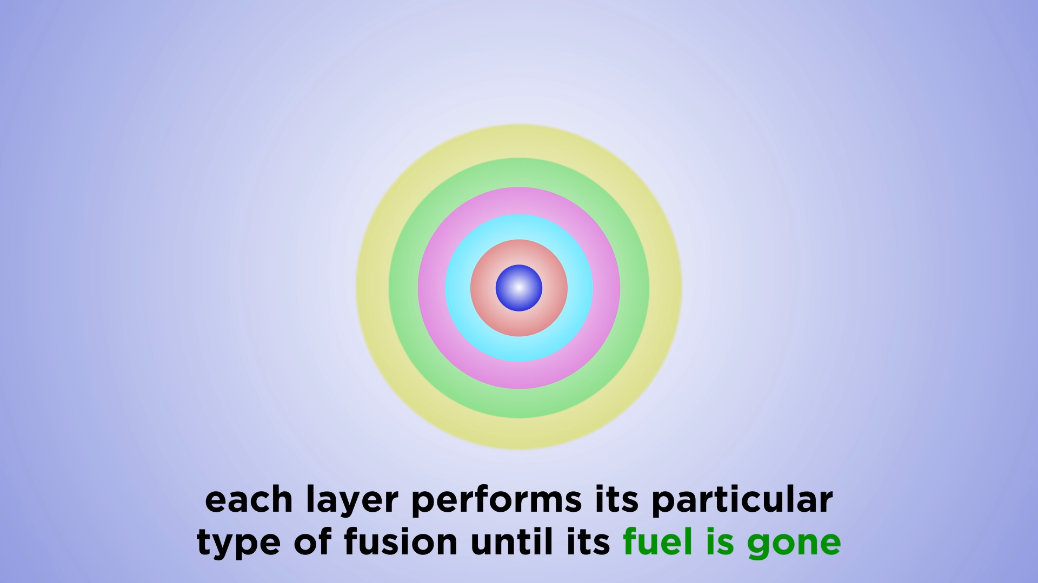

Slide 36
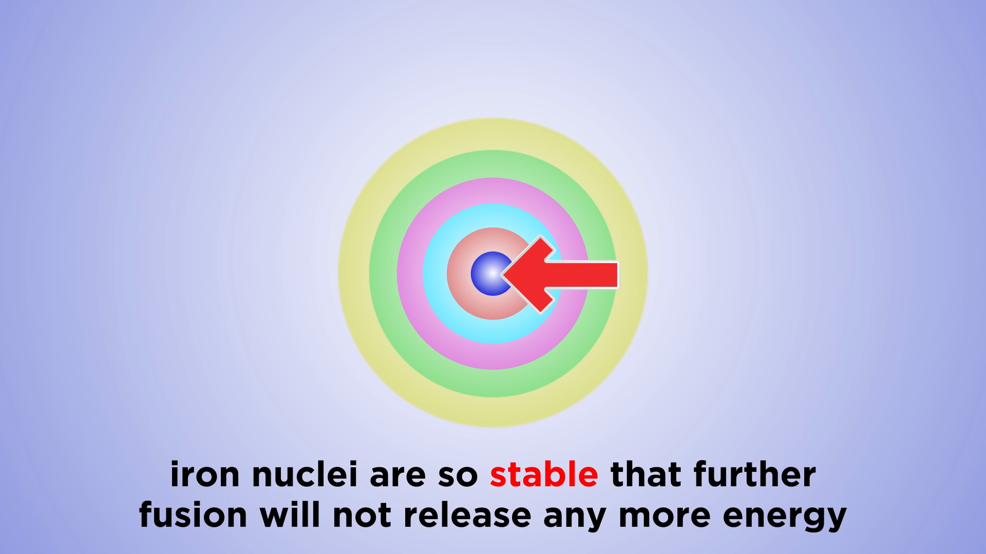

Slide 37
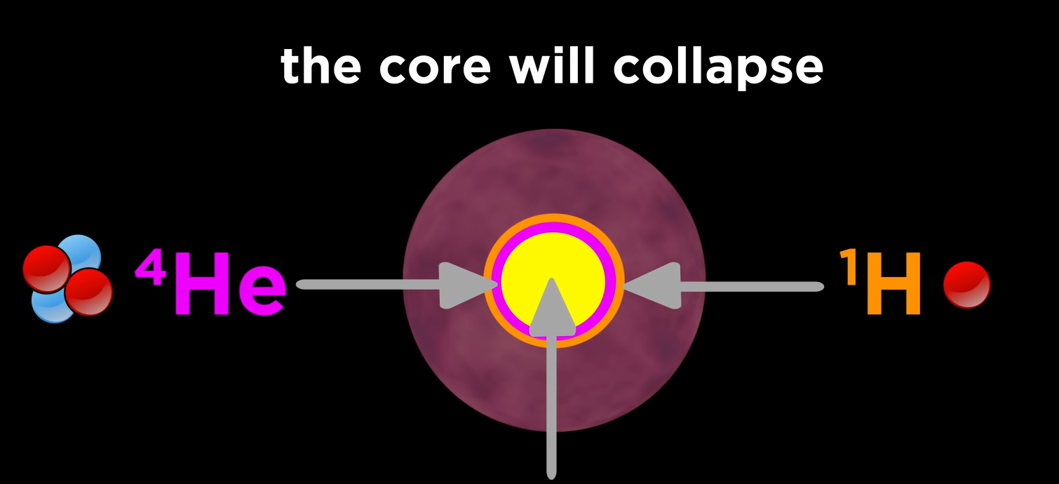

Slide 38
SUPERNOVA

Slide 39
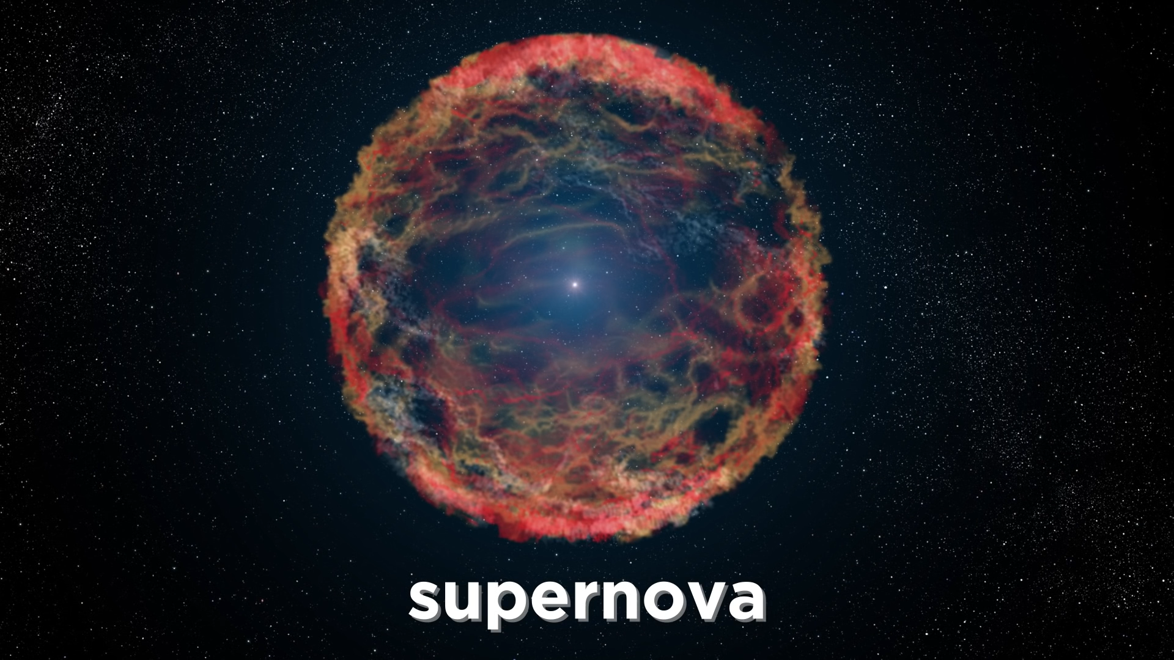

Slide 40
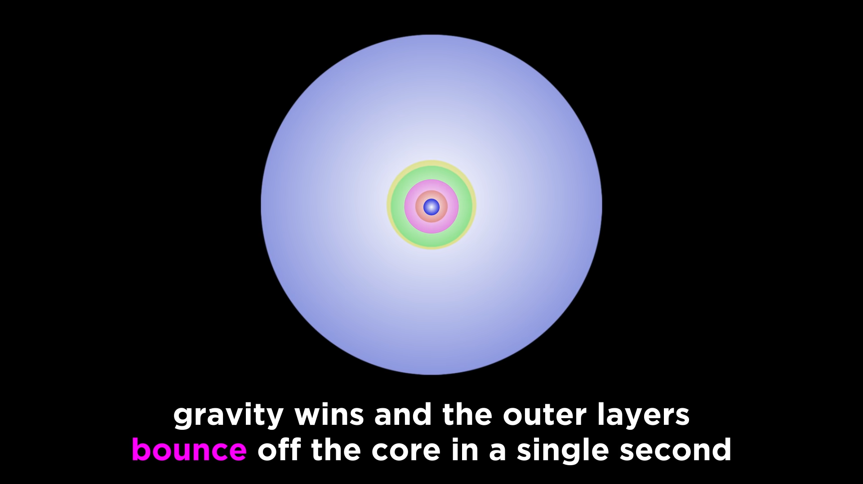

Slide 41
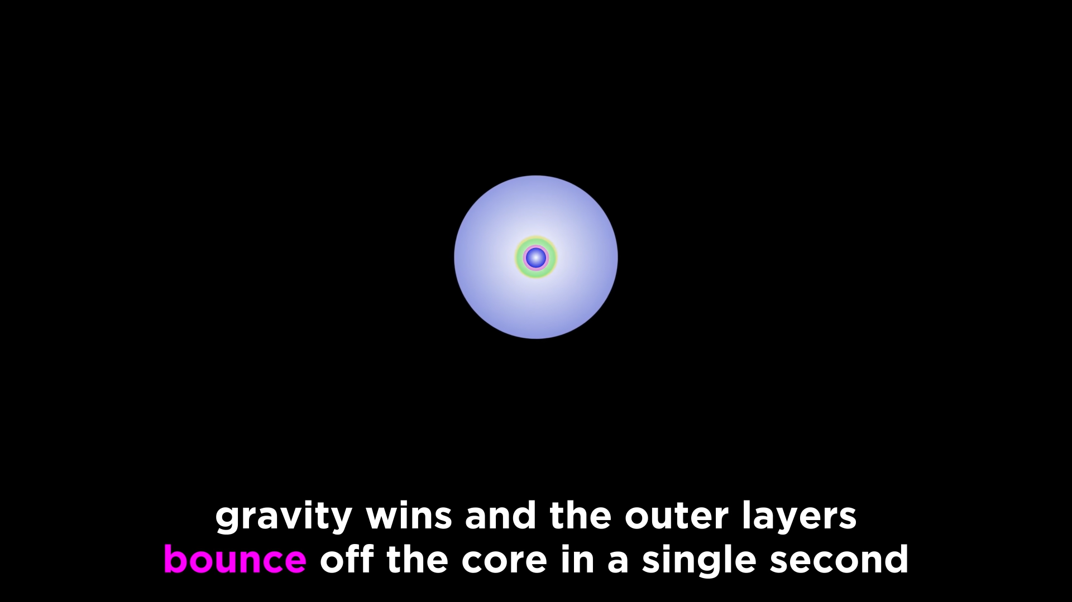

Slide 42
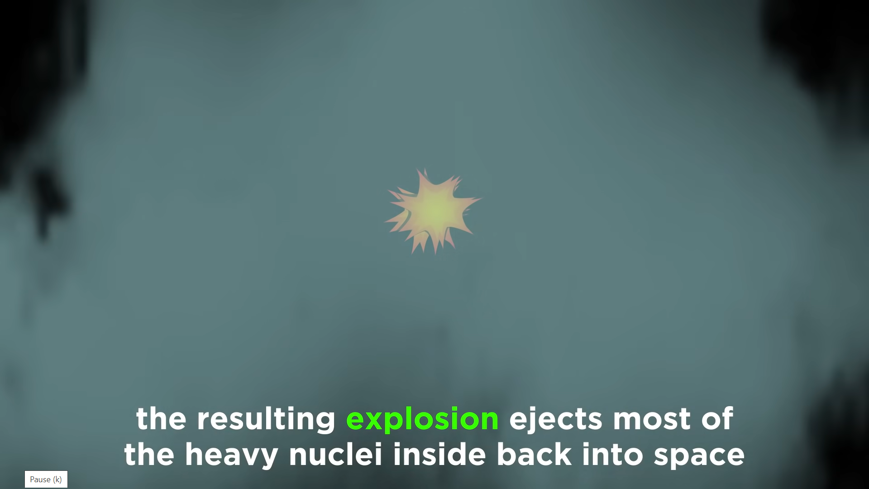
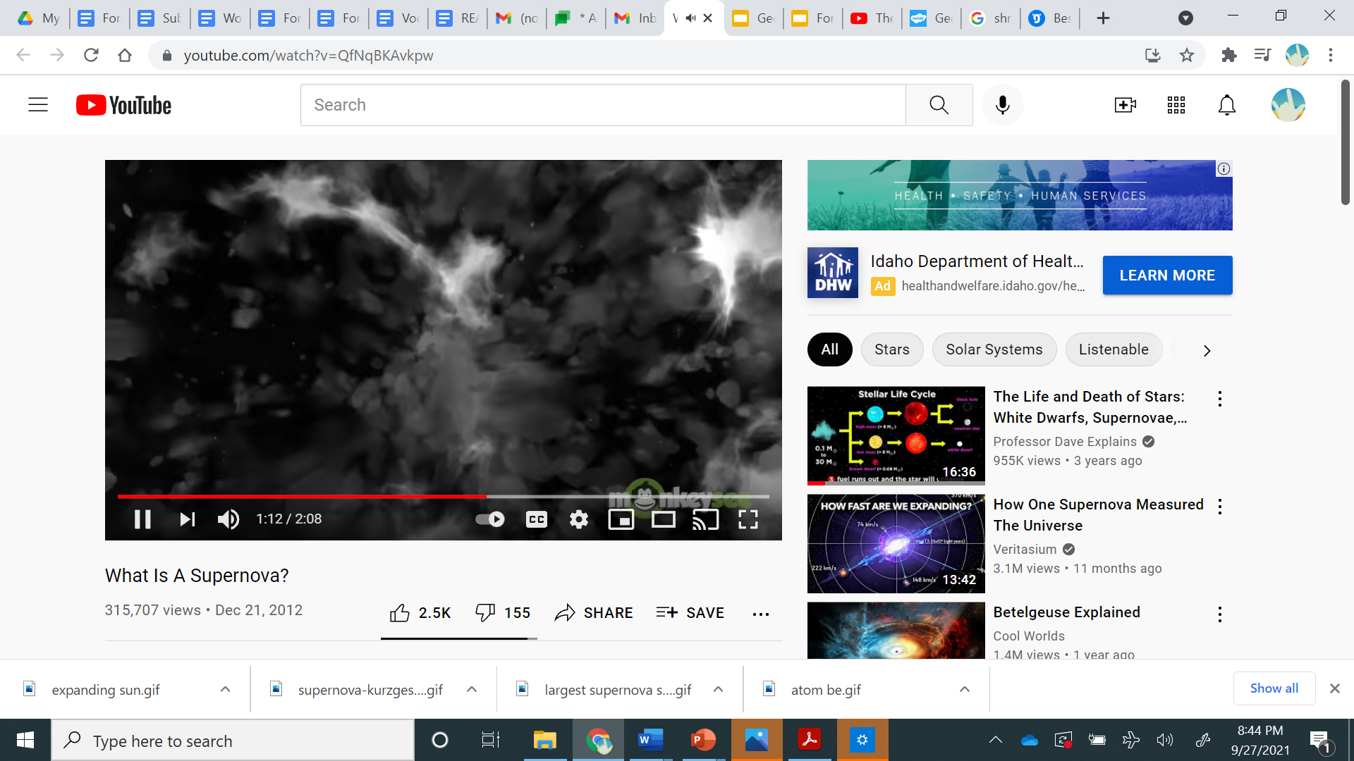
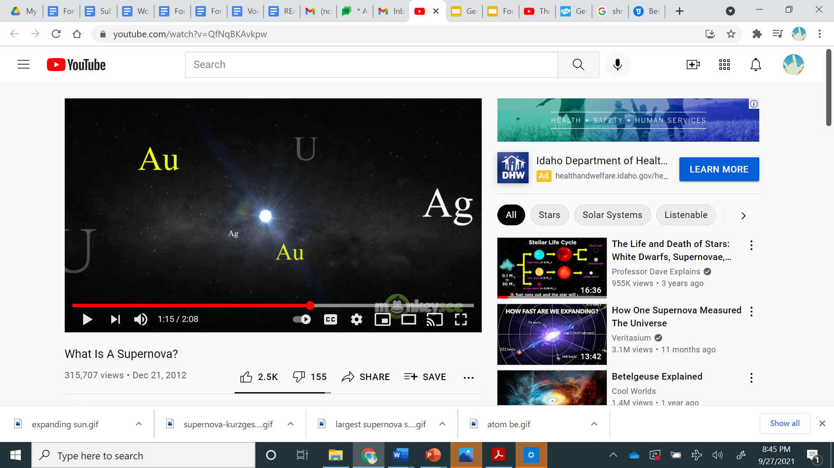

Slide 43

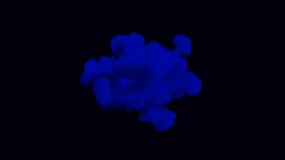

Slide 44
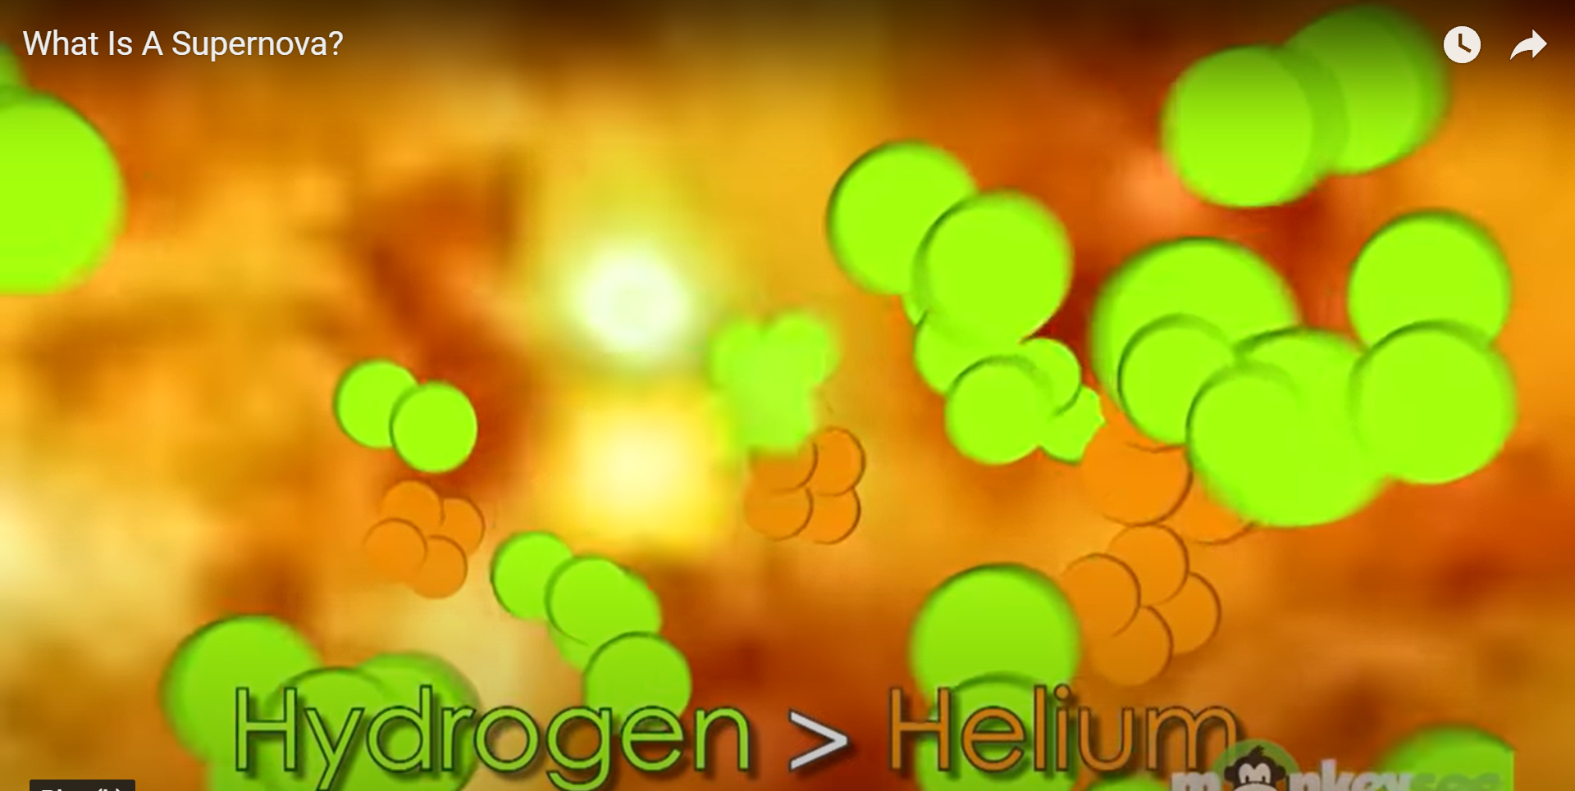
HYDROGEN TO HELIUM

Slide 45
LIFE CYCLE of A STAR

Slide 46
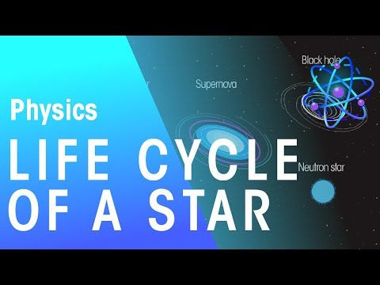
LIFE CYCLE OF A STAR

Slide 47
DOUBLE STAR EXPLOSION

Slide 48
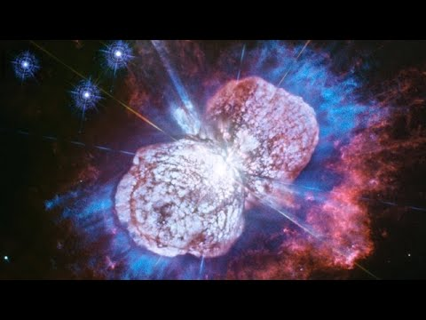
DOUBLE STAR EXPLOSION

Slide 49
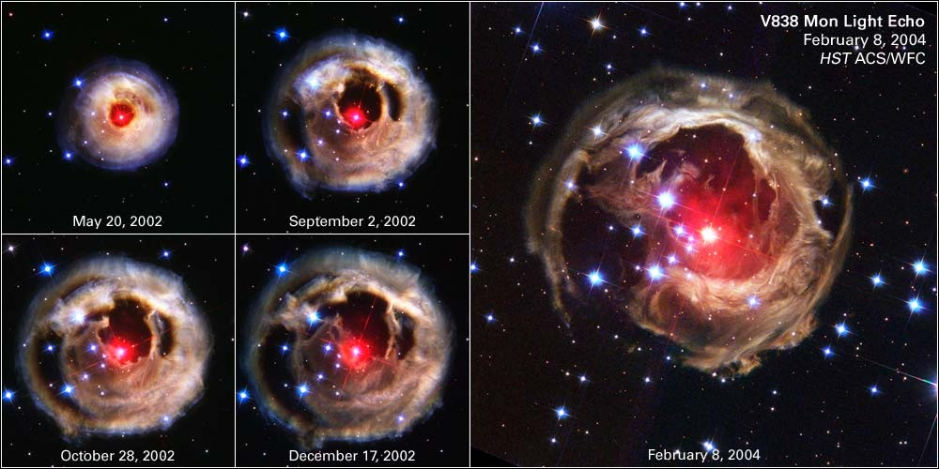
Images of a red giant after it sent off an explosion (although the whole star did not explode or go supernova) and created light "flashes".
You can see the dust from previous explosions expanding away from the red giant over time.
This red giant will eventually collapse as more of its atoms fuse into iron and explode into a supernova...but hasn't yet.

Slide 50

Vocabulary

Slide 51

SPACE
the physical universe beyond the earth's atmosphere

Slide 52


Slide 53


Slide 55


