Slide 1


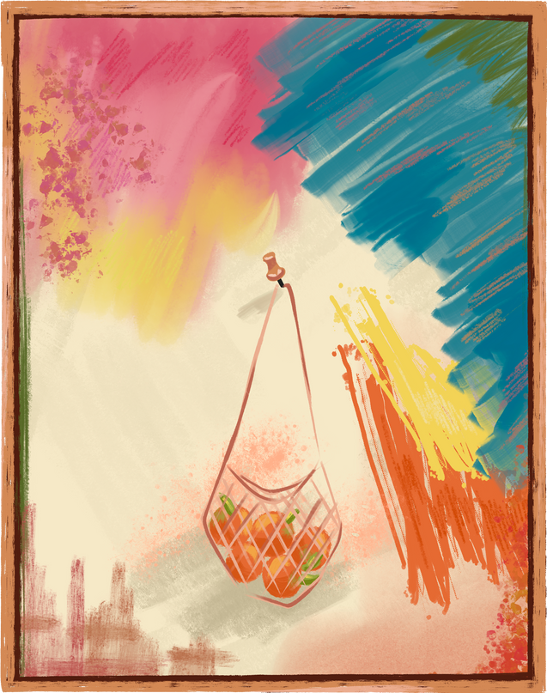

Abstract
Art

Slide 2

Untitled Blue Monochrome (IKB 108), 1956 by Yves Klein
The introduction to the exhibition included: “Reader, take note: what these monochrome propositions demand of you is that fragment of receptiveness which can make revolutions and bring down tyrants.”

Slide 3
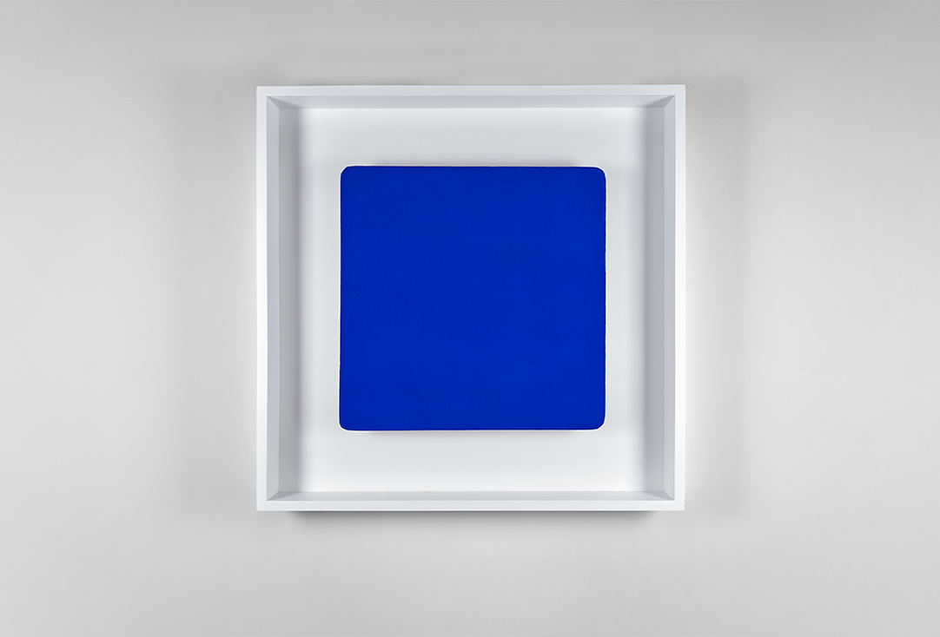

Slide 4
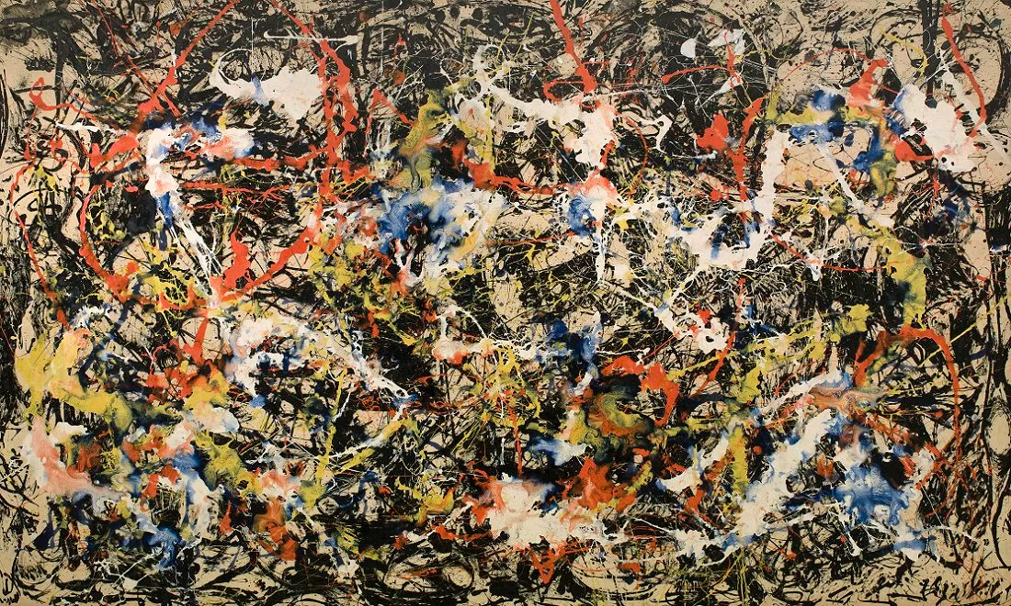
Convergence (1951), Jackson Pollock

Slide 5
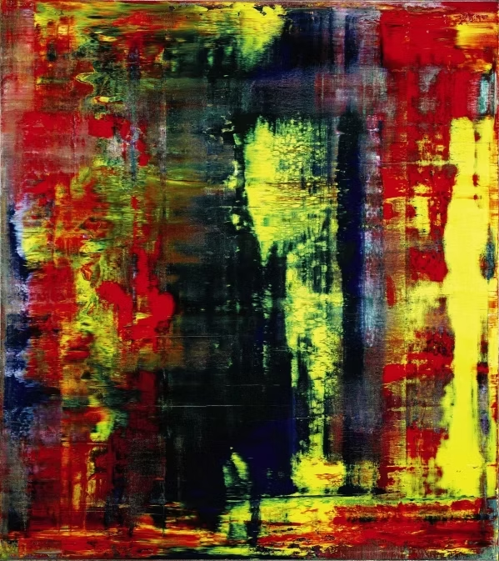
Abstraktes Bild 809-4(1932),
Gerhard Richter

Slide 6
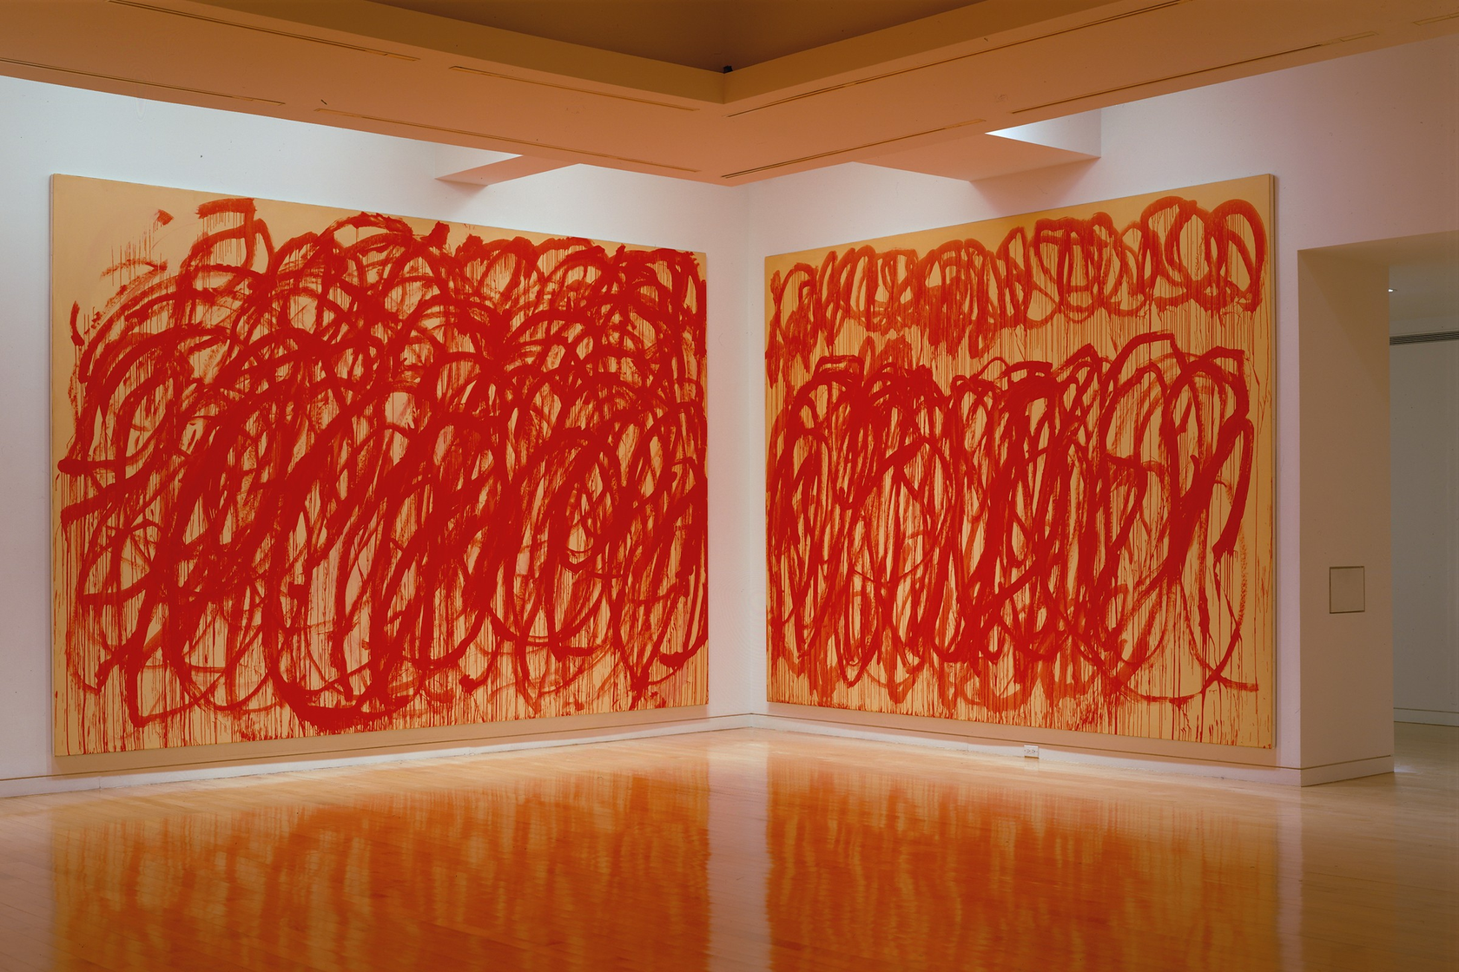
Untitled, Bacchus (2005), Cy Twombly

Slide 7
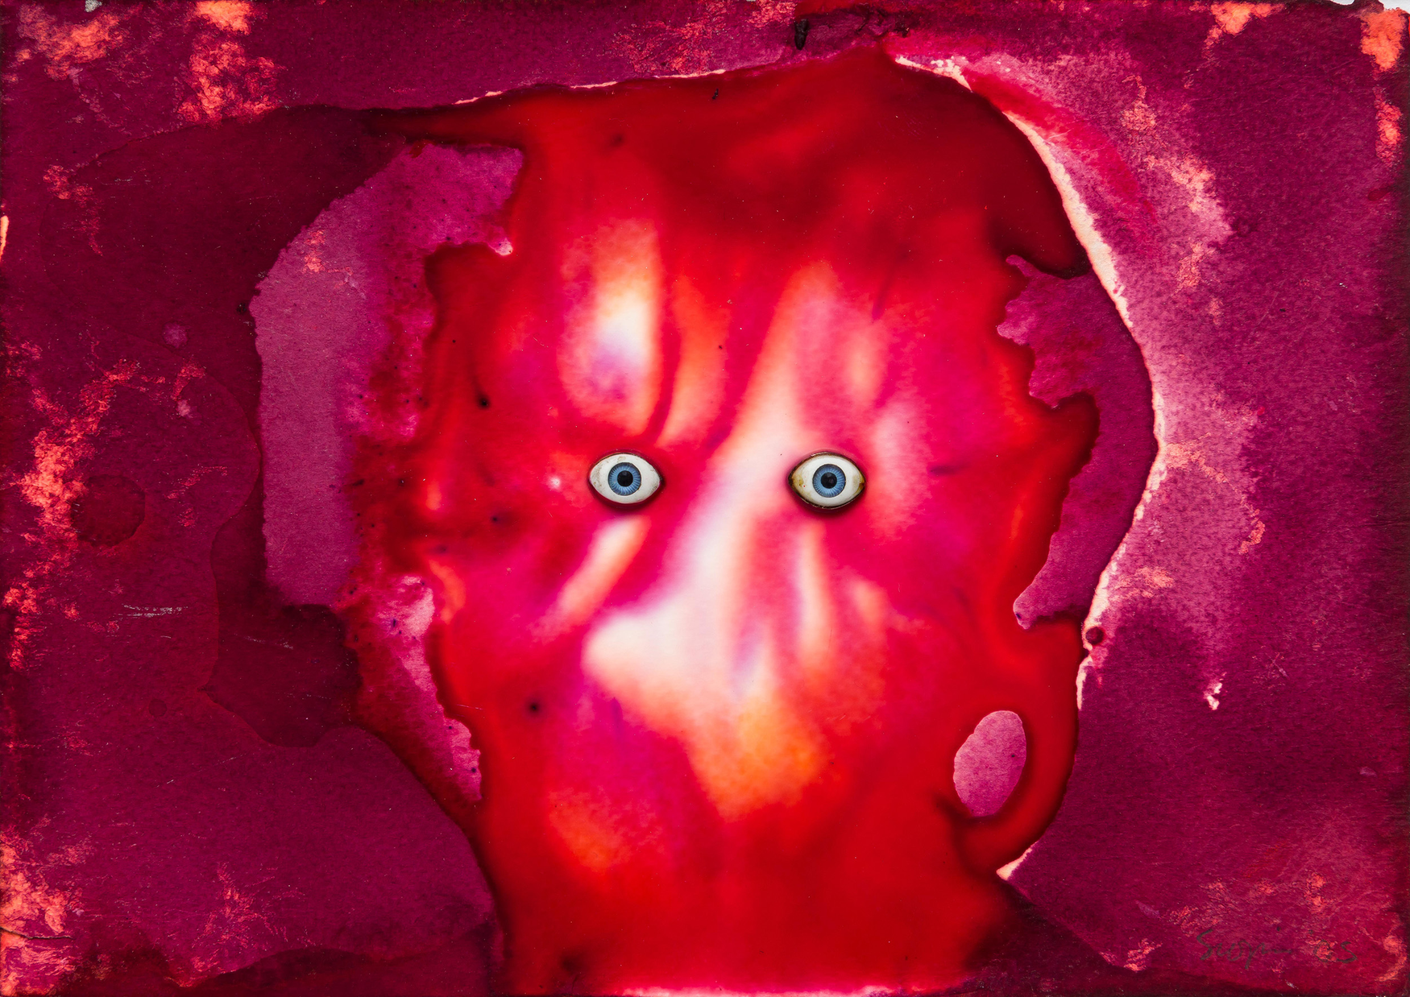
Untitled (2005), Penny Siopis

Slide 8
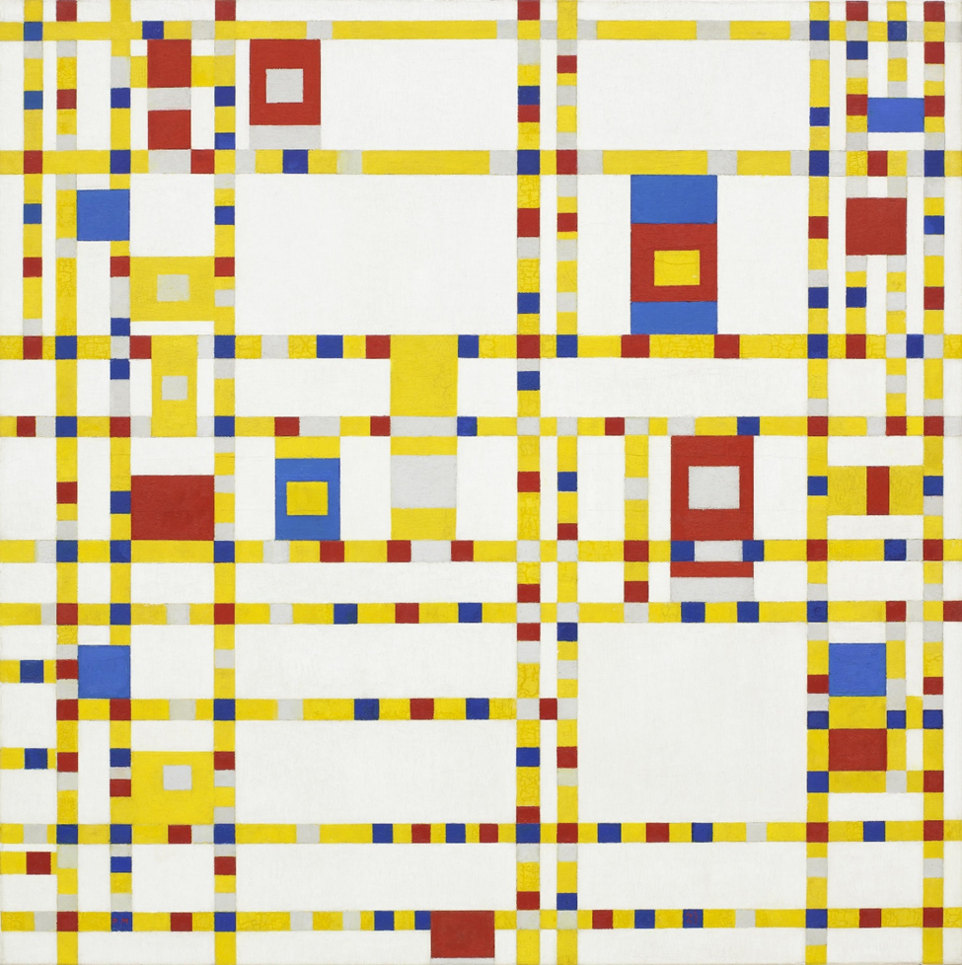
Broadway Boogie
Woogie (1942-43),
Piet Mondrian

