Slide 1


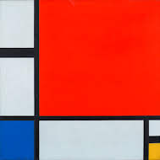
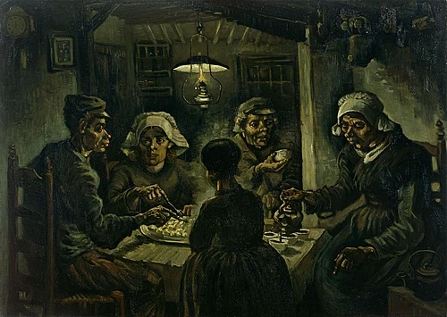

The Potato Eaters (1885), Vincent Van Gogh
Composition with Red Blue and Yellow (1930), Piet Mondrian

Slide 2

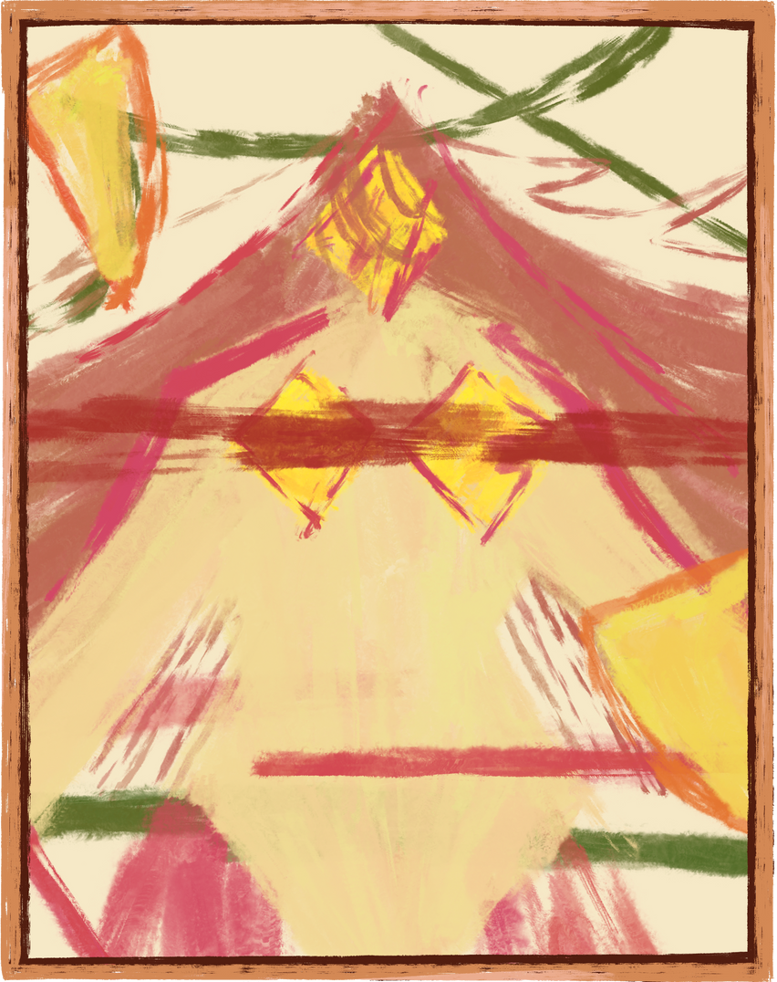
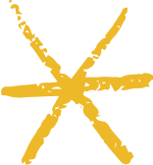
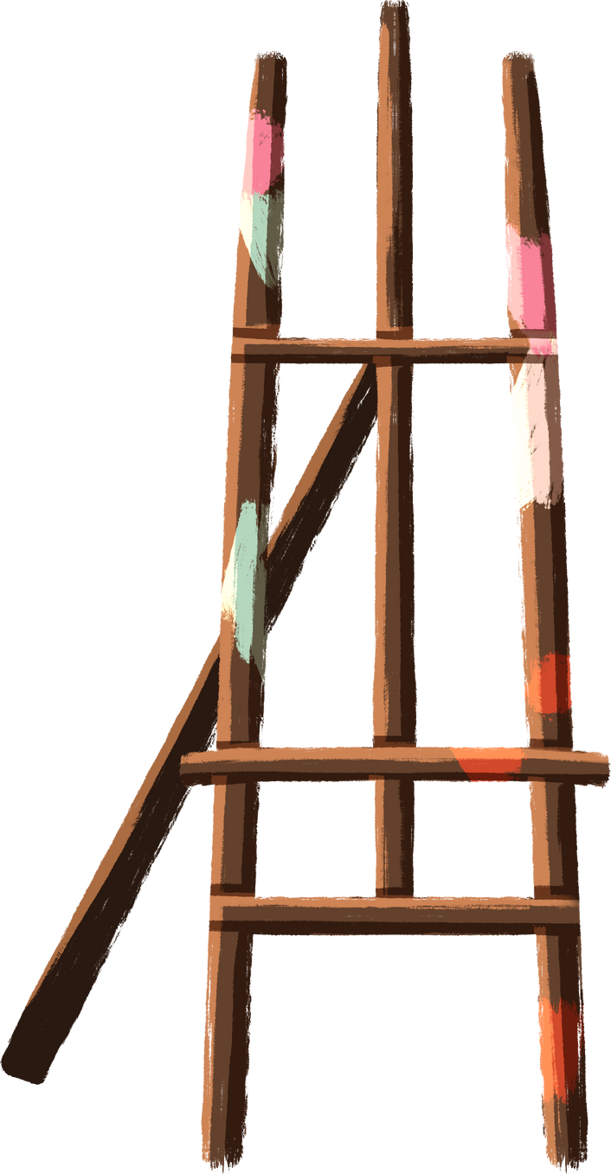



Abstract Art 101

Slide 3

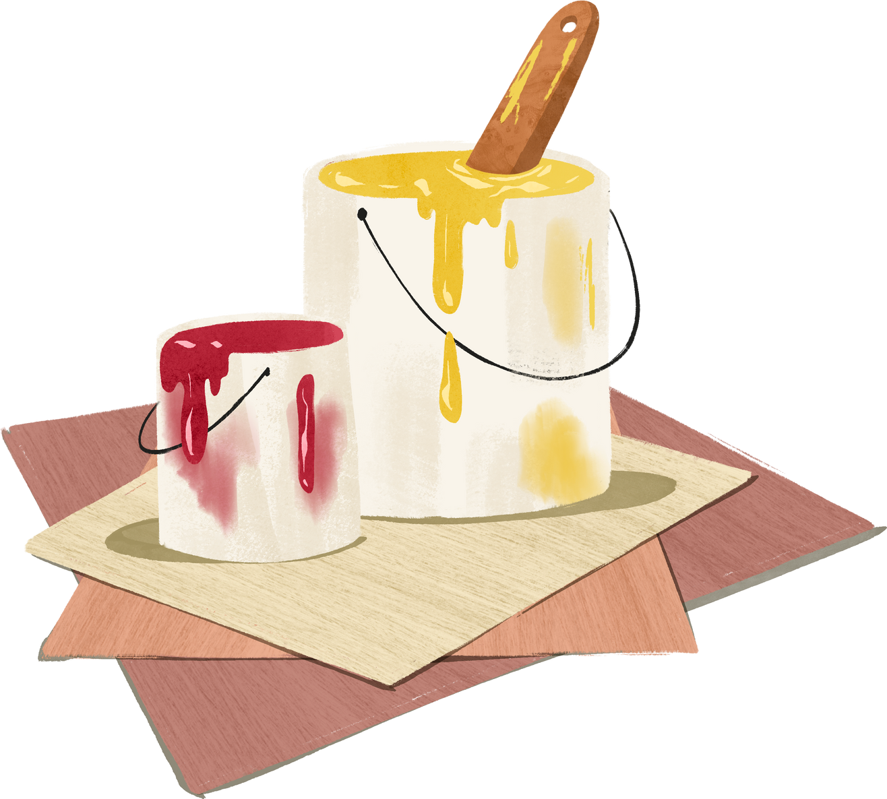
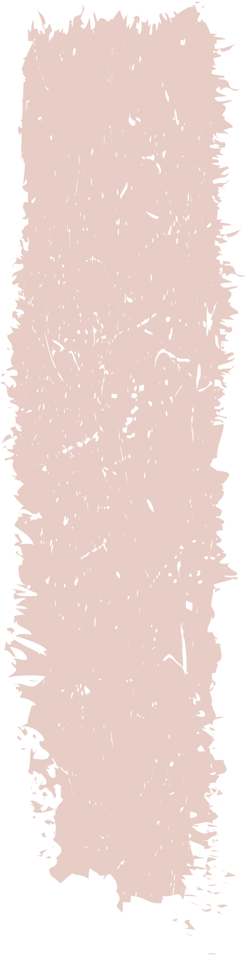
What is
Abstract Art?
  What are its key elements?

Slide 4

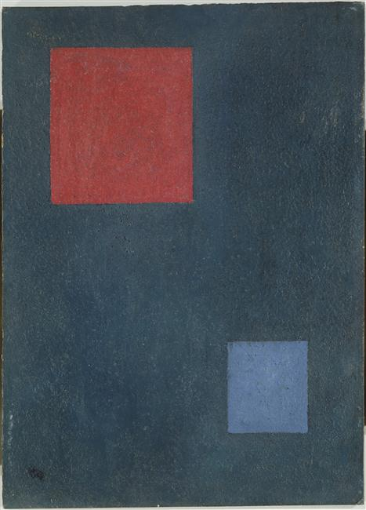
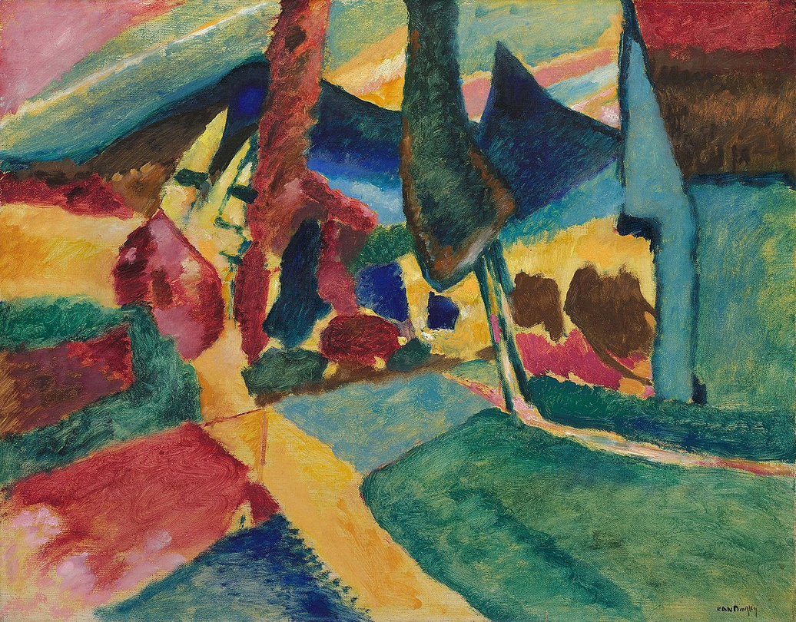

Landscape with Two Poplars (1912), Wassily Kandinsky
Two Squares (1930), Wassily Kandinsky

Slide 5

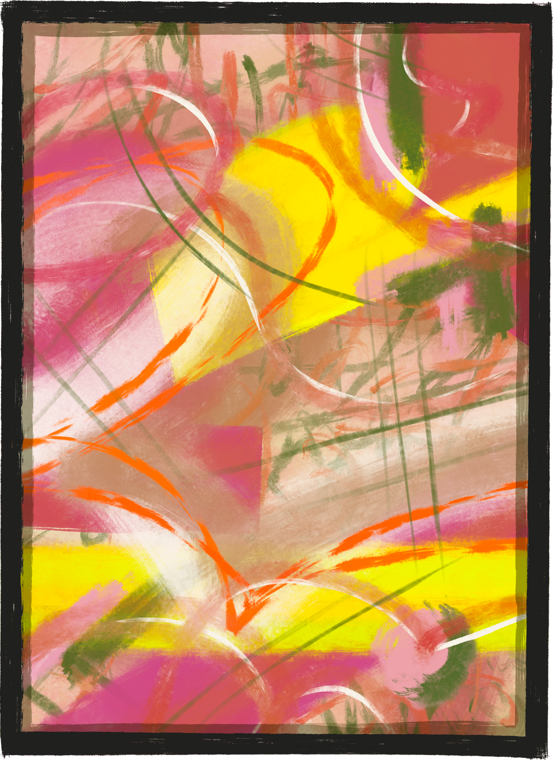
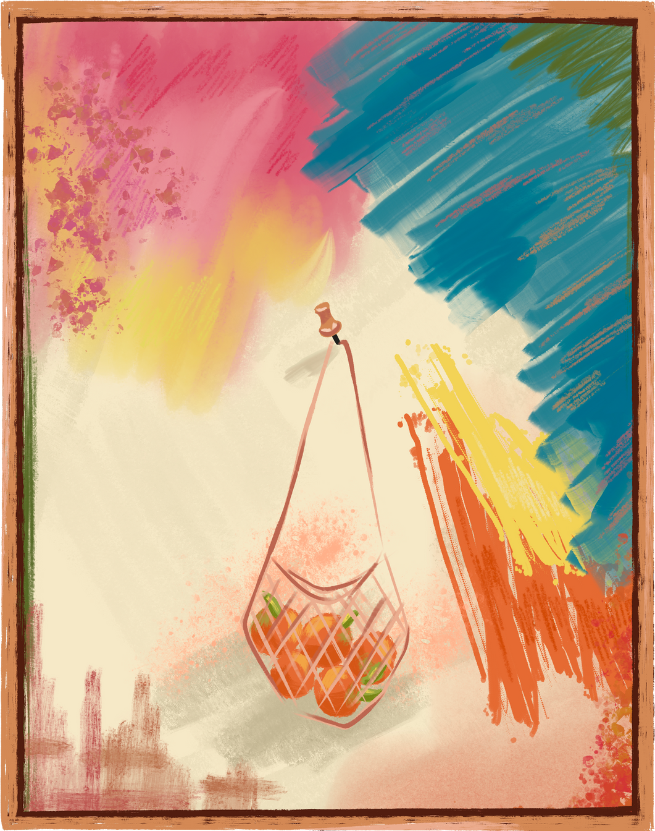
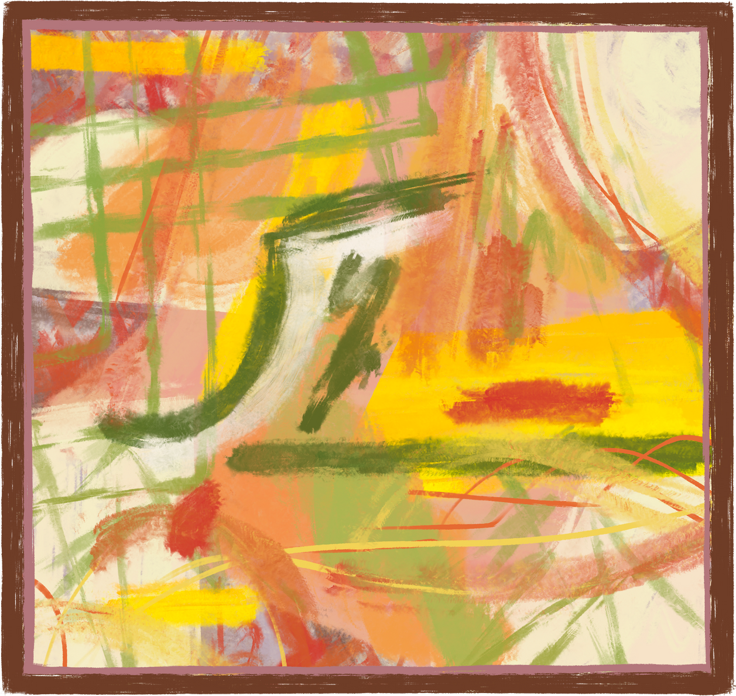
Why move away from reality?
Abstract art emerged in the early 20th century, challenging traditional representation. Until then, artists were primarily preoccupied with realism.
Why then?

Slide 6
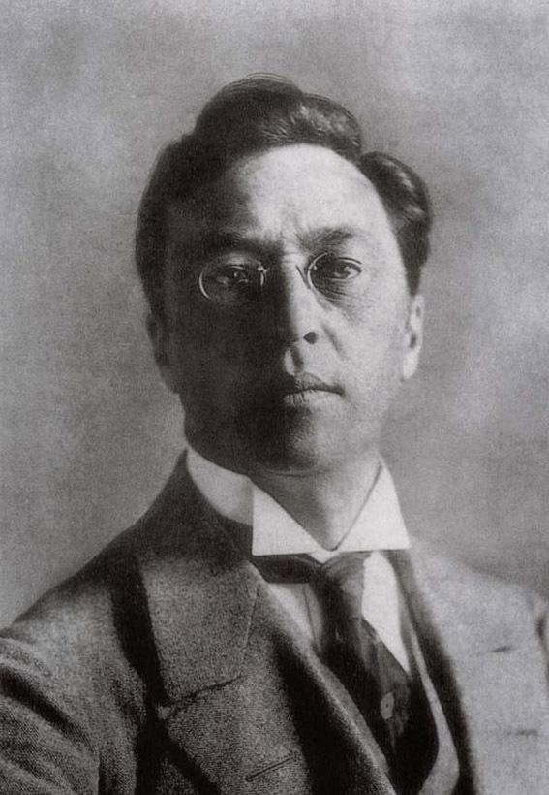
Wassily Kandinsky
1866-1944
  Father of abstract art?

Slide 7
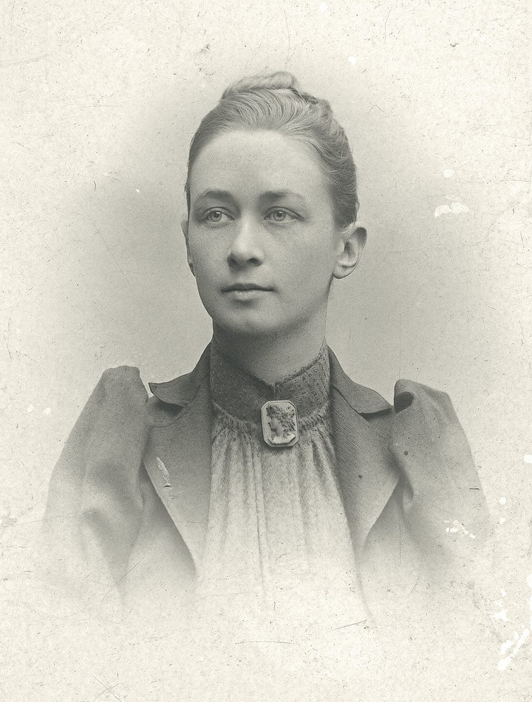
Hilma af Klint
1862-1944
She belonged to a group called "The Five", comprising a circle of women inspired by Theosophy, an american cult, who shared a belief in the importance of trying to contact the so-called "High Masters"—often by way of séances.

Slide 8
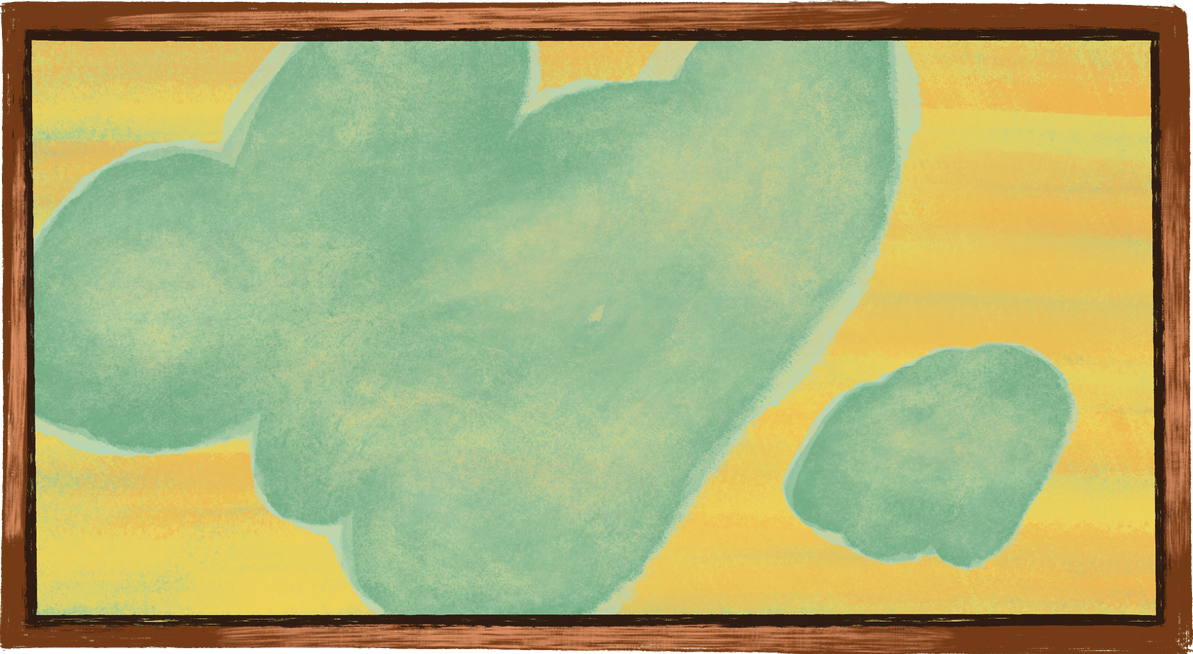
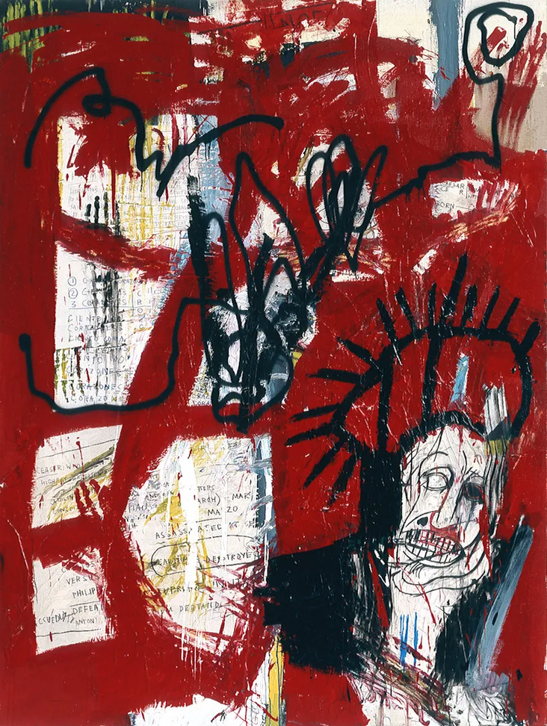
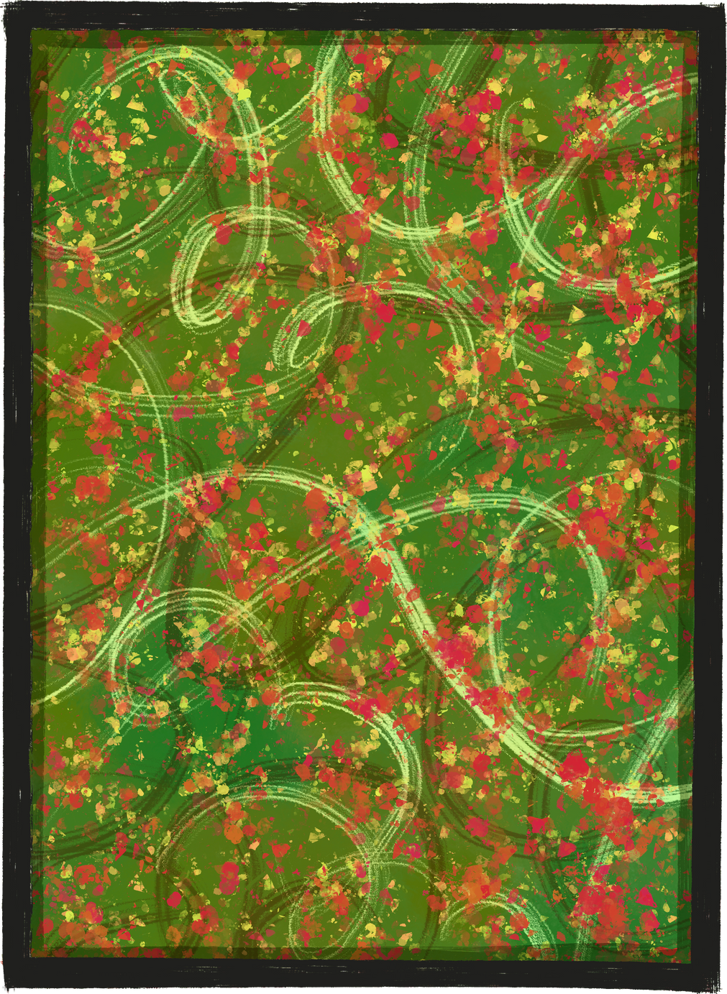
But what’s the point?
My kid can paint that...
Untitled (1981), Jean Michel Basquiat

Slide 9



Unlike kids drawings abstract art:
unique, non-representational interpretations that resonate emotionally or intellectually with viewers
feelings, ideas, even political statements, that require great skill and creativity on the part of the artist
intellectual challenge, enjoying the process of interpreting and finding meaning
visual pleasure of colour and form, finding beauty in the harmony or tension of abstract compositions.

Slide 10


What do the following paintings mean to you?

Slide 11
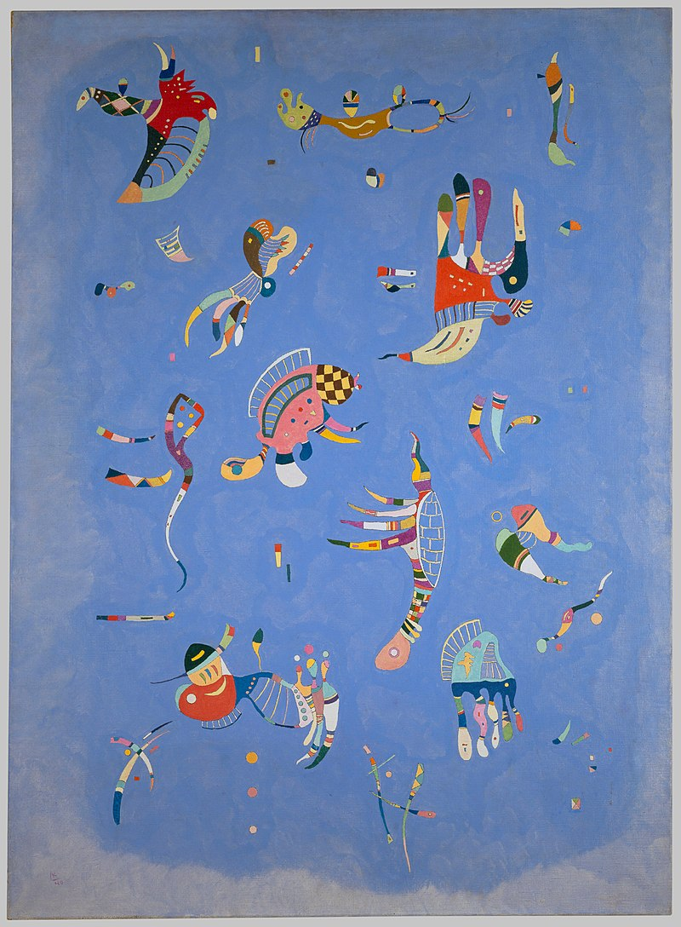
Sky Blue (1940), Wassily Kandinsky

Slide 12

Landscape with 2 Poplars (1912), Wassily Kandinsky

Slide 13


Thank you for your attention!

