Slide 1
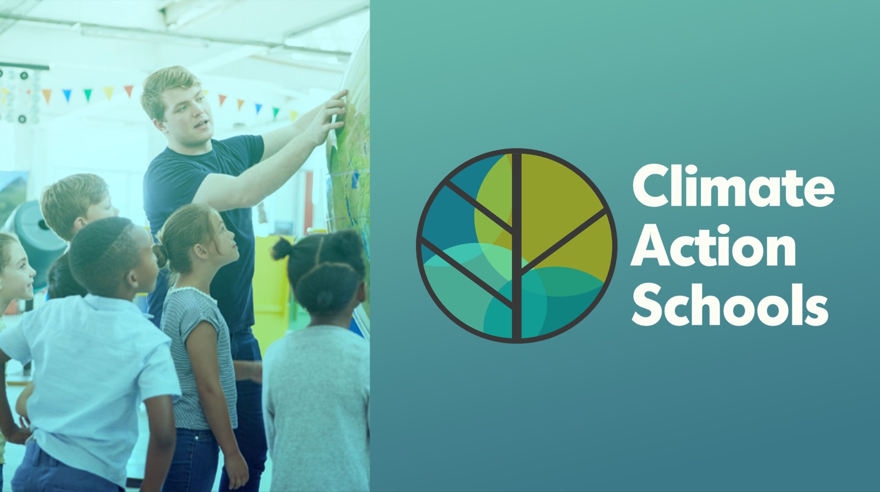
Global Handshake
2024-2025

Slide 2
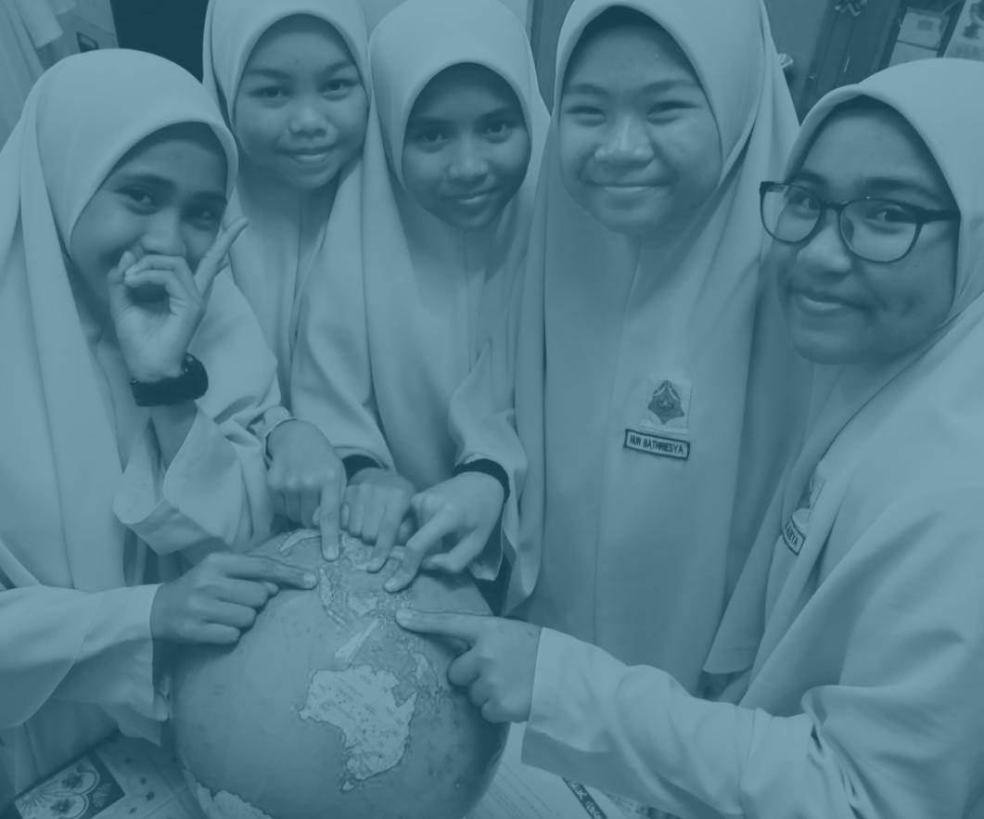
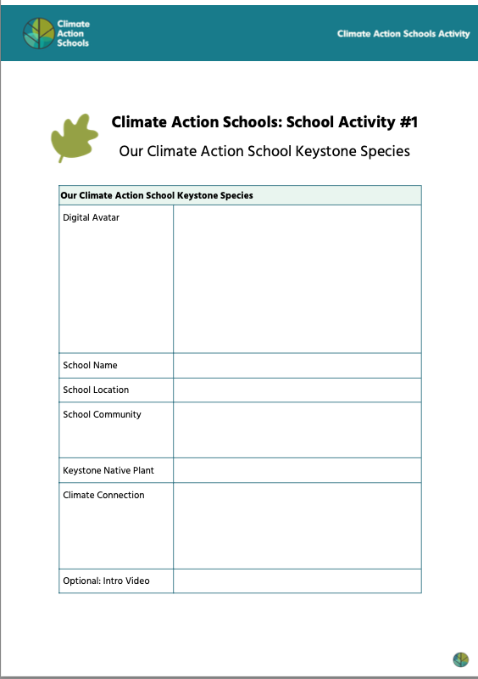
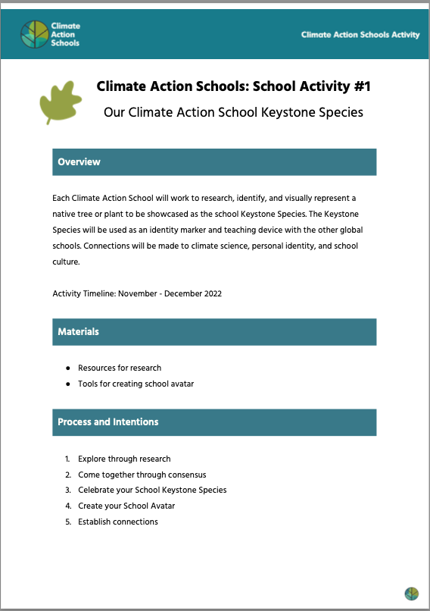
Congratulations on completing Activity #1: Keystone Species with your school.
As you complete the activity, please add your school and “meet” the other schools.
Please complete by January 10th (or a little later if you need some extra time)
Step 1: Add your digital avatar (keystone species graphic) to THIS MAP
Step 2: Find your school slide and add in your details. See the example on Slide 4.
Step 3: Review the map, keystone species, and other schools with your community of teachers and students. Prepare to meet your Matched Schools in January!

Slide 3
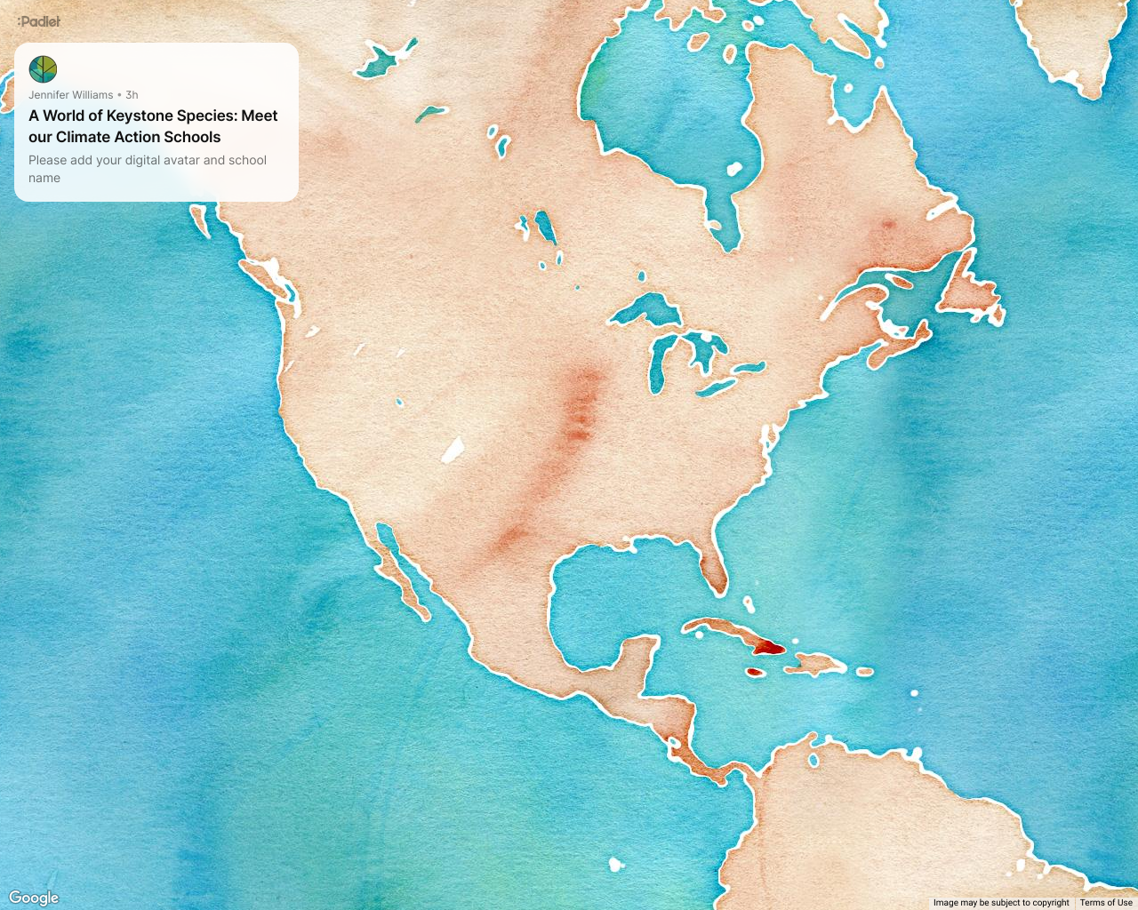
Link to our Keystone Species Map!
Notes:
https://padlet.com/lindsay_zilly/our-world-of-climate-action-schools-2024-2025-19o87udvn6xj9230

Slide 4
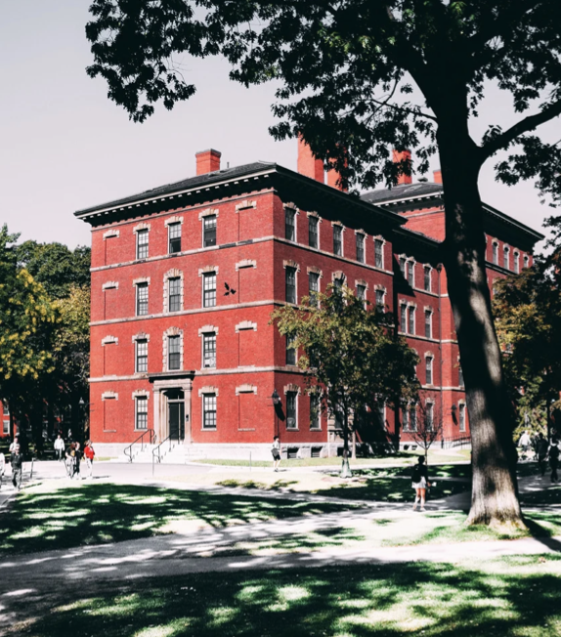
EXAMPLE:
Odesa Primary School
Ukraine
Meet Our Climate Action School
Our school is located in the city of Odesa in the country of Ukraine. We serve 1,200 students ages 5-14. We have a beautiful red building that is well known in our community we also are known for our amazing rooftop garden of sunflowers. Visit our website at xxx@school.edu.
Our Keystone Species: Sunflowers
Vertical growth, less land needed and inhibit growth of weeds
Support pollinators like bees and caterpillars
Sunflower seeds are high in fat and keep birds warm in colder months
Absorb toxic heavy metals and “detoxify” the soil

Slide 5
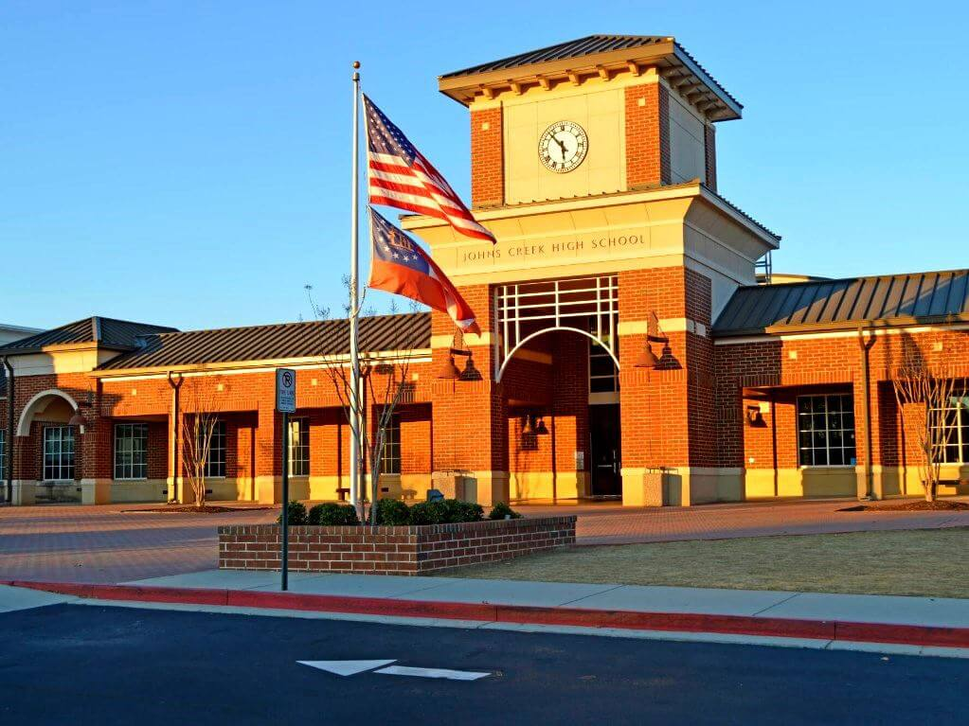
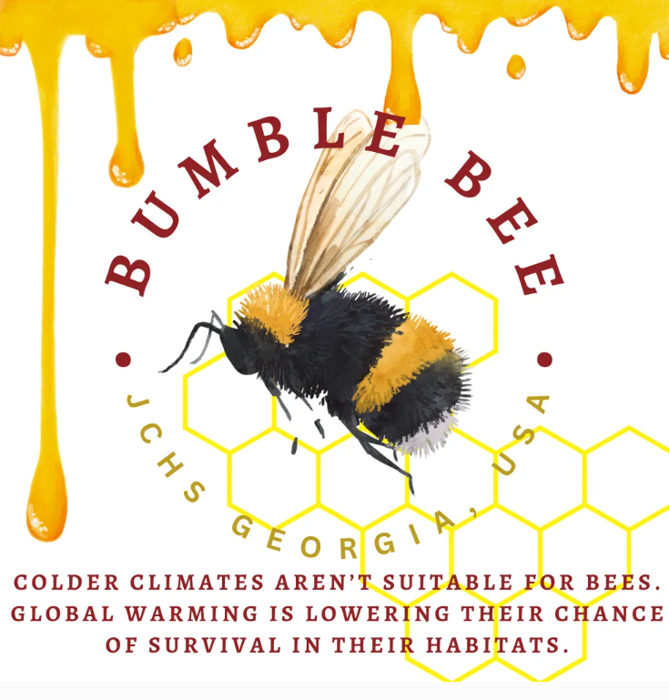
Johns Creek High School
United States
Meet Our Climate Action School
Description
Keystone Species:
Fact 1
Fact 2
Fact 3
Fact 4
Notes:
Add any additional information or links here.

Slide 6
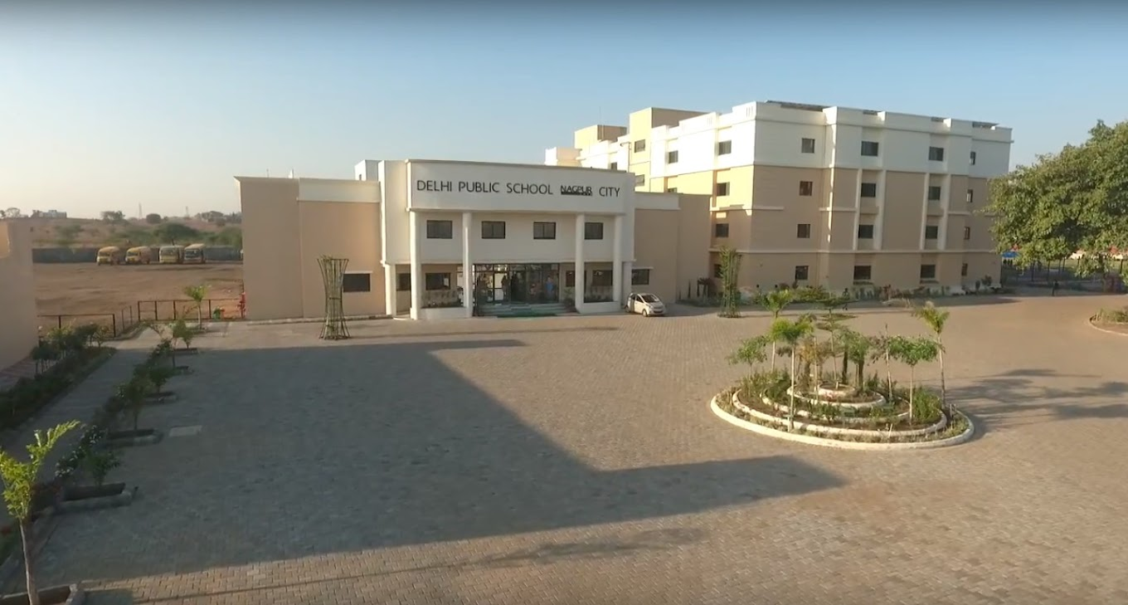
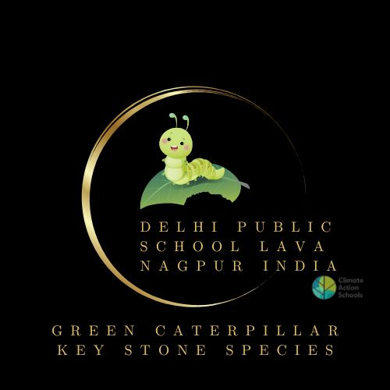
DELHI PUBLIC SCHOOL,LAVA,NAGPUR,
INDIA
IMAGE OF SCHOOL
Meet Our Climate Action School
Keystone Species: GREEN COMMON MORMON CATERPILLAR
Green common mormon Caterpillar
Prunes the t=lemon and curry leaves tree
Common Mormon butterfly (Papilio polytes) is born from these caterpillars
The butterflies are the pollinators
KEYSTONE SPECIES
AVATAR
Notes:
Add any additional information or links here.

Slide 7
Grandma’s Family Homeschool
USA
Meet Our Climate Action School
An after school intergenerational team ( 1 grandma, 2 grandkids), meeting weekly for a couple of hours, to learn and take small actions to heal our earth.
Keystone Species: Sugar Maple
Mammals and insects use the sugar maple tree as a source of food.
Woodpeckers and other birds nest on its branches
The sugar maple is the source of maple syrup, a multimillion industry
Shorter winters are disruptive of the maple sugaring season
KEYSTONE SPECIES
AVATAR
Notes:
Add any additional information or links here.

Slide 8
DELHI PUBLIC SCHOOL,
VARANASI, INDIA
Country
Meet Our Climate Action School
Keystone Species:
They provide food and shelter to many birds, reptiles, frogs, bats, insects, crustaceans, fungi and lichens. It also helps to maintain the AQI of the city .
The most attractive feature of a banyan tree is its ability to survive hundreds of years.
Digital Avatar
Notes:
Add any additional information or links here.

