Slide 1
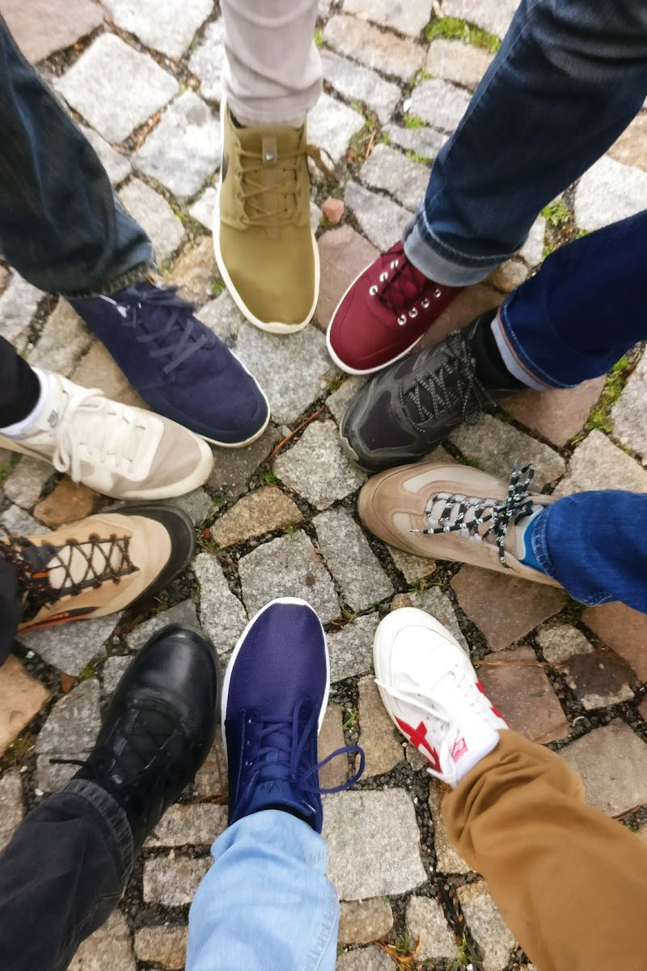
Unity in Diversity Embracing Differences Together
Photo by Pexels

Slide 2
1
The Beauty of Diversity
Embrace Unique Differences
Diversity enriches our lives by offering various perspectives, ideas, and experiences that lead to personal and collective growth. Different cultures, religions, and ideas help us learn more about ourselves and the world around us, fostering empathy and respect. Embracing diversity can challenge our preconceived notions, enabling us to think critically and see beyond our own experiences. Ultimately, diversity is the cornerstone of a vibrant, innovative society, pushing boundaries and breaking barriers.
Photo by Pexels

Slide 3
2
Value of Different Cultures
Learn and Grow
Understanding different cultures allows teenagers to appreciate various ways of life, expanding their worldview and cultural knowledge. Cultural awareness promotes tolerance and reduces stereotypes, creating a more inclusive environment for everyone. Exploring different traditions and practices enriches social interactions and strengthens community bonds. This cultural exchange encourages curiosity and kindness towards others, shaping compassionate future leaders.
Photo by Pexels

Slide 4
3
Religious Tolerance
Respecting Beliefs
Understanding and respecting diverse religions promotes peaceful coexistence, reducing conflicts associated with intolerance. Religious tolerance encourages open dialogue, helping teenagers to see the common values shared among different faiths. Celebrating religious holidays together fosters community spirit, understanding, and unity among diverse groups. Teenagers play a crucial role in promoting interfaith dialogue, working towards harmony and acceptance.
Photo by Pexels

Slide 5
4
Ideas and Innovation
Collaboration Breeds Creativity
Diverse ideas lead to innovative solutions, as people from different backgrounds contribute unique perspectives and experiences. Collaboration among teenagers with different thoughts encourages critical thinking and problem-solving skills. Understanding the value of diverse ideas prepares teens for future workplaces, where inclusivity drives success. Encouraging open-mindedness in discussions can spark creativity, inspiring teenagers to become the next generation of innovators.
Photo by Pexels

Slide 6
5
Building Tolerance
Ways to Foster Acceptance
Promoting respectful dialogues helps teenagers understand different viewpoints, creating a foundation for tolerance and acceptance. Engaging in community service with diverse groups fosters connections and reduces biases among teenagers. Participating in cultural events allows teenagers to experience and appreciate diversity firsthand. Encouraging empathy and kindness equips teenagers to handle conflicts with understanding rather than aggression.
Photo by Pexels
Photo by Pexels

Slide 7
6
The Role of Education
Learning about Diversity
Educational institutions must prioritize diversity education, fostering an environment where every student feels valued and included. Incorporating diverse perspectives into curricula prepares teenagers for a globalized world, encouraging acceptance and understanding. Teachers play a vital role in modeling behaviors of tolerance and respect, setting an example for students to follow. Encouraging critical discussions about diversity prepares teenagers to navigate complex social landscapes responsibly.
Photo by Pexels

Slide 8
7
Media Influence
Shaping Perceptions
Media plays a powerful role in shaping perceptions of diversity; inclusive representation can promote understanding and acceptance. Encouraging critical consumption of media helps teenagers recognize biases and stereotypes that may exist. Advocating for diverse stories in media can foster empathy and greater appreciation for different experiences. Teenagers can be empowered to be change-makers, amplifying diverse voices in their communities.
Photo by Pexels

Slide 9
8
Global Citizenship
Belonging to One World
Teenagers should be encouraged to see themselves as global citizens, recognizing their role in a interconnected world. Understanding global issues related to diversity fosters a sense of responsibility to advocate for equality and justice. Promoting global awareness prepares teenagers to engage in meaningful actions that support unity in diversity. Through global citizenship, teenagers can inspire change, creating a future rooted in tolerance and understanding.
Photo by Pexels

Slide 10
9
A Call to Action
Empower Change
Each teenager holds the power to challenge stereotypes and promote acceptance within their social circles and communities. Taking actions for diversity—big or small—can create ripples of change and inspire others to follow suit. Embracing diversity is a collective responsibility; everyone can contribute to a more tolerant world. Together, let’s cultivate a culture of acceptance, understanding, and love, where everyone can thrive.
Photo by Pexels

Slide 11
10
Thank You!
Together as One
Thank you for joining this journey towards understanding the value of diversity and the importance of tolerance among teenagers. Let’s continue to celebrate our differences and work together for a more unified future. Your role in promoting diversity and acceptance is vital; every effort helps build a better world for all.
Photo by Pexels

