Slide 1




Children’s Rights

Slide 2



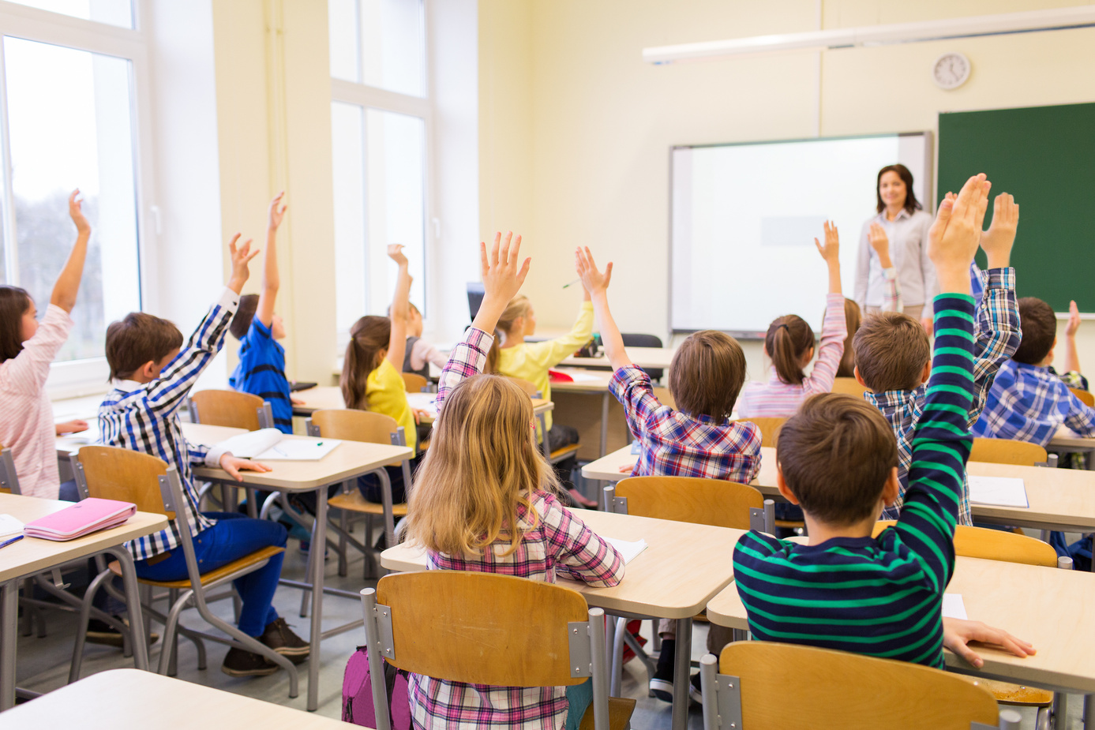
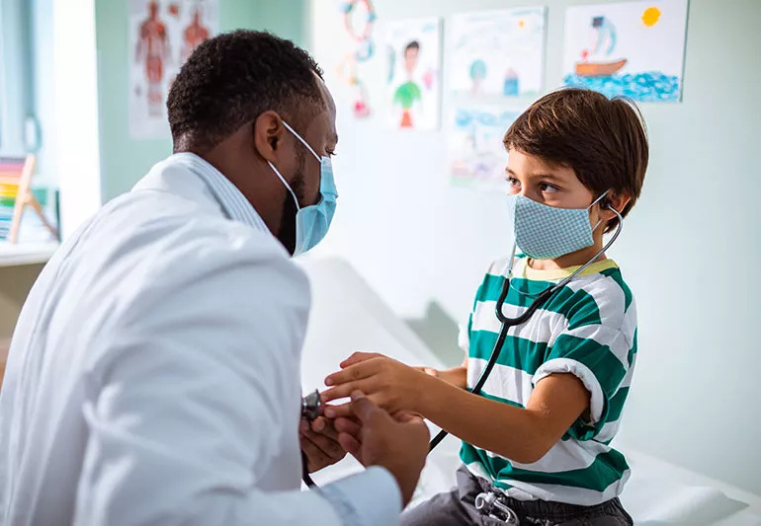

Which right is shown in the pictures?

Slide 3
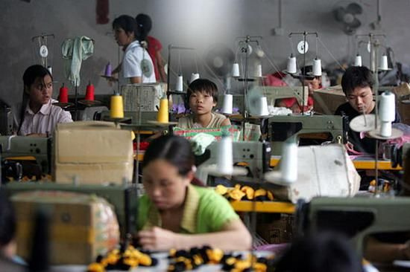
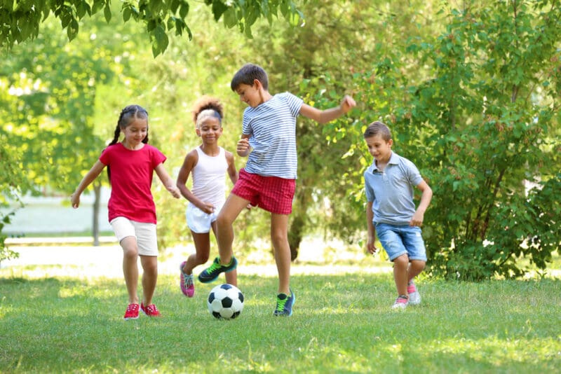
Which right is shown in the pictures?

Slide 4




What do you think are the most important rights?

