Slide 1
FAMOUS PEOPLE

Slide 2
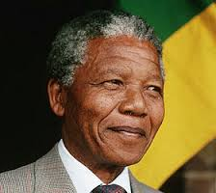
He was the first black President of South Africa.
He worked to achieve human rights and a better future for everyone in South Africa.
He became President of South Africa in 1994, and retired in1999.
He became famous for his long fight against bad government and racial prejudice.
He became a hero to people all over the world.
As South Africa's President, he was respected for his courage and wisdom in bringing people together to live in peace.
Who is he?
Nelson Mandela

Slide 3
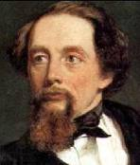
He is a famous English writer.
People all over the world enjoy his stories.
He was born in England in 1812. He died in 1870.
He was very clever at making up characters.
People all over the world know Oliver Twist, Scrooge and David Copperfield, even if they have not read the books in which these characters appear.
Who is he?
Charles Dickens

Slide 4
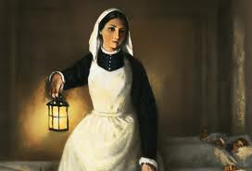
She went to the Crimean War to nurse wounded soldiers.
She and her nurses saved many lives.
She was born in 1820.
She died in 1910, after the age of electricity, cars and planes began.
She made hospitals cleaner places.
She showed that trained nurses and clean hospitals helped sick people get better.
She was the founder of modern nursing.
Who is she?
Florence Nightingale

Slide 5
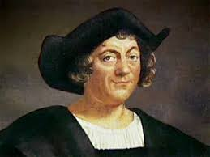
He was an explorer.
In 1492, he sailed from Europe to America.
He and his sailors crossed the Atlantic Ocean, not knowing where they would land.
He was born in 1451.
It was a time of new ideas and discoveries in Europe.
We call this time the Renaissance - a word that means 'rebirth'.
His voyage started regular contact between America and Europe.
Who is he?
Christopher Columbus

Slide 6
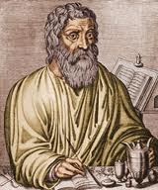
He was famous as a physicist, philosopher and medicine expert.
He was Greek and lived in Ancient Greece.
He was born in 460 BC and died in 370 BC.
He is an important name in the history of medicine.
He brought a new form into the field of ancient Greek medicine.
His ‘Oath’ is very commonly known.
Who is he?
Hippocrates

Slide 7
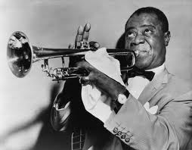
He was an American musician.
He was born in 1901 in New Orleans and died in 1971.
He was the father of jazz music and winner of several Grammy Awards.
He is considered as one of the greatest in the history of jazz music.
He was a distinguished pop artist, who made the people around him go crazy.
A popular song is ‘What a wonderful world’
Who is he?
Louis Armstrong

Slide 8
Sources
http://www.bbc.co.uk/schools/primaryhistory/
famouspeople/
http://www.thefamouspeople.com/

