Slide 1




WRITING LOVE LETTERS

Slide 2





What is a love letter?
  LOVE LETTERS ARE NOT ROMANTIC
  YOU DON’T HAVE TO BE GOOD WITH WORDS

Slide 3
BUT WHY WOULD I DO IT?
  SHOULD THERE BE A REASON?
  IS THERE VALUE TO A LETTER IF IT DOESN’T GET A RESPONSE?

Slide 4
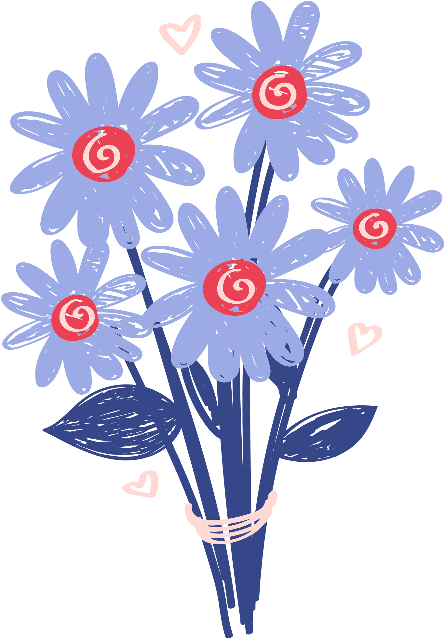
Be dramatic!
This is not an email! so write from the heart

Slide 5

“We get old and get use to each other. We think alike. We read each other’s minds. We know what the other wants without asking. Sometimes we irritate each other a little bit. Maybe sometimes take each other for granted”
famous letters
Johnny Cash, 1994
‘The important thing is I don’t want to be without you for the next 20 years, or 40, or however many there are. I’ve gotten very used to being happy and I love you very much indeed.”
Ronald Reagan, 1972

Slide 6
“I can only live, either altogether with you or not at all.”
Ludwig van Beethoven, 1812
“A few days ago I thought I loved you; but since I last saw you I feel I love you a thousand times more.”
famous letters
Napoleon Bonaparte, 1790s
“I can’t say how every time I ever put my arms around you, I felt that I was home. Nor too many things. But we were always cheerful and jokers together”
Ernest Hemingway, 1951

