Slide 1
Our School
1st Model High School of Athens
Michael Douvikas

Slide 2
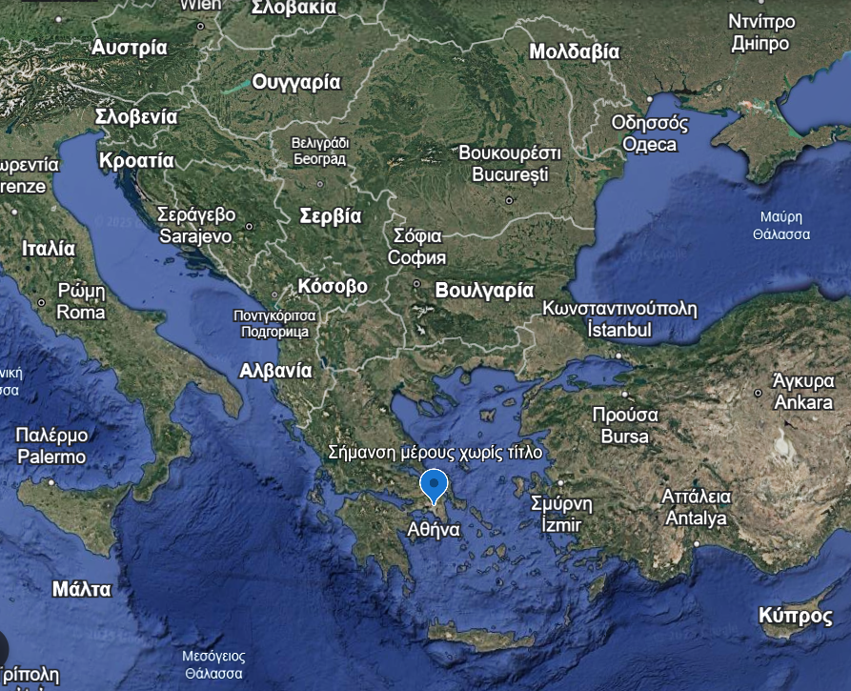
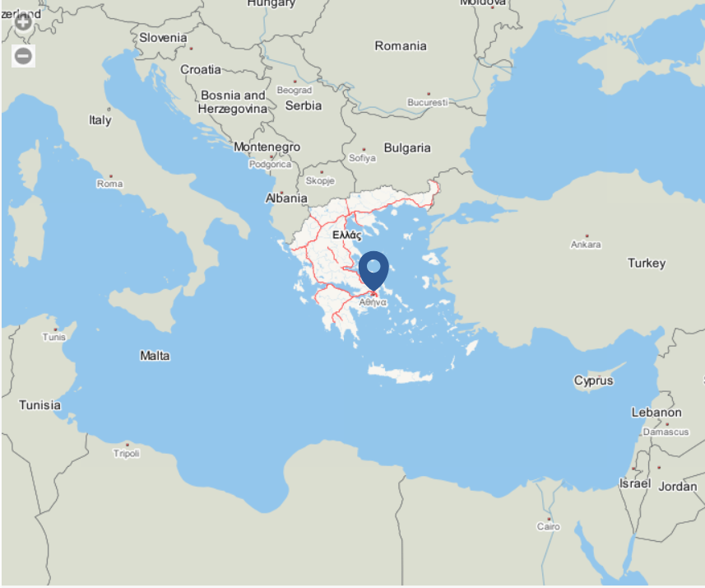
Do you need a map?

Slide 3
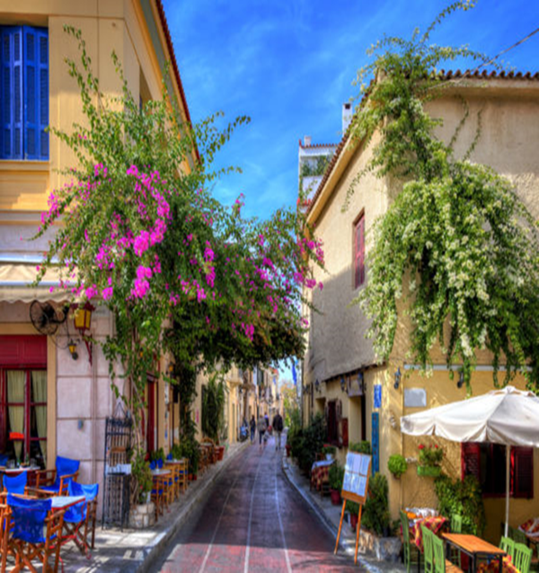
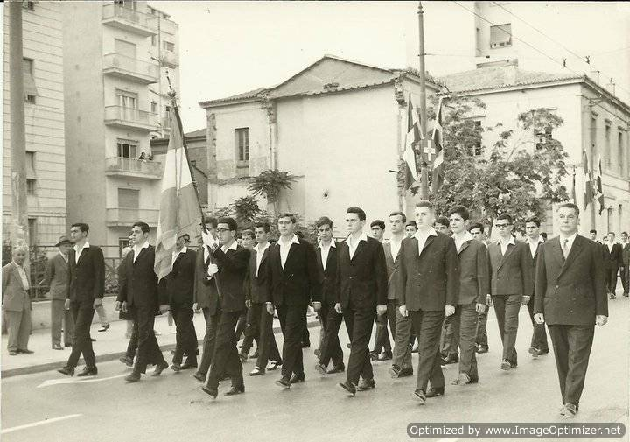
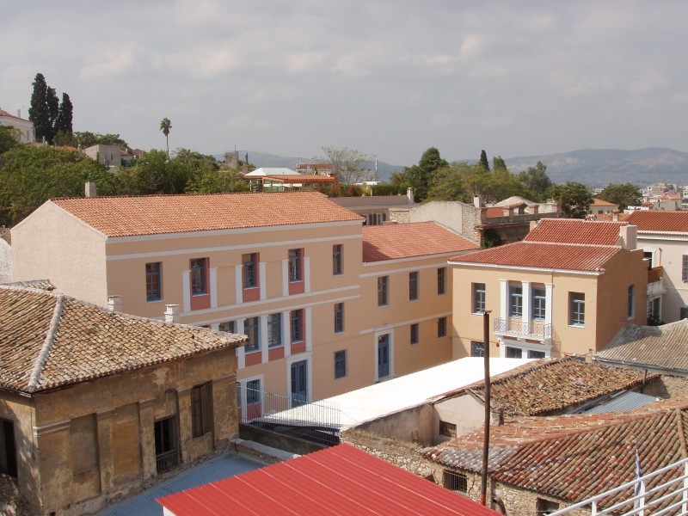
1st Model High School of Athens
Location and History:
Our school, the 1st Model High School of Athens, is located in Plaka,(right
under the Acropolis along side with many archaeological sights) Athens,
Greece, at 114 Adrianou street, in the heart of the city. It holds the
distinction of being the oldest school in Greece

Slide 4
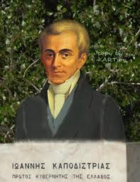
The history of our school
The 1st Model High School of Athens has a prestigious heritage, tracing back to the first secondary school in the newly established Greek state which Ioannis Kapodistrias(our first governor) founded. It was initially named the Central School and was established in 1829 in Aegina, the temporary capital. Its purpose was to educate and prepare students for higher studies abroad. After relocating to Athens, it was renamed to the Royal School and remained the city's only secondary institution. It is important to point out that the school accepted only male students and not female, as at that time, schools were single-gender, either for boys or girls.

Slide 5
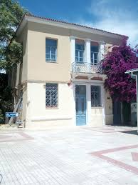
Our School: An Old Building with a Warm Atmosphere
Our school is not one of the most modern, as it was built a long time ago. Although we have some classrooms for science and computer studies, the school yard is small, making breaks and physical education challenging. PE classes take place on a small court next to the school. We also lack an event hall, but with the support of our teachers and our own efforts, we manage everything well, creating a pleasant atmosphere. The building is old, with wooden windows and high ceilings, as it is considered a preserved structure. Despite the difficulties, the benefits of our school are far greater.

Slide 6

Curriculum

Slide 7
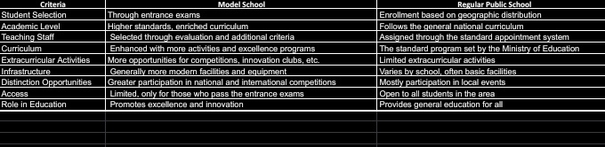
The main differences between our school and all the other schools of Greece
Our school provides a rich academic environment combined with extracurricular activities, ensuring a well-rounded education for students.

Slide 8
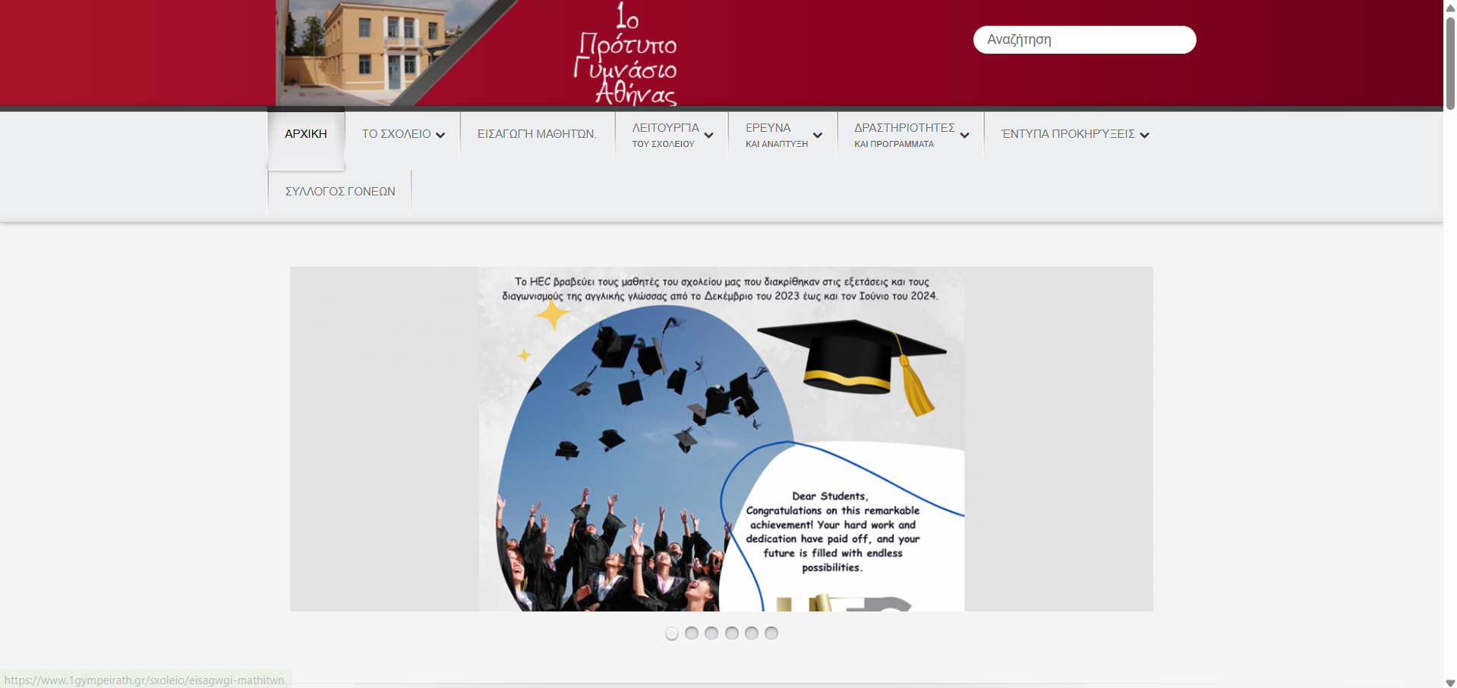
Admission Process:
To enter our school, students must pass entrance exams. These exams take place every April and are open to 12-year-old students. Our school offers secondary education and maintains high academic standards.
link

Slide 9
1st Year of Secondary Education:
Ancient Greek Language (2h)
Epic poetry(Odyssey) (2h)
Modern Greek Language (3h)
Modern Greek Literature (2h)
History (2h)
Mathematics (4h)
Physics (1h)
Biology (1h)
Geography (2h)
Religious Studies (2h)
Technology (1h)
Information Technology (2h)
Home Economics (1h)
English (3h) (2h from the ministry's book + 1h KPG, a test book created by our school)
French or German (2h)
Gymnastics(2h)
Music(1h)
Art lab(1h)
Skills workshops(1h)

Slide 10
2nd class of secondary education:
Ancient Greek language (2h)
Epic poetry (Ιliad) (2h)
Modern Greek language (2h)
Modern Greek literature (2h)
History(2h)
Maths(4h)
Physics(2h)
Biology(1h)
Chemistry(1h)
Geography (2h)
Religiously(2h)
Technology (1h)
Information technology (1h)
English(3h) 2h the book of the ministry and 1h kpg (2h from the ministry's book + 1h KPG, a test book created by our school)
French or German (2h)
Gymnastics(2h)
Music(1h)
Art lab(1h)
Skills workshops(1h)

Slide 11
3rd Year of Secondary Education:
Ancient Greek Language (2h)
Ancient Tragedy (Iliad) (2h)
Modern Greek Language (2h)
Modern Greek Literature (2h)
History (2h)
Social and Political Education (3h)
Mathematics (4h)
Physics (2h)
Biology (1h)
Chemistry (1h)
Religious Studies (2h)
Technology (1h)
Information Technology (1h)
English (3h) (2h from the ministry's book + 1h KPG)
French or German (2h)
Gymnastics (2h)
Music (1h)
Art Lab (1h)
Skills Workshops (1h)

Slide 12
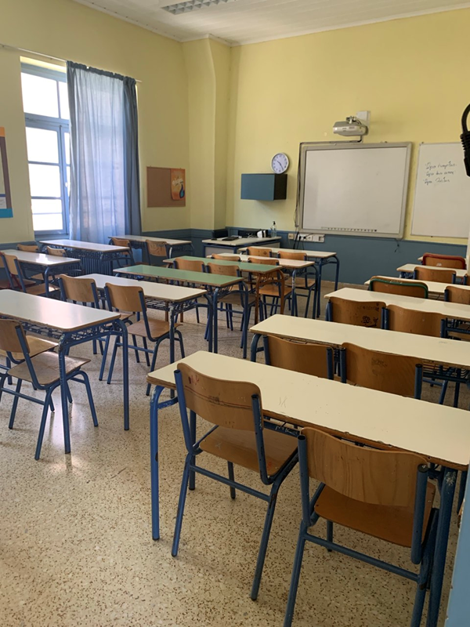
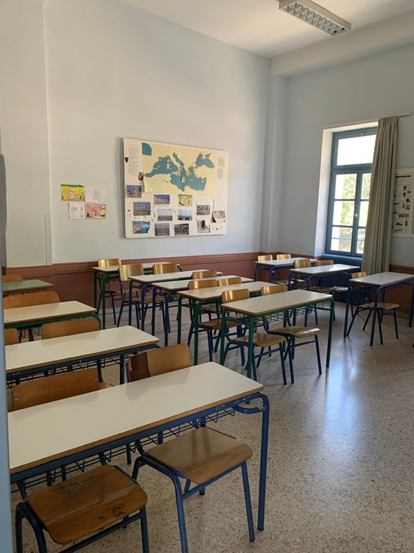
Student Life and Activities

Slide 13
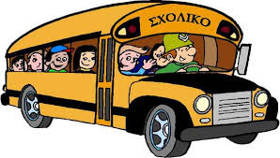
The students of our school come from different areas, which are usually far away, so this free school bus service is very important. So, our school provides buses for students from different neighborhoods to ensure easy access to the school.
Transportation:

Slide 14

Extracurricular Programs:
3)Various educational programs are offered by the Ministry of Education, such as book reading initiatives and specialized academic activities.
1)Our school actively participates in Erasmus programs, allowing students to engage with peers from other countries and develop friendships while enhancing their communication skills.
2)We also take part in Model United Nations (MUN), where students simulate UN meetings and gain experience in diplomacy and global affairs.

Slide 15
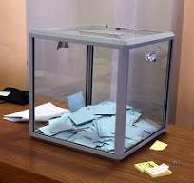
Student Community and Leadership:
The school has a structured student community system with class councils and a school council. Each class council consists of five members responsible for various tasks within their class. The school council includes 15 members, who discuss and address school-related issues. The council organizes bazaars and parties every two months to foster school spirit and engagement.

Slide 16
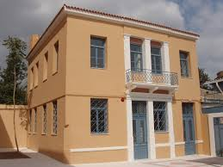
Thank you for your attention
1st Model High school of Athens
Michael Douvikas

