Slide 1
Problem Solving and Computing
Lesson 1: Intro to Problem Solving
(Option 1: Aluminum Boats)
(Option 2: Newspaper Tables)
(Option 3: Spaghetti Bridges)
(Option 4: Paper Towers)
Lesson 2: The Problem Solving Process
Lesson 3: Exploring Problem Solving
(Option 1: Original Theme)
(Option 2: Animal Theme)
(Option 3: Games Theme)
Lesson 4: What is a Computer?
Lesson 5: Input and Output
Lesson 6: Processing
Lesson 7: Storage
Lesson 8: Project: Propose an App

Slide 2
Problem Solving and Computing
Lesson 1
Intro to Problem Solving
(Aluminum Boats)

Slide 4
Problem Solving and Computing Lesson 1 - Warm Up
Journal Prompt:
What makes someone a good problem solver? Be ready to share three ideas with your group.

Slide 5
Problem Solving and Computing Lesson 1 - Warm Up
Question of the Day
What can help us to work together and solve problems as a team?

Slide 7
Aluminum Boats
Problem Solving and Computing Lesson 1 - Activity
Goal
Build a boat that holds the most possible pennies, using a piece of aluminum foil.
You will build two boats and will try to improve your design between the first and the second.
Rules
You may only use a single piece of foil to build your boat
You may not touch or adjust your boat once it is in the water
You must add pennies one at a time

Slide 8
Develop a Plan
Problem Solving and Computing Lesson 1 - Activity
Answer these questions on your activity guide
What kind of boat does your group plan to make?
What are the strengths of this design?
What possible weaknesses might this design have?
Once your group is ready, come get your aluminum foil

Slide 9
Test Your Boat
Problem Solving and Computing Lesson 1 - Activity
Work together in your group to build your boat
Once you're ready, test your boat in the water.
You may not touch or adjust your boat once it is in the water
You must add pennies one at a time
Answer the following questions on your activity guide
How many pennies did your boat hold?
Why did your boat eventually sink?
What needs to be improved?

Slide 10
Evaluate and Improve
Problem Solving and Computing Lesson 1 - Activity
Share with other groups the results of your first boat.
What are the most common kinds of problems you see among the boats tested?
What ideas seem to be working well?

Slide 11
Develop a New Plan
Problem Solving and Computing Lesson 1 - Activity
Answer these questions on your activity guide
What kind of boat does your group plan to make?
What are the strengths of this design?
What possible weaknesses might this design have?
Once your group is ready, come get your aluminum foil

Slide 12
Test Your Boat
Problem Solving and Computing Lesson 1 - Activity
Work together in your group to build your boat
Once you're ready, test your boat in the water.
You may not touch or adjust your boat once it is in the water
You must add pennies one at a time
Answer the following questions on your activity guide
How many pennies did your new boat hold?
Why did your boat eventually sink?
What needs to be improved?

Slide 14
Problem Solving and Computing Lesson 1 - Wrap Up
Journal Prompt:
You worked in teams for this activity.
How did working in a team make this activity easier?
How did it make the activity more challenging?
What helped your group overcome these challenges?

Slide 15
Problem Solving and Computing Lesson 1 - Wrap Up
Question of the Day
What can help us to work together and solve problems as a team?

Slide 16
Problem Solving and Computing
Lesson 1
Intro to Problem Solving
(Newspaper Tables)
Notes:
This is an alternate lesson to Aluminum Boats. You can find the lesson plan for Newspaper Tables here: https://www.codecurricula.com/csd-20/unit1/9/

Slide 18
Problem Solving and Computing Lesson 1 - Warm Up
Journal Prompt:
What makes someone a good problem solver? Be ready to share three ideas with your group.

Slide 19
Problem Solving and Computing Lesson 1 - Warm Up
Question of the Day
What can help us to work together and solve problems as a team?

Slide 21
Newspaper Table
Problem Solving and Computing Lesson 1 - Activity
Goal
Build a table that can hold as many books as possible, using only newspaper and tape.
You will build two tables and will try to improve your design between the first and the second.
Rules
You may only use only the newspaper and tape that your teacher gives you.
Your table must hold the books at least one foot (or 30 cm) off the ground.
You may not touch or adjust your table while you are adding books.
You must add books one at a time.

Slide 22
Develop a Plan
Problem Solving and Computing Lesson 1 - Activity
Answer these questions on your activity guide
What kind of table does your group plan to make?
What are the strengths of this design?
What possible weaknesses might this design have?
Once your group is ready, come get your newspaper.

Slide 23
Test Your Table
Problem Solving and Computing Lesson 1 - Activity
Work together in your group to build your table.
Once you're ready, test your table with books.
You may not touch or adjust your table once books are on it.
You must add books one at a time.
Your table must hold the books at least one foot (or 30 cm) off the ground.
Answer the following questions on your activity guide
How many books did your table hold?
Why did your table eventually fall?
What needs to be improved?

Slide 24
Evaluate and Improve
Problem Solving and Computing Lesson 1 - Activity
Share with other groups the results of your first table.
What are the most common kinds of problems you see among the tables tested?
What ideas seem to be working well?

Slide 25
Develop a New Plan
Problem Solving and Computing Lesson 1 - Activity
Answer these questions on your activity guide.
What kind of table does your group plan to make?
What are the strengths of this design?
What possible weaknesses might this design have?
Once your group is ready, come get your newspaper.

Slide 26
Test Your Table
Problem Solving and Computing Lesson 1 - Activity
Work together in your group to build your table
Once you're ready, test your table with books
You may not touch or adjust your table once books are on it.
You must add books one at a time
Your table must hold the books at least one foot (or 30 cm) off the ground
Answer the following questions on your activity guide
How many books did your table hold?
Why did your table eventually fall?
What needs to be improved?

Slide 28
Problem Solving and Computing Lesson 1 - Wrap Up
Journal Prompt:
You worked in teams for this activity.
How did working in a team make this activity easier?
How did it make the activity more challenging?
What helped your group overcome these challenges?

Slide 29
Problem Solving and Computing Lesson 1 - Wrap Up
Question of the Day
What can help us to work together and solve problems as a team?

Slide 30
Problem Solving and Computing
Lesson 1
Intro to Problem Solving
(Spaghetti Bridges)
Notes:
This is an alternate lesson to Aluminum Boats. You can find the lesson plan for Spaghetti Bridges here: https://www.codecurricula.com/csd-20/unit1/10/

Slide 32
Problem Solving and Computing Lesson 1 - Warm Up
Journal Prompt:
What makes someone a good problem solver? Be ready to share three ideas with your group.

Slide 33
Problem Solving and Computing Lesson 1 - Warm Up
Question of the Day
What can help us to work together and solve problems as a team?

Slide 35
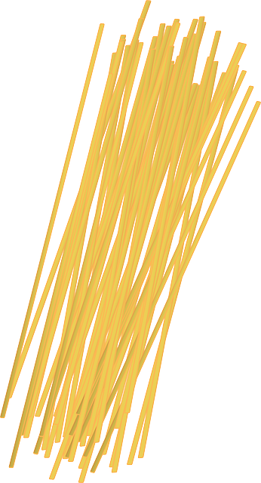
Spaghetti Bridge
Problem Solving and Computing Lesson 1 - Activity
Goal
Build a bridge that holds the most possible books, using spaghetti and glue.
You will build two bridges and will try to improve your design between the first and the second.
Rules
You may only use the spaghetti and the glue that your teacher gives you.
The bridge must cross a one foot (or 30 cm) gap.
You may not touch or adjust your bridge once the books are on it.
You must add books one at a time.

Slide 36
Develop a Plan
Problem Solving and Computing Lesson 1 - Activity
Answer these questions on your activity guide
What kind of bridge does your group plan to make?
What are the strengths of this design?
What possible weaknesses might this design have?
Once your group is ready, come get your spaghetti

Slide 37
Test Your Bridge
Problem Solving and Computing Lesson 1 - Activity
Work together in your group to build your bridge.
Once you're ready, test your bridge with books.
You may not touch or adjust your bridge once the books are on it.
You must add books one at a time.
Your bridge must cross at least one foot (or 30 cm) gap.
Answer the following questions on your activity guide:
How many books did your bridge hold?
Why did your bridge eventually fall?
What needs to be improved?

Slide 38
Evaluate and Improve
Problem Solving and Computing Lesson 1 - Activity
Share with other groups the results of your first bridge.
What are the most common kinds of problems you see among the bridges tested?
What ideas seem to be working well?

Slide 39
Develop a New Plan
Problem Solving and Computing Lesson 1 - Activity
Answer these questions on your activity guide:
What kind of bridge does your group plan to make?
What are the strengths of this design?
What possible weaknesses might this design have?
Once your group is ready, come get your spaghetti.

Slide 40
Test Your Bridge
Problem Solving and Computing Lesson 1 - Activity
Work together in your group to build your bridge
Once you're ready, test your bridge with books
You may not touch or adjust your bridge once the books are on it.
You must add books one at a time
Your bridge must cross at least one foot (or 30 cm) gap
Answer the following questions on your activity guide
How many books did your bridge hold?
Why did your bridge eventually fall?
What needs to be improved?

Slide 42
Problem Solving and Computing Lesson 1 - Wrap Up
Journal Prompt:
You worked in teams for this activity.
How did working in a team make this activity easier?
How did it make the activity more challenging?
What helped your group overcome these challenges?

Slide 43
Problem Solving and Computing Lesson 1 - Wrap Up
Question of the Day
What can help us to work together and solve problems as a team?

Slide 44
Problem Solving and Computing
Lesson 1
Intro to Problem Solving
(Paper Towers)
Notes:
This is an alternate lesson to Aluminum Boats. You can find the lesson plan for Paper Towers here: https://www.codecurricula.com/csd-20/unit1/11/

Slide 46
Problem Solving and Computing Lesson 1 - Warm Up
Journal Prompt:
What makes someone a good problem solver? Be ready to share three ideas with your group.

Slide 47
Problem Solving and Computing Lesson 1 - Warm Up
Question of the Day
What can help us to work together and solve problems as a team?

Slide 49
Paper Tower
Problem Solving and Computing Lesson 1 - Activity
Goal
Build a tower that goes as high as possible and can stand for at least 30 seconds, using sheets of paper.
You will build two towers and will try to improve your design between the first and the second.
Rules
You may only the paper provided by your teacher to build your tower
You may not touch or adjust your tower once everyone let goes of it

Slide 50
Develop a Plan
Problem Solving and Computing Lesson 1 - Activity
Answer these questions on your activity guide:
How does your group plan to build your tower?
What are the strengths of this design?
What possible weaknesses might this design have?
Once your group is ready, come get your paper.

Slide 51
Test Your Tower
Problem Solving and Computing Lesson 1 - Activity
Work together in your group to build your tower.
Once you're ready, test your tower.
You may only use the paper provided by your teacher to build your tower.
You may not touch or adjust your tower once everyone let goes of it.
Answer the following questions on your activity guide:
Did your tower stand for 30 seconds?
How tall was it?
What needs to be or can be improved?

Slide 52
Evaluate and Improve
Problem Solving and Computing Lesson 1 - Activity
Share with other groups the results of your first tower.
What are the most common kinds of problems you see among the towers tested?
What ideas seem to be working well?

Slide 53
Develop a New Plan
Problem Solving and Computing Lesson 1 - Activity
Answer these questions on your activity guide
How does your group plan to build your tower?
What are the strengths of this design?
What possible weaknesses might this design have?
Once your group is ready, come get your paper

Slide 54
Test Your Tower
Problem Solving and Computing Lesson 1 - Activity
Work together in your group to build your tower.
Once you're ready, test your tower.
You may only the paper provided by your teacher to build your tower.
You may not touch or adjust your tower once everyone let goes of it.
Answer the following questions on your activity guide:
Did your tower stand for 30 seconds?
How tall was it?
What needs to be or can be improved?

Slide 56
Problem Solving and Computing Lesson 1 - Wrap Up
Journal Prompt:
You worked in teams for this activity.
How did working in a team make this activity easier?
How did it make the activity more challenging?
What helped your group overcome these challenges?

Slide 57
Problem Solving and Computing Lesson 1 - Wrap Up
Question of the Day
What can help us to work together and solve problems as a team?

Slide 58
Problem Solving and Computing
Lesson 2
The Problem Solving Process

Slide 60
Problem Solving and Computing Lesson 2 - Warm Up
Journal Prompt:
We use the term "problem" to refer to lots of different situations.
Brainstorm as many different kinds of problems as you can and be ready to share with the class.

Slide 61
Problem Solving and Computing Lesson 2 - Warm Up
Question of the Day
What are some common steps we can use to solve many different types of problems?

Slide 63
Problem Solving and Computing Lesson 2 - Activity
How did you follow the problem solving process in the last lesson?
How could you use this process on a problem in your everyday life?

Slide 64
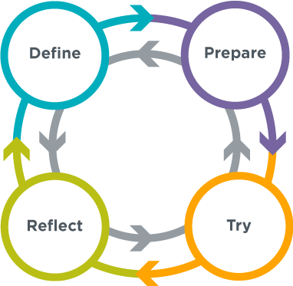
Problem Solving Process
Problem Solving and Computing Lesson 2 - Activity
Define
What problem are you trying to solve?
What are your constraints?
What does success look like?
Prepare
Brainstorm / research possible solutions
Compare pros and cons
Make a plan
Try
Put your plan into action
Reflect
How do your results compare to the goals you set while defining the problem?
What can you learn from this or do better next time?
What new problems have you discovered?

Slide 65
Building Challenge
Problem Solving and Computing Lesson 2 - Activity
Think about the building challenge you did last class
Which parts of that activity were part of the following steps?
Define
Prepare
Try
Reflect
What strategies did you use in solving this problem that could help you solve other problems?
Share with your neighbor once you're done

Slide 66
What are you good at?
Problem Solving and Computing Lesson 2 - Activity
Think about a type of problem you are good at solving
Write down which parts of your process fit into these steps
Define
Prepare
Try
Reflect
What strategies did you use in solving this problem that could help you solve other problems?
Share with your neighbor once you're done

Slide 67
What do you and your partner want to get better at?
Problem Solving and Computing Lesson 2 - Activity
Get in pairs with your neighbor
Think about a type of problem both you and your partner want to get better at solving
Write down strategies or steps you would take to solve this problem using the problem solving process
Define
Prepare
Try
Reflect
Share with your neighbor once you're done

Slide 69
Problem Solving and Computing Lesson 2 - Wrap Up
Journal Prompt:
You saw a lot of different types of problems today, but they all used our Problem Solving Process.
For each step of the process, think of one general tip that could be useful no matter what problem someone is trying to solve.

Slide 70
Problem Solving and Computing Lesson 2 - Wrap Up
Question of the Day
What are some common steps we can use to solve many different types of problems?

Slide 71
Problem Solving and Computing
Lesson 3
Exploring Problem Solving

Slide 73
Problem Solving and Computing Lesson 3 - Warm Up
Journal Prompt:
Think of the silliest problem the problem solving process could help with.
Be prepared to say how each step of the process could apply.

Slide 74
Problem Solving and Computing Lesson 3 - Warm Up
Question of the Day
How can we apply the problem solving process to many different kinds of problems?

Slide 76
Word Search
Problem Solving and Computing Lesson 3 - Activity
Get into groups of 2-4 to do the word search
Try to use the steps of the problem solving process:
Define
Prepare
Try
Reflect

Slide 77
Birthday Guests
Problem Solving and Computing Lesson 3 - Activity
In your groups, read the Birthday Guests problem
Before starting the problem, try thinking about how to use the steps of the problem solving process
Define
Prepare
Try
Reflect

Slide 78
Redesign Your Classroom
Problem Solving and Computing Lesson 3 - Activity
In groups, start by choosing goals
What will your classroom plan do well?
Write down your goals.
Think about how to use the problem solving process while designing your classroom
Define
Prepare
Try
Reflect
Once you have an initial plan, share with another group
Adjust your design based on the feedback you receive

Slide 79
Reflect
Problem Solving and Computing Lesson 3 - Activity
Reflect on how you used the steps of the problem solving process for each problem
Problem Solving Process
Define
Prepare
Try
Reflect

Slide 80
Problem Solving and Computing Lesson 3 - Activity
Understanding the Problem Solving Process
For each step in the problem solving process...
What is its purpose?
Why is it included?
Are there any kinds of problems that the problem solving process is particularly helpful at solving?

Slide 82
Problem Solving and Computing Lesson 3 - Wrap Up
Prompt:
We saw today that without a well-defined problem the rest of the problem solving process is difficult to follow.
What are some questions or strategies we can use to help us better understand and define problems before we try to solve them?

Slide 83
Problem Solving and Computing Lesson 3 - Wrap Up
Question of the Day
How can we apply the problem solving process to many different kinds of problems?

Slide 84
Problem Solving and Computing
Lesson 3
Exploring Problem Solving
(Animals Theme)
Notes:
This is an alternate themed lesson for Exploring Problem Solving. You can find the lesson plan for the animals theme here:

Slide 86
Problem Solving and Computing Lesson 3 - Warm Up
Journal Prompt:
Think of the silliest problem the problem solving process could help with.
Be prepared to say how each step of the process could apply.

Slide 87
Problem Solving and Computing Lesson 3 - Warm Up
Question of the Day
How can we apply the problem solving process to many different kinds of problems?

Slide 89
Tangrams
Problem Solving and Computing Lesson 3 - Activity
Get into groups of 2-4 to recreate the animal pictures with tan pieces
Try to use the steps of the problem solving process
Define
Prepare
Try
Reflect

Slide 90
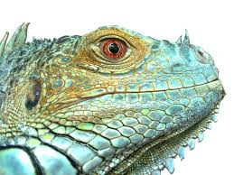
The Perfect Pet
Problem Solving and Computing Lesson 3 - Activity
In your groups, read the Perfect Pet problem
Before starting the problem, try thinking about how to use the steps of the problem solving process
Define
Prepare
Try
Reflect

Slide 91
Plan a Pet Adoption
Problem Solving and Computing Lesson 3 - Activity
In groups, start by choosing goals
What will your adoption event plan do well?
Write your goals in the left column
Think about how to use the problem solving process while planning the event
Define
Prepare
Try
Reflect
Once you have an initial plan, share with another group
Adjust your design based on the feedback you receive

Slide 92
Reflect
Problem Solving and Computing Lesson 3 - Activity
Reflect on how you used the steps of the problem solving process for each problem
Problem Solving Process
Define
Prepare
Try
Reflect

Slide 93
Problem Solving and Computing Lesson 3 - Activity
Understanding the Problem Solving Process
For each step in the problem solving process...
What is its purpose?
Why is it included?
Are there any kinds of problems that the problem solving process is particularly helpful at solving?

Slide 95
Problem Solving and Computing Lesson 3 - Wrap Up
Prompt:
We saw today that without a well-defined problem the rest of the problem solving process is difficult to follow.
What are some questions or strategies we can use to help us better understand and define problems before we try to solve them?

Slide 96
Problem Solving and Computing Lesson 3 - Wrap Up
Question of the Day
How can we apply the problem solving process to many different kinds of problems?

Slide 97
Problem Solving and Computing
Lesson 3
Exploring Problem Solving
(Games Theme)
Notes:
This is an alternate themed lesson for Exploring Problem Solving. You can find the lesson plan for the games theme here: https://www.codecurricula.com/csd-20/unit1/13/

Slide 99
Problem Solving and Computing Lesson 3 - Warm Up
Journal Prompt:
Think of the silliest problem the problem solving process could help with.
Be prepared to say how each step of the process could apply.

Slide 100
Problem Solving and Computing Lesson 3 - Warm Up
Question of the Day
How can we apply the problem solving process to many different kinds of problems?

Slide 102
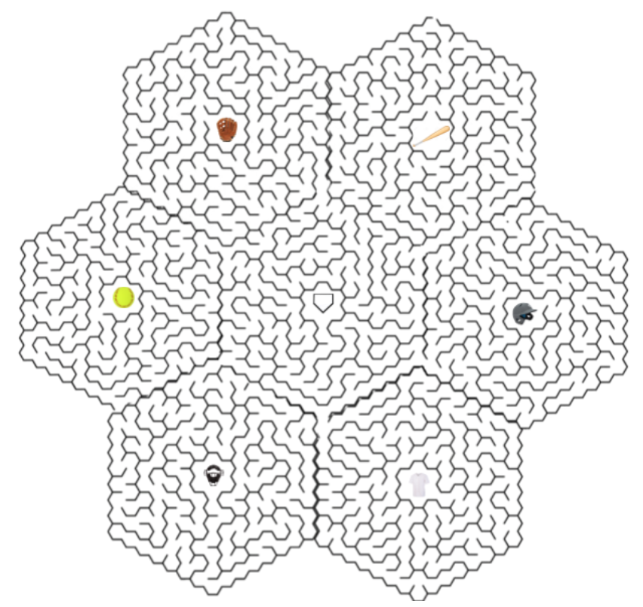
Maze
Problem Solving and Computing Lesson 3 - Activity
Get into groups of 2-4 to solve the maze
Try to use the steps of the problem solving process
Define
Prepare
Try
Reflect

Slide 103
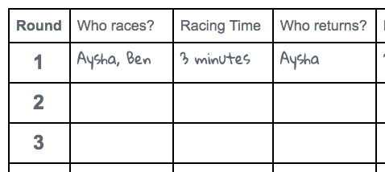
Partner Race Relay
Problem Solving and Computing Lesson 3 - Activity
In your groups, read the Partner Race Relay problem
Before starting the problem, try thinking about how to use the steps of the problem solving process
Define
Prepare
Try
Reflect

Slide 104
Make a Game
Problem Solving and Computing Lesson 3 - Activity
In groups, start by choosing goals
What are the most important things about your game?
Write your goals in the left column
Think about how to use the problem solving process while planning the event
Define
Prepare
Try
Reflect
Once you have an initial plan, share with another group
Adjust your design based on the feedback you receive

Slide 105
Reflect
Problem Solving and Computing Lesson 3 - Activity
Reflect on how you used the steps of the problem solving process for each problem
Problem Solving Process
Define
Prepare
Try
Reflect

Slide 106
Problem Solving and Computing Lesson 3 - Activity
Understanding the Problem Solving Process
For each step in the problem solving process...
What is its purpose?
Why is it included?
Are there any kinds of problems that the problem solving process is particularly helpful at solving?

Slide 108
Problem Solving and Computing Lesson 3 - Wrap Up
Prompt:
We saw today that without a well-defined problem the rest of the problem solving process is difficult to follow.
What are some questions or strategies we can use to help us better understand and define problems before we try to solve them?

Slide 109
Problem Solving and Computing Lesson 3 - Wrap Up
Question of the Day
How can we apply the problem solving process to many different kinds of problems?

Slide 110
Problem Solving and Computing
Lesson 4
What is a Computer?

Slide 112
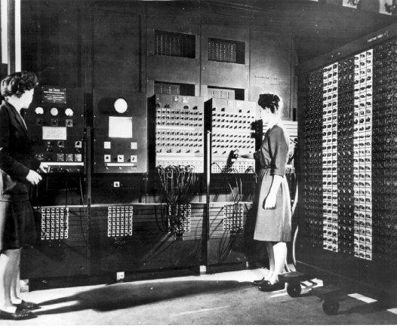
Problem Solving and Computing Lesson 4 - Warm Up
Journal 3-2-1:
This picture shows one of the world's first computers, and two of the world's first computer programmers.
What are 3 ways this computer is different from computers that we use today?
What are 2 ways that it is the same?
What is 1 thing you think is true of ALL computers?

Slide 113
Problem Solving and Computing Lesson 4 - Warm Up
Question of the Day
What is a computer?

Slide 115
Problem Solving and Computing Lesson 4 - Activity
What is a Computer?
Draw a line down the middle of your poster, label one side "Computer" and the other "Not a Computer".
Discuss as a group which of the objects in your set (from the activity guide) belong in each category.
Once your group is in agreement. tape your objects to the appropriate side.
Develop a list of characteristics your groups used to determine whether an object is a computer.

Slide 116
Problem Solving and Computing Lesson 4 - Activity
What is a Computer?
What rules or definition did you use to categorize your objects?
Which item was most difficult for you to categorize? How did you eventually make the decision of where to place it?

Slide 117
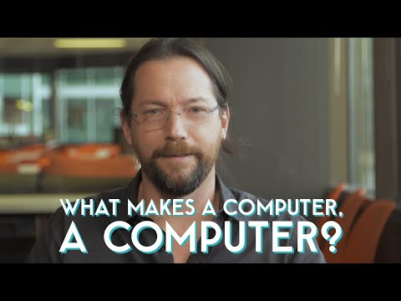
Problem Solving and Computing Lesson 4 - Activity
What made computers different from machines that came before them?

Slide 118
Problem Solving and Computing Lesson 4 - Activity
Key Vocabulary
Computer - A machine that works with information

Slide 119
Problem Solving and Computing Lesson 4 - Activity
What is a Computer? Rethink!
Revise your posters using your new knowledge.
Think about...
What types of problems is this device used to solve?
Does the device use information to solve problems?
Where does it get the information?
How does it use the information to solve problems?

Slide 120
Problem Solving and Computing Lesson 4 - Activity
What is a Computer?
Did your group change your mind about whether something was a computer?
What about the definition convinced you?

Slide 122
Problem Solving and Computing Lesson 4 - Wrap Up
Prompt:
Think of a problem that a computer can help you to solve.
What is the information problem?
What information does the computer need to solve that problem?
What type of thinking work does the computer need to do to solve the problem?

Slide 123
Problem Solving and Computing Lesson 4 - Wrap Up
Key Vocabulary
Computer - a machine that works with information

Slide 124
Problem Solving and Computing Lesson 4 - Wrap Up
Question of the Day
What is a computer?

Slide 125
Problem Solving and Computing
Lesson 5
Input and Output

Slide 127
Problem Solving and Computing Lesson 5 - Warm Up
Prompt:
Imagine that you are going to recommend a pet to someone
What are three questions you would ask them to help make that recommendation?

Slide 128
Problem Solving and Computing Lesson 5 - Warm Up
Prompt:
Take turns asking your questions and making a recommendation to your partner

Slide 129
Problem Solving and Computing Lesson 5 - Warm Up
Key Vocabulary:
Input - the information computers get from users, devices, or other computers
Output - the information computers give to users, devices, or other computers

Slide 130
Problem Solving and Computing Lesson 5 - Warm Up
Question of the Day
How do computers use input and output to get and give the information that they need to solve problems?

Slide 132
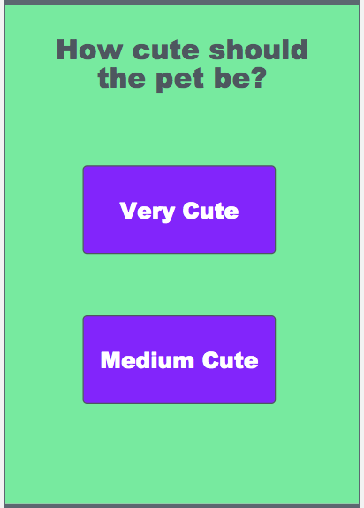
Problem Solving and Computing Lesson 5 - Activity
Pet Chooser App
Try playing this pet chooser app a few times.
What are the inputs?
What are the outputs?

Slide 133
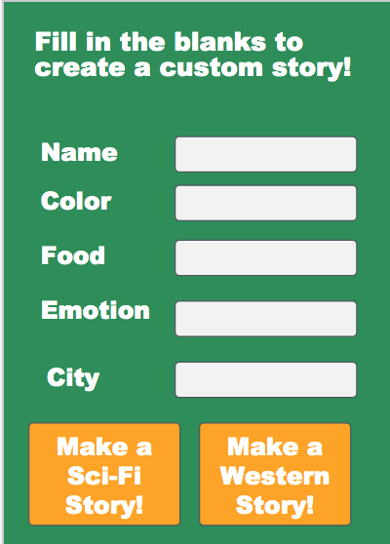
Problem Solving and Computing Lesson 5 - Activity
Story Creator App
Try out this app that writes a custom story for you.
What are its inputs?
What are its outputs?

Slide 134
Problem Solving and Computing Lesson 5 - Activity
Your App Idea
With your partner, think of a new app idea.
What does the app do?
What inputs and outputs does it need?
?

Slide 135
Problem Solving and Computing Lesson 5 - Activity
Other Sources of Input
So far, all of the input that we have seen comes directly from the user.
Is there any other way that apps can get the information that they need?

Slide 136
Problem Solving and Computing Lesson 5 - Activity
Improved Pet Chooser App
This new version of the pet chooser app also tells you where you can find a pet.
What are the new inputs?
What are the sources of the new inputs?

Slide 138
Problem Solving and Computing Lesson 5 - Wrap Up
Prompt:
Brainstorm an everyday activity you or people you know do with an app or computer
What is the input used for that activity?
What is the output?

Slide 139
Problem Solving and Computing Lesson 5 - Wrap Up
Key Vocabulary:
Input - the information computers get from users, devices, or other computers
Output - the information computers give to users, devices, or other computers

Slide 140
Problem Solving and Computing Lesson 5 - Wrap Up
Question of the Day
How do computers use input and output to get and give the information that they need to solve problems?

Slide 141
Problem Solving and Computing
Lesson 6
Processing

Slide 143
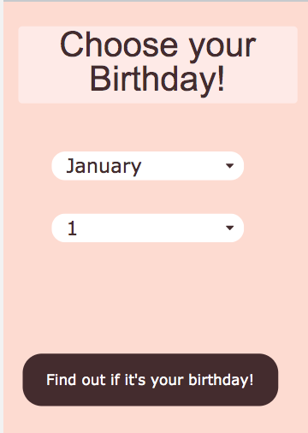
Problem Solving and Computing Lesson 6 - Warm Up
Prompt:
Go on Code Studio to try out the birthday app.
It has three possible outputs. Try to find each one.
What is the input to the app?
What is the output?
How do you think the app decides which output to give to the user?

Slide 144
Problem Solving and Computing Lesson 6 - Warm Up
Key Vocabulary:
Processing - the thinking work computers do to turn input into output

Slide 145
Problem Solving and Computing Lesson 6 - Warm Up
Question of the Day
What are the different ways computers can process information?

Slide 147
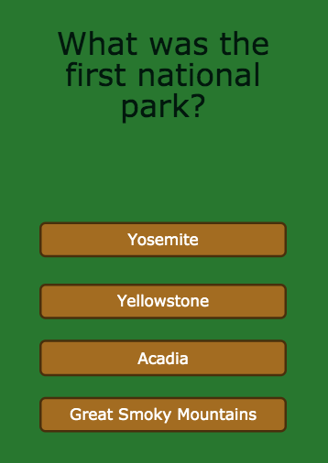
Problem Solving and Computing Lesson 6 - Activity
National Park Quiz
Try out this quiz about America's national parks.
How does this app use comparing and if/then to turn the input into output?

Slide 148
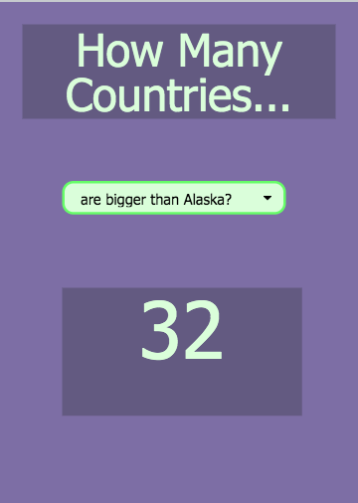
Problem Solving and Computing Lesson 6 - Activity
How Many Countries...
This app tells you some fun facts different countries.
What new kinds of processing
might it use to turn input to output?

Slide 149
Problem Solving and Computing Lesson 6 - Activity
Four Kinds of Processing
If/Then - If something is true, do something else.
Comparing - Check whether things are the same, or one is bigger than the other.
Finding a Match - Search a list or group of things for a match.
Counting - Keep track of how many of something there are.

Slide 150
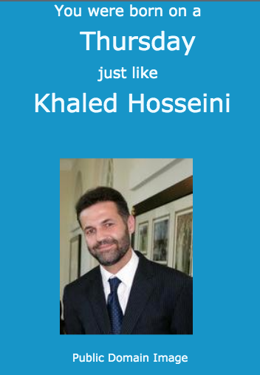
Problem Solving and Computing Lesson 6 - Activity
App and Processing
For each app, choose one type of processing it uses and explain how it is used.

Slide 151
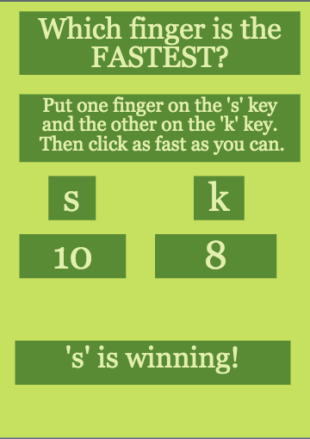
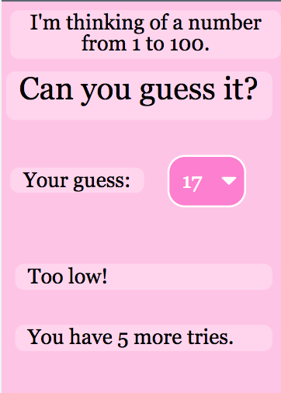
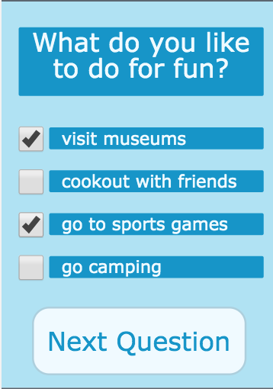
Problem Solving and Computing Lesson 6 - Activity
More Processing
For each app, choose two types of processing it uses and explain how they are used.

Slide 152
Problem Solving and Computing Lesson 6 - Activity
Your App Idea
With your partner, think of a new app idea.
What inputs does it need?
What outputs?
What types of processing does it use to change the input to output?
?

Slide 154
Problem Solving and Computing Lesson 6 - Wrap Up
Prompt:
We saw four different types of processing today, but there are many more
What’s another type of processing that you think would be useful?
What kind of app might use it?

Slide 155
Problem Solving and Computing Lesson 6 - Wrap Up
Key Vocabulary:
Processing - the thinking work computers do to turn input into output

Slide 156
Problem Solving and Computing Lesson 6 - Wrap Up
Question of the Day
What are the different ways computers can process information?

Slide 157
Problem Solving and Computing
Lesson 7
Storage

Slide 159
Problem Solving and Computing Lesson 7 - Warm Up
Journal Prompt:
Go on Code Studio to look at the outfit picker app.
What is one input, one output, and one kind of processing it might use?
If you used this app every day, what information would you want it to remember?

Slide 160
Problem Solving and Computing Lesson 7 - Warm Up
Key Vocabulary
Storage - saving information to use in the future

Slide 161
Problem Solving and Computing Lesson 7 - Warm Up
Question of the Day
Why is storage an important part of the computing process?

Slide 163
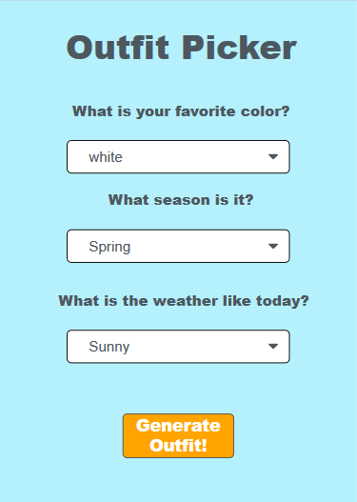
Storage: Outfit Picker
Problem Solving and Computing Lesson 7 - Activity
Get into groups of 2-3 and go to Code studio.
Based on the outfit picker app in Code studio, answer the following questions:
Should the following information be stored?
Why or why not?
Favorite color
Season
Weather

Slide 164
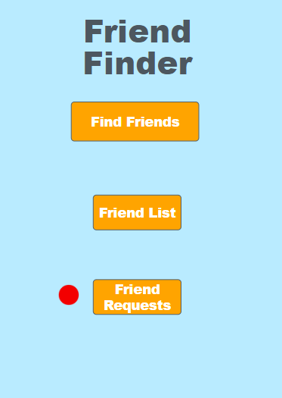
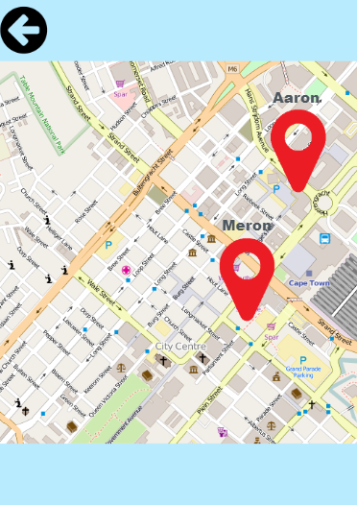
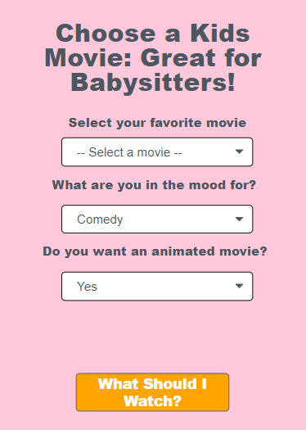
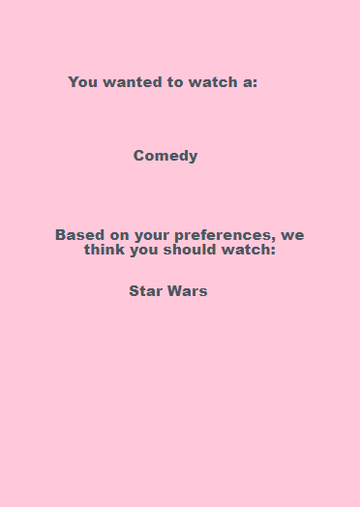
Friend Finder and Movie Picker
Problem Solving and Computing Lesson 7 - Activity
In your groups, try out these two apps.
On your activity guide, explain which information should and should not be stored and why.

Slide 165
Guidelines for Storage
Problem Solving and Computing Lesson 7 - Activity
In your groups, brainstorm at least two guidelines about what types of information should and should not be stored.
“If the information ______________, then that information (should / should not) be stored because _____________. For example, ____________ (should / should not) be stored.”

Slide 166
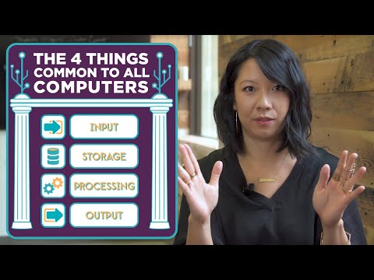
Problem Solving and Computing Lesson 7 - Activity
Think of something you do on the computer. What sort of input, output, storage, and processing are happening?

Slide 167
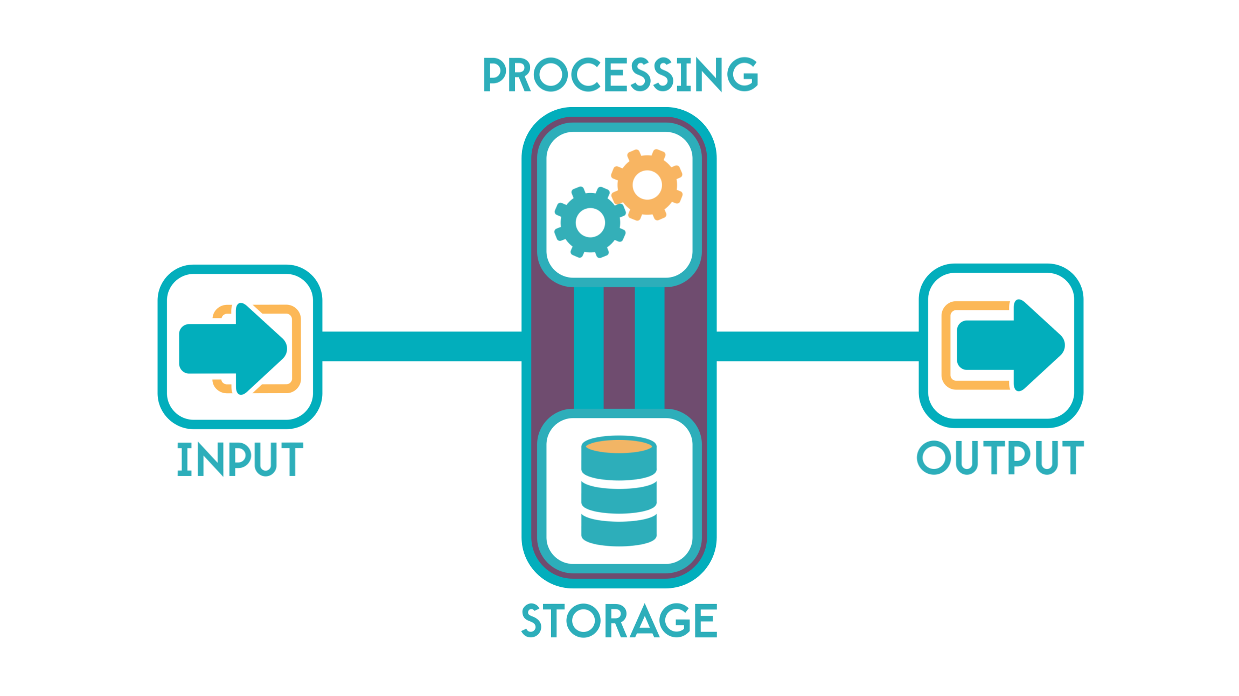
Problem Solving and Computing Lesson 7 - Activity
Input-Output-Storage-Processing Model
What kinds of input, output, storage, and processing are used in a modern smartphone?

Slide 169
Problem Solving and Computing Lesson 7 - Wrap Up
Prompt:
Think of an app you would like to make.
What information would it store?

Slide 170
Problem Solving and Computing Lesson 7 - Wrap Up
Key Vocabulary
Storage - saving information to use in the future

Slide 171
Problem Solving and Computing Lesson 7 - Wrap Up
Question of the Day
Why is storage an important part of the computing process?

Slide 172
Problem Solving and Computing
Lesson 8
Project: Propose an App

Slide 174
Problem Solving and Computing Lesson 8 - Warm Up
Prompt:
Of the apps we've seen in this unit, what was your favorite? What problem did it solve?

Slide 175
Problem Solving and Computing Lesson 8 - Warm Up
Question of the Day
How can the IOSP model help us to design an app that solves a problem?

Slide 177
Problem Solving and Computing Lesson 8 - Activity
Project Overview
You will…
Work with a partner
Define a real world problem
Brainstorm ways an app could help solve that problem
Identify the inputs/outputs/storage/processing your app uses
Share your ideas with another group for peer feedback
Incorporate feedback to create a final version of the app
Create a poster of your app to share with the class

Slide 178
Problem Solving and Computing Lesson 8 - Activity
Brainstorm Problems
You might think about...
Things you’d like to improve in your school, neighborhood, or community
A task in your everyday life that you wish could be completed more easily
A cause that you feel strongly about
Something that is currently inconvenient or annoying to do

Slide 179
Problem Solving and Computing Lesson 8 - Activity
Choose Your Problem
Your problem should be...
Interesting: Both group members are interested in the problem
Well-Defined: You can explain who specifically the problem affects, what needs to change, and how you’ll be able to tell that the problem had been solved
Computing is Relevant: The problem is an “information problem” that can be solved with “thinking work.”

Slide 180
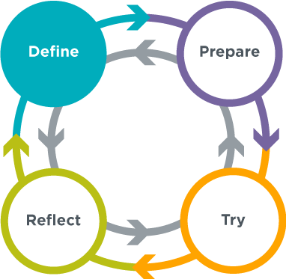
Problem Solving and Computing Lesson 8 - Activity
Define
What is the problem?
Who does the problem affect?
How will you be able to know that a solution has worked?

Slide 181
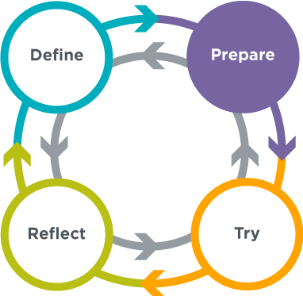
Problem Solving and Computing Lesson 8 - Activity
Prepare
What will your app do?
What will it look like?
What inputs and outputs will it use?
What processing will it use?
What types of information will it store?

Slide 182
Problem Solving and Computing Lesson 8 - Activity
Peer Review
Fill out the top part of the peer review guide, then swap project and peer review guides with another group.
Read over the other group’s ideas and give them feedback in the peer review guide.
Trade back and look at the feedback you got on your app.
Reflect on the feedback and decide what changes you will make based on the other group’s ideas.

Slide 183
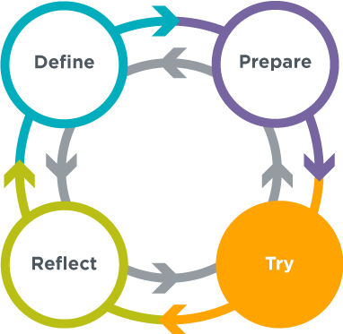
Problem Solving and Computing Lesson 8 - Activity
Try
Finalize your app .
Create a poster based on your app.
Get ready to present your ideas to the class.

Slide 185
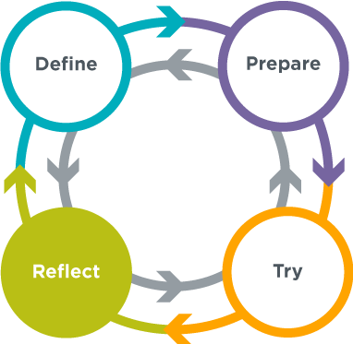
Problem Solving and Computing Lesson 8 - Wrap Up
Prompt:
What are you most proud of in your project?

Slide 186
Problem Solving and Computing Lesson 8 - Wrap Up
Question of the Day
How can the IOSP model help us to design an app that solves a problem?

