Slide 1

Gardner's Multiple Intelligences: Discover Your Unique Strengths
Welcome to an exciting journey of self-discovery! Today, we'll explore how everyone possesses different types of intelligence. Understanding your unique strengths can help you learn better, choose activities you'll love, and appreciate how wonderfully diverse human minds truly are.

Slide 2
What is Intelligence?
For many years, people believed intelligence was simply about doing well in school or scoring highly on tests. But is that really the full picture? Think about your classmates – some excel at maths, others write brilliant stories, and some are natural athletes or artists. Are they not all intelligent in their own ways?
In 1983, psychologist Howard Gardner revolutionised our understanding by proposing that intelligence isn't just one thing. Instead, he suggested that humans possess multiple types of intelligence. This groundbreaking theory means that everyone is smart in different ways – you just need to discover which intelligences are your strongest!
Gardner's work helps us celebrate diversity and recognise that traditional academic subjects represent only a fraction of human potential.

Slide 3
Gardner's Theory of Multiple Intelligences
The Revolutionary Theory
01
Gardner identified 8 distinct types of intelligence that work together to make each person unique. His research changed education worldwide, helping teachers understand why students learn differently.
Proposed in 1983
Gardner's book 'Frames of Mind' introduced the theory
02
Eight Intelligence Types
Each represents a different way of processing information
03
Individual Profiles
Everyone has a unique combination of these intelligences
04
Lifelong Development
Your intelligences can be strengthened with practice

Slide 4

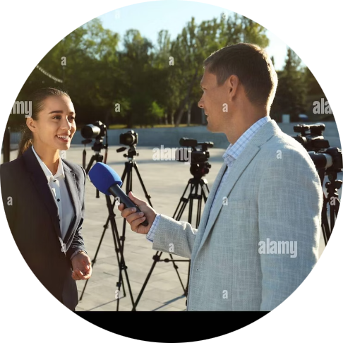
1. Linguistic Intelligence
People with strong linguistic intelligence have a special gift for language. They think in words rather than pictures and have a natural ability to express themselves through speaking and writing. These individuals often have excellent memories for names, dates, and facts they've read.
Poets and Writers
Journalists and Speakers
They craft beautiful stories, poems, and articles that move people emotionally. Think of J.K. Rowling creating the magical world of Harry Potter through words.
They communicate ideas clearly to large audiences. News presenters and public speakers like Malala Yousafzai use linguistic intelligence to inspire change.
You might have linguistic intelligence if you: Love reading books, enjoy word games and crosswords, find it easy to remember song lyrics, like debating or telling jokes, or keep a personal journal.

Slide 5

2. Logical-Mathematical Intelligence
This intelligence involves the capacity to analyse problems logically, carry out mathematical operations, and investigate issues scientifically. People with strong logical-mathematical intelligence think conceptually and abstractly, and can see patterns and relationships that others might miss.
They enjoy experimenting, solving puzzles, and asking cosmic questions. These are the people who love to understand how things work and why things happen.
Scientists
Computer Programmers
Mathematicians
Marie Curie discovered radioactivity through careful experimentation and logical thinking. Scientists use this intelligence to form hypotheses and conduct research.
They create apps and software by using logic to solve problems. Programmers like Mark Zuckerberg built platforms that connect billions of people.
They work with numbers and abstract concepts to solve complex problems. Think of how engineers use maths to design safe bridges and buildings.

Slide 6

3. Musical Intelligence
Musical intelligence is the capacity to recognise and compose musical pitches, tones, and rhythms. People with strong musical intelligence don't just enjoy music – they understand it deeply. They can hear when someone sings off-key, remember melodies after hearing them once, and often find themselves tapping rhythms unconsciously.
This intelligence involves both creating and appreciating music. Some people with musical intelligence become performers, whilst others work as music teachers, sound engineers, or music therapists who use music to help people heal.
Signs you have musical intelligence:
You learn songs quickly
You play one or more instruments
You notice background music in films
You can keep a steady rhythm
Music improves your mood
Singers and Composers
Artists like Ed Sheeran or Adele create songs that touch millions of hearts worldwide
Music Producers
They arrange and mix sounds to create the perfect recording

Slide 7
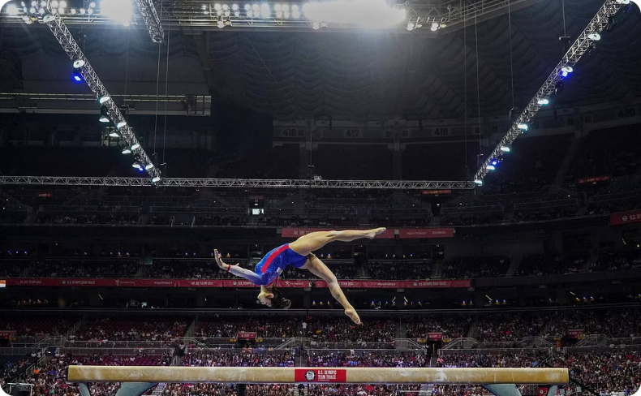


4. Bodily-Kinaesthetic Intelligence
This intelligence is all about physical movement and body awareness. People with bodily-kinaesthetic intelligence have excellent hand-eye coordination, balance, and timing. They learn best by doing rather than watching or reading, and they often struggle to sit still for long periods because their bodies want to move!
This intelligence isn't just about sports – it includes anyone who uses their body skilfully. Surgeons performing delicate operations, craftspeople creating beautiful furniture, and actors expressing emotions through gesture all demonstrate bodily-kinaesthetic intelligence.
Athletes
Craftspeople
Surgeons
Olympic gymnast Simone Biles demonstrates extraordinary body control. Football players like Cristiano Ronaldo show perfect coordination and timing.
Carpenters, sculptors, and jewellers use their hands with incredible precision to create beautiful and functional objects.
Medical professionals use fine motor skills and steady hands to perform life-saving procedures with millimetre precision.

Slide 8
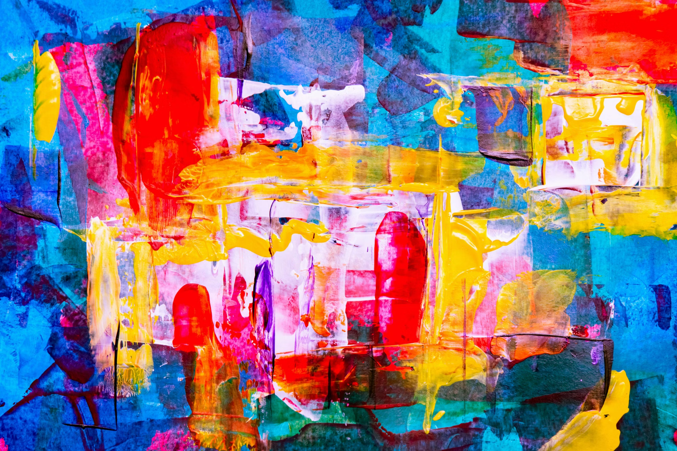
5. Visual-Spatial Intelligence
Visual-spatial intelligence is the ability to think in pictures and visualise outcomes. People with this intelligence can mentally manipulate objects, enjoy puzzles and mazes, and have a strong sense of direction. They notice colours, shapes, and visual details that others might overlook.
These individuals often think in images rather than words. When you tell them about your holiday, they create a mental picture of the place. They can easily imagine how furniture would look in a room or how to navigate through an unfamiliar city.
Artists and Illustrators
Architects
Photographers
Video Game Designers
Painters like Frida Kahlo expressed complex emotions through visual imagery. Graphic designers create the logos and advertisements we see every day.
They design buildings by visualising three-dimensional spaces. Zaha Hadid created stunning, futuristic structures that seemed impossible to build.
They capture moments by understanding composition, lighting, and perspective. Their images tell stories without words.
They create immersive virtual worlds that millions explore, requiring strong spatial reasoning and visual creativity.

Slide 9
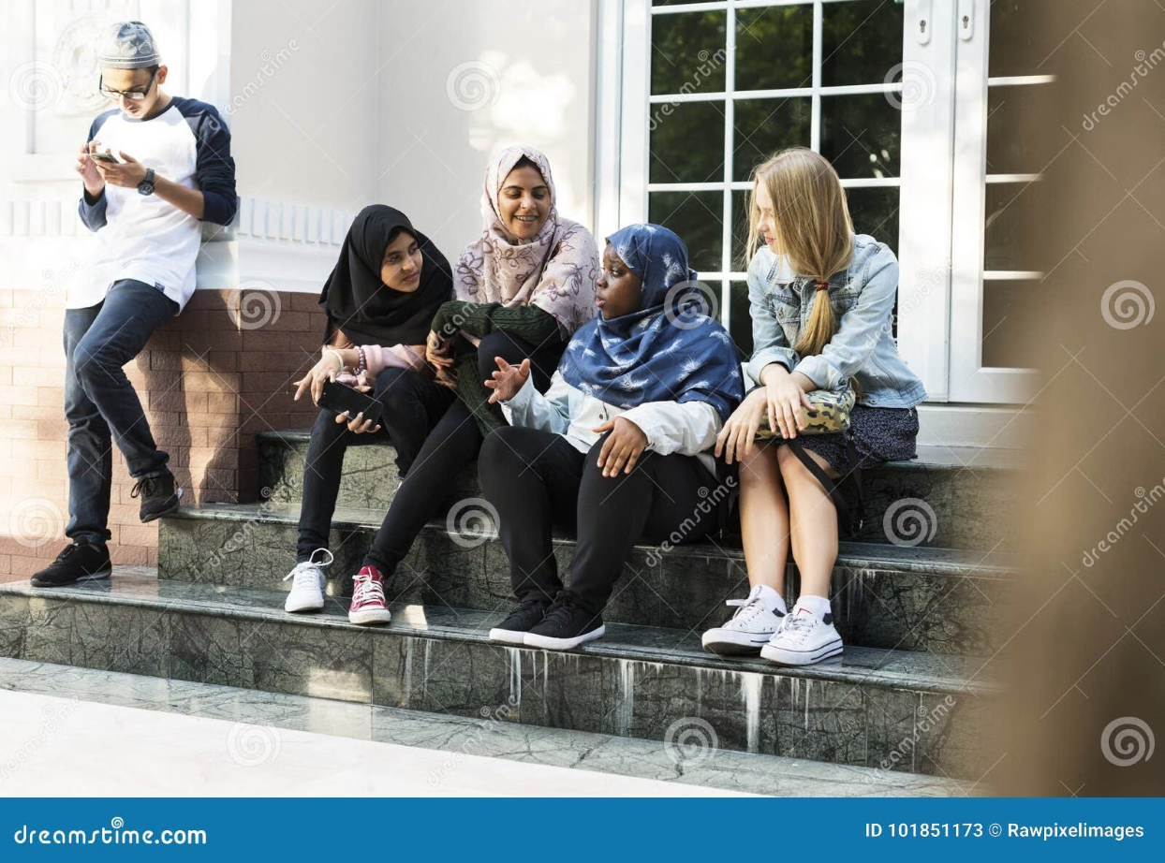

6. Interpersonal & Intrapersonal Intelligences
These two intelligences work with understanding – one focuses outward on others, whilst the other focuses inward on yourself. Both are crucial for emotional wellbeing and success in life.
Interpersonal Intelligence
Intrapersonal Intelligence
This is the ability to understand and interact effectively with others. People with strong interpersonal intelligence can sense others' feelings, motivations, and intentions. They're natural leaders and peacemakers.
This involves understanding yourself – your emotions, goals, and motivations. People with intrapersonal intelligence are self-reflective and enjoy spending time alone to think deeply about life's big questions.
Examples include:
Examples include:
Philosophers who explore human existence
Writers who express inner experiences
Life coaches who guide personal development
Anyone who practices mindfulness
Teachers who inspire students
Counsellors who help people solve problems
Politicians like Nelson Mandela who unite people
Team leaders in any field
You might excel at interpersonal intelligence if you make friends easily, enjoy group activities, or can mediate conflicts. You might have intrapersonal intelligence if you understand your emotions well, set personal goals, or enjoy journaling.

Slide 10



7. Naturalistic Intelligence
Naturalistic intelligence is the ability to recognise, categorise, and understand patterns in nature. People with this intelligence feel deeply connected to the natural world. They notice changes in weather, can identify different species of plants and animals, and feel most alive when spending time outdoors.
This intelligence was crucial for human survival for thousands of years – our ancestors needed to know which plants were edible, which animals were dangerous, and how to predict weather patterns. Today, naturalistic intelligence is vital for environmental conservation and understanding our planet's ecosystems.
Biologists and Environmentalists
Park Rangers and Guides
Veterinarians
They understand animal behaviour and biology, using their naturalistic intelligence to heal and care for creatures great and small.
Scientists like Jane Goodall spent decades studying chimpanzees, revolutionising our understanding of animal behaviour and conservation.
They protect natural habitats and educate others about ecosystems, helping people appreciate and preserve the environment.
You might have naturalistic intelligence if you: Love hiking or camping, enjoy caring for pets or plants, notice seasonal changes, collect natural objects like shells or rocks, or feel passionate about environmental issues.

