Slide 2
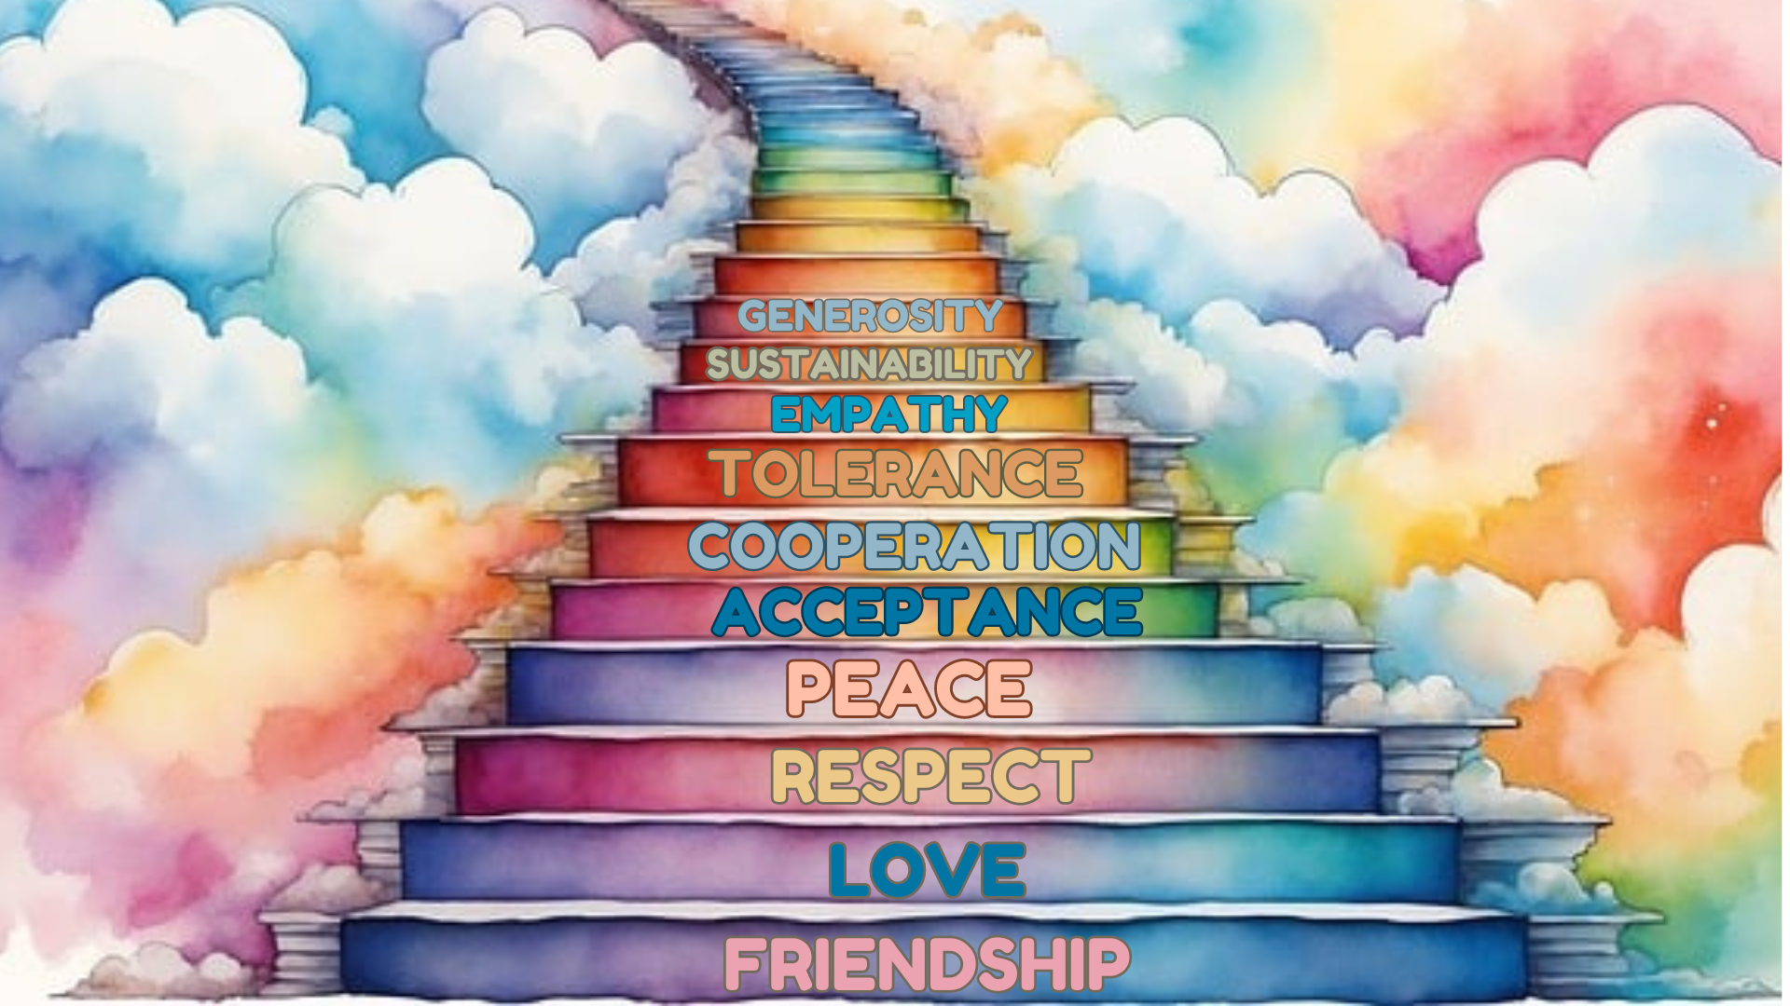

Slide 3
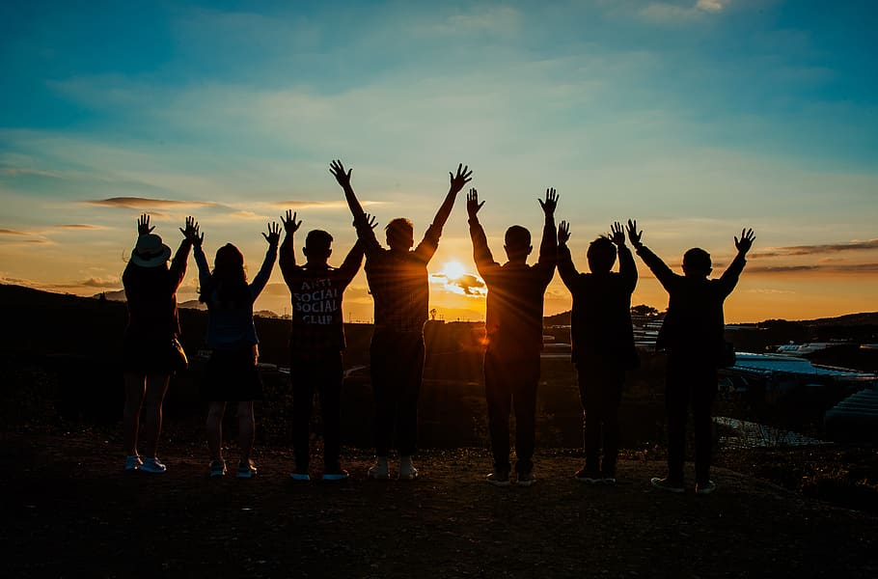
Team 1

Slide 4
A SPECIAL FRIEND
The Science Quiz
On Wednesday afternoon, Lou goes to Yannick's house, a classmate of hers. Yannick is very friendly and very good at science. Tomorrow they’re taking a quiz and they’ve decided to study together. It's the first time Lou goes to Yannick's house, so she checks the address on her phone: 25 Theater Street.

Slide 5
Lou rings the intercom: Driiiiiin.
"Is it you, Lou?" a voice answers.
"We're on the second floor." It's not Yannick's voice, it's a girl's voice. "So Yannick has a sister?" Lou wonders. She climbs the stairs; on the second floor, a door is open. A blonde girl greets Lou.

Slide 6
"Good morning, I'm Matilde, Yannick's sister."
"Hi Matilde, I'm…"
"I know, you're Lou, my brother's classmate."
"Is Yannick here?" Lou asks.
"Not yet, he's running late."
"Ah, okay…"
"Come to the living room, let's wait together."

Slide 7
Matilde seems really kind. Lou takes the opportunity to get to know her.
"How old are you, Matilde?"
"I'm 11 years old."
"You really look like Yannick!"
"Do you think so? I'm happy: Yannick is my favourite brother!"
She laughs: "Actually, he's my only brother… I like joking!"
Lou also laughs:
"I like joking, too!"
"I like playing …"
"I also like playing, singing and dancing."

Slide 8
Lou is happy: Yannick's sister is a very cheerful girl! But suddenly, Matilde's face turns sad.
"I love my friends very much, they are very important to me. Lisa, my dance friend, left with her family: now they live in Bordeaux."
"Bordeaux? It's quite far!" Lou understands Matilde well because her friend moved to Canada, as well! She also becomes sad. Matilde looks at Lou and changes the subject.

Slide 9
Yannick is happy, he loves his sister very much. Matilde is a radiant girl with Down syndrome. She has a full life, and she and her brother are very close and share many things.
Later, in Yannick's room, the two classmates study science.
"Do you want to take a break?" Yannick asks.
"Sure! You know, your sister is really nice!"
"True, Matilde is sweet, patient…"
"And also funny! We’ve joked around before!!"
"You're right, she's different and so what?"
"Different? I don't think so!"

Slide 10
Knock knock… Matilde knocks on the door.
"Mom and I have prepared some cookies for you!"
"Thank you, that's very kind," says Lou. The smell of the cookies is delicious. Lou, being very
greedy, takes a cookie and… "But Matilde! You're a true baker!" Yannick looks at his friend and laughs:
"See, Matilde has many gifts!"

Slide 11
After the break, the two classmates continue studying science. They study for hours and around 10:00 p.m., Lou returns home. It was a long but full day with a new friend, Matilde.
Next day at school they both try their best in the quiz. Yannick finds it easy, but Lou finds it very, very difficult.
During the school break….

Slide 12
“How did it go? I suppose you did well!” says Lou.
“Yes, I think I did! What about you?”, asks Yannick.
“Hm… I don’t know. It was a bit difficult for me”, says Lou.
Jessica hears that and starts laughing…
“What? Did you find the quiz difficult?”, shouts too loud to make sure that everyone can hear it.

Slide 13
Jessica is a brunette girl, quite tall but with a very bad attitude. She is jealous, behaves in a selfish and impolite way and wants to be better than anyone else. Lou and Yannick along with other kids hate her and in general, they don’t want to speak to her at all!
“The quiz was soooo easy! If you get a mark below borderline, you are really dumb. Maybe you should hang out with Yannick’s sister, you know the girl with the Down syndrome”, says laughing and walks away.

Slide 14
Yannick is ready to throw a punch at her. He is furious with what Jessica just said! Lou tries to calm him down. She reminds him that if he hits her, he will have to go to the Principal's office.
Lou really wants to beat her too but she tells Yannick:
“I don’t want to get punished for her sake!”

Slide 15
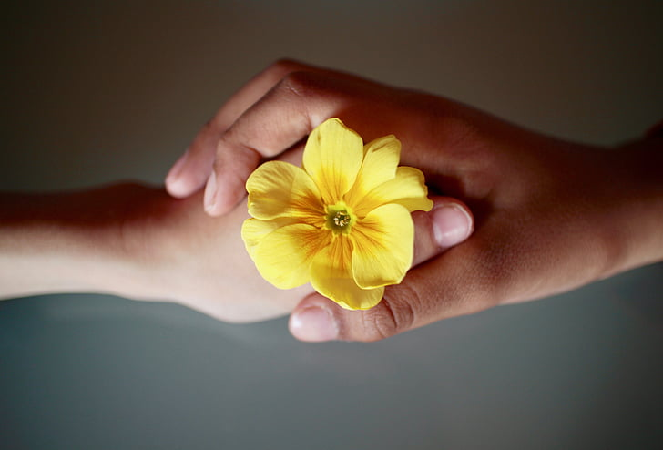
Team 2

Slide 16
2. At the park
Yannick doesn’t listen to Lou and punches Jessica. Then, he is taken to the Principal’s office and gets punished. Jessica is crying and secretly plans to get revenge…

Slide 17
It is Friday and all the classmates go to the nearby park to do some roller skating. All of Lou and Yannick’s friends are there but so is Jessica. Lou suggested that Yannick brings his sister in order to make new friends.
Lou and Yannick are skating when suddenly Jessica kicks Yannick and he falls down. Lou quickly helps him to stand up. Luckily, he is not hurt. Matilde, who sees the incident, is really mad at Jessica, so she decides to ask her why Jessica kicked her brother.

Slide 18
Matilde notices that Jessica has already left and without telling Yannick, she leaves to find Jessica. When Lou and Yannick realise that Matilde is not there, they decide to call their parents and they immediately start searching for her.
As Lou and Yannick are looking all over the park, Lou sees Matilde and Jessica sitting together on a bench eating cookies and laughing…Yannick comes along and they both feel a bit scared, but Matilde's smile makes them feel at ease and they go closer.

Slide 19
Something special had happened before…
Jessica is sitting alone on the bench and she’s crying. She feels bad for what she did. Matilde sits next to her and asks: « Why did you kick my brother?». Jessica confesses to Matilde that she has anger issues and that she doesn’t control herself. She feels lonely because not controlling her anger doesn’t help her to make friends. «Do you wanna be friends»? says Matilde and offers her cookies. Everyone is happy to see a new friendship being born!

Slide 20
3. Making the school more green
One day they decide to organize an event for the World Earth Day at their school, involving all students to clean up the area around the campus and raise awareness about the importance of caring for the environment.
Jessica says: "I have a suggestion: a tree in front of the school”. “And let's also plant flowers around the tree," adds Yannick.

Slide 21
Lou continues: "Let's create a garden and everyone will take care of it: planting, watering, pruning branches… doing something good for April 22nd is nice, but acting every day for the planet is even better!
Then other students make suggestions: “We could make sure students walk to school. – Why don’t we have a small market to recycle old items or a market for organic and fair trade products?”. The ideas are endless.

Slide 22
The class council asks for a meeting with the Principal to inform him on their idea, and of course, he approves of creating a garden at school.
World Earth Day has finally arrived…
It's April 22nd , all the students are in front of the school, the Principal is there and the teacher explains the project of his class: there is the ground and a hole in the soil. It's the big moment: Lou, Yannick, his sister Matilde and Jessica plant the tree. The procedure is not difficult: the tree is small but the gesture is important.

Slide 23
Everyone applauds and Lou with his classmates are very happy. The Principal is proud of his students:" Congratulations, guys!" And he exclaims: "Do you have a slogan for the World Earth Day?"
Lou, Yannick, and Jessica look puzzled. Matilde hesitates for a moment and then she says: "Our slogan is: One day for the Earth and a tree every day!"

Slide 24
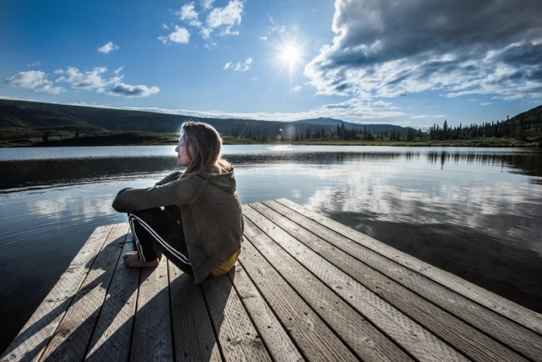
Team 3

Slide 25
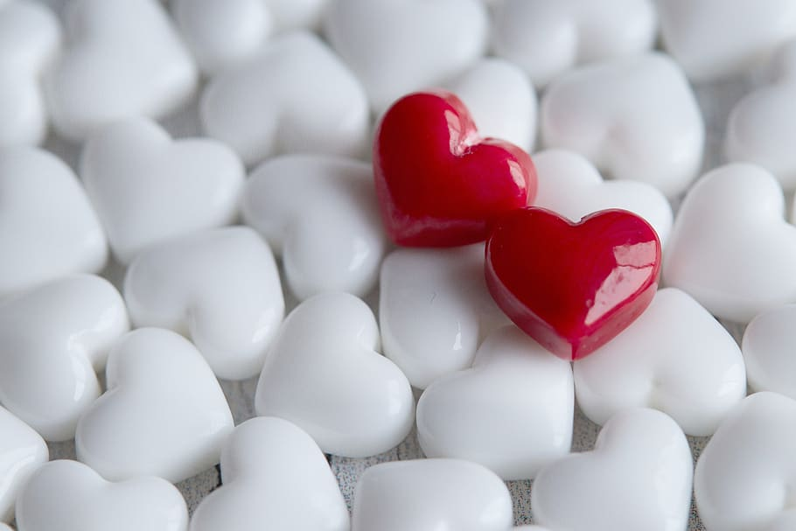
Team 4

