Slide 3
Team 1

Slide 4
A SPECIAL FRIEND
On Wednesday afternoon, Lou goes to Yannick's house, a classmate of hers. Yannick is very friendly and very good at science. Tomorrow they’re taking a quiz and they’ve decided to study together. It's the first time Lou goes to Yannick's house, so she checks the address on her phone: 25 Theater Street.

Slide 5
Lou rings the intercom: Driiiiiin.
"Is it you, Lou?" a voice answers.
"We're on the second floor." It's not Yannick's voice, it's a girl's voice. "So Yannick has a sister?" Lou wonders. She climbs the stairs; on the second floor, a door is open. A blonde girl greets Lou.

Slide 6
"Good morning, I'm Matilde, Yannick's sister."
"Hi Matilde, I'm…"
"I know, you're Lou, my brother's classmate."
"Is Yannick here?" Lou asks.
"Not yet, he's running late."
"Ah, okay…"
"Come to the living room, let's wait together."

Slide 7
Matilde seems really kind. Lou takes the opportunity to get to know her.
"How old are you, Matilde?"
"I'm 11 years old."
"You really look like Yannick!"
"Do you think so? I'm happy: Yannick is my favourite brother!"
She laughs: "Actually, he's my only brother… I like joking!"
Lou also laughs:
"I like joking, too!"
"I like playing …"
"I also like playing, singing and dancing."

Slide 8
Lou is happy: Yannick's sister is a very cheerful girl! But suddenly, Matilde's face turns sad.
"I love my friends very much, they are very important to me. Lisa, my dance friend, left with her family: now they live in Bordeaux."
"Bordeaux? It's quite far!" Lou understands Matilde well because her friend moved to Canada, as well! She also becomes sad. Matilde looks at Lou and changes the subject.

Slide 9
Yannick is happy, he loves his sister very much. Matilde is a radiant girl with Down syndrome. She has a full life, and she and her brother are very close and share many things.
Later, in Yannick's room, the two classmates study science.
"Do you want to take a break?" Yannick asks.
"Sure! You know, your sister is really nice!"
"True, Matilde is sweet, patient…"
"And also funny! We’ve joked around before!!"
"You're right, she's different and so what?"
"Different? I don't think so!"

Slide 10
Knock knock… Matilde knocks on the door.
"Mom and I have prepared some cookies for you!"
"Thank you, that's very kind," says Lou. The smell of the cookies is delicious. Lou, being very
greedy, takes a cookie and… "But Matilde! You're a true baker!" Yannick looks at his friend and laughs:
"See, Matilde has many gifts!"

Slide 11
After the break, the two classmates continue studying science. They study for hours and around 10:00 p.m., Lou returns home. It was a long but full day with a new friend, Matilde.
Next day at school they both try their best in the quiz. Yannick finds it easy, but Lou finds it very, very difficult.
During the school break….

Slide 12
“How did it go? I suppose you did well!” says Lou.
“Yes, I think I did! What about you?”, asks Yannick.
“Hm… I don’t know. It was a bit difficult for me”, says Lou.
Jessica hears that and starts laughing…
“What? Did you find the quiz difficult?”, shouts too loud to make sure that everyone can hear it.

Slide 13
Jessica is a brunette girl, quite tall but with a very bad attitude. She is jealous, behaves in a selfish and impolite way and wants to be better than anyone else. Lou and Yannick along with other kids hate her and in general, they don’t want to speak to her at all!
“The quiz was soooo easy! If you get a mark below borderline, you are really dumb. Maybe you should hang out with Yannick’s sister, you know the girl with the Down syndrome”, says laughing and walks away.

Slide 14
Yannick is ready to throw a punch at her. He is furious with what Jessica just said! Lou tries to calm him down. She reminds him that if he hits her, he will have to go to the Principal's office.
Lou really wants to beat her too but she tells Yannick:
“I don’t want to get punished for her sake!”

Slide 15
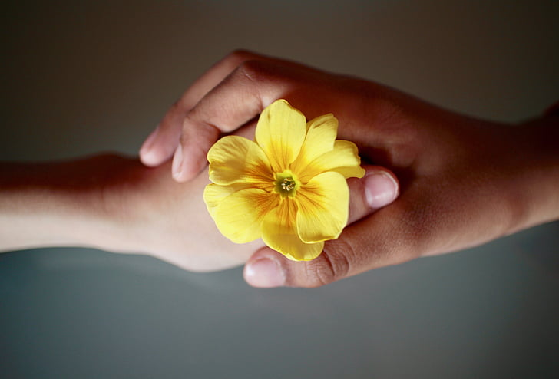
Team 2

Slide 21
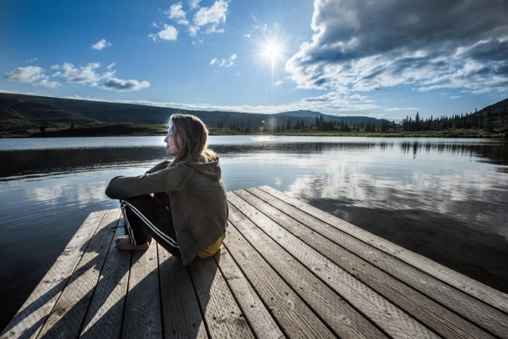
Team 3

Slide 22
Team 4

