Slide 1
Presenting an Ancient Civilization -UNIT 2
Welcome, B’ Junior High School students! This presentation will guide you through the steps for your ancient civilization project.
by theodora bougioukou

Slide 2
Successful Project Tips
Delivery
Content
Structure
Visuals
Remember your presentations skills. Check Extra 1 in e-class for helpful tips.
Research thoroughly. Use reliable sources. Include specific details.
Organize your presentation logically. Use clear transitions. Keep it concise.
Add images, charts, or other visuals to enhance your presentation.

Slide 3
Team Roles
The Project Advocate
This person oversees the project's planning and progress. This a traditional project manager type of role. As such, they take on the responsibility for having the general overview of the project, the general planning and ensuring that everything is on schedule.
The Specialist
This is a team member who is particularly good at something. This person has a specialized skillset and takes on a specific area of the project. If there is not one such person, you may skip it.

Slide 4
Team Roles (Continued)
The Researcher(s)
The researcher(s) will have the responsibility to come up with ways to gather the information the team needs and ensure the team can utilize it.
The Report Writer(s)
This person types and edits the presentation so as to be presented in class. It can be more than one. They need to work closely with the researcher(s).

Slide 5
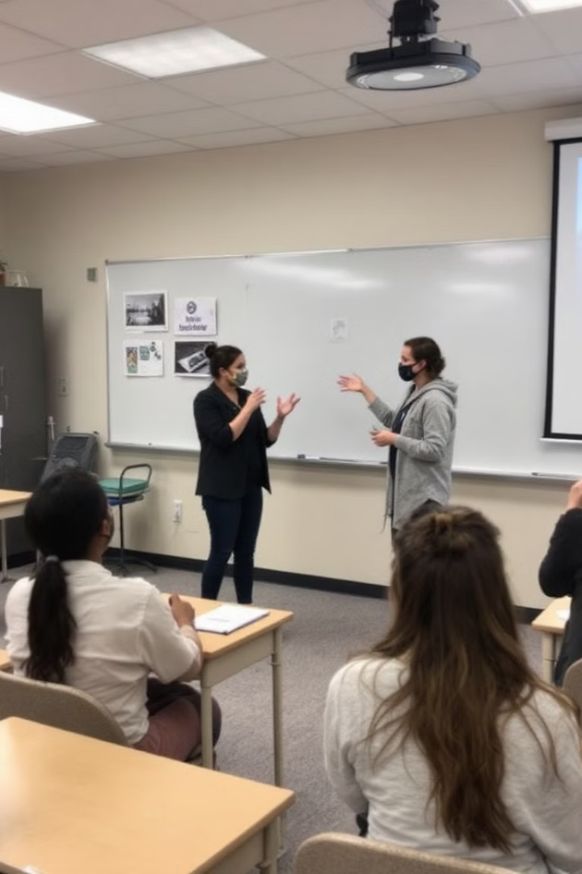
Team Roles (Continued)
The Project Presenter(s)
This person presents the final work to the class. It can be more than one. You decide!

Slide 6
Choosing Your Civilization
Remember to use the GRAPES lens when researching your civilization: Geography, Religion, Achievements, Politics, Economy, Social Structure.

Slide 7
Best of luck to all teams!!!

