Slide 1
DIGITAL CONTENT CREATION

Slide 2
About the Digital Upbringing Project
With the world becoming more reliant on digital technologies, the goal of the Digital Upbringing project is to enhance the digital skills and knowledge of parents across Europe.
Digital Upbringing supports parents and educators to help their children to develop the digital skills needed to safely navigate the digital world.
A digital competence framework has been developed which highlights what a parent or guardian should be able to do in order to navigate their children's way in the digital world, safeguard them, and promote their opportunities.

Slide 3
The digital competence framework for parents and the series of workshops on the different competence levels:
Module 1: Information and Data Literacy
Module 2: Communication and Collaboration
Module 3: Digital Content Creation
Module 4: Digital Safety
Module 5: Digital Problem Solving
Module 6: Facilitating their Children’s Digital Competences

Slide 4
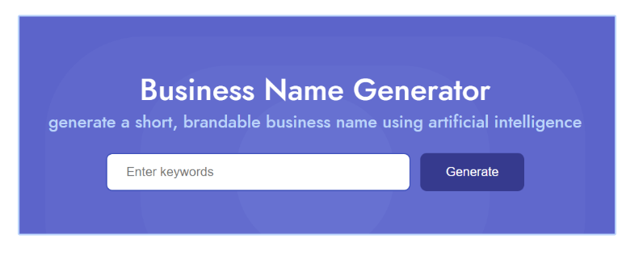
USEFUL ONLINE TOOLS
https://namelix.com/

Slide 5
https://www.namecheap.com/logo-maker/

Slide 6
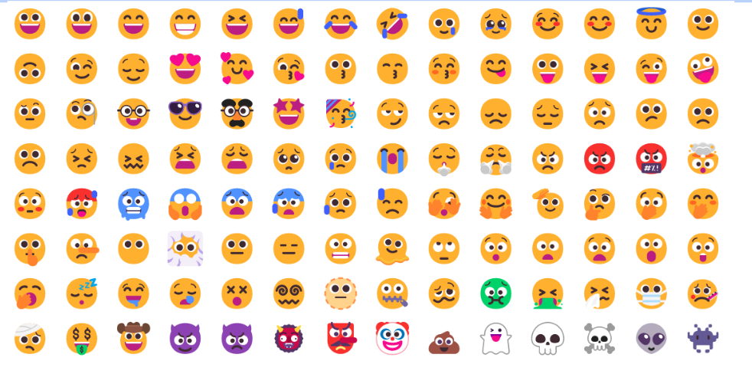
https://getemoji.com/

Slide 7
https://lumen5.com/

Slide 8
https://storyset.com

Slide 9
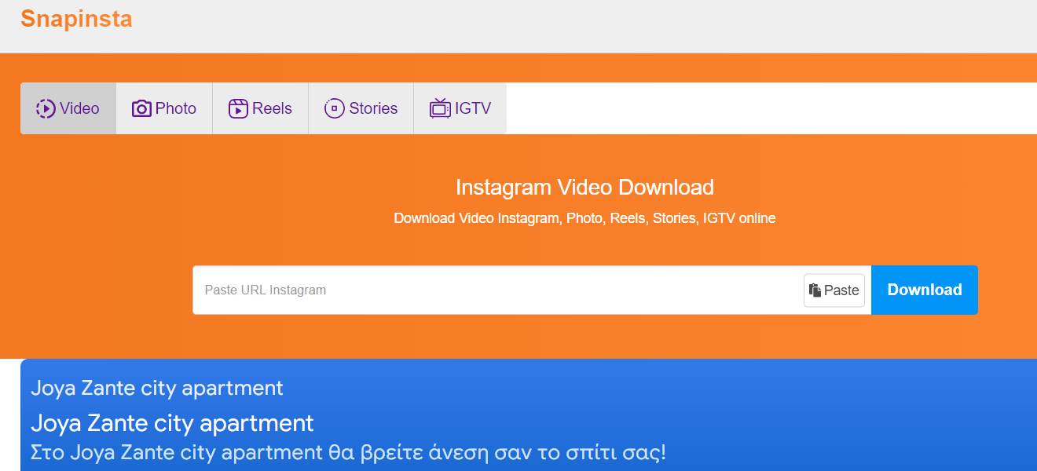
https://snapinsta.app/

Slide 10
https://scoopsproject.com/pills/english/

Slide 11
Mentimeter

Slide 12
https://www.saymine.com/
Sign Up & Check how many companies are holding your Data!

Slide 13
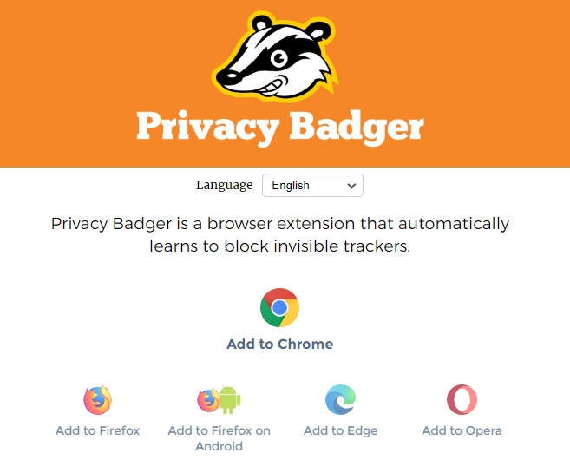
Block invisible trackers

Slide 14
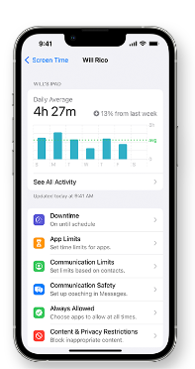
Measure your engagement and managing your digital wellbeing

Slide 15
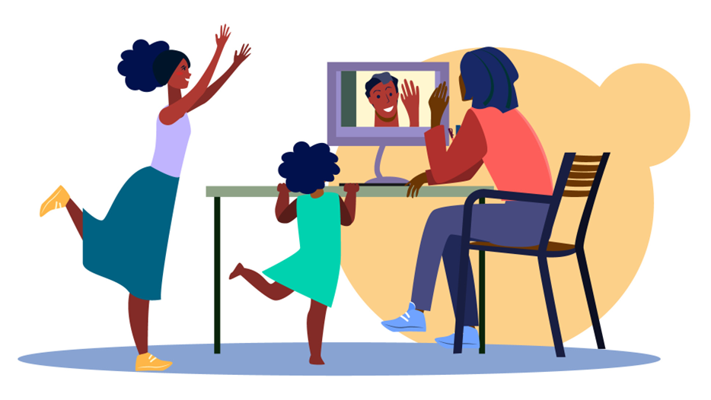
Thank you!

