Slide 1
ERASMUS+ 2024-2025 "SustAInability in our diet??-IT works!!!"

Slide 2
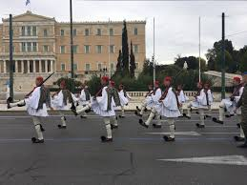
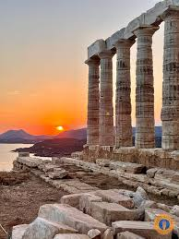
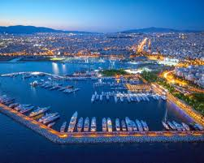
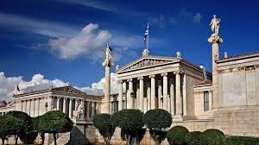
Athens greece

Slide 3
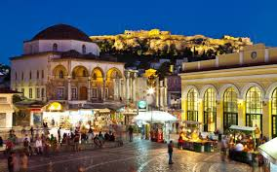
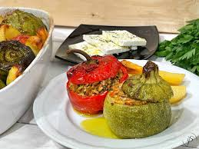
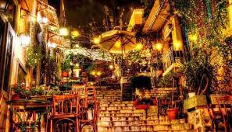
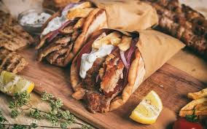
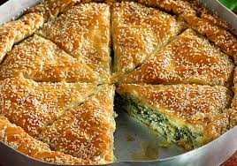
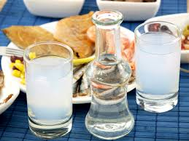
the historic center of Athens

Slide 4
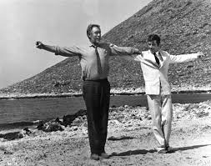
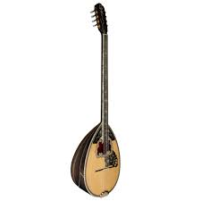
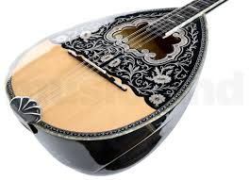
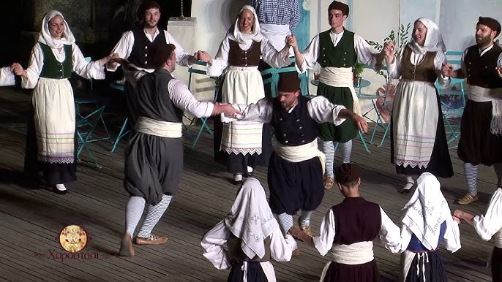
The Greek entertainment
Bouzouki traditional musical instrument
zorbas
sirtaki and Greek music
https://www.youtube.com/watch?v=kG12C1oX5Eo

Slide 5
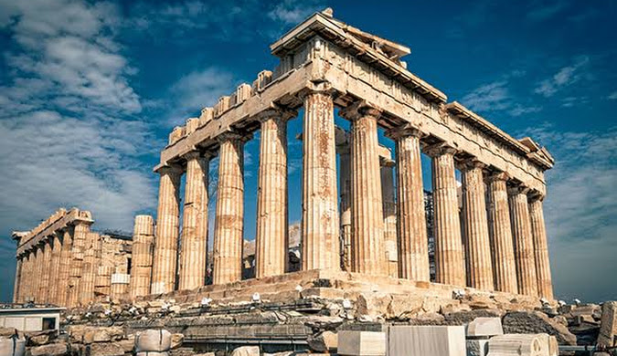
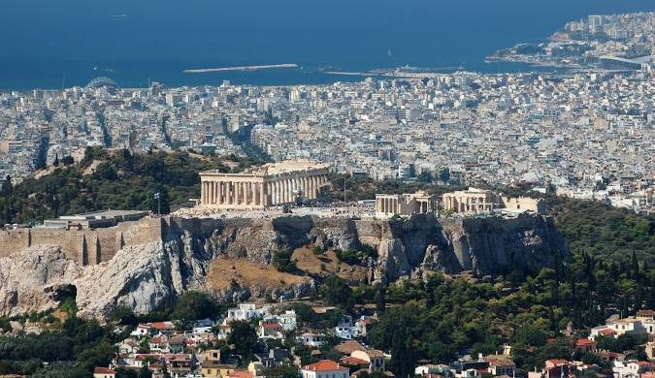
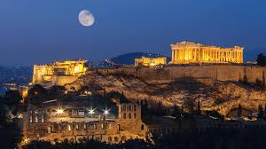
THE Athens acropolis

Slide 6
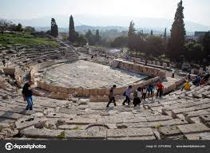
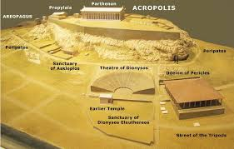
the Ancient theatre of Dionissos
Ancient Drama Aeschylus,
Sophocles,
Euripides

Slide 7
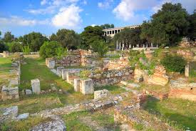
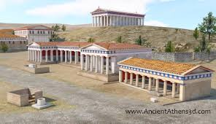
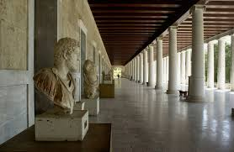
the Ancient Agora of Athens

Slide 8
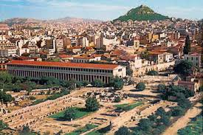

Slide 9
RAPHAEL (1483-1520) School of Athens,

Slide 10
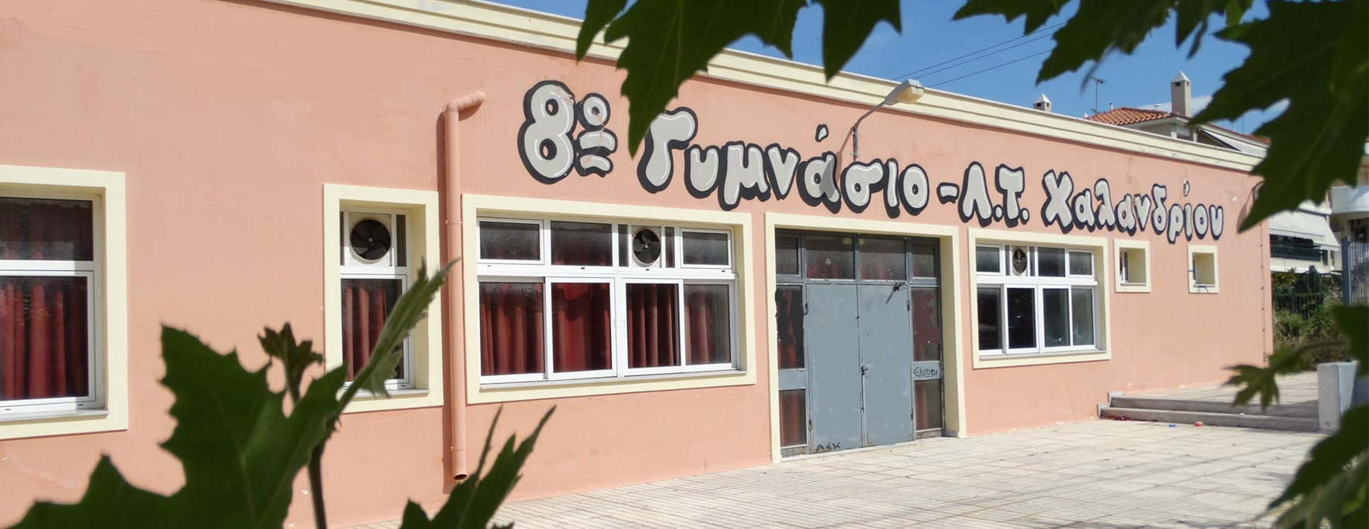
8th JUNIOR HIGH SCHOOL OF CHALANDRI

Slide 11
8th JUNIOR HIGH SCHOOL OF CHALANDRI
The 8th Junior High School of Chalandri, is located in the suburb Athens, Greece
https://maps.app.goo.gl/RRTNN4i8gncNxPvg6
Our school is very active in terms of competitions, actions and field trips in Greece and also abroad
Our website: https://8gym-lt-chalandr.gr/

Slide 12
OUR DIGITAL SCHOOL PRESS & OUR DIGITAL SCHOOL CHANNEL
Our school is interested in listening itsstudents’ voice and also wishes its students to be well-informed about every possible issue. We have a newspaper called “Η ΦΛΥΑρία των teen8ers”. It is digital and therefore can be easily read everywhere.
We also have quite a few programs such as philosophy, environmental studies, theater, political education, and volunteering."

