Slide 1



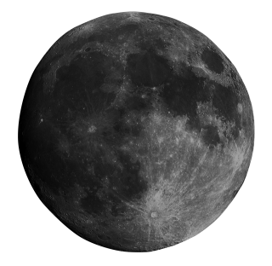

THE ERASMUS+PROGRAMME
Erasmus+ is a programme created by the European Union that gives people the opportunity to study, train, work, or volunteer in another country. It is mainly for students, teachers, and young people who want to gain new experiences outside their home country.
Through Erasmus+, university students can study abroad or do internships, while young people can take part in exchanges or volunteer projects. The programme usually lasts from a few days to several months, depending on the activity.

Slide 2


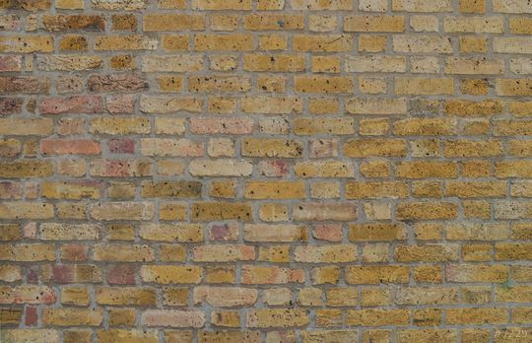





THE ADVANTAGES OF ERASMUS+
Erasmus+ offers many advantages for the people who take part in it. One of the most important benefits is the chance to improve language skills. By living in another country, participants practice a foreign language every day, which helps them become more confident and fluent.
Another advantage is meeting new people and experiencing different cultures. Students and young people make friends from all over the world, learn about new traditions, and become more open-minded. This can help them better understand others and adapt more easily to new situations.
In addition, living abroad helps people become more independent and responsible. They learn how to manage their time, money, and daily life on their own.

Slide 3

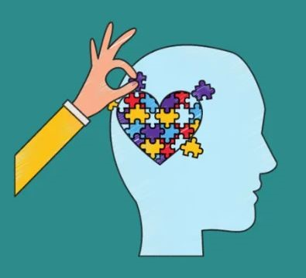
Environmental Ethics
12/12/2025
Chalandri - Napoli

Slide 4


Do natural objects and living beings have moral status? Are they worthy of moral concern?

Slide 5
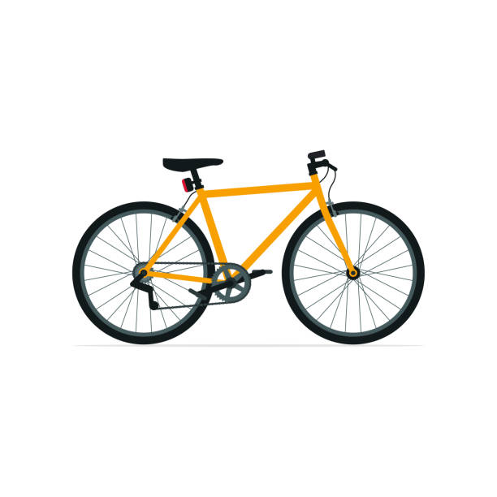


Do natural objects have moral value simply because they exist? Or do they only have instrumental value?

Slide 6

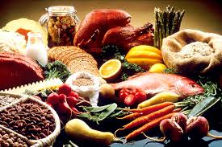

Should clean air, food, and water be considered resources for human use?

Slide 7
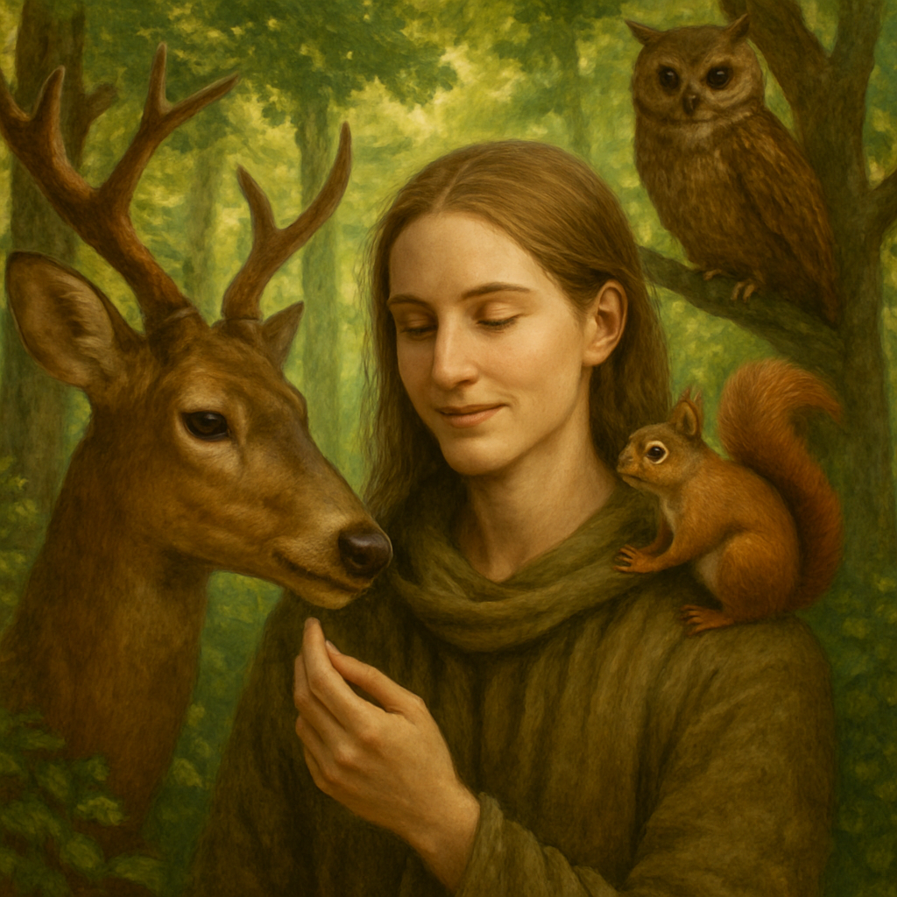
Should human beings be regarded merely as another species, as part of nature?

Slide 8
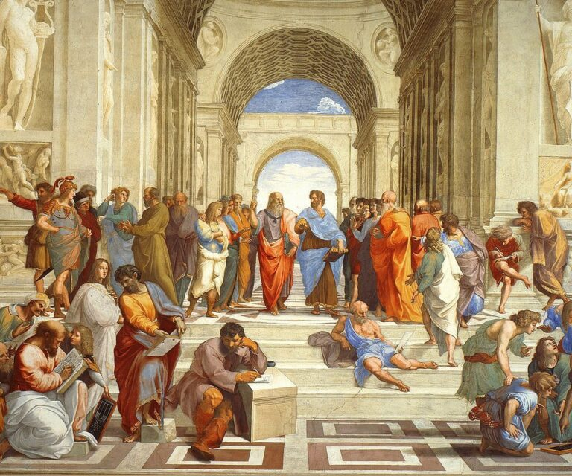
Ethics in the work of Plato and Aristotle
Ancient Greek Philosophy
The moral thought of the two philosophers determines the way of understanding good and virtue.
Εικόνα

Slide 9
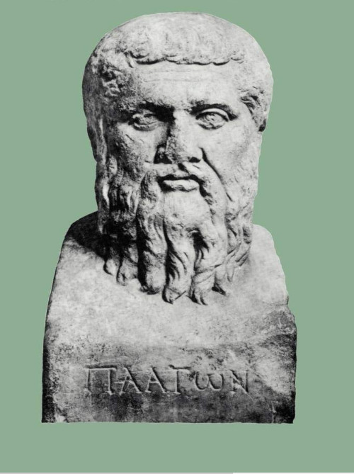
What is Moral Philosophy
• Branch of philosophy
• Studies good and evil
• Seeks the right lifestyle
• Goal: the good life

Slide 10
The Idea of the Good
• Supreme Idea in the world of Ideas
• Source of knowledge and values
• Right and wrong criterion
• Guides the moral act

Slide 11
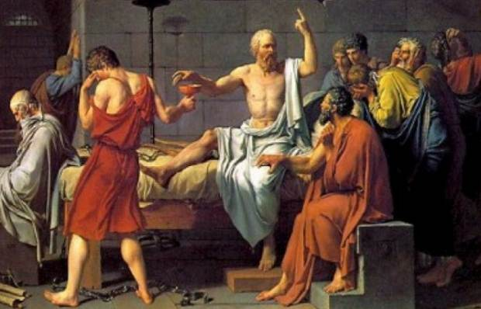
Justice in Plato
•Harmony of the parts of the soul
• Mastery of accounting – Mastery of logic
• Internal balance
• Moral man = just man

Slide 12
Πλατων και Φύση
Plato and Nature
According to Plato, the world was created by the Creator, who did not wish to keep absolute goodness to himself, but chose to put in order all visible things that were in chaotic disorder, because he considered order superior to Chaos. In particular, Plato argues that whatever the Creator constructs, which takes form, will necessarily be good, because its creation is based on a model (idea) that never changes and is an example. So necessarily, what is being constructed will be good, just as it happens with the world that is perceived by our senses. In fact, since his maker is good, then it is obvious that he took as his model the eternal and unchangeable (Plato, Timaeus)

Slide 13
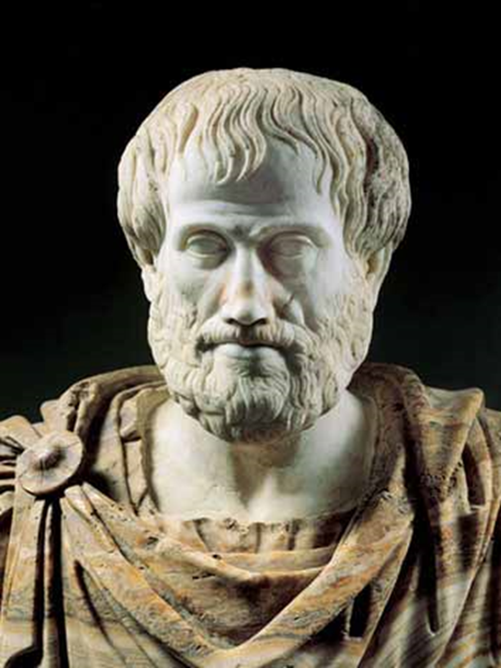
Ethics in Aristotle
Practical approach to ethics
Emphasis on experience and practice
Purpose of life: bliss
Emphasis on practice
Ethics through Habits: Six

Slide 14

The Golden Mean
Between lack and exaggeration
Example: Cowardice – Bravery – Audacity

Slide 15
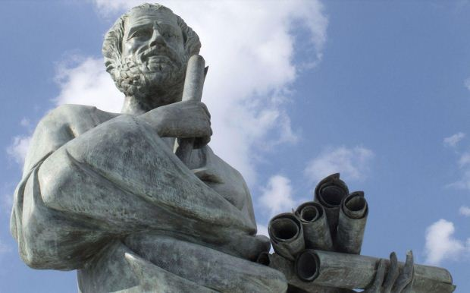
Bliss
Supreme human good
Ultimate purpose of life
Life according to reason and virtue

Slide 16
Environment, Ethics and Artificial Intelligence. Towards a responsible future.
8th Junior High School of Chalandri, Greece
Collège Pierre de Coubertin, Le Luc France
Naples, Italy

Slide 17
"Overpopulation of the land is a major cause of environmental problems"
DISAGREE
I AGREE
I STRONGLY AGREE
DISAGREE RADICALLY
I DON’T HAVE AN OPINION

Slide 18
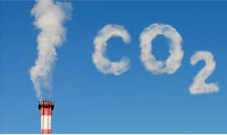
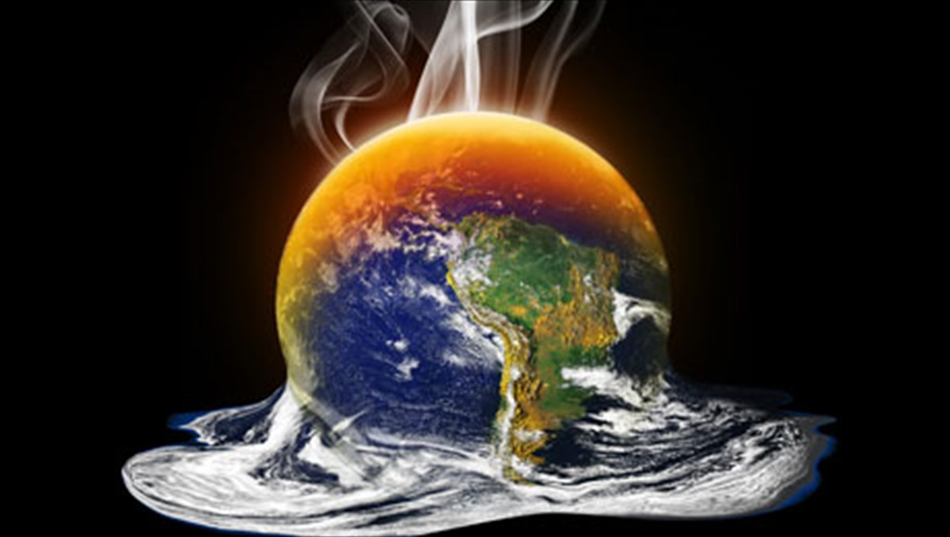
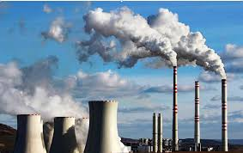
Climate change

Slide 19
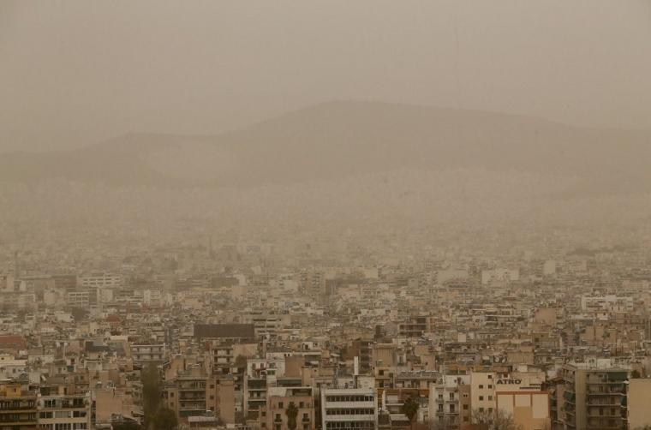
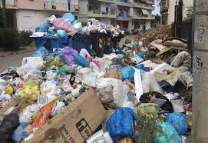
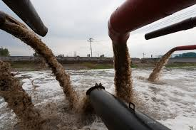
Pollution

Slide 20

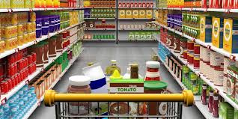

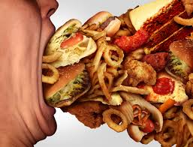
Is overconsumption in the richest developed countries also to blame?

Slide 21
Environment, Ethics and Artificial Intelligence. Towards a responsible future
8th Junior High School of Chalandri, Greece
Le Luc France
Naples, Italy

Slide 22
"2030 Agenda for Sustainable Development"
The "2030 Agenda for Sustainable Development" is a global action plan of the United Nations (UN) adopted in 2015, with the aim of eradicating poverty, protecting the planet and ensuring prosperity for all by 2030, through 17 Sustainable Development Goals (SDGs) and 169 sub-goals, integrating social, economic and environmental dimensions.

Slide 23
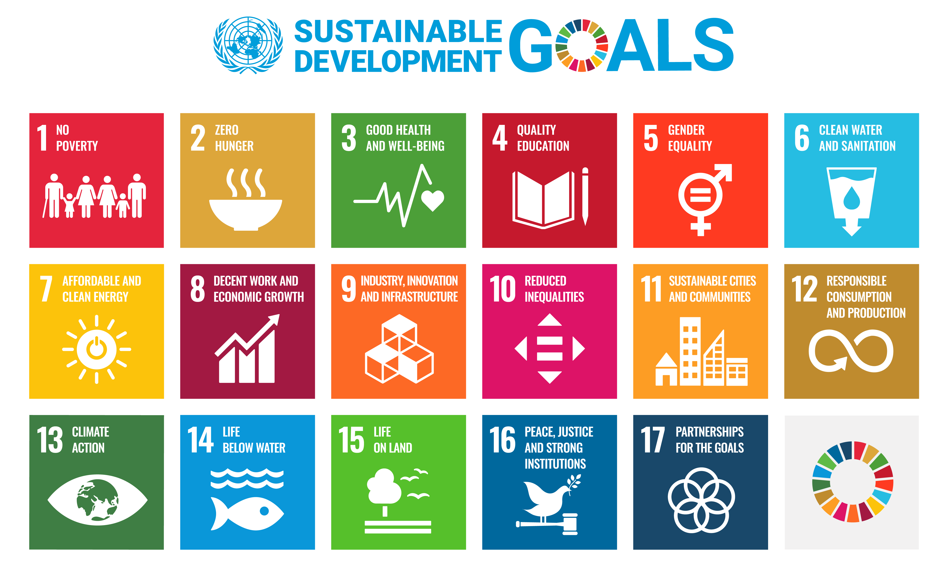
What about achieving the goals worldwide?

Slide 24
Health and climate actions
Impose taxes on energy-dense UPFs (ultra-processed foods) and sugary drinks.
Provide subsidies to make minimally processed and healthy foods more affordable, through revenues from the taxation of unhealthy foods.
Strengthening public awareness of the real cost of food, through education of the public and health professionals.
Warning labels on packaging and restrictions on the advertising of unhealthy foods aimed at children.
Implement policies that support healthy school meals and local food supply.
Shift to minimally processed, fiber-rich plant foods and reduce the consumption of animal products.

Slide 25
Reforming global food systems is an urgent priority for both protecting public health and tackling the climate crisis
"Treating individuals—not the system that makes them sick—perpetuates the misconception that obesity is due to a lack of willpower. To reduce the health and climate footprint of the food system, governments must first recognize that both climate change and obesity are the result of systemic problems aimed at profit and address them at their root."

