Slide 1

How to describe a building?

Slide 2
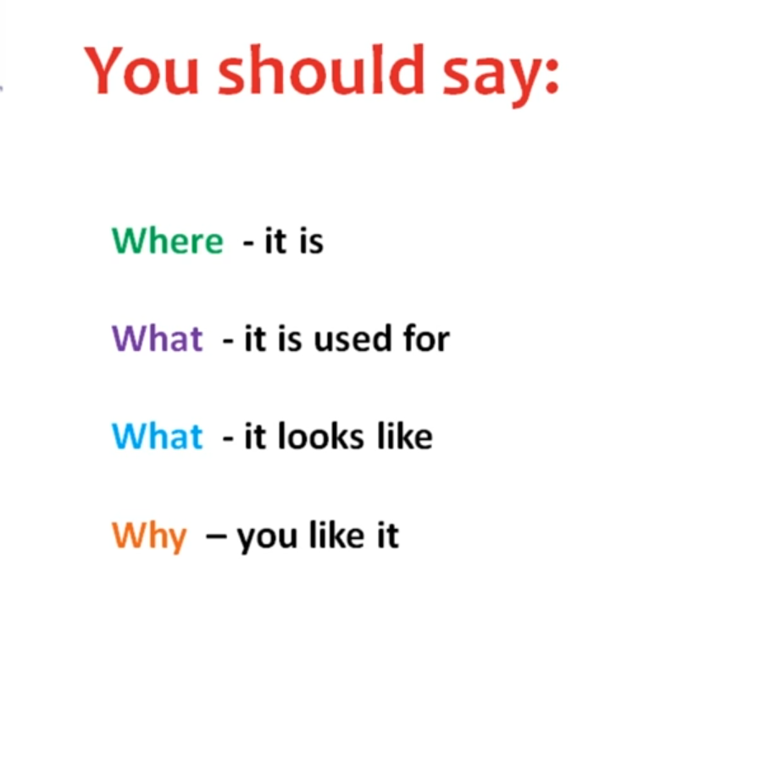

Slide 3
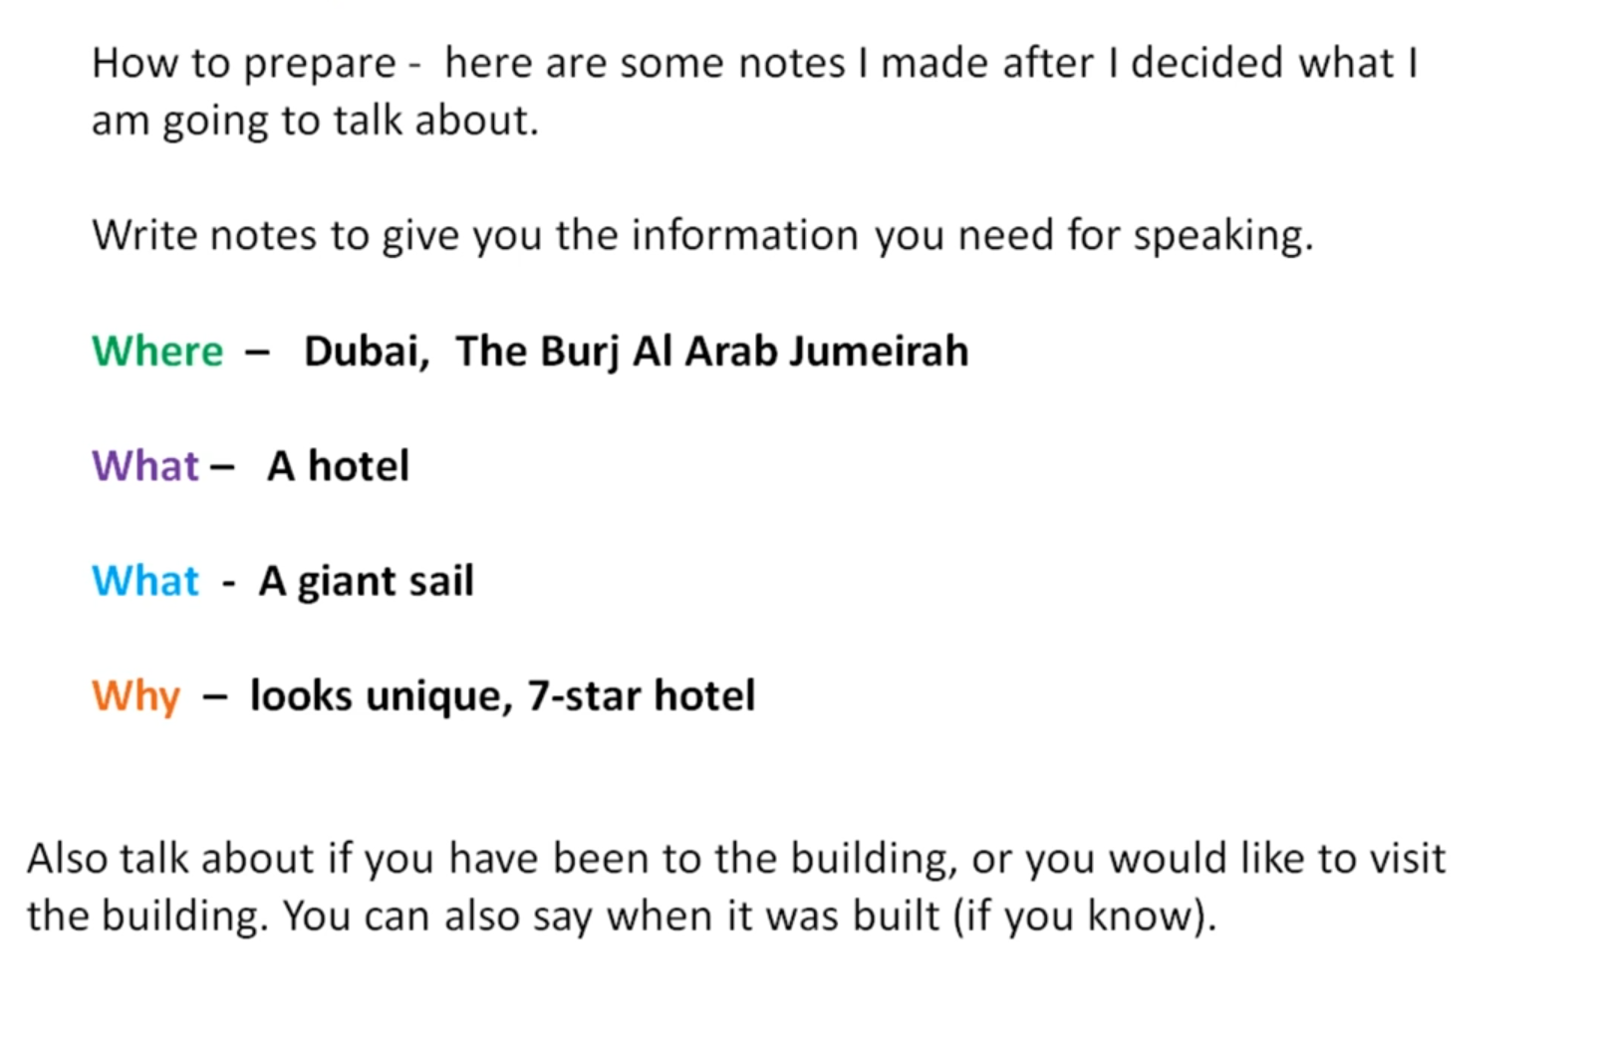

Slide 4
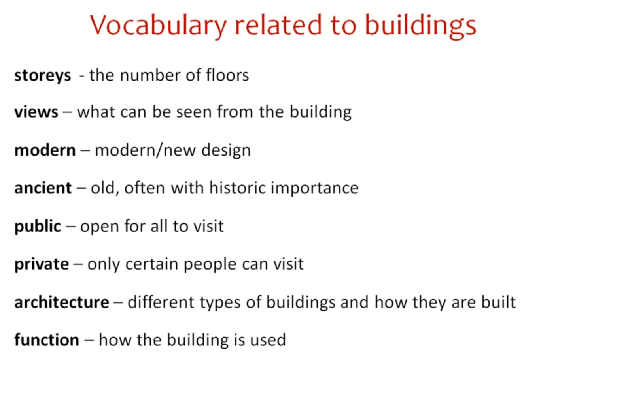

Slide 5
More Descriptive Words:
new, old, large, main, story, small, whole, public, present, modern, original, entire, nation, wooden, fine, tall,
separate, beautiful, big, low, handsome, huge, storey, central, state, ancient, magnificent, oldest, largest,
commercial, tallest, concrete, gothic, rectangular,road, historic, residential, terminal, municipal, century,
square, rise, massive, federal, substantial, circular, spacious, vast, storied, suitable, plain, permanent,
adjacent, style, shaped, like, empty, bridge, nearby, impressive, temporary, splendid, elegant, noble, neat,
sacred, gray, adjoining

Slide 6
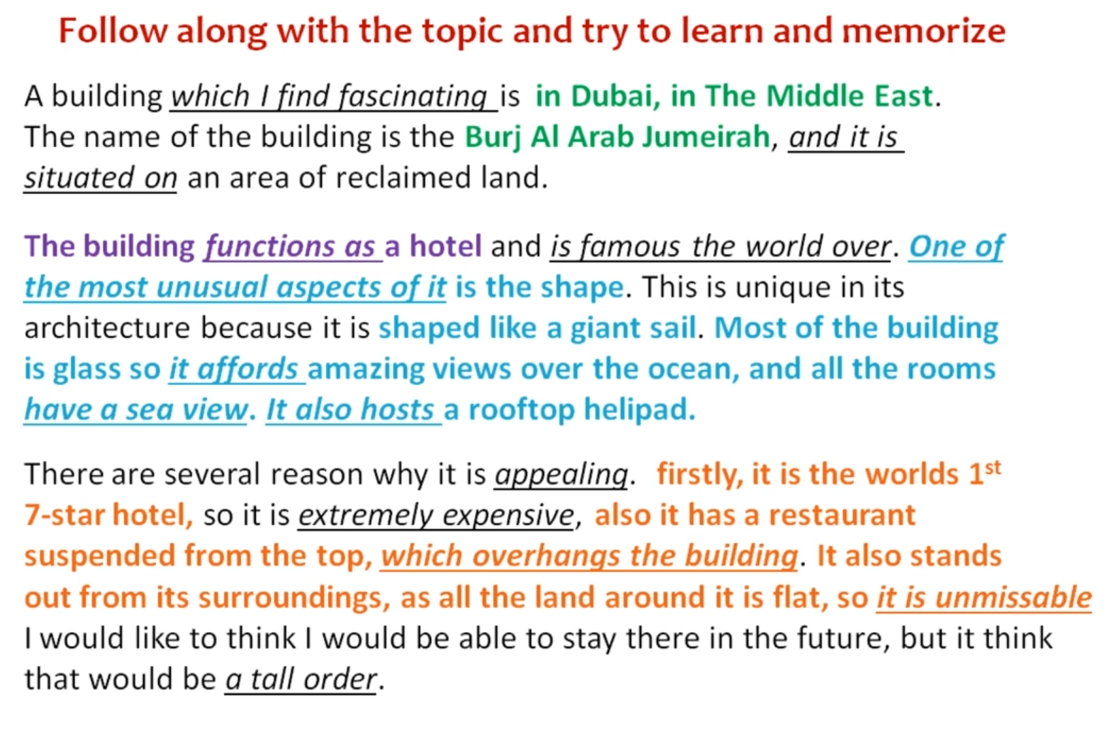
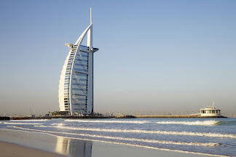

Slide 7

THANK YOU FOR WATCHING

