Slide 1
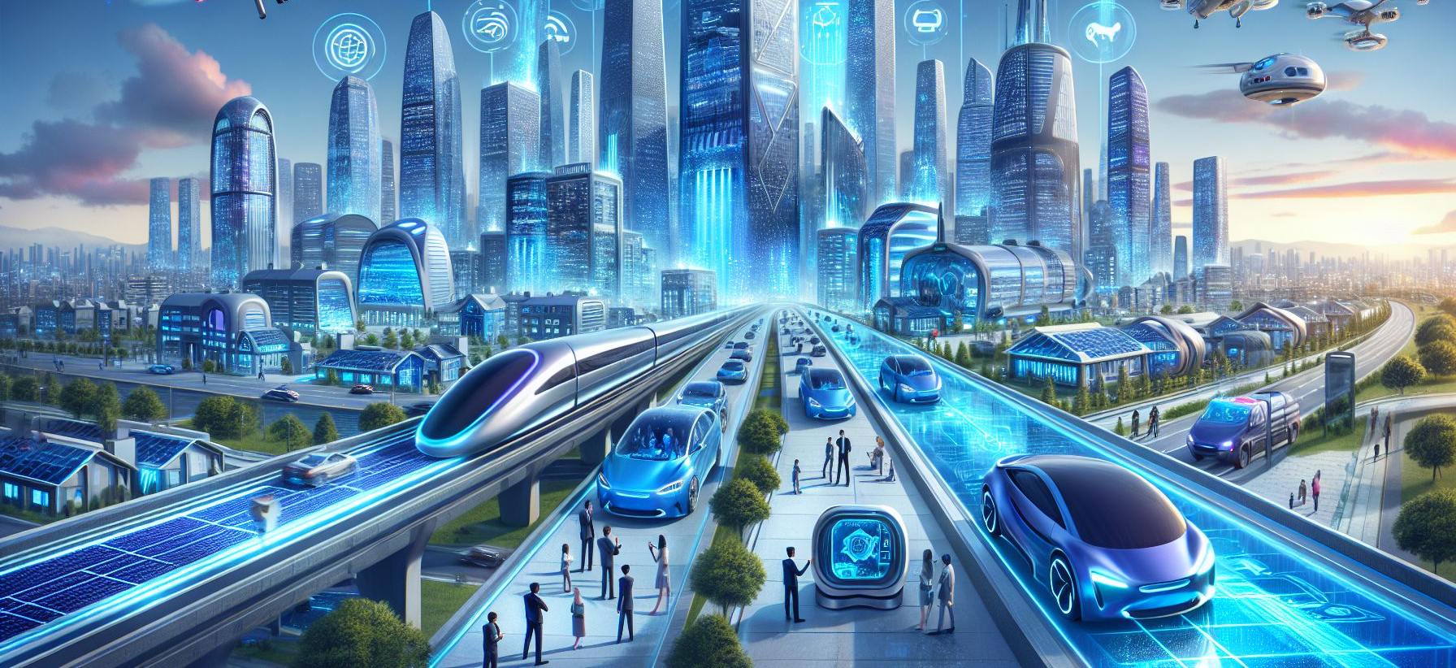
Would You Rather...? 🚀
Talking about the future

Slide 2
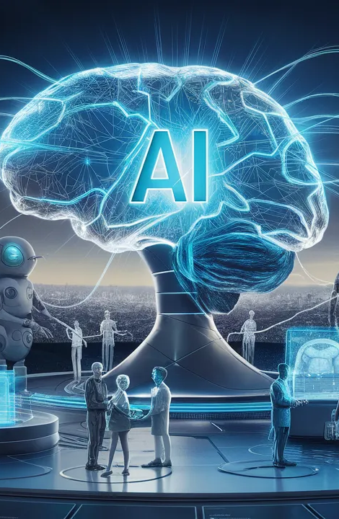
Warm-up
What comes to your mind when you hear the word “future”?
What kind of technology do you think we will have in the future?
Would you like to live in a very technological world? Why / why not?
What invention would you like to have in your life?

Slide 3
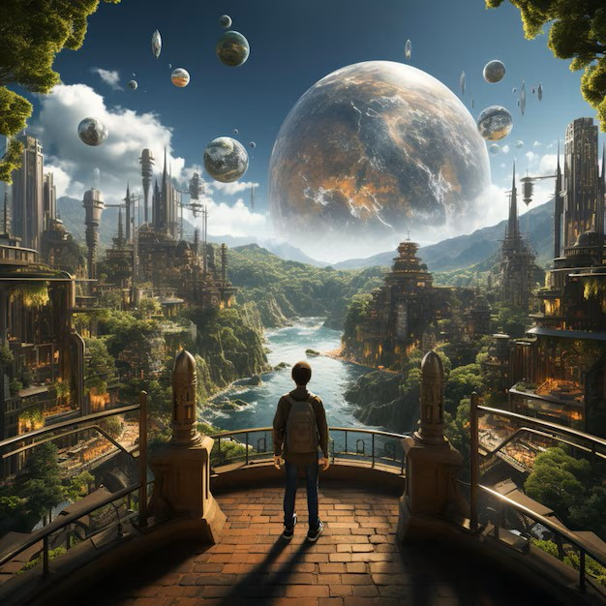
Useful Language
I would rather...
I think...
In my opinion...
Robot
Technology
Invention
useful / useless
dangerous / safe
fun / exciting / boring

Slide 4
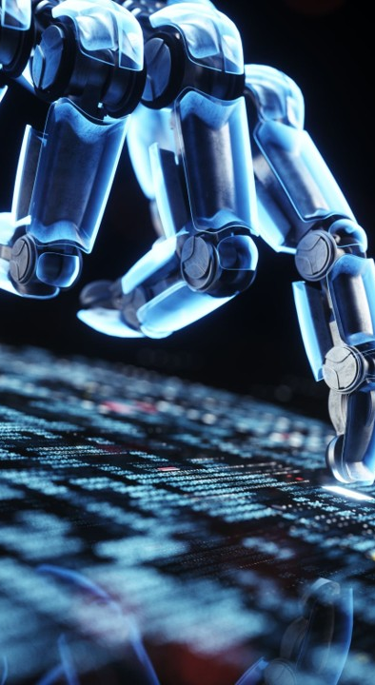
Questions: Would you rather…
1. …have a robot that does your homework OR do everything yourself at super speed?
3. …have glasses that translate all languages OR be able to speak all languages?
2. …live on another planet OR on a floating city on earth?
4. …have a flying bike OR a teleport machine?
5. …go to school with robot teachers OR have online lessons forever?
6. …have a robot friend OR a pet friend?

