Slide 1

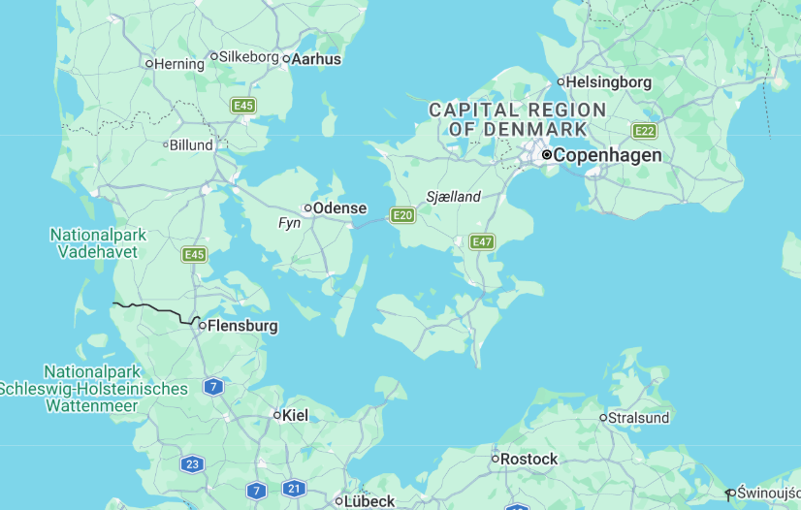
Hans Christian Andersen: Life and Literary Legacy

Slide 2

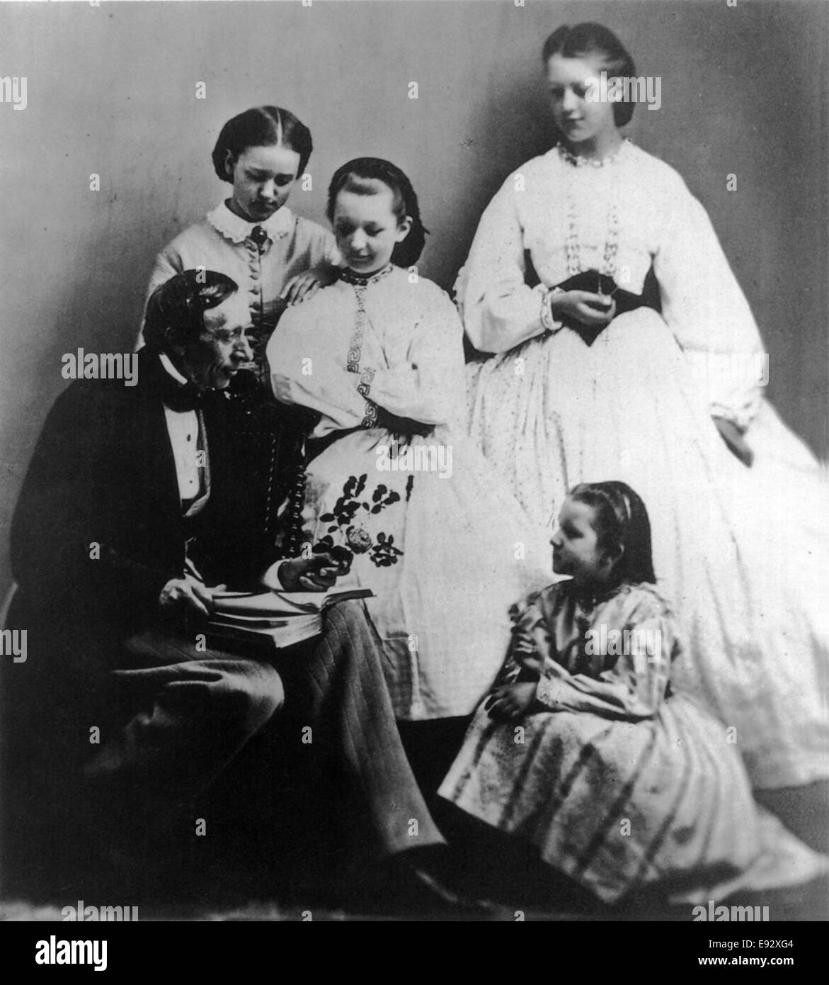
Early Life and Childhood
Born on April 2, 1805, in Odense, Denmark
Grew up in a poor family with a humble background
His father was a shoemaker, his mother worked as a washerwoman
Showed early interest in literature and storytelling
Dreamed of becoming an actor and writer from a young age
Notes:
Image from: https://www.alamy.com/stock-photo-hans-christian-andersen-1805-75-danish-writer-portrait-reading-story-74438116.html

Slide 3
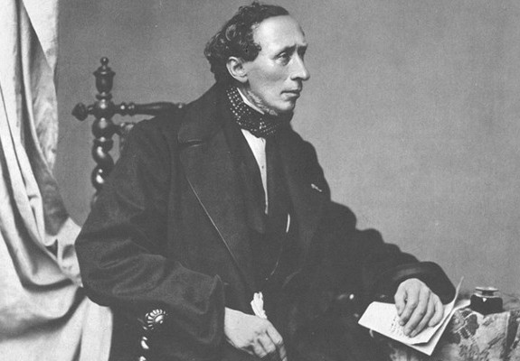
Journey to Becoming a Writer
Moved to Copenhagen at age 14 to pursue his artistic dreams
Struggled initially with poverty and rejection
Received support from wealthy patrons who recognized his talent
Began writing plays, novels, and travel books before focusing on fairy tales
First fairy tales published in 1835
Notes:
Image from: https://www.copenhagenet.dk/cph-hca2005.htm

Slide 4

Famous Fairy Tales
Wrote over 160 fairy tales during his lifetime
Most famous stories include "The Little Mermaid"
Other notable tales: "The Snow Queen"
"The Ugly Duckling"
"The Emperor's New Clothes"
Stories often contained moral lessons and social commentary

Slide 5

Writing Style and Themes
Used simple language accessible to children and adults
Explored themes of transformation and personal growth
Often incorporated elements of fantasy and imagination
Wrote about social inequality and human emotions
Pioneered the modern fairy tale genre
Notes:
Image from: https://www.1stdibs.com/furniture/storage-case-pieces/desks/antique-danish-hans-christian-andersen-desk-writing-table-figured-walnut/id-f_29675512/

Slide 6
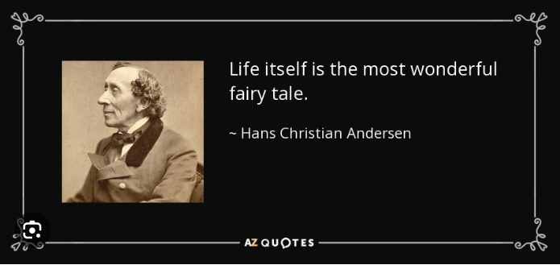
International Recognition
Became internationally renowned during his lifetime
Traveled extensively across Europe
Received numerous honors and recognition
Celebrated as Denmark's most famous writer
Influenced literature worldwide
His birthday now celebrated as International Children's Book Day
Notes:
Image from: https://www.ibby.org/awards-activities/awards/hans-christian-andersen-award/hans-christian-andersen-awards-2024

Slide 7
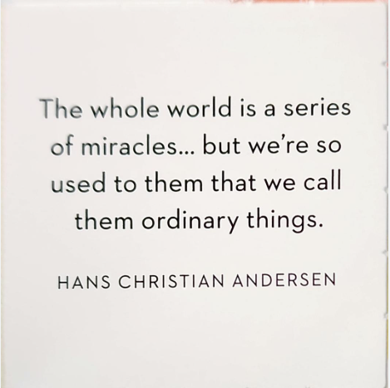
Legacy and Impact
Considered a pioneer of children's literature
Inspired countless writers and storytellers
His works translated into more than 125 languages
Disney adapted several of his stories into films
Continues to be read and celebrated globally
Remembered as a key figure in literary history

