Slide 1

Shakespeare: Life, Works, and Language Legacy

Slide 2

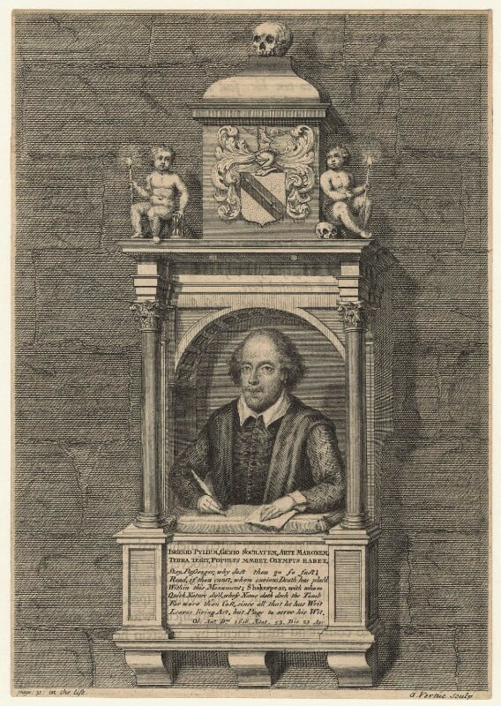
Who Was William Shakespeare?
Born in Stratford-upon-Avon, England in April 1564
Considered the greatest playwright in the English language
Wrote 39 plays and 154 sonnets
Lived during the Elizabethan era (Renaissance period)
Worked as an actor and playwright in London
Notes:
Image from: https://www.npg.org.uk/collections/search/portrait/mw91013/Monument-to-William-Shakespeare-in-Holy-Trinity-Church-Stratford-upon-Avon

Slide 3
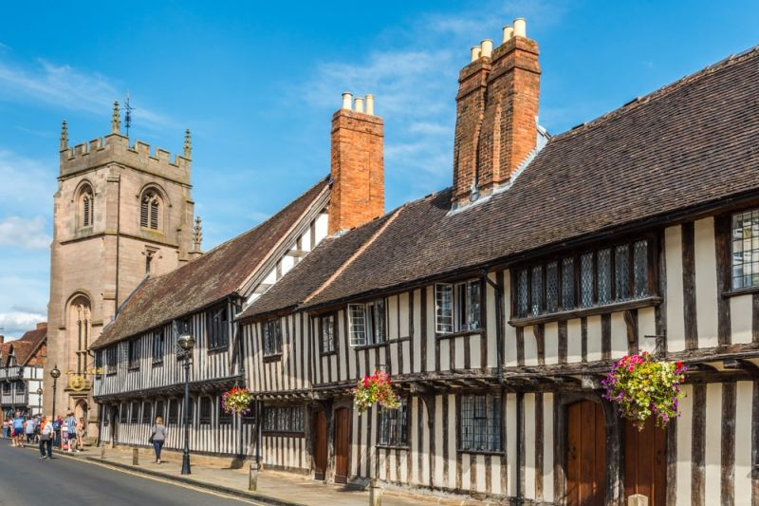
Early Life and Education
Born to John Shakespeare, a glove maker and local official
Attended local grammar school in Stratford
Learned Latin and classical literature
Limited formal education beyond basic schooling
Came from a middle-class family with local influence
Notes:
Image from: https://www.britainexpress.com/counties/warwickshire/az/Stratford/King-Edward-School.htm

Slide 4
Marriage and Family
Married Anne Hathaway in 1582
Anne was 8 years older than Shakespeare
Had three children: Susanna, and twins Hamnet and Judith
Hamnet died at age 11, which deeply affected Shakespeare
Spent much of his professional life in London

Slide 5
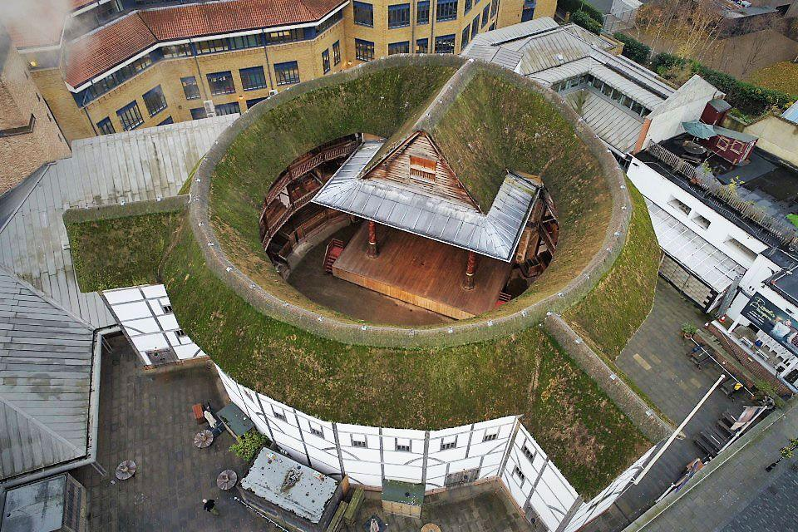
The Globe Theatre
Co-owned the famous Globe Theatre in London
Performed plays with his acting company, the Lord Chamberlain's Men
Later renamed the King's Men under King James I
Theatre was an open-air wooden structure
Could hold up to 3,000 audience members
Notes:
Image from: https://www.britannica.com/topic/Globe-Theatre/The-design-of-the-Globe

Slide 6
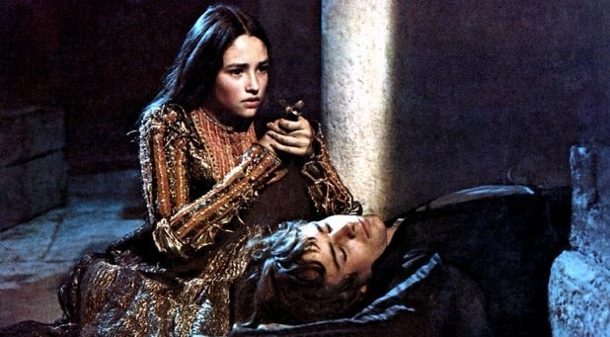
Famous Tragedies
Hamlet: Story of Danish prince seeking revenge
Romeo and Juliet: Tragic love story
Macbeth: Tale of ambition and supernatural elements
King Lear: Drama of family betrayal
Othello: Exploration of jealousy and manipulation
Notes:
Image from: https://nosweatshakespeare.com/tragic-shakespeare-moments/

Slide 7
Famous Comedies
A Midsummer Night's Dream
Much Ado About Nothing
Twelfth Night
As You Like It
The Merchant of Venice

Slide 8
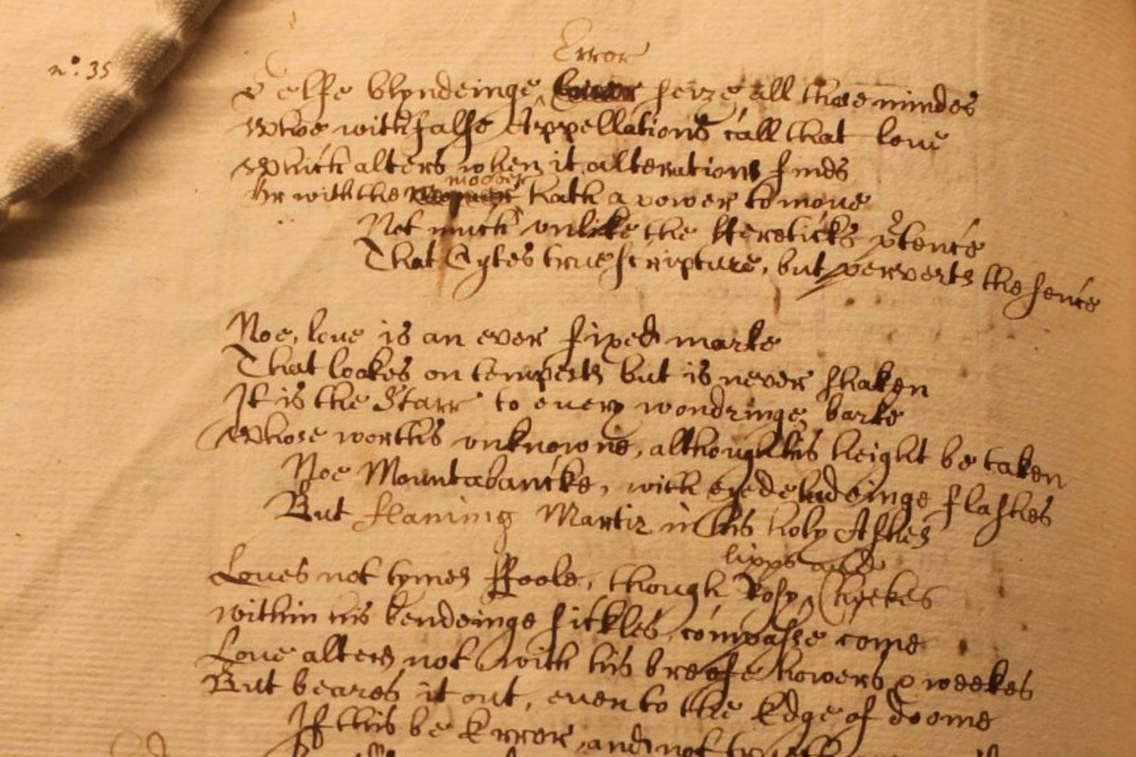
Shakespearean Sonnets
Wrote 154 sonnets between 1593-1609
Explored themes of love, beauty, mortality
Often dedicated to a mysterious "Dark Lady"
Considered some of the most beautiful poetry in English
Followed strict 14-line structure with specific rhyme scheme
Notes:
Image from: https://gizmodo.com/rare-handwritten-copy-of-famous-shakespeare-sonnet-found-in-oxford-library-2000570872

Slide 9
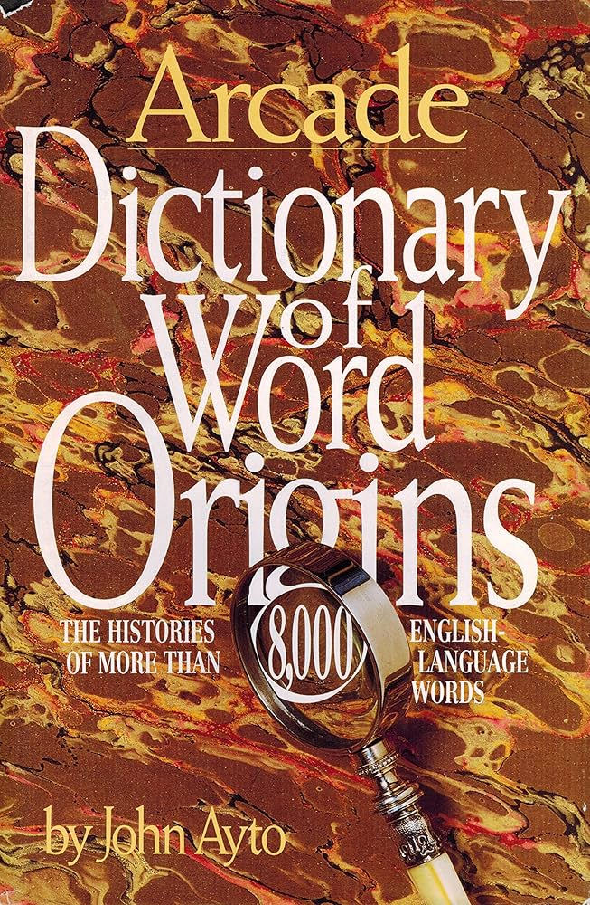
Words Shakespeare Invented
Assassination
Bedazzled
Critic
Eyeball
Fashionable
Lonely
Swagger
Uncomfortable
Unreal
Watchdog
Notes:
Image from: https://www.amazon.com/Dictionary-Word-Origins-Histories-English-Language/dp/1559701331

Slide 10
Famous Shakespeare Quotes
"To be, or not to be"
"All the world's a stage"
"Romeo, Romeo, wherefore art thou Romeo?"
"Some are born great, some achieve greatness"
"Love is blind"

Slide 11
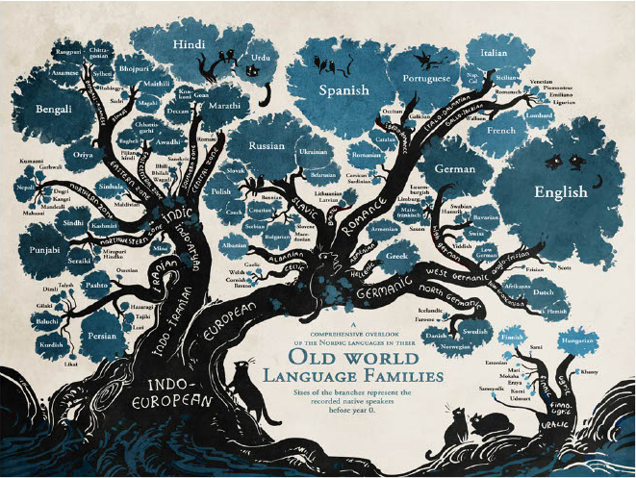
Shakespeare's Language Impact
Expanded English vocabulary dramatically
Introduced hundreds of new words
Influenced modern English grammar
Wrote in both prose and verse
Captured complex human emotions in language
Notes:
Image from: https://acutrans.com/the-history-of-the-english-language/

Slide 12
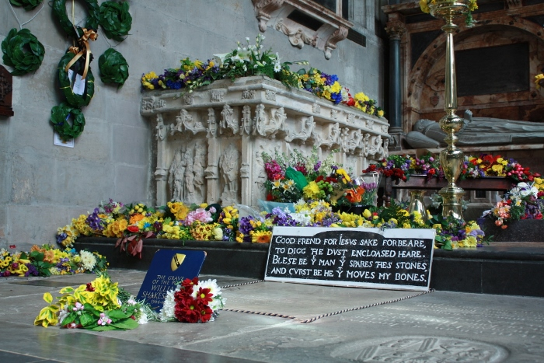
Later Life and Death
Retired to Stratford around 1613
Died on April 23, 1616
Buried in Holy Trinity Church
Left most of his wealth to his daughter Susanna
Considered a literary genius even during his lifetime
Notes:
Image from: https://www.stratford-upon-avon.org/shakespeare

Slide 13
Shakespeare's Lasting Legacy
Considered the greatest writer in English literature
Plays performed worldwide
Influenced countless writers and artists
Works translated into over 100 languages
Continues to be studied in schools globally

