Slide 1

Tasty Britain: A Culinary Journey Through English Food

Slide 2
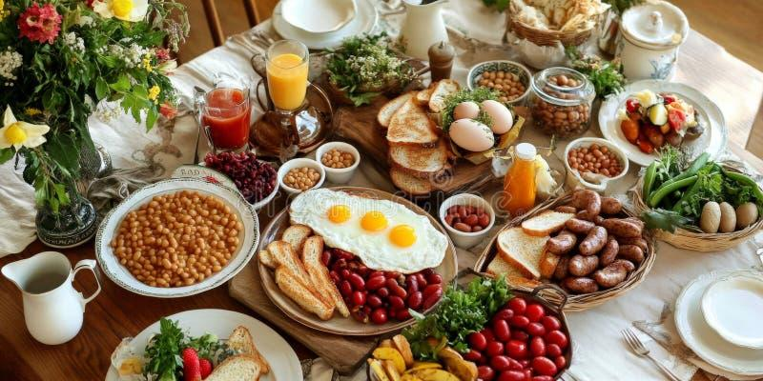
Introduction to British Cuisine
Explore the rich and diverse world of English food
Discover traditional dishes that define British culinary culture
Learn about iconic sweets and beloved tea traditions
Notes:
Image from: https://www.dreamstime.com/traditional-english-breakfast-spread-eggs-sausages-baked-beans-toast-beautifully-presented-rustic-table-image347556434

Slide 3
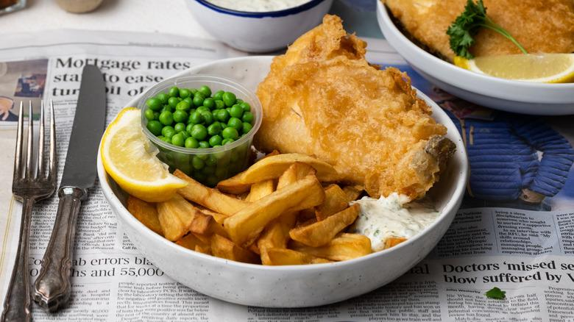
Classic Main Dishes: Fish and Chips
National dish of the United Kingdom
Crispy battered fish served with golden french fries
Traditionally wrapped in newspaper and eaten as street food
Often served with mushy peas and tartar sauce
Notes:
Image from: https://www.tastingtable.com/1129125/classic-british-fish-and-chips-recipe/

Slide 4
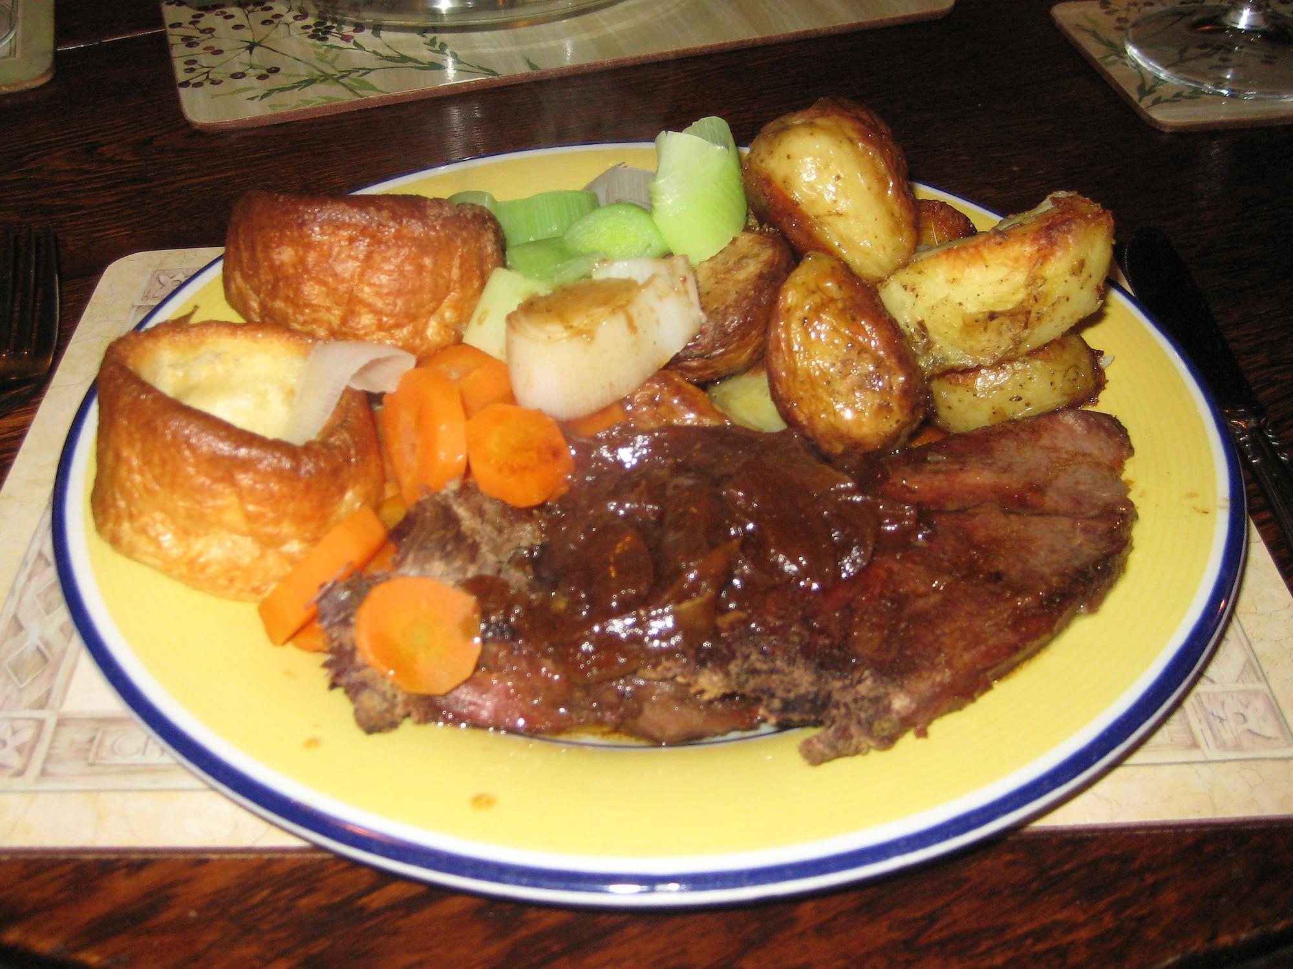
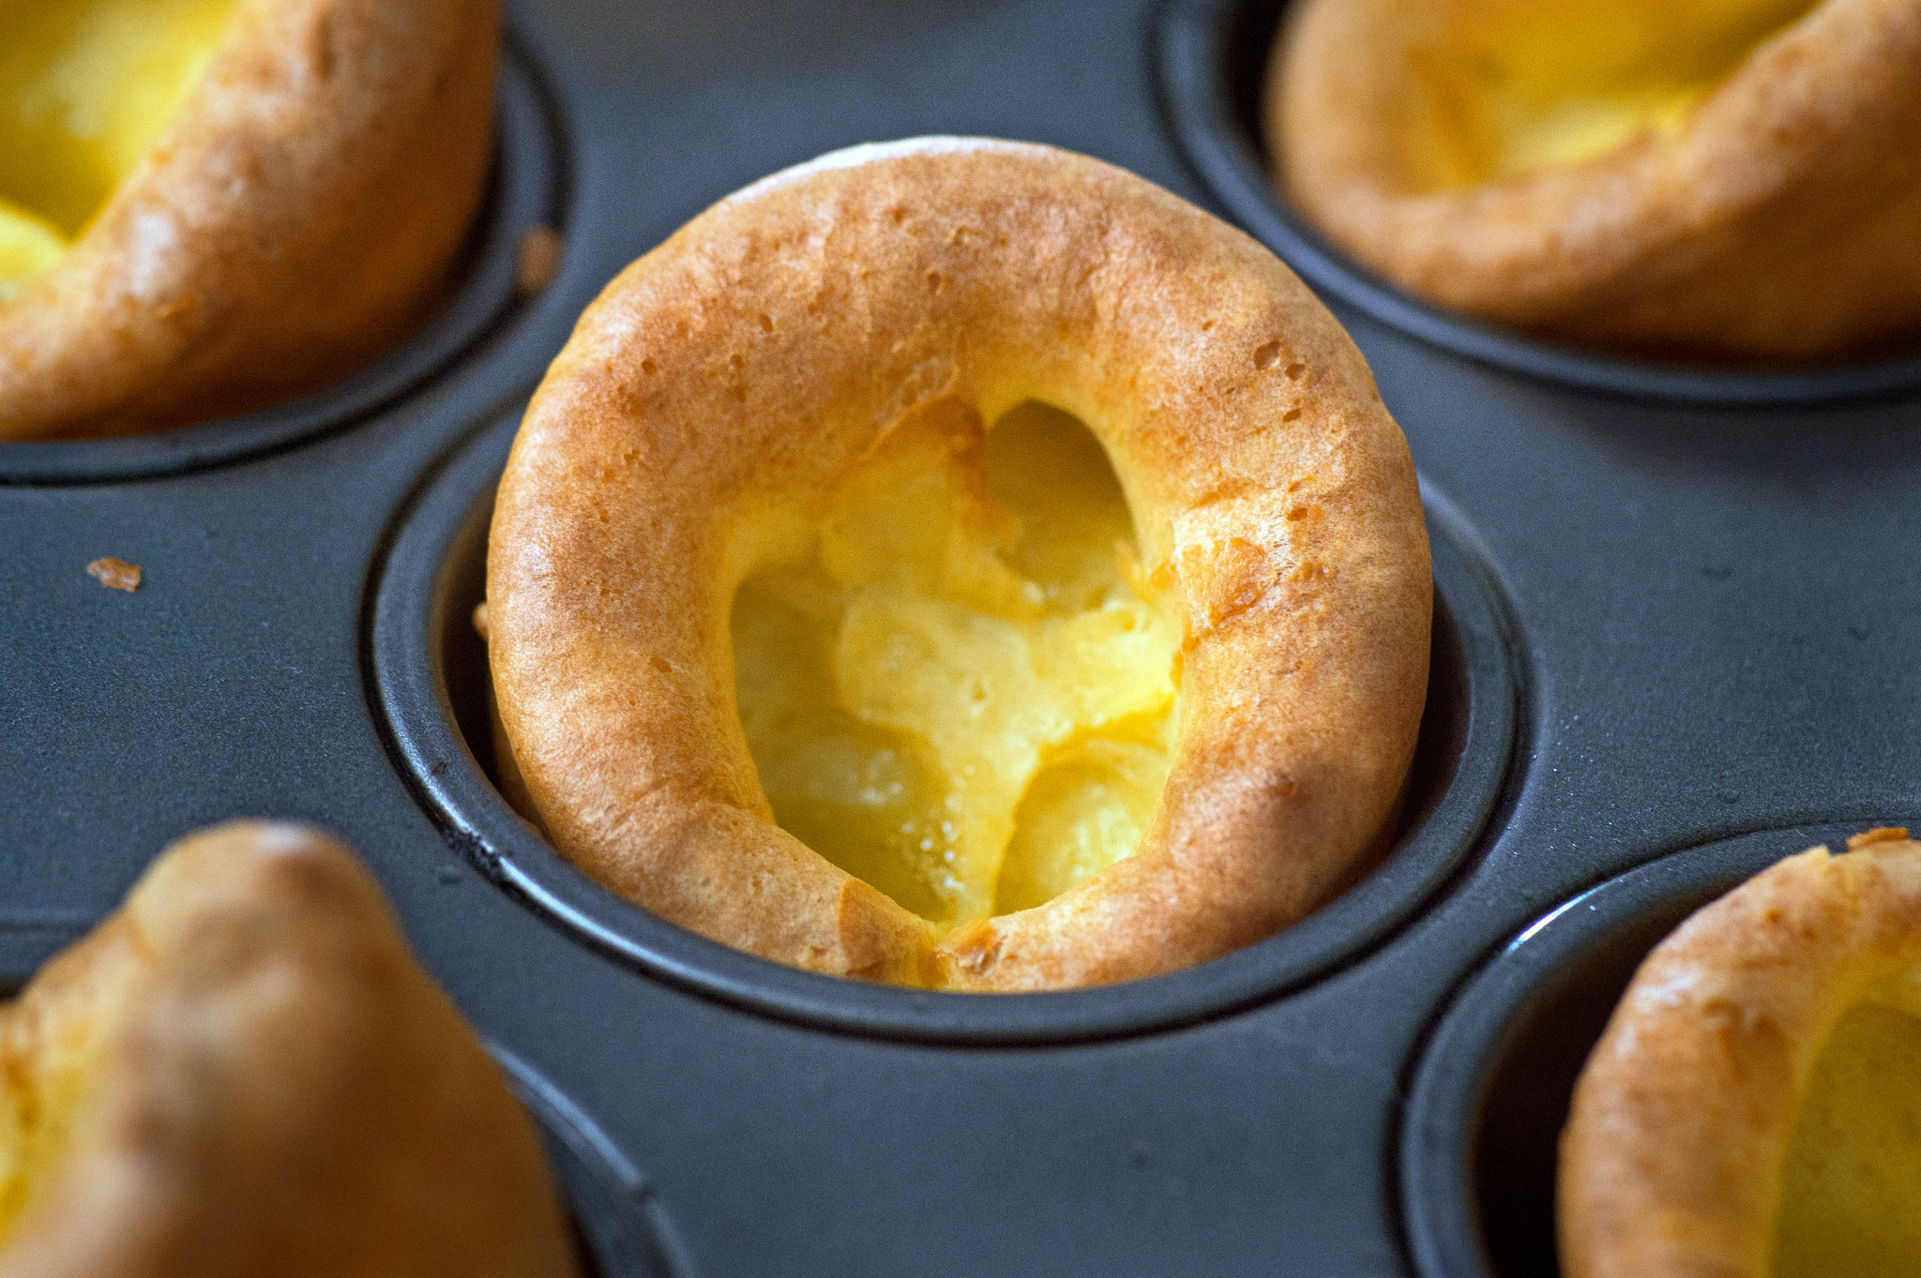
Sunday Roast: A British Tradition
Weekly family meal typically served on Sundays
Includes roasted meat (beef, chicken, or lamb)
Accompanied by roasted potatoes and seasonal vegetables
Topped with rich gravy and Yorkshire pudding

Slide 5
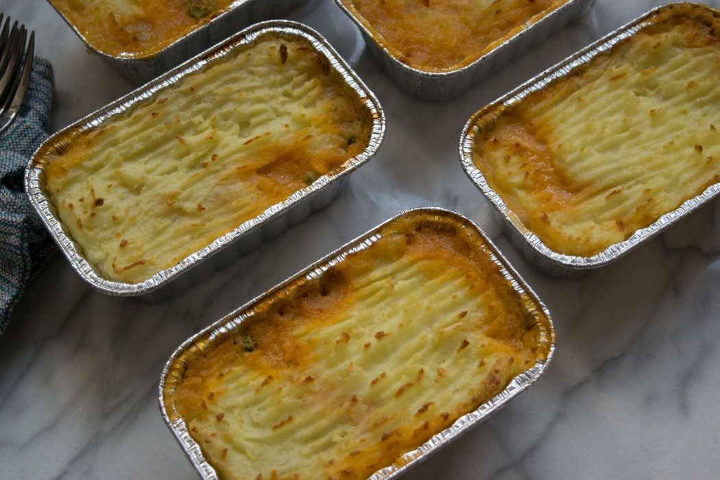
Shepherd's Pie: Comfort Food Classic
Traditional meat pie with ground lamb
Topped with creamy mashed potatoes
Baked until golden brown
Hearty meal perfect for cold weather
Notes:
Image from: https://www.wittenkitchen.com/recipe/easy-entertaining-shepherds-pie/

Slide 6

Classroom Interaction: Dish Discussion
Turn to your partner and discuss:
What traditional dish from your culture is similar to these?
How do cooking methods differ between countries?
Share your thoughts with the class
Notes:
Image from: https://www.fortheloveofteachers.com/7-tips-on-how-to-talk-about-food-and-nutrition-in-the-classroom/?srsltid=AfmBOooKnLh0-z-NWzHqSceMzZ6iKvc1irXx3eoT9fAoidYFimWioEdZ

Slide 7
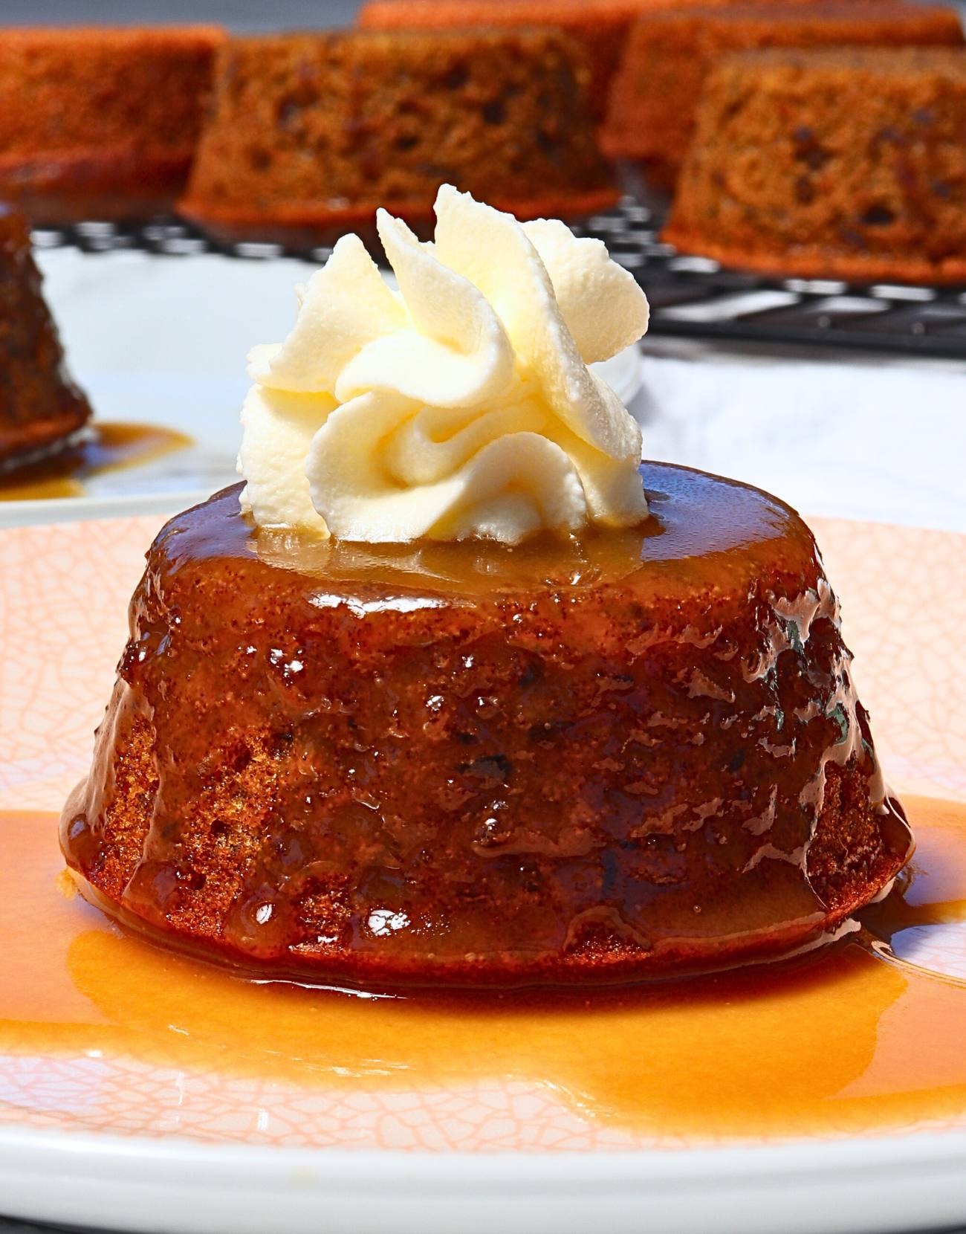
Sweet Treats: Sticky Toffee Pudding
Rich dessert made with dates
Covered in warm toffee sauce
Often served with vanilla custard or ice cream
Originated in Northwest England

Slide 8
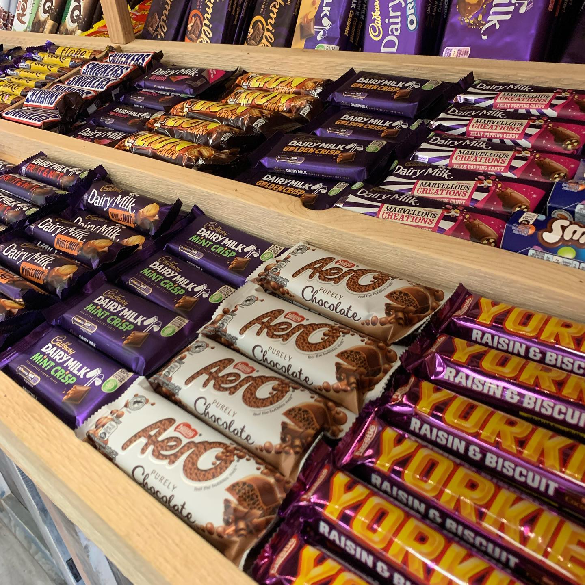
Classic English Sweets
Treacle tart
Spotted dick pudding
Trifle
Shortbread
Scones with clotted cream
Notes:
Image from: https://thehamletny.com/collections/sweets?srsltid=AfmBOorzI6raGiS0NsGbbBF3mO8JaOVi_7patLhFadXPMFeTvjmbzHHq

Slide 9
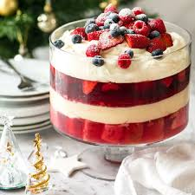
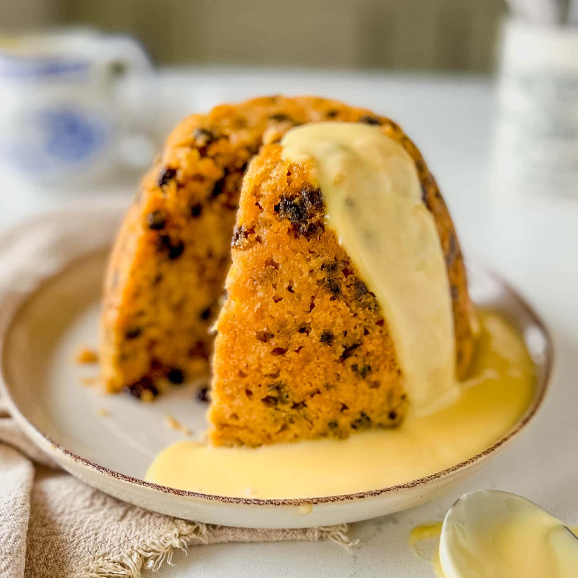
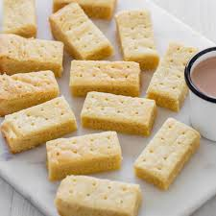
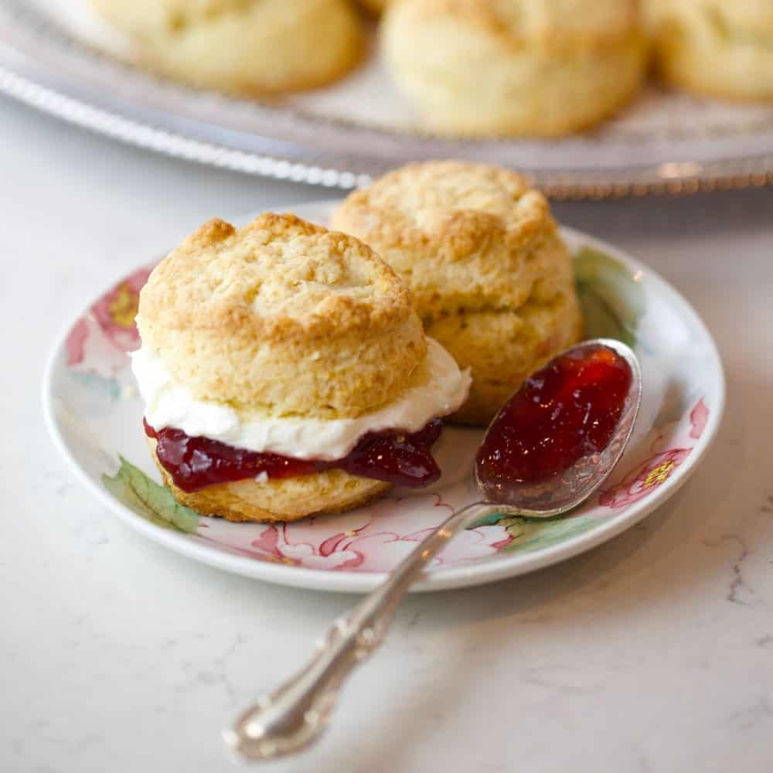
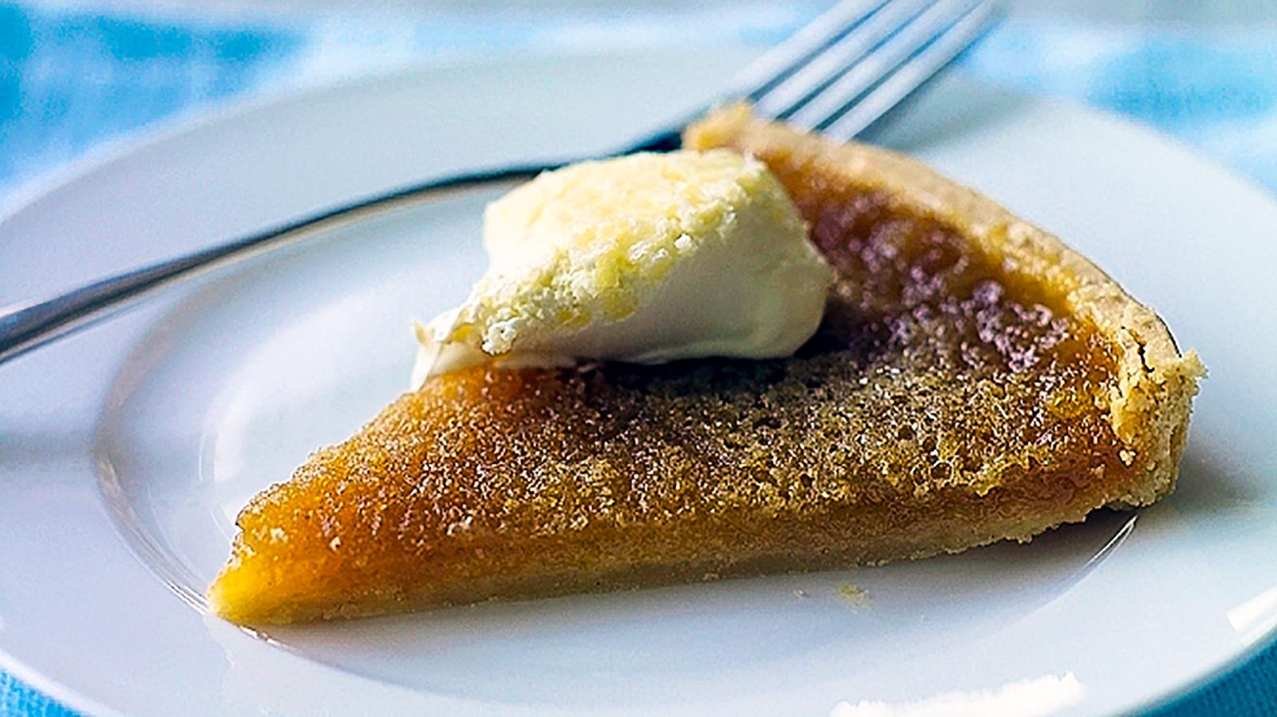
Classic English Sweets
Treacle tart
Spotted dick pudding
Shortbread
Scones with clotted cream
Notes:
Image from: https://thehamletny.com/collections/sweets?srsltid=AfmBOorzI6raGiS0NsGbbBF3mO8JaOVi_7patLhFadXPMFeTvjmbzHHq

Slide 10
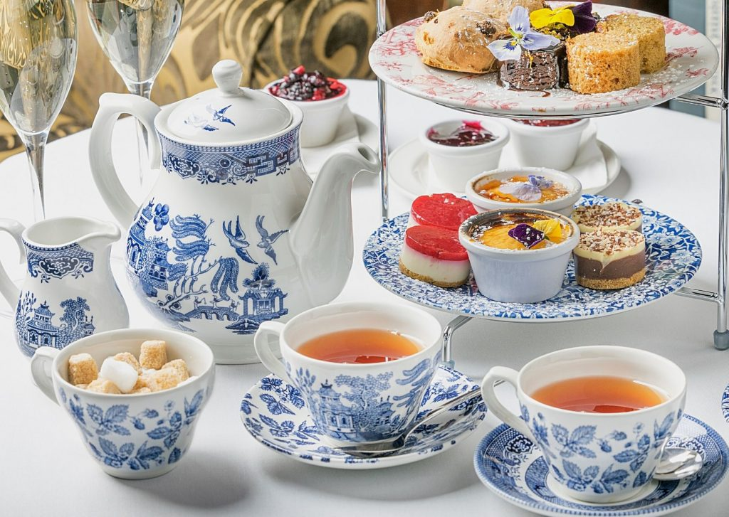
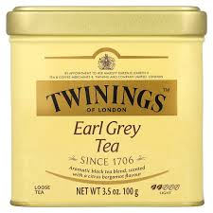
Tea Culture in England
Tea is more than a drink - it's a cultural ritual
Afternoon tea typically served between 3-5 PM
Traditional tea includes sandwiches, scones, and pastries
Most popular teas: English Breakfast and Earl Grey
Notes:
Image from: https://www.teawithmum.com/english-afternoon-tea/

Slide 11
Tea Preparation Etiquette
Use loose tea leaves when possible
Warm the teapot before brewing
Steep black tea for 3-5 minutes
Add milk after tea is poured
Use fine china if available

Slide 12
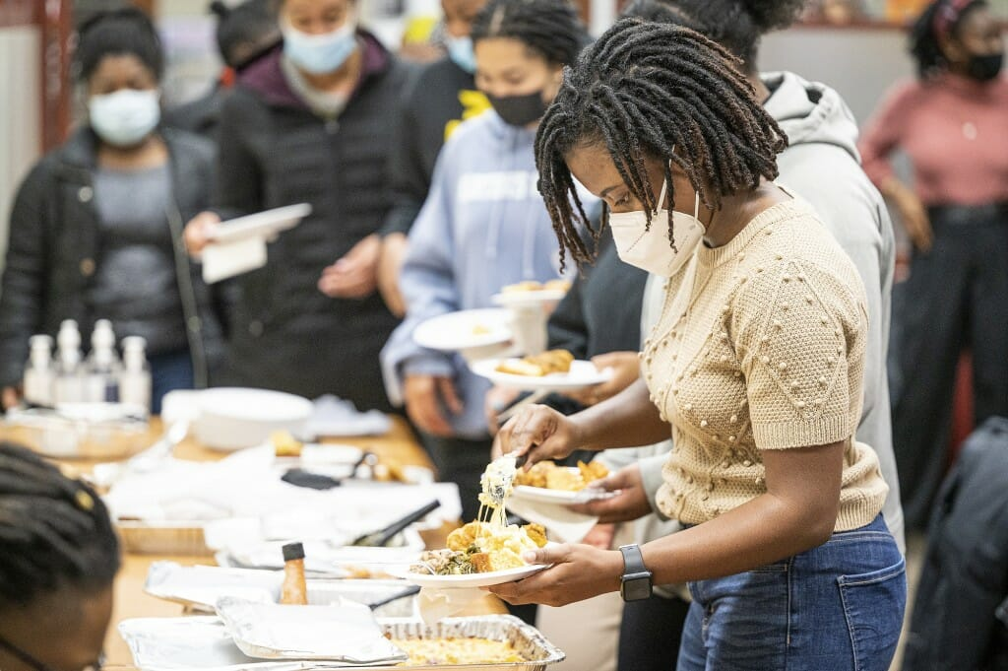
Reflection and Discussion
First, traditional dishes like Fish and Chips show the influence of Britain’s industrial past. It became popular in the 19th century as a cheap, filling meal for working-class people in rapidly growing cities.
Meals such as Sunday Roast highlight the importance of family and routine in British life. This weekly meal reflects strong social traditions where families gather together, often linked to religious customs like Sunday church.
Dishes like Shepherd's Pie represent rural life and agriculture. Made with simple ingredients like lamb and potatoes, it shows how British cuisine developed from local farming and the need for hearty, warming food.
Desserts such as Sticky Toffee Pudding and other sweets reflect regional traditions and the British love for rich, comforting treats, often influenced by historical availability of sugar during the colonial period.
Finally, tea culture, especially Afternoon Tea, reflects Britain’s global history and trade connections, particularly with countries where tea was produced. It also shows the importance of social rituals and etiquette in everyday life.
Notes:
Image from: https://news.wisc.edu/soul-talk-food-then-discussion/

