Slide 1







EUROPA QUEST
⸺
Beginners version
Council of the European Union
General Secretariat
Directorate-General for Communication and Information

Slide 2



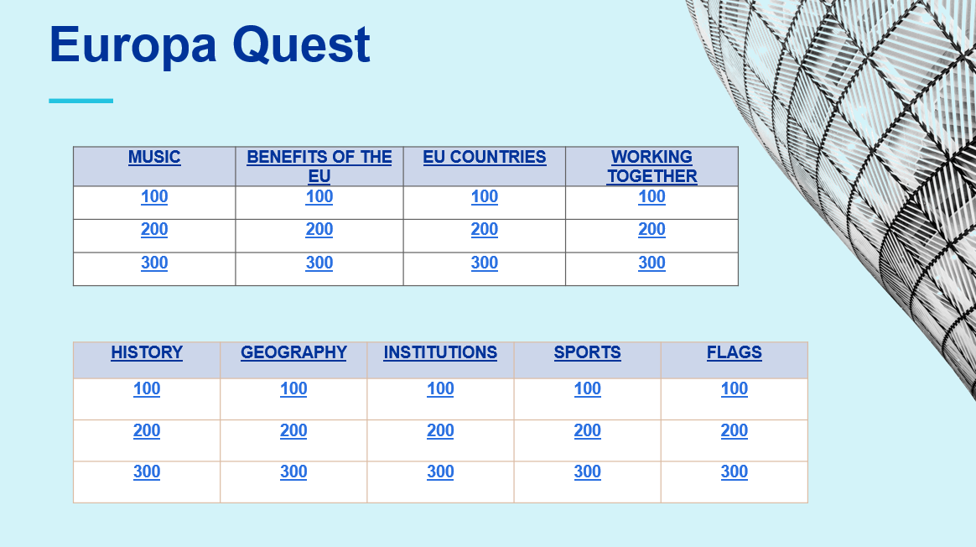

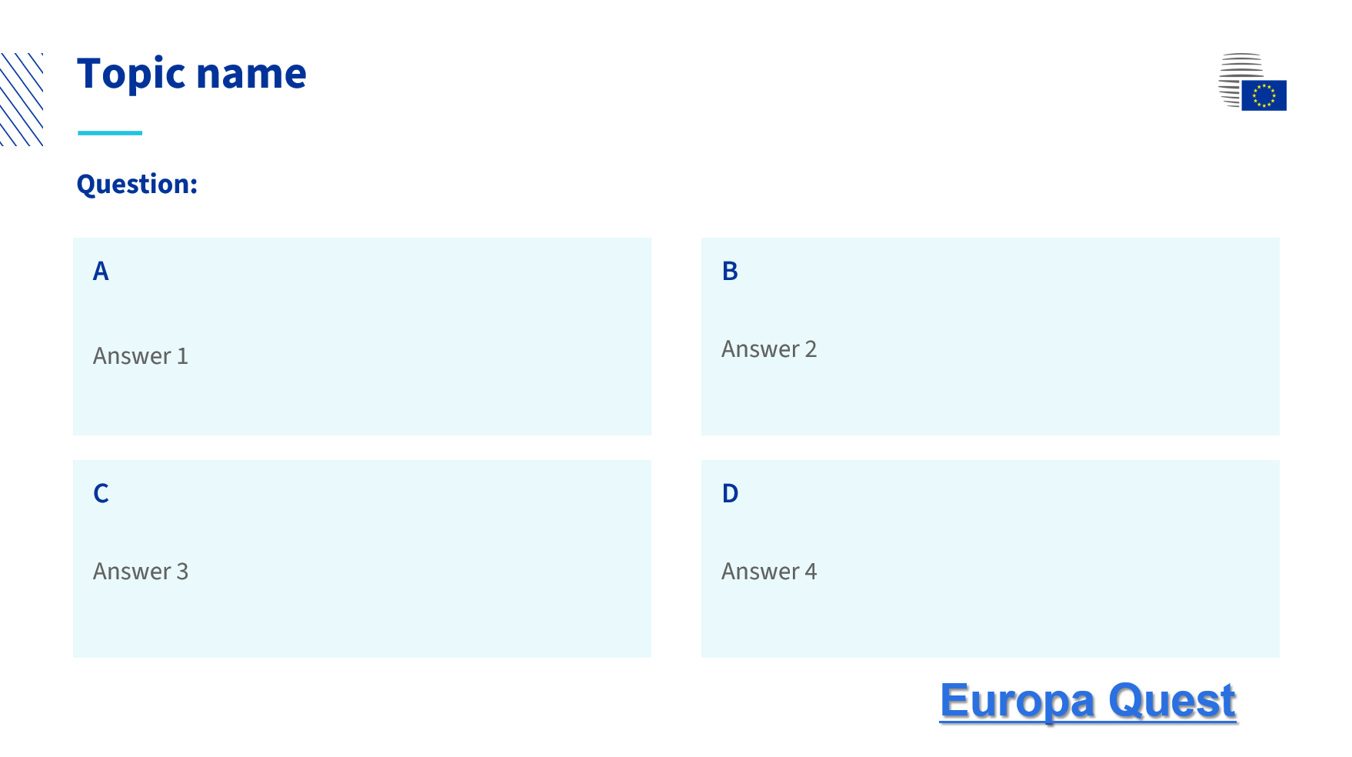
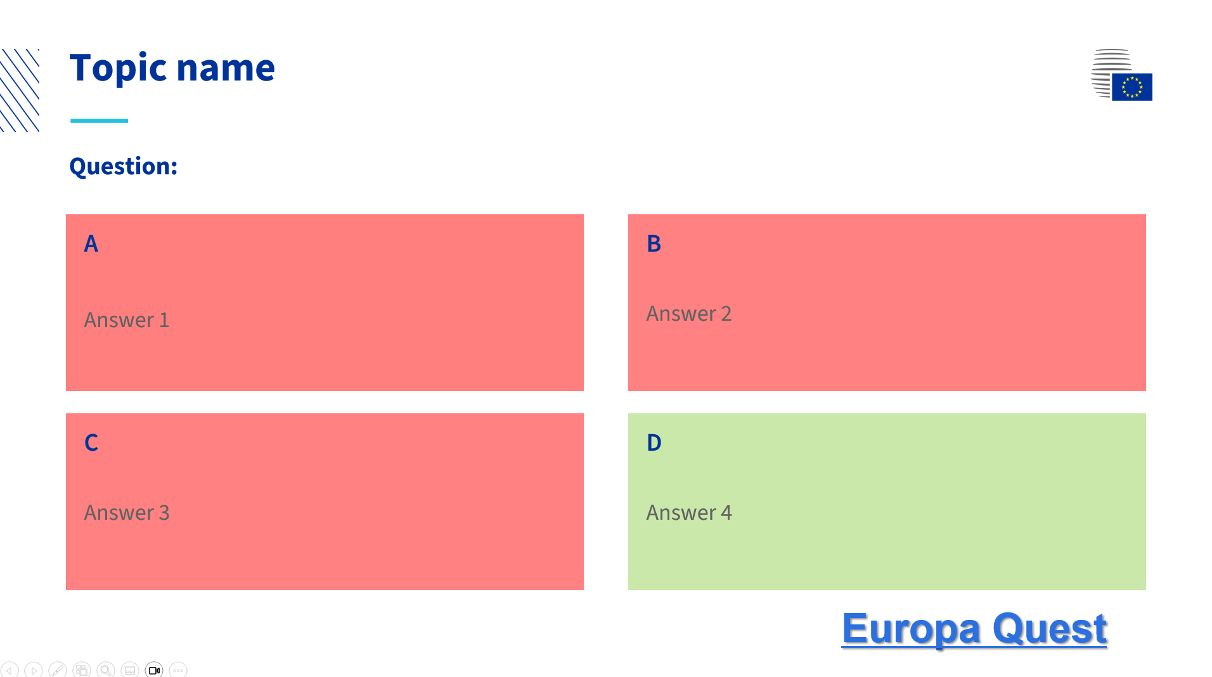


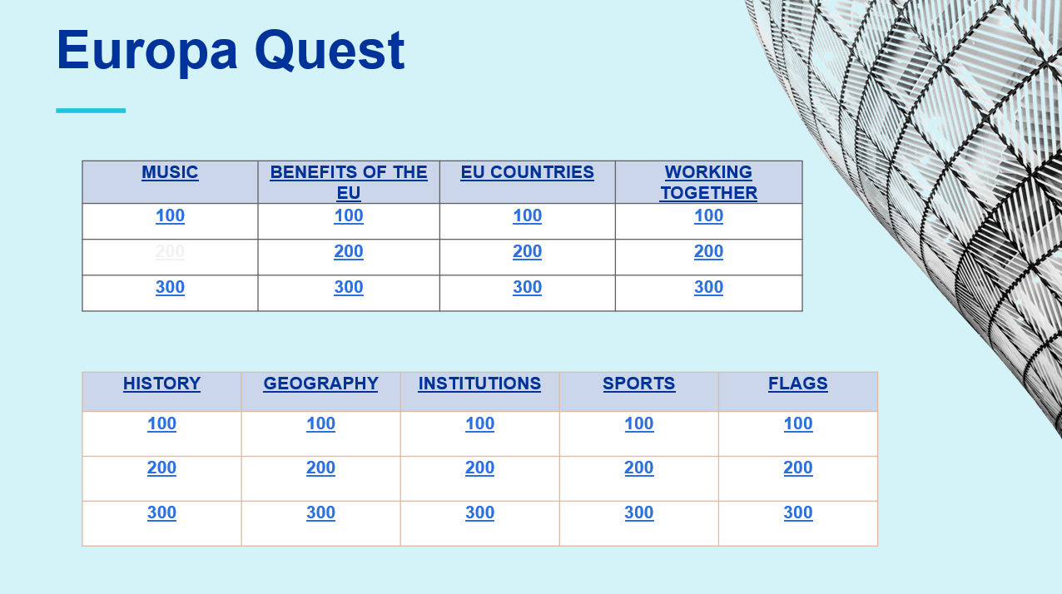
How to use
⸺
Click on the question of choice
After the team gives their answer, click to reveal the correct answer
Click on ‘Europa Quest’ to go back to the table and choose another question.
The question already used will have turned white

Slide 3
Europa Quest
⸺
MUSIC | BENEFITS OF THE EU | EU COUNTRIES | WORKING TOGETHER
100 | 100 | 100 | 100
200 | 200 | 200 | 200
300 | 300 | 300 | 300
HISTORY | GEOGRAPHY | INSTITUTIONS | SPORTS | FLAGS
100 | 100 | 100 | 100 | 100
200 | 200 | 200 | 200 | 200
300 | 300 | 300 | 300 | 300

Slide 4
Music 100
⸺
Which Swedish pop group is famous for hits such as ‘Dancing Queen’ and ‘Mamma Mia’?
A
The Beatles
B
  ABBA
C
  Spice Girls
D
  Queen
Europa Quest

Slide 5
Music 200
⸺
Which Italian composer is best known for his work ‘The Four Seasons’ and is considered one of the greatest Baroque composers?
A
Giuseppe Verdi
B
  Johann Sebastian Bach
C
  Wolfgang Amadeus Mozart
D
  Antonio Vivaldi
Europa Quest

Slide 6
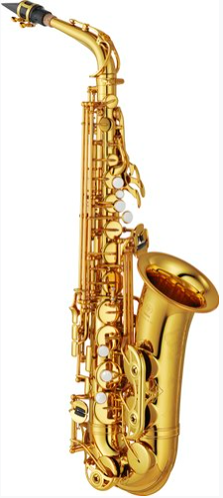
Music 300
⸺
Where did Adolphe Sax, the creator of the saxophone, come from?
A
Germany
B
  France
C
  Belgium
D
  Denmark
Europa Quest

Slide 7
Benefits of the EU 100
⸺
Which of the following allows citizens of EU countries to travel freely within the EU without needing a visa or going through border control?
A
Schengen agreement
B
  common agricultural policy
C
  European Central Bank
D
  Court of Justice of the European Union
Europa Quest

Slide 8
Benefits of the EU 200
⸺
Which programme provides funding to students to study in another EU country, promoting cultural exchange and learning?
A
Erasmus+
B
  Horizon Europe
C
  European Solidarity Corps
D
  Youth Guarantee
Europa Quest

Slide 9
Benefits of the EU 300
⸺
What is the common element on all 1 euro coins?
A
a horse
B
  an olive branch
C
  a map of Europe
D
  a star
Europa Quest

Slide 10
EU countries 100
⸺
Which country is known for pizza, pasta and its famous leaning tower?
A
Spain
B
  Italy
C
  France
D
  Greece
Europa Quest

Slide 11
EU countries 200
⸺
Which country, located in the Mediterranean, is the smallest EU country by land area?
A
Malta
B
  Cyprus
C
  Luxembourg
D
  Slovenia
Europa Quest

Slide 12
EU countries 300
⸺
The capital of which country is a coastal city?
A
Bulgaria
B
  Czechia
C
  Finland
D
  Spain
Europa Quest

Slide 13
Working together 100
⸺
How many official EU languages are there?
A
24
B
  27
C
  3
D
  1
Europa Quest

Slide 14
Working together 200
⸺
What is the motto of the EU?
A
United we are stronger
B
  United in diversity
C
  Let’s win
D
  Together for peace
Europa Quest

Slide 15
Working together 300
⸺
Which EU initiative aims to promote cooperation and mutual assistance among member countries in the event of natural disasters or other emergencies?
A
European Stability Mechanism
B
  European Assistance Agency
C
  European External Action Service
D
  EU Civil Protection Mechanism
Europa Quest

Slide 16
History 100
⸺
The European Union was awarded the Nobel Peace Prize in:
A
2012
B
  1957
C
  1908
D
  1858
Europa Quest

Slide 17
History 200
⸺
Which two countries were among the six founding members of (what would later become) the European Union?
A
France and Poland
B
  Italy and Spain
C
  Belgium and Luxembourg
D
  Netherlands and Denmark
Europa Quest
Notes:
Poland joined in 2004
Spain joined in 1986
Denmark joined in 1973

Slide 18
History 300
⸺
What major event happened in 2002?
A
10 new countries joined the EU, taking the number of member countries to 25
B
  The euro entered circulation
C
  Spain won the Eurovision Song Contest for the first time
D
  The first elections for the European Parliament were held
Europa Quest
Notes:
10 new countries joined the EU in 2004
Spain won Eurovision for the first time in 1968
The first European Parliament elections were in 1979

Slide 19
Geography 100
⸺
Which country is known for its windmills, tulip fields and wooden shoes?
A
Italy
B
  Greece
C
  Netherlands
D
  Ireland
Europa Quest

Slide 20
Geography 200
⸺
Which mountain range separates France and Spain, stretching approximately 430 km?
A
Alps
B
  Pyrenees
C
  Carpathians
D
  Apennines
Europa Quest

Slide 21
Geography 300
⸺
How many EU countries have no land border with another EU country?
A
0
B
  1
C
  2
D
  3
Europa Quest
Notes:
Cyprus, Malta and Ireland

Slide 22
Institutions 100
⸺
Which of the following has a role in the EU law-making process?
A
European Parliament
B
  European Association of Lawmakers
C
  Council of Europe
D
  European Central Bank
Europa Quest

Slide 23
Institutions 200
⸺
Which EU institution represents the governments of the member countries?
A
European Parliament
B
  Council of the EU
C
  European Commission
D
  European Central Bank
Europa Quest

Slide 24
Institutions 300
⸺
Which EU institution is responsible for proposing new laws and implementing decisions?
A
European Commission
B
  European Court of Auditors
C
  European Council
D
  European Parliament
Europa Quest

Slide 25
Sports 100
⸺
Which sport is popular in Spain, with players needing a racquet to play it?
A
tennis
B
  basketball
C
  football
D
  bullfighting
Europa Quest

Slide 26
Sports 200
⸺
In which EU capital are you most likely to see the Tour de France?
A
Helsinki
B
  Berlin
C
  Paris
D
  Madrid
Europa Quest

Slide 27
Sports 300
⸺
In football, which country has never won a UEFA European championship title?
A
Hungary
B
  Denmark
C
  Portugal
D
  Greece
Europa Quest
Notes:
Denmark won in 1992
Portugal won in 2016
Greece won in 2004

Slide 28
Flags 100
⸺
Which country has black in its flag?
A
Romania
B
  Belgium
C
  Spain
D
  Italy
Europa Quest

Slide 29
Flags 200
⸺
How many stars are there in the EU flag?
A
1
B
  10
C
  12
D
  27
Europa Quest

Slide 30
Flags 300
⸺
How many EU countries have black in their flags?
A
0
B
  1
C
  2
D
  3
Europa Quest
Notes:
Belgium, Estonia, Germany

