Slide 1
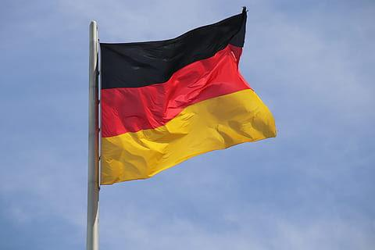
Berlin recap

Slide 2
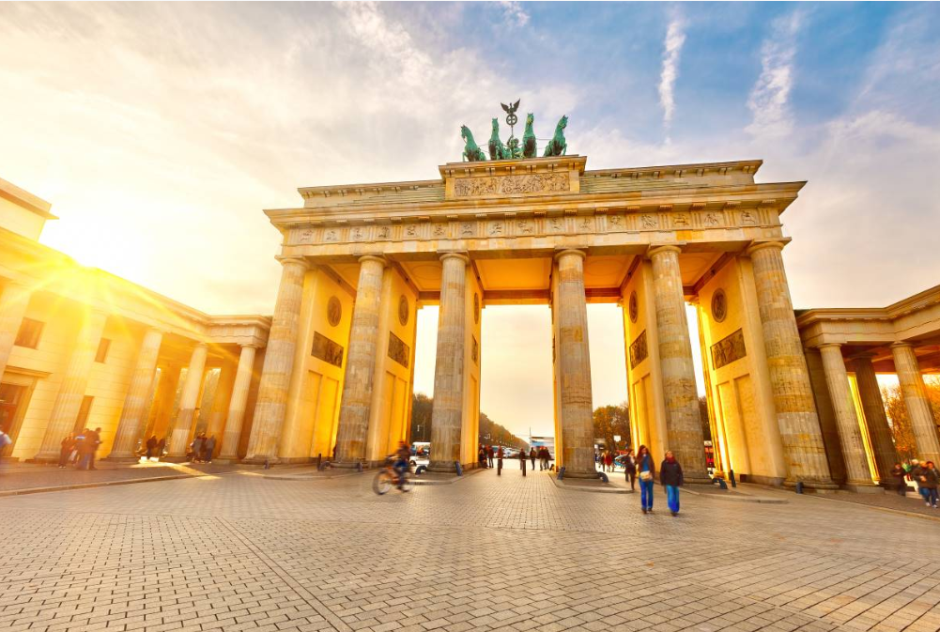

Slide 3
Brandenburger Tor (ή The Brandenburger Gate – Η Πύλη του Βρανδεμβούργου)

Slide 4
Fun fact: From 1814 to 1919, only the royal family and members of the aristocratic Pfuel family were permitted to pass through the central arch. Something that would not have been quite so amusing for us ordinary people.

Slide 5
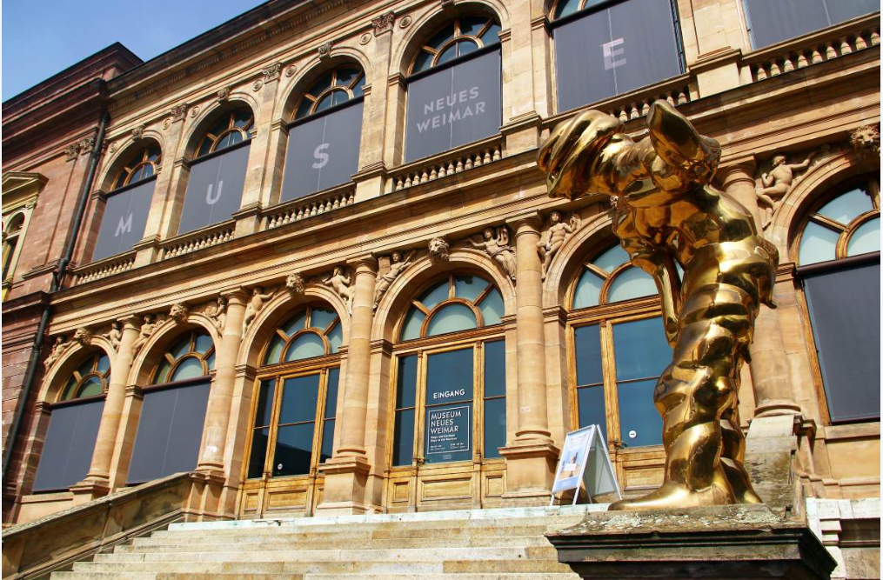

Slide 6
Neues Museum

Slide 7
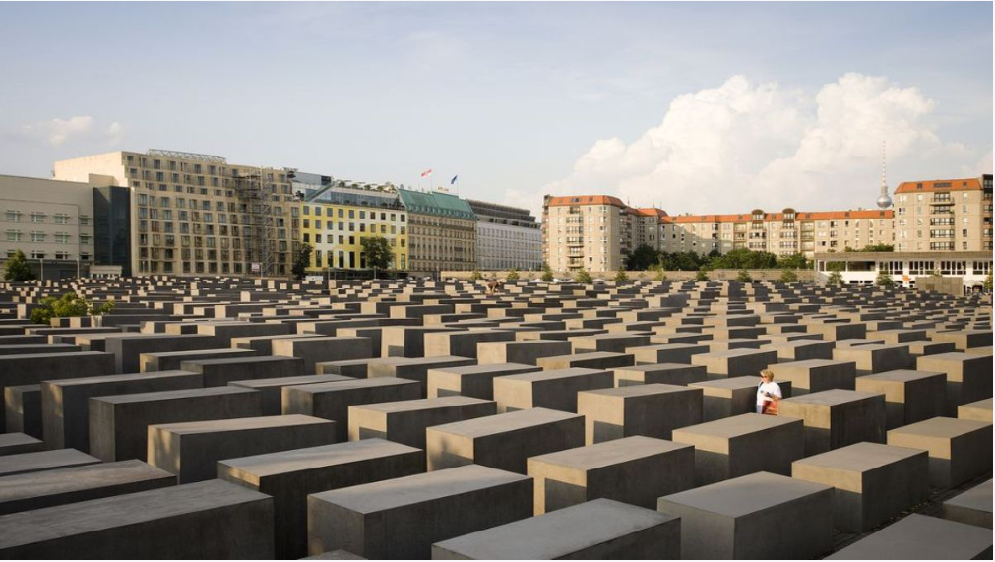

Slide 8
Denkmal für die ermordeten Juden Europas - ΜΟΥΣΕΙΟ ΟΛΟΚΑΥΤΩΜΑΤΟΣ

Slide 9
The Memorial to the Murdered Jews of Europe by the architect Peter Eisenman is deliberately disorienting: it is a striking sculptural statement that invites visitors in, creating a sense of unease, and due to its design, you may experience a feeling of confinement. Initially, criticism of the memorial often focused on its perceived lack of specificity—there are no Stars of David, no obvious symbolism, and no explicit acknowledgment of German guilt—but it has since gained widespread recognition.

Slide 10
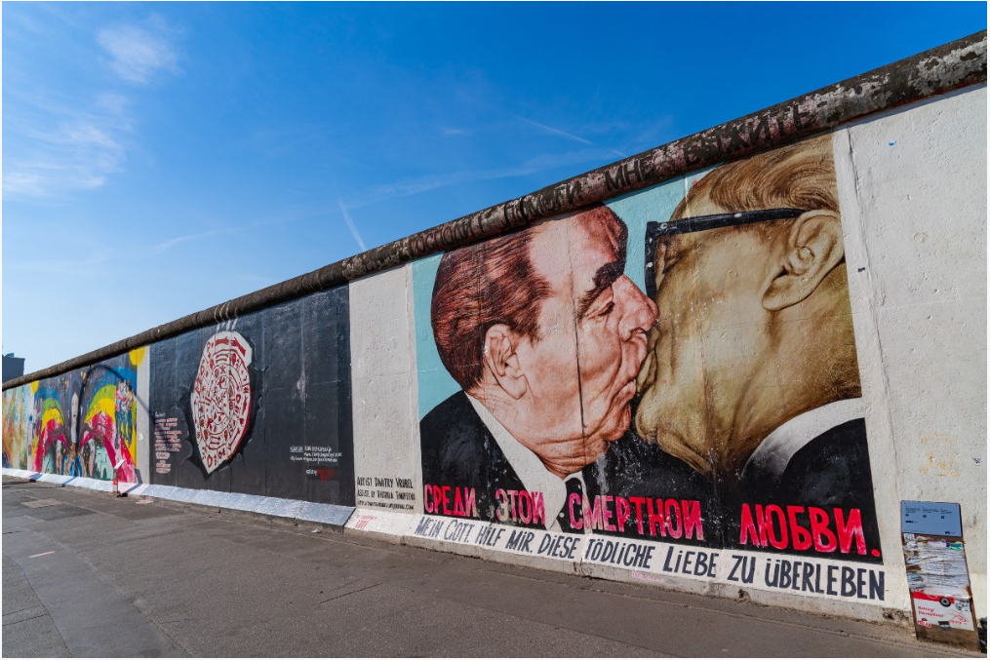

Slide 11
East Side Gallery

Slide 12
Along the Spree river for 1.3 km from the Oberbaum Bridge to the Ostbahnhof lies one of Berlin's most photographed tourist attractions. This is the longest remaining section of the Wall still standing, decorated with 101 paintings by international artists since 1990. Dmitri Vrubel's striking portrait depicting the kiss between Brezhnev and Honecker – a Soviet sign of great respect between socialist leaders – is easily its most iconic image. In 2017, in an effort to prevent the kind of vandalism that had plagued it in recent years, a metal fence was erected around the perimeter of the Wall, something that was nonetheless met with irony by visitors.

Slide 13
Leonid Ilyich Brezhnev (1906–1982) was a Soviet politician and General Secretary of the Communist Party of the Soviet Union from 1964 until his death in 1982. His tenure was the second longest after Joseph Stalin's and defined the so-called "Era of Stagnation
Erich Honecker (1912–1994) was a German communist politician and leader of East Germany (the German Democratic Republic, GDR) from 1971 to 1989. He was a central figure of the Cold War and one of the most emblematic symbols of the Soviet bloc in Europe.

Slide 14
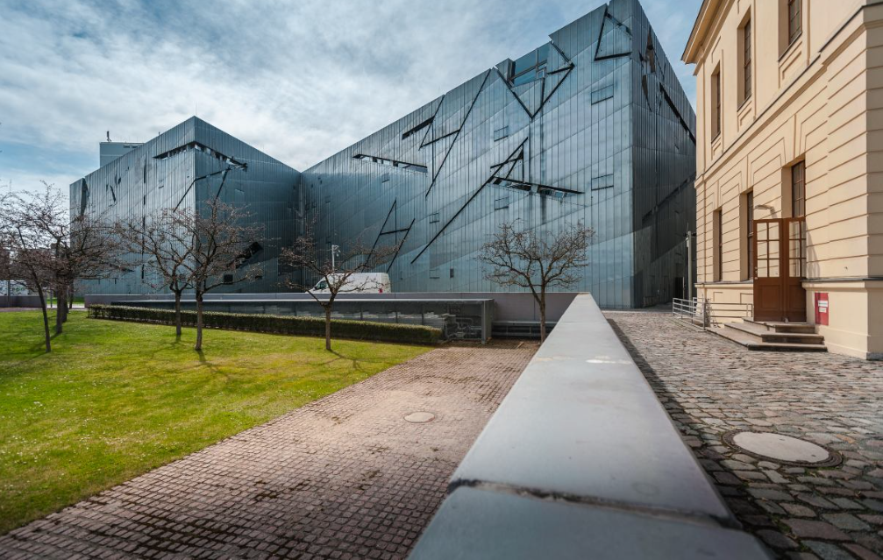

Slide 15
Μουσείο Jüdisches

Slide 16
Named the largest Jewish museum in Europe (3,500 square meters of floor space, to be precise), Daniel Libeskind's beautiful building houses a masterful museum dedicated to the turbulent history of Judaism in Germany. It opened in 2001, with a permanent exhibition that tells the stories of prominent Jews and their impact. Here, you can also learn about Jewish holiday traditions, the difficult road to emancipation, and much more.

Slide 17
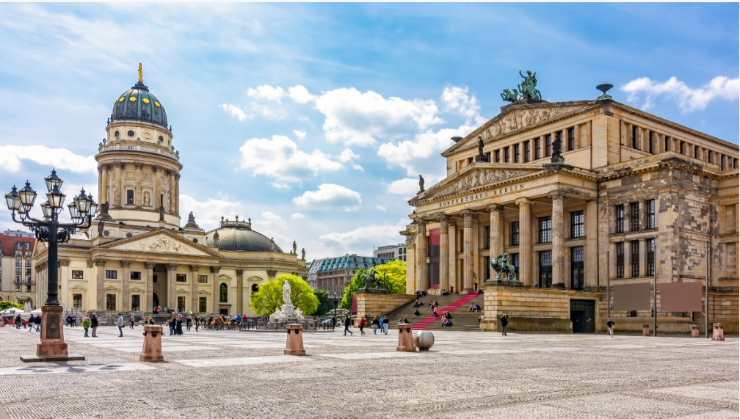

Slide 18
Konzerthaus

Slide 19
Berlin's most famous concert hall, home to the world-renowned Berlin Philharmonic Orchestra, is also architecturally bold: a wonderfully playful piece of organic modernism. Designed by Hans Scharoun, the golden building with its distinctive vaulted roof opened in 1963. Its reputation for exceptional acoustics is accurate, but depends on where you sit. Behind the orchestra, the acoustics leave much to be desired, but in front (where the seats are considerably more expensive), the sound is heavenly. The Berlin Phil gives approximately 100 performances in the city during the season from August to June, plus 20 to 30 concerts around the world.

Slide 20
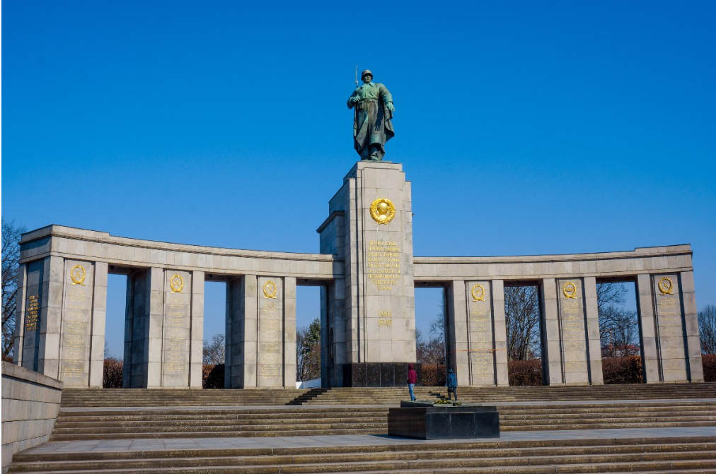

Slide 21
Σοβιετικό Μνημείο Τίργκαρτεν (Sowjetisches Ehrenmal am Treptower Park)

Slide 22
One of Berlin's most striking public monuments, this memorial to the Soviet soldiers killed in World War II (one of three in Berlin) and military cemetery is located in a quiet park in the east of the city. It is as awe-inspiring as one might expect. Treptower Park covers a vast area and is worth a visit in its own right, so combine your stop with a bike ride along the Spree or a stroll around the nearby Karpfenteich (carp pond)

Slide 23
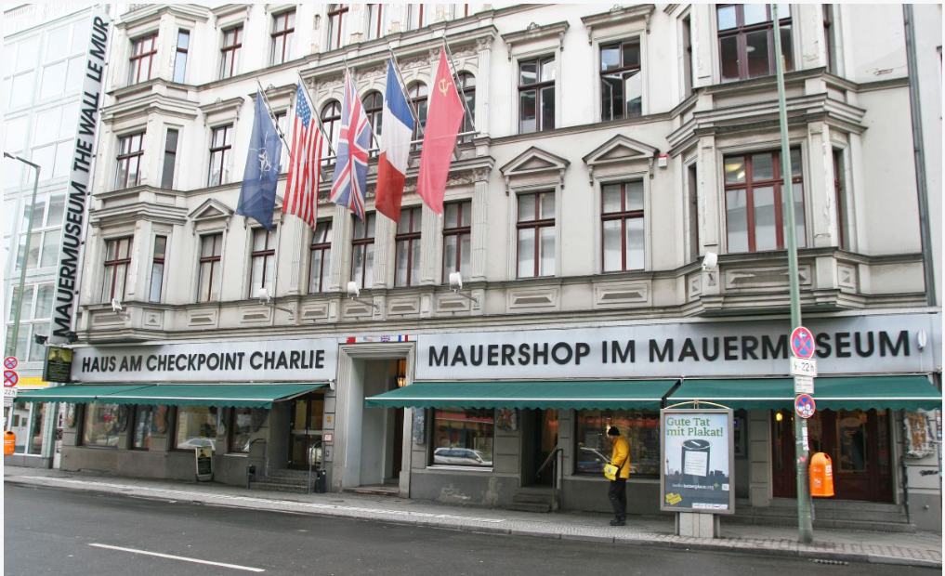

Slide 24
Haus am Checkpoint Charlie

Slide 25
Checkpoint Charlie was a famous gate in Berlin during the Cold War. Berlin was divided into two parts: East Berlin (communist) and West Berlin (free). The only way most people could cross from one side to the other was through this gate.
Many East Germans tried to escape to the West through here. It was a very tense and dangerous place, with American and Soviet soldiers facing each other on opposite sides.
When the Berlin Wall fell in 1989, the gate was no longer needed. Today it is a popular tourist spot in Berlin.

Slide 26
Main info to remember…..
Berlin is divided into 12 main administrative districts
U-Bahn (Underground Railway) Total lines: 9 lines
Over 2,500 public parks and gardens (Largest parks include: Tiergarten (Central Park), Tempelhofer Feld (Former airport turned into a massive public park), Grunewald Forest,Treptower Park)
Population: Approximately 3.7 million people
Known for: History, art, music, and cultural diversity
Over 20% of Berlin's population has an immigrant background
More than 190 nationalities live in the city

