Slide 1

Cultural Guide of Greece Volume III
Exploring Cultures Through Teens’
eyes - cultural guide 2025-2026

Slide 2
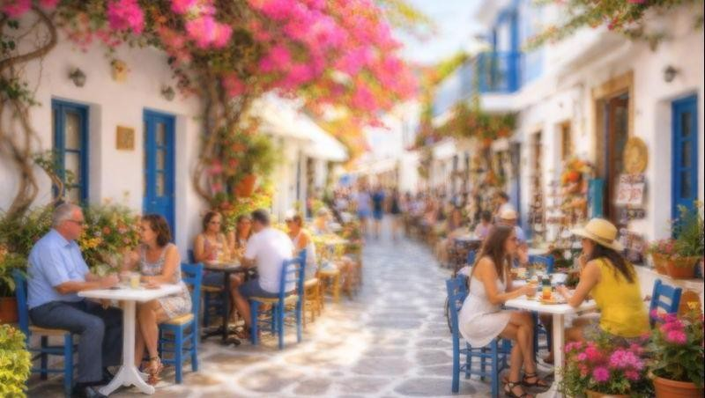
Daily Life in Greece
Sofia-Argyro

Slide 3
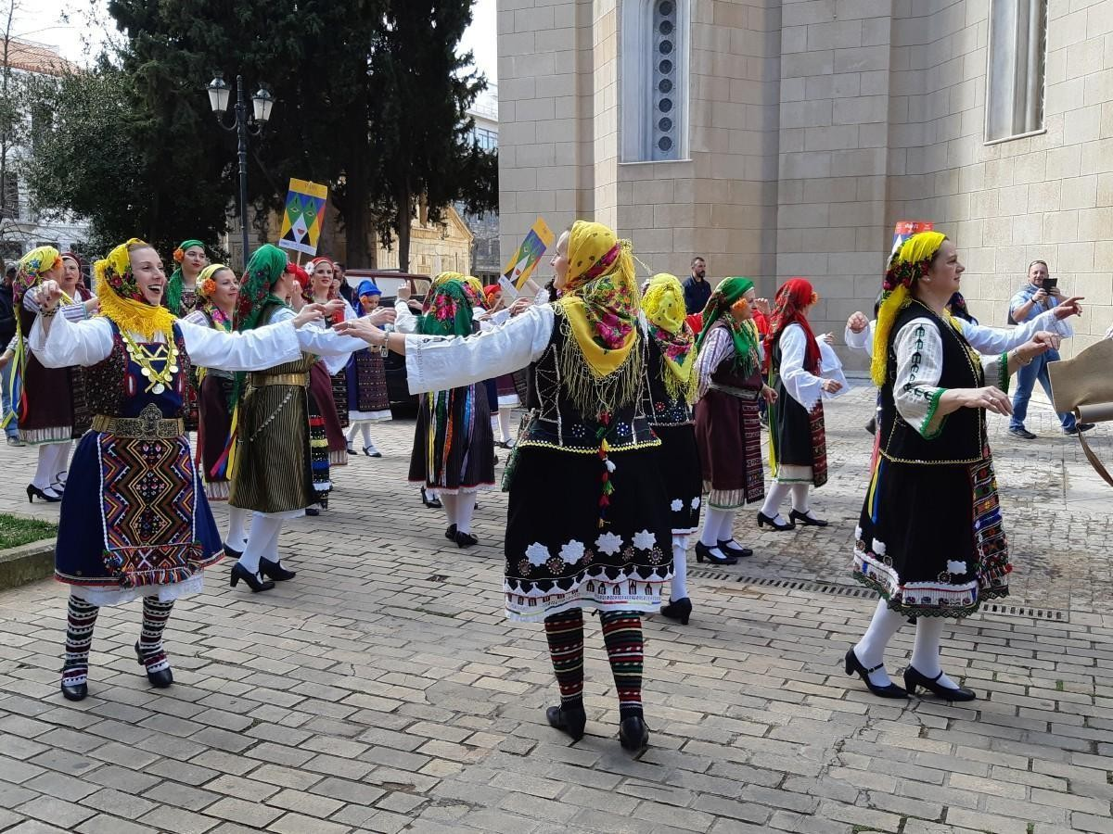
Daily life in Greece is shaped by a balance between modern living and long- standing traditions. Although Greece is a modern European country, many cultural habits have remained unchanged for generations. Family relationships, social interaction, and enjoying everyday moments are considered very important. People often prefer to spend time with others rather than rushing through their daily routines, which creates a more relaxed and social lifestyle.

Slide 4

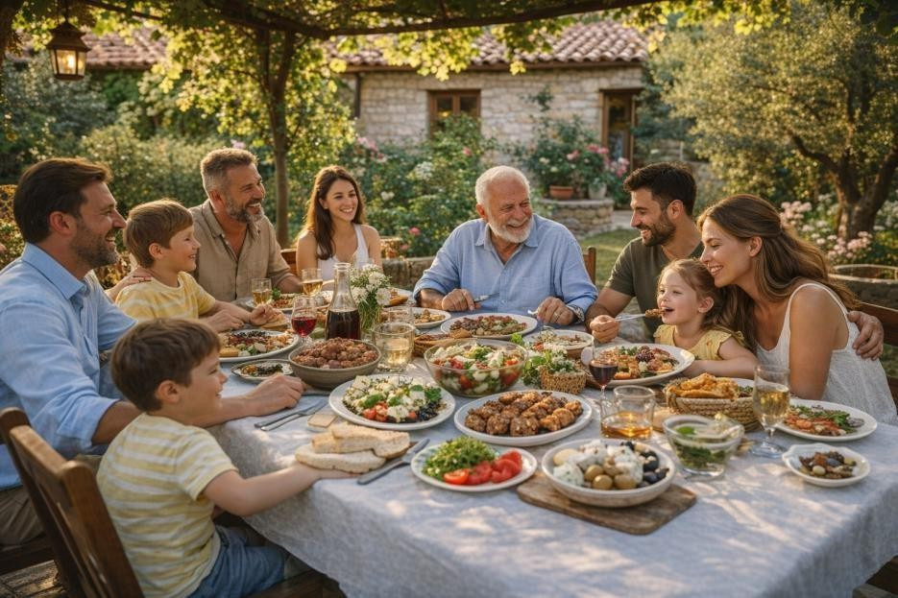
Family life
Family life is one of the most important parts of everyday life in Greece. Greek families are usually very close, and relatives often live near each other or stay in frequent contact. Parents play a strong role in their children’s lives, offering support with school and activities. Grandparents are also very involved and often help with taking care of the children, especially when parents are working. Meals are an important family activity, and many families try to eat together whenever possible. Lunch or dinner is not only about food but also about spending time together, talking about the day, and strengthening relationships. On weekends and holidays, families often gather for larger meals or celebrations, which helps keep traditions alive and brings family members closer together.

Slide 5

School life
School life is an important part of a Greek student’s routine. Most students attend public schools, though there are also private schools. School usually starts early in the morning and finishes in the early afternoon. Students study subjects like Greek language and literature, mathematics, science, history, and foreign languages, especially English. Homework is common, and many students also attend afternoon tutoring or private lessons to prepare for exams. Relationships between classmates are often close, and friendships formed at school can last many years. Teachers are respected, and education is taken seriously, especially in the final years of high school.

Slide 6

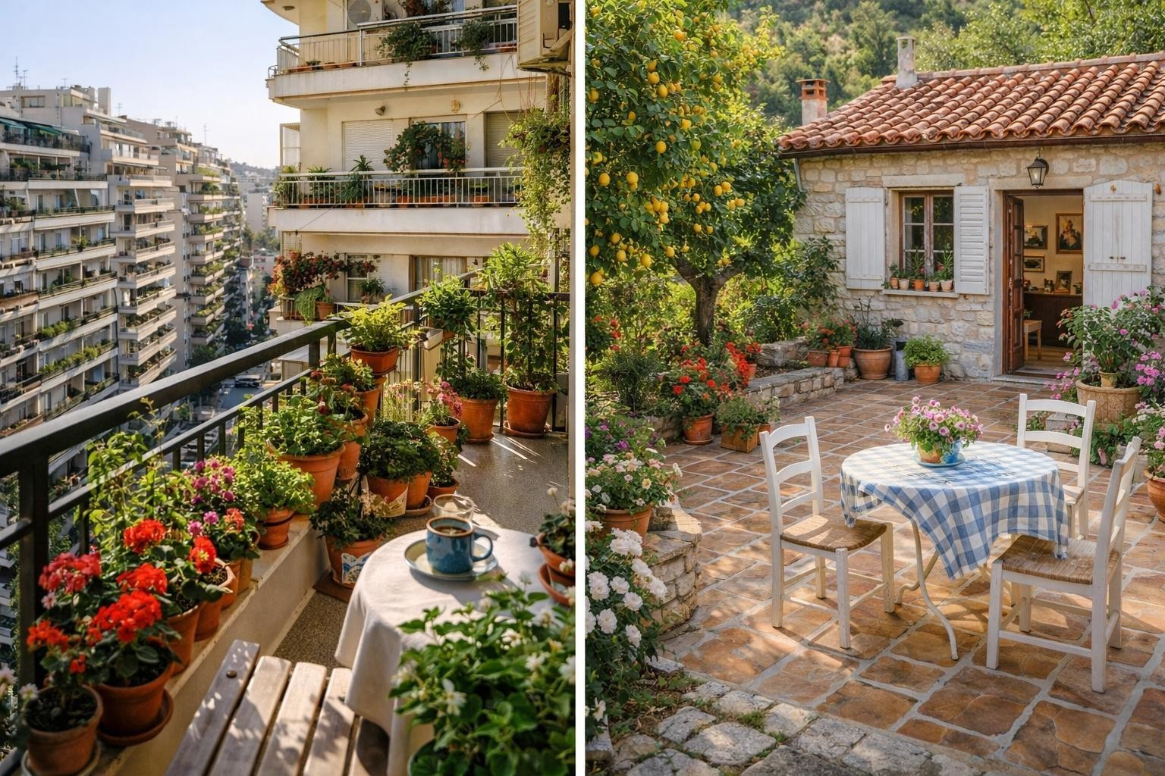
Housing
Housing in Greece depends on whether people live in cities or villages. In cities, most families live in apartments in tall buildings. These apartments often have balconies, which are used to relax, enjoy the fresh air, or grow plants. Even if apartments are small, they are comfortable and practical for everyday life. In villages and smaller towns, people usually live in houses with yards or gardens. Houses are built to stay cool in the hot summer, using thick walls, shutters, and tiled floors. Inside, homes are often decorated with family photos, small ornaments, and sometimes religious items, which make the house feel warm and welcoming.

Slide 7

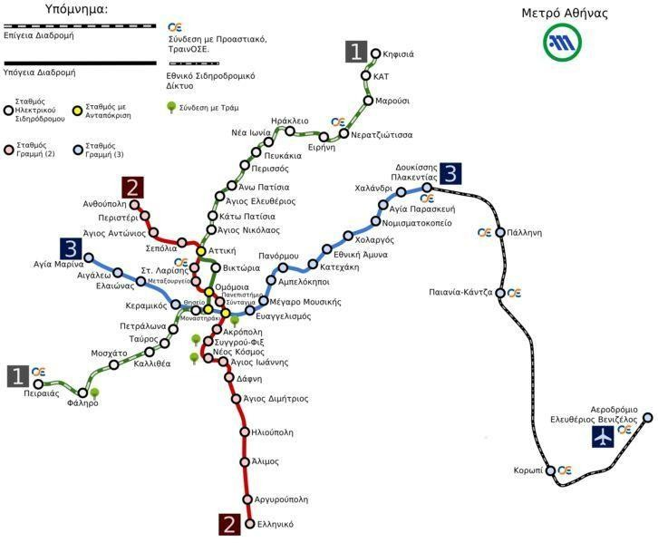
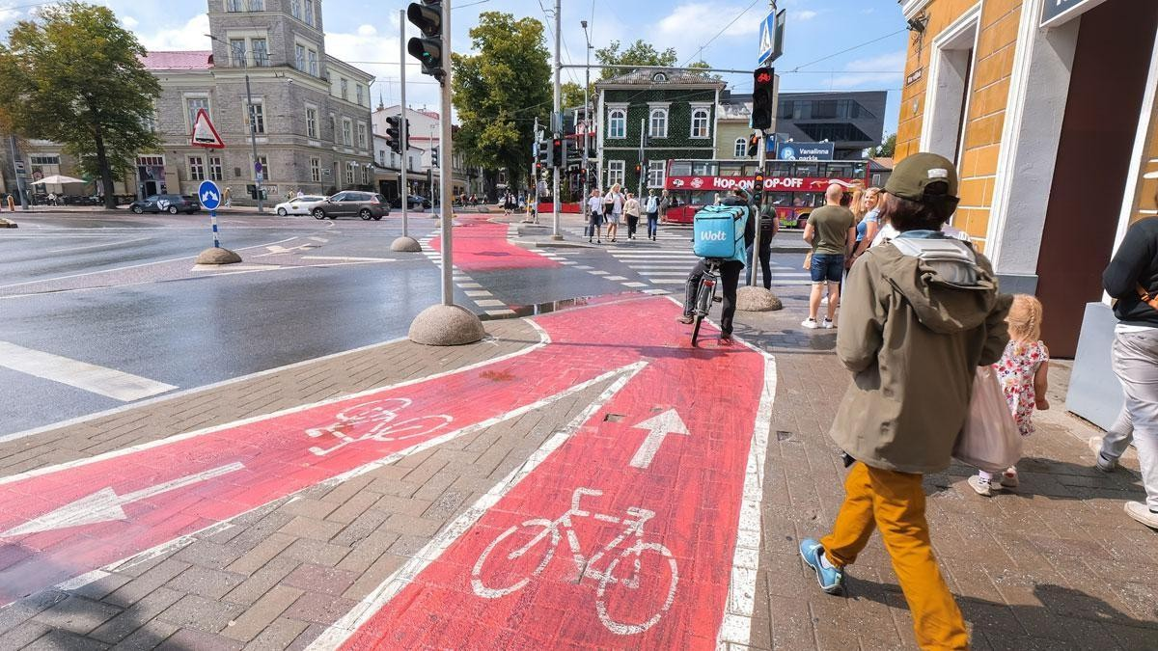
Transportation and cycling
Transportation and cycling depends a lot on where people live. In large cities, people often use public transportation such as buses and metros. Walking is also very common, especially for short distances. Cycling is becoming more popular, particularly among young people, but it is still not as common as in some other European countries. This is partly due to traffic and limited bike lanes, although some cities are working on improved areas for cycling. In smaller towns and islands, people may rely more on walking and cars.

Slide 8

In general, daily life in Greece is social, close to family, and balanced. People value relationships, shared meals, and time spent together. Even with modern responsibilities, Greeks try to enjoy life at a relaxed pace and stay connected to their traditions.

Slide 9



Thank you for your attention!

Slide 10
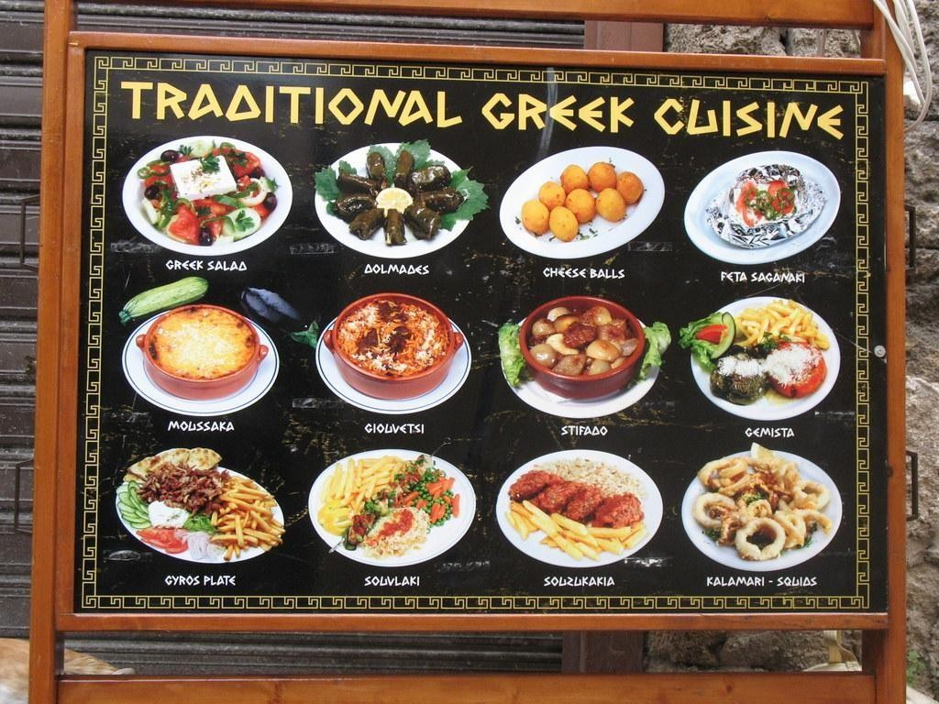
Food and Eating Habits in Greece
Name: Alex, Melina, Marina

Slide 11
Introduction
Food plays an important role in Greek culture and daily life.
Meals are not only about eating but also about spending time with family and friends.
Greek cuisine is connected to history, geography, and tradition.
Most dishes are based on simple and fresh ingredients.
©2025- 2026 Alex, Melina ,Marina — Όμιλος Exploring Cultures Through Teens' eyes Διαθέσιμο με άδεια Creative Commons BY-SA 4.0

Slide 12
Basic Characteristics of Greek Cuisine
Greek food is part of the Mediterranean diet.
Olive oil is the main source of fat.
Fresh vegetables and fruits are widely used.
Legumes such as lentils and beans are common.
Cheese, yogurt, fish, and moderate amounts of meat are included.
©2025- 2026 Alex, Melina ,Marina — Όμιλος Exploring Cultures Through Teens' eyes Διαθέσιμο με άδεια Creative Commons BY-SA 4.0

Slide 13
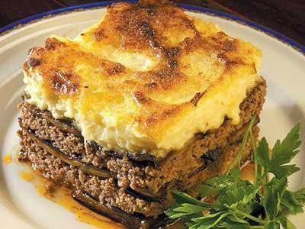
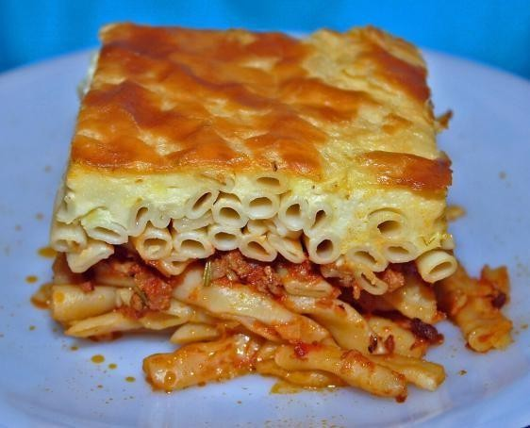

Typical Greek Main Dishes
Moussaka – A baked dish with eggplant, minced meat, and béchamel sauce.
Souvlaki – Grilled meat served on a skewer or inside a type of bread called
pita.
Pastitsio – Baked pasta with minced meat and cream sauce.
Gemista – Tomatoes and peppers stuffed with rice and herbs.
Αυτή η φωτογραφία από Άγνωστος συντάκτης με άδεια χρήσης CC BY-NC-ND
Αυτή η φωτογραφία από Άγνωστος συντάκτης με άδεια χρήσης CC BY-SA
©2025- 2026 Alex, Melina ,Marina — Όμιλος Exploring Cultures Through Teens' eyes Διαθέσιμο με άδεια Creative Commons BY-SA 4.0

Slide 14

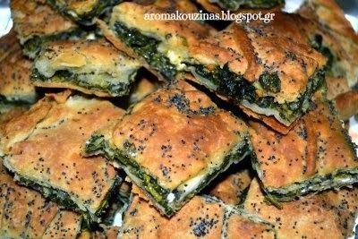
Traditional Snacks and Street Food
Tiropita(Cheesepie) – A pie filled with cheese and wrapped in filo pastry.
Spanakopita – A pie filled with spinach and feta cheese.
Gyros – Meat cooked on a vertical rotisserie and served in pita bread.
These snacks are popular for breakfast or lunch.
Αυτή η φωτογραφία από Άγνωστος συντάκτης
με άδεια χρήσης CC BY-NC-ND
Αυτή η φωτογραφία από Άγνωστος συντάκτης με άδεια χρήσης CC BY-NC-ND
©2025- 2026 Alex, Melina ,Marina — Όμιλος Exploring Cultures Through Teens' eyes Διαθέσιμο με άδεια Creative Commons BY-SA 4.0

Slide 15
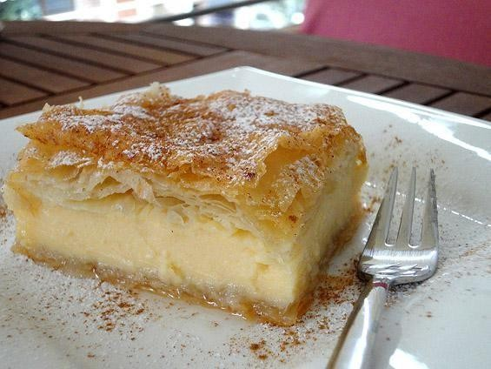
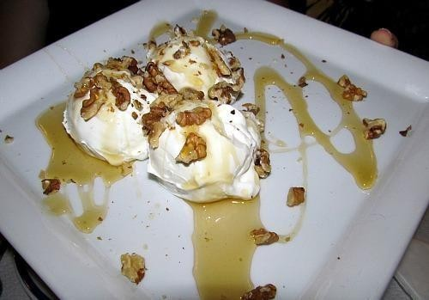
Greek Desserts
Baklava – A dessert made with filo pastry, nuts, and syrup.
Galaktoboureko – A pie filled with custard and covered in syrup.
Greek yogurt with honey and walnuts is also popular.
Many desserts are prepared during holidays and celebrations.
Αυτή η φωτογραφία από Άγνωστος συντάκτης με άδεια χρήσης
CC BY-NC-ND
Αυτή η φωτογραφία από Άγνωστος συντάκτης με άδεια χρήσης
CC BY
©2025- 2026 Alex, Melina ,Marina — Όμιλος Exploring Cultures Through Teens' eyes Διαθέσιμο με άδεια Creative Commons BY-SA 4.0

Slide 16
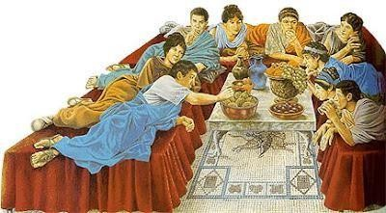
Eating Habits in Greece
Breakfast is usually light (coffee, toast, or pie).
Lunch is eaten in the early afternoon. Dinner is usually after 8:00 or 9:00 PM.
Family meals and Sunday gatherings are very important and common in Greek culture.
Αυτή η φωτογραφία από Άγνωστος συντάκτης με άδεια χρήσης CC BY-NC-ND

Slide 17
Unwritten rules when eating in a Greek household
- When eating in a Greek household as a stranger you get served and treated like you belong to the family.
-No one remains hungry and there is always enough food for a second plate of food(especially if the Greek Yiayia took care of the cooking)
*Yiayia means grandma and Pappous means Grandpa
©2025- 2026 Alex, Melina ,Marina — Όμιλος Exploring Cultures Through Teens' eyes Διαθέσιμο με άδεια Creative Commons BY-SA 4.0

Slide 18
Conclusion
Greek food is an important part of Greek culture and identity.
It is based on fresh ingredients and traditional recipes.
Eating in Greece is about connection, family, and tradition.
©2025- 2026 Alex, Melina ,Marina — Όμιλος Exploring Cultures Through Teens' eyes Διαθέσιμο με άδεια Creative Commons BY-SA 4.0

