Slide 1

Dresden: A Journey Through History and Culture

Slide 2

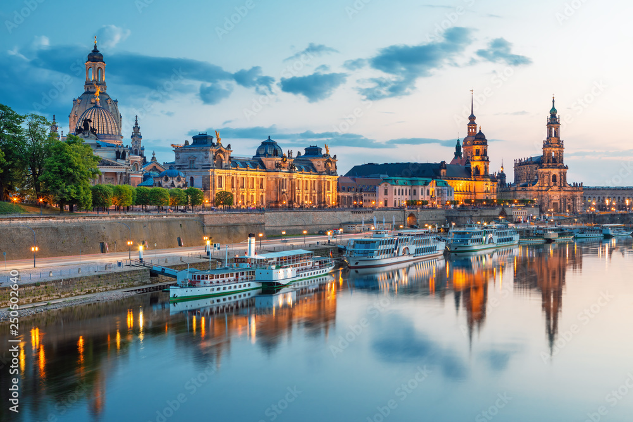
Welcome to Dresden
Located in eastern Germany, Saxony region
Rich historical and cultural significance
Known as the "Florence of the Elbe"
Renowned for art, architecture, and resilience
Notes:
Image from: https://stock.adobe.com/images/beautiful-dresden-city-skyline-at-elbe-river-and-augustus-bridge-dresden-saxony-germany/250502640

Slide 3
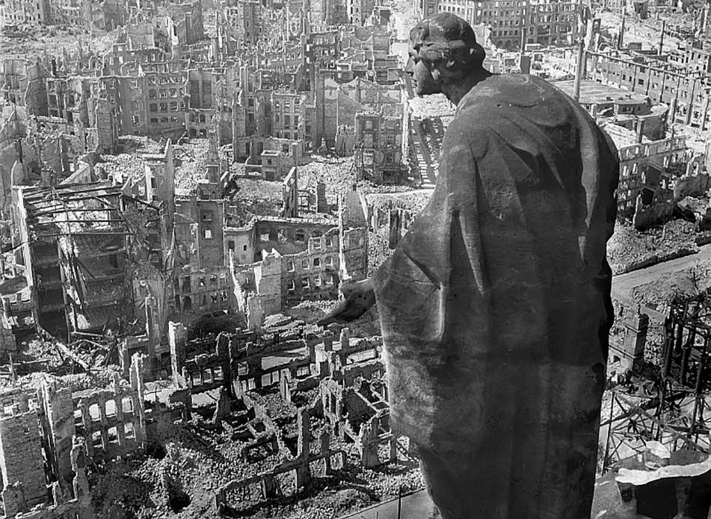
Historical Background
Founded in the 13th century as a small town
Became capital of Saxon royal kingdom
Suffered massive destruction during World War II
Extensively rebuilt and restored after reunification
Notes:
Image from: https://www.nationalww2museum.org/war/articles/apocalypse-dresden-february-1945

Slide 4
Frauenkirche: Symbol of Reconciliation
Iconic baroque church in city center
Completely destroyed during 1945 bombing
Rebuilt between 1994-2005
Represents peace and reconstruction
Now a memorial and active church

Slide 5
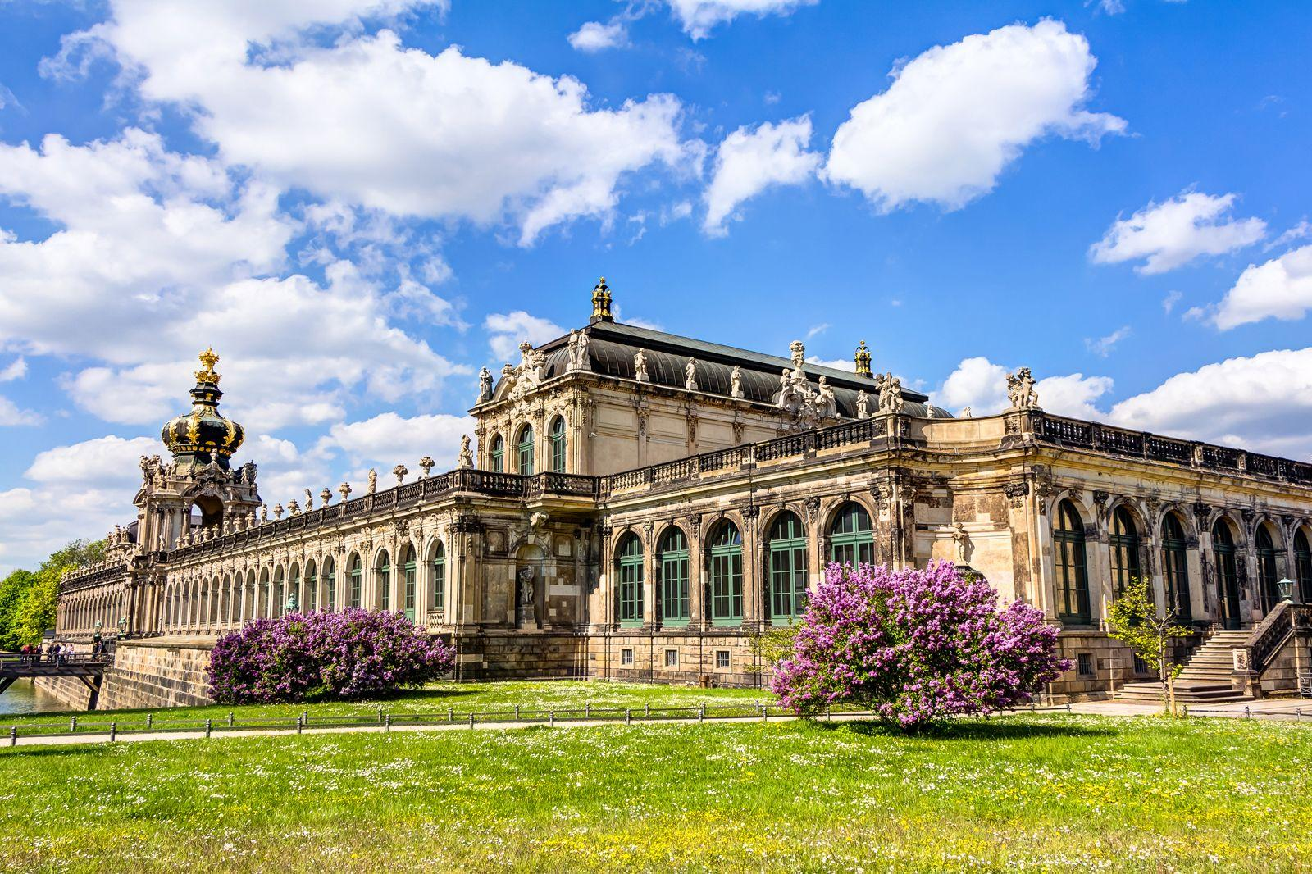
Zwinger Palace: Baroque Masterpiece
Magnificent baroque palace complex
Built in early 18th century
Houses multiple museums
Features stunning gardens and courtyards
Designed by Matthäus Daniel Pöppelmann
Notes:
Image from: https://www.britannica.com/topic/Zwinger

Slide 6
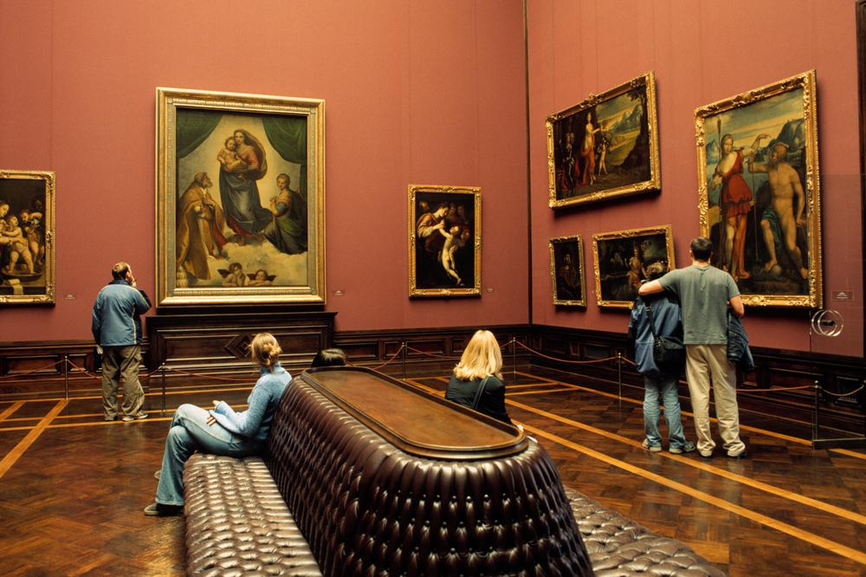
Dresden's Art Collections
Home to world-famous art museums
Old Masters Picture Gallery
Green Vault (historic royal treasure chamber)
Extensive collection of European masterpieces
Significant cultural and artistic heritage
Notes:
Image from: https://visitsaxony.com/poi/old-masters-gallery-and-sculpture-collection-till-1800-dresden

Slide 7
Royal Palace of Dresden
Former residence of Saxon monarchs
Gothic and Renaissance architectural styles
Now a museum complex
Houses important historical artifacts
Symbolizes Dresden's royal history

Slide 8
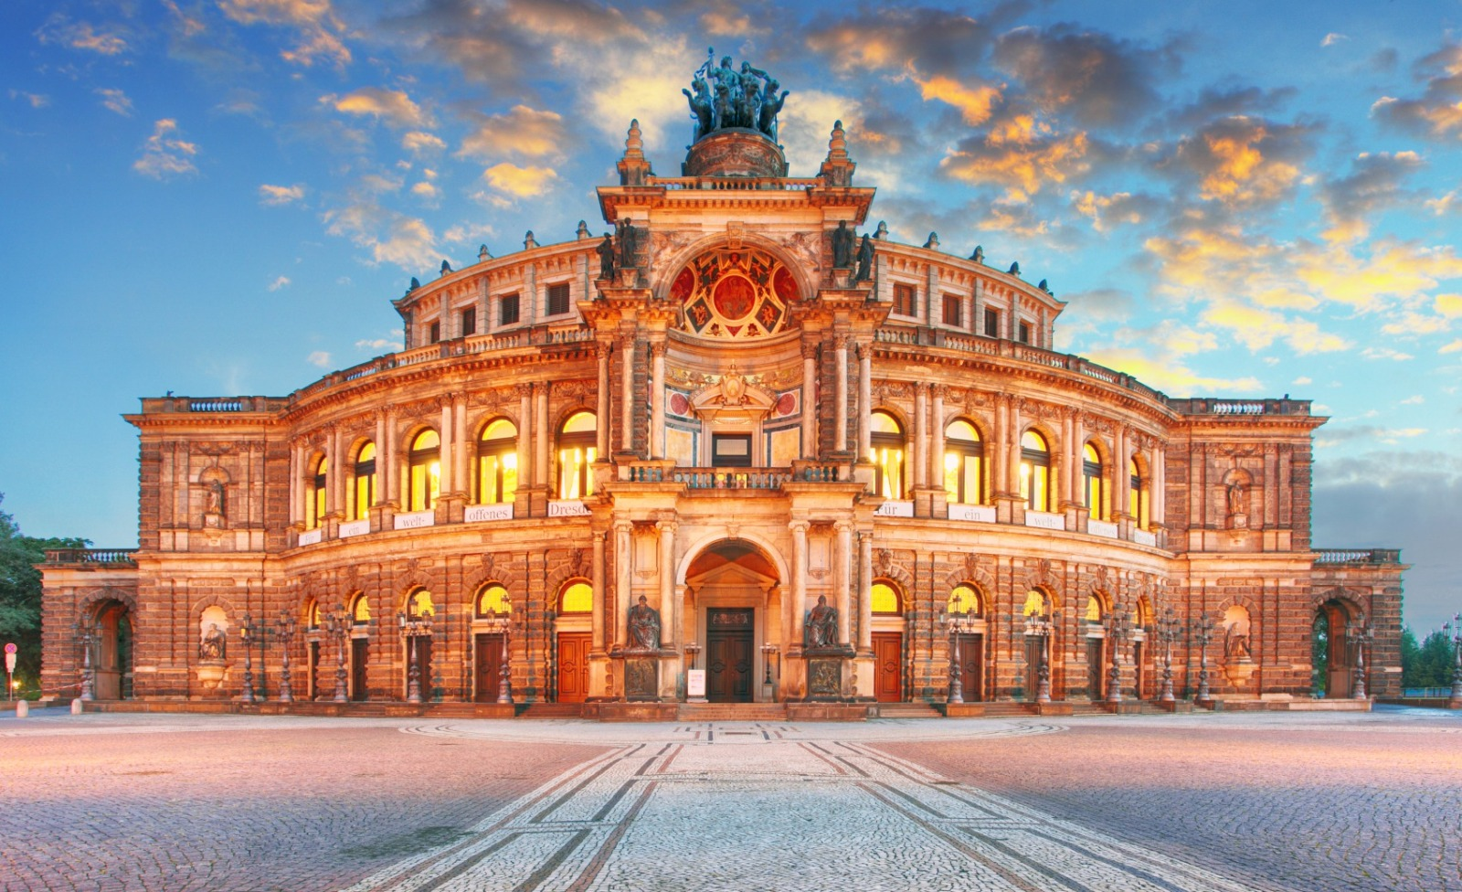
Cultural Significance
Strong musical and artistic traditions
Dresden State Opera renowned worldwide
Home to famous composers and musicians
Vibrant contemporary cultural scene
Annual festivals and cultural events
Notes:
Image from: https://www.opera-charm.com/articles/semperoper-dresden/

Slide 9
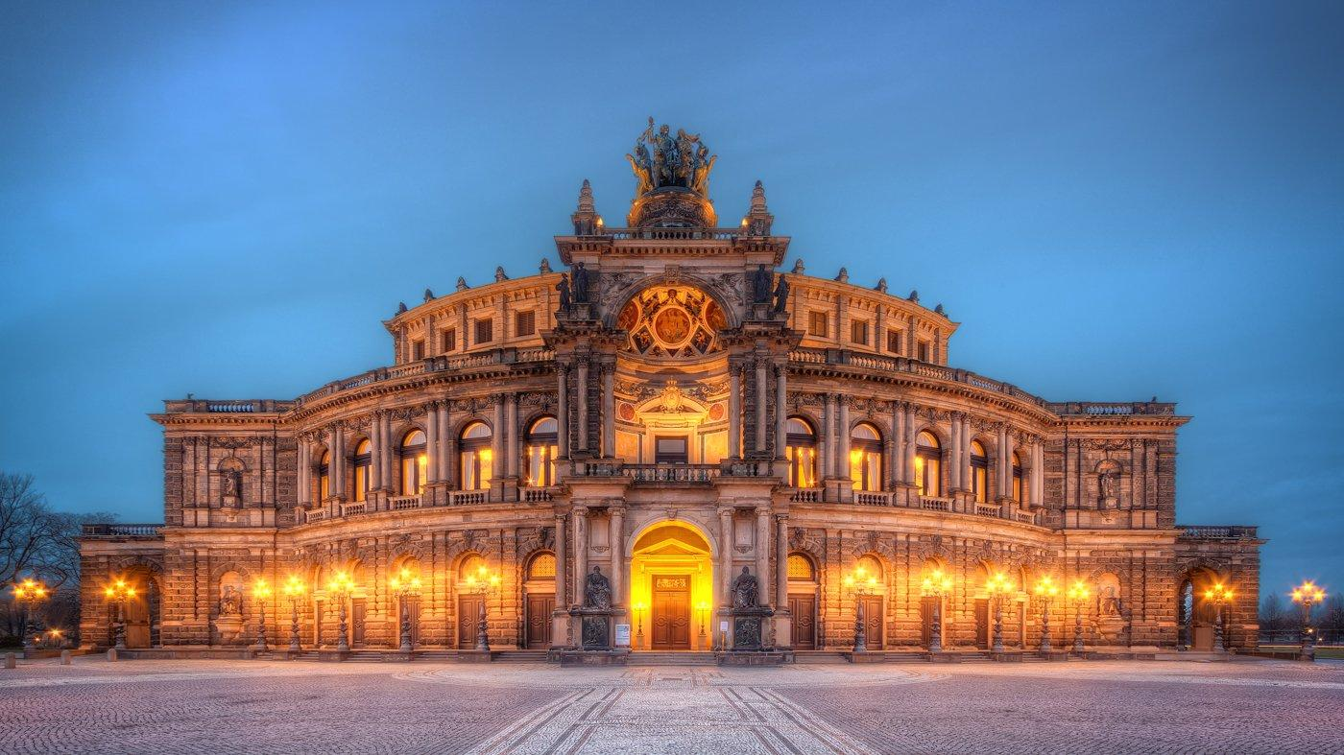
Semperoper: Opera House
Stunning 19th-century opera house
Designed by Gottfried Semper
Destroyed and rebuilt multiple times
World-class performance venue
Architectural and musical landmark
Notes:
Image from: https://sumfinity.com/photos/photos/germany/dresden/semperoper-opera-house/

Slide 10
Natural Beauty
Beautiful location along Elbe River
Numerous parks and green spaces
Great Garden (Großer Garten) historic park
Scenic walking and cycling routes
Blend of urban and natural landscapes

Slide 11
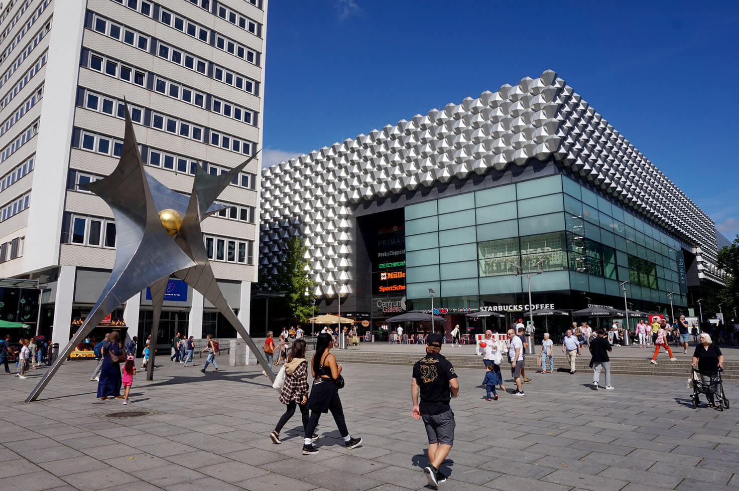
Modern Dresden
Thriving modern technology hub
Strong research and innovation center
Growing economic importance
Balances historical preservation with progress
Attractive destination for young professionals
Notes:
Image from: https://happyfrogtravels.com/top-dresden-attractions-architecture/

Slide 12
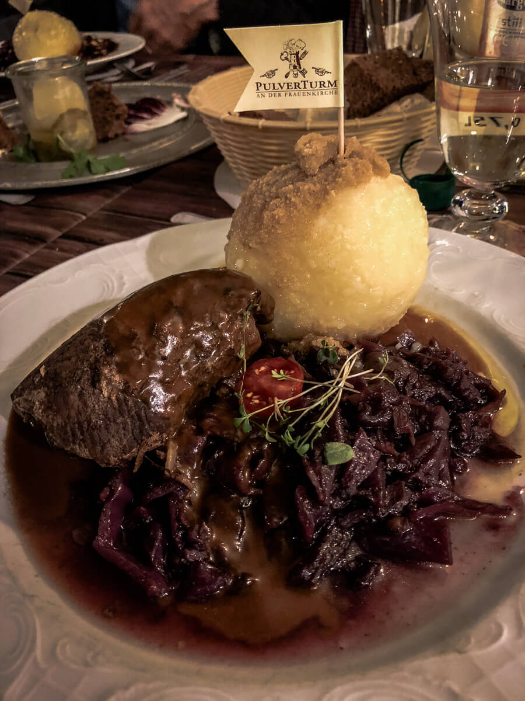
Culinary Traditions
Famous for traditional Saxon cuisine
Dresdner Christstollen (Christmas cake)
Local beer and wine traditions
Hearty regional dishes
Vibrant food and restaurant culture
Notes:
Image from: https://theculinarytravelguide.com/where-to-eat-in-dresden/

Slide 13
Christmas Market Tradition
Oldest Christmas market in Germany
Striezelmarkt dating back to 1434
Unique holiday atmosphere
Traditional crafts and foods
Major tourist attraction

Slide 14
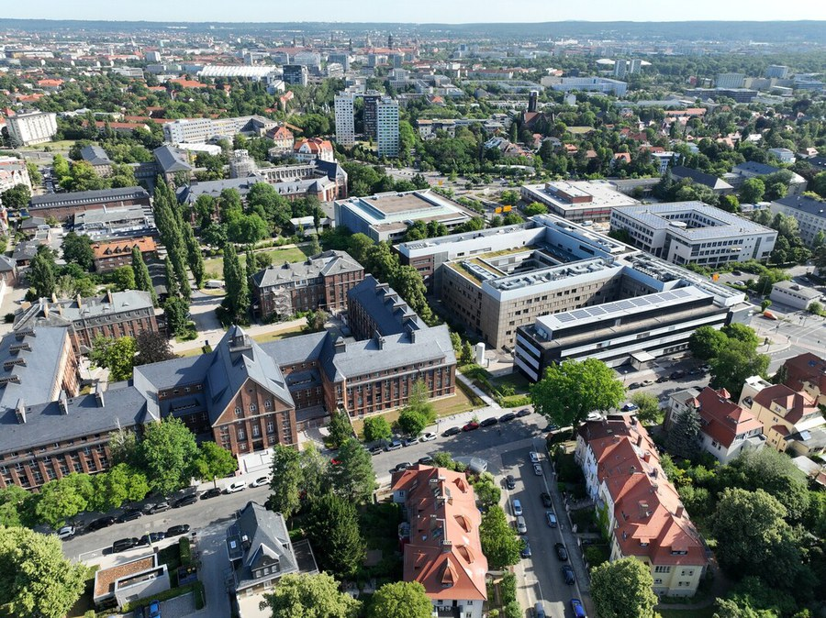
Educational Institutions
Dresden Technical University
Multiple research institutions
Strong focus on science and technology
International student population
Innovation and academic excellence
Notes:
Image from: https://tu-dresden.de/tu-dresden/profil/zahlen-und-fakten?set_language=en

Slide 15
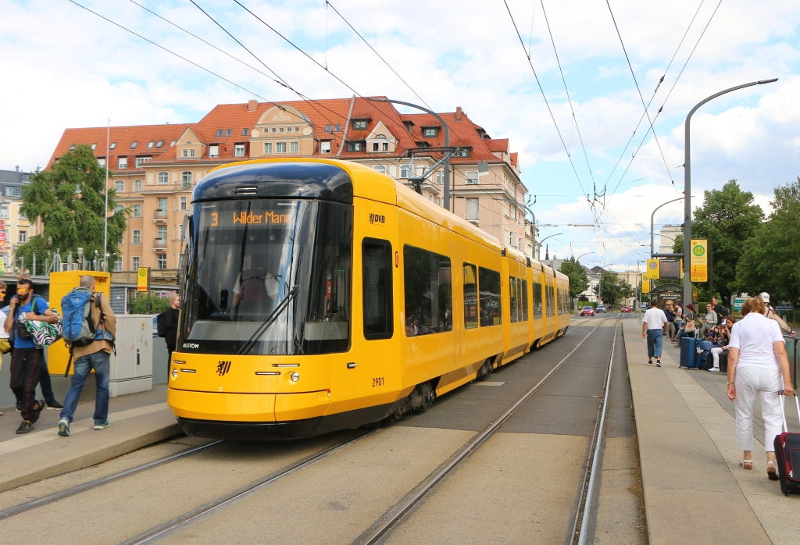
Transportation and Accessibility
Excellent public transportation system
Trams and buses covering entire city
Connected to major German rail networks
Close to Czech and Polish borders
Easy international travel connections
Notes:
Image from: https://www.urban-transport-magazine.com/en/now-40-new-trams-for-dresden-additional-order-for-alstom/

Slide 16
Dresden Today
Vibrant, modern European city
Successfully blends history and innovation
Major cultural and economic center
Symbol of resilience and reconstruction
Continues to inspire visitors worldwide

