Slide 1

Famous Historical and Cultural Figures of Germany

Slide 2

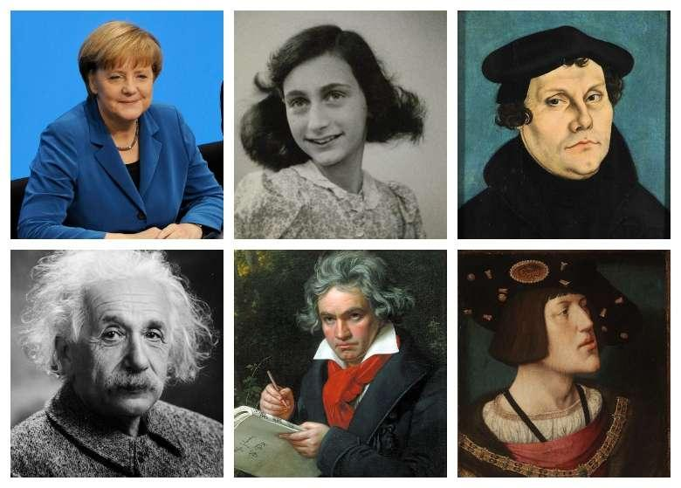
Introduction to German Influential Figures
Germany has produced numerous influential figures across various fields
We'll explore remarkable individuals who shaped world history and culture
Our journey will cover scientists, philosophers, artists, and leaders
Each figure represents a unique contribution to global knowledge
Notes:
Image from: https://www.thetravelbuglife.com/famous-germans-in-history/

Slide 3
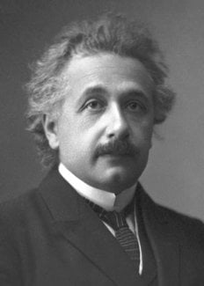
Albert Einstein: Scientific Genius
Born in Ulm, Germany in 1879
Developed the theory of relativity
Nobel Prize winner in Physics
Revolutionized understanding of space, time, and gravity
Notes:
Image from: https://www.nobelprize.org/prizes/physics/1921/einstein/biographical/

Slide 4
Karl Marx: Philosophical Revolutionary
Born in Trier, Germany in 1818
Founder of modern communist philosophy
Wrote "The Communist Manifesto"
Profoundly influenced political and economic thought worldwide

Slide 5
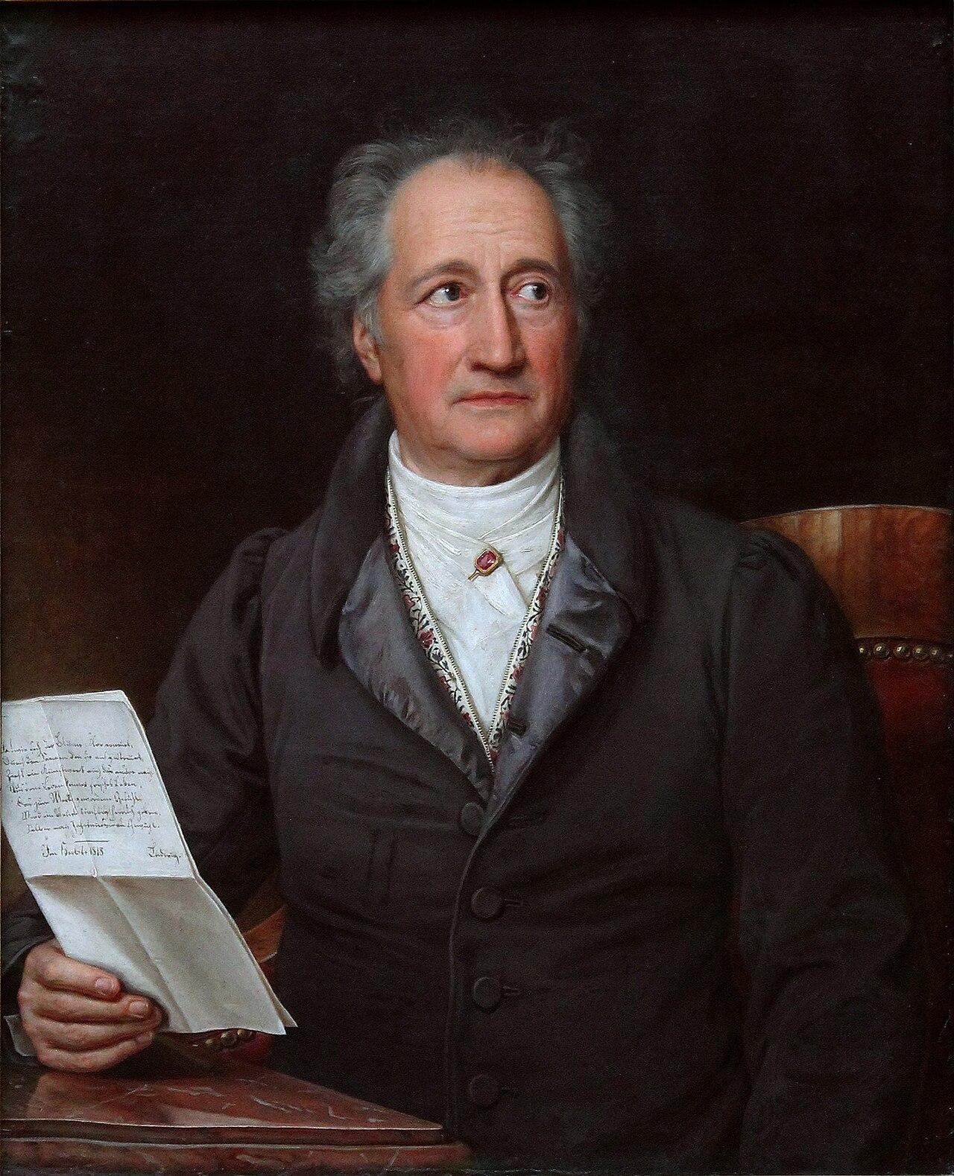
Johann Wolfgang von Goethe: Literary Master
Renowned poet, novelist, and playwright
Wrote "Faust", a landmark of German literature
Key figure of the Weimar Classicism movement
Significant contributor to world literature
Notes:
Image from: https://en.wikipedia.org/wiki/Johann_Wolfgang_von_Goethe

Slide 6
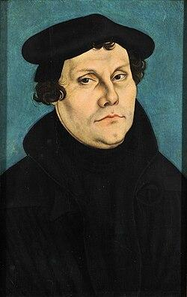
Martin Luther: Religious Reformer
Initiated the Protestant Reformation in 1517
Translated the Bible into German
Challenged Catholic Church practices
Fundamental figure in Christian religious history
Notes:
Image from: https://en.wikipedia.org/wiki/Martin_Luther

Slide 7
Beethoven: Musical Genius
Revolutionary classical music composer
Composed despite progressive hearing loss
Created symphonies like "Ode to Joy"
Bridged Classical and Romantic musical periods

Slide 8
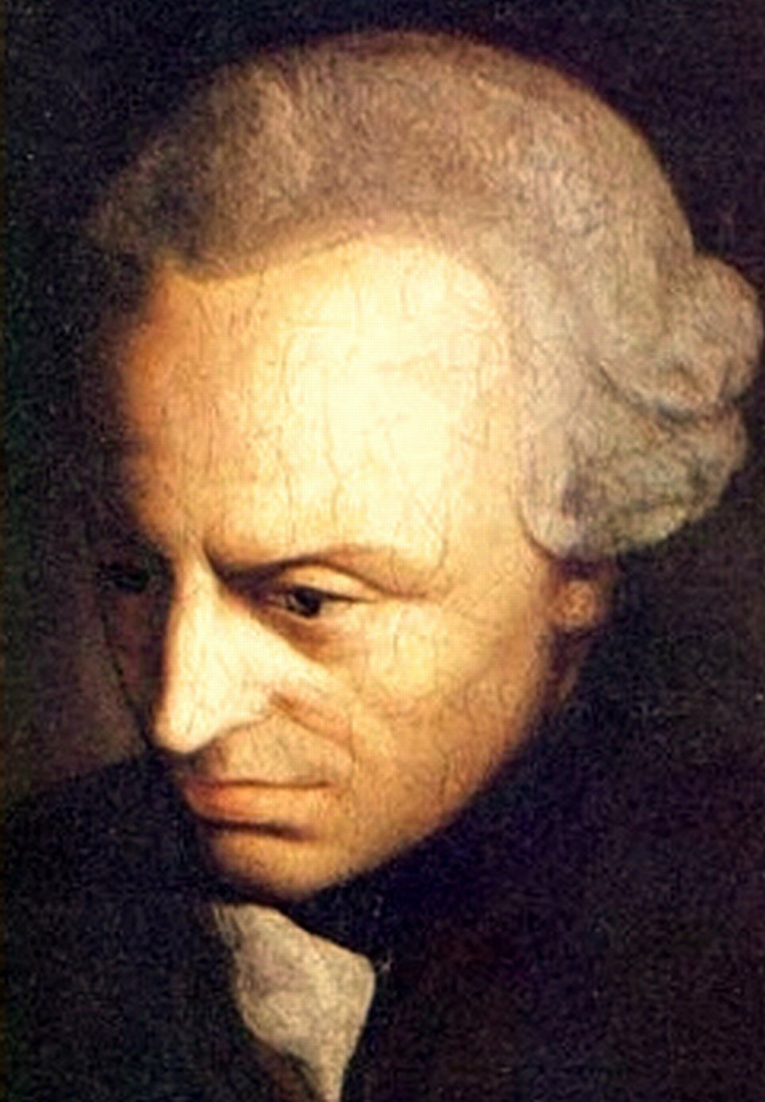
Immanuel Kant: Philosophical Innovator
Influential Enlightenment philosopher
Developed critical philosophy approach
Wrote "Critique of Pure Reason"
Explored ethics, metaphysics, and human knowledge
Notes:
Image from: https://commons.wikimedia.org/wiki/File:Immanuel_Kant_(painted_portrait).jpg

Slide 9
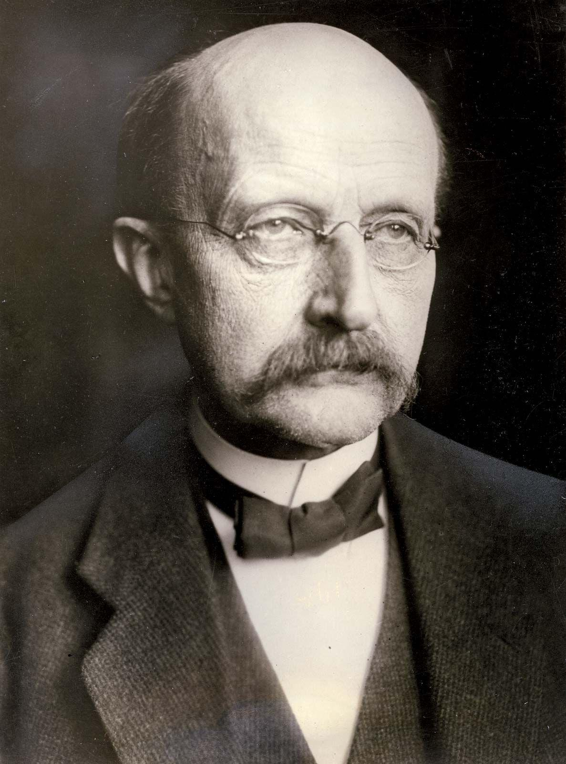
Max Planck: Quantum Physics Pioneer
Founder of quantum theory
Nobel Prize winner in Physics
Developed quantum mechanics principles
Transformed understanding of atomic structures
Notes:
Image from: https://www.britannica.com/biography/Max-Planck

Slide 10
Marlene Dietrich: Cultural Icon
Internationally renowned actress and singer
Pioneered gender-challenging performance styles
Hollywood and European cinema star
Advocate against Nazi regime

Slide 11
Conclusion: Germany's Global Impact
These figures demonstrate Germany's rich intellectual history
Contributions span science, arts, philosophy, and culture
Their work continues to influence global understanding
Celebrate diversity of human achievement

