Slide 1
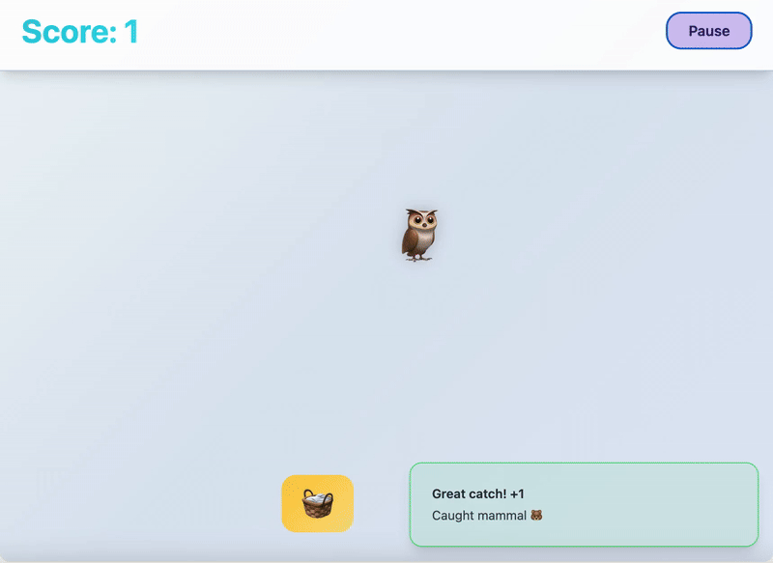
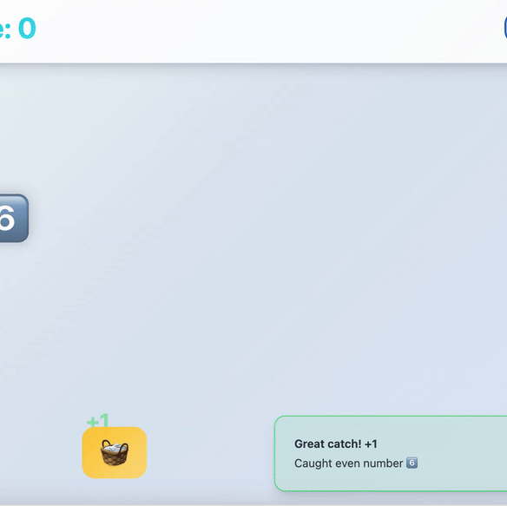
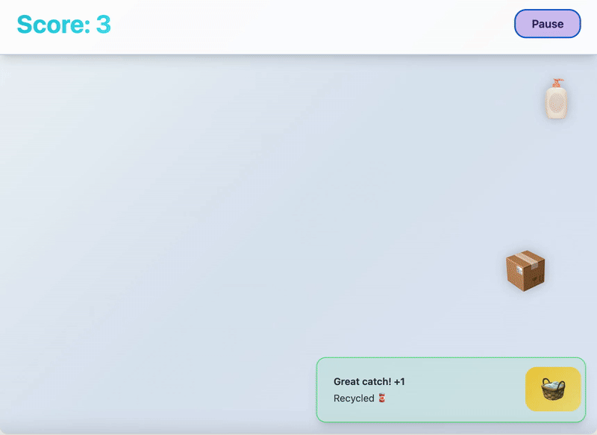
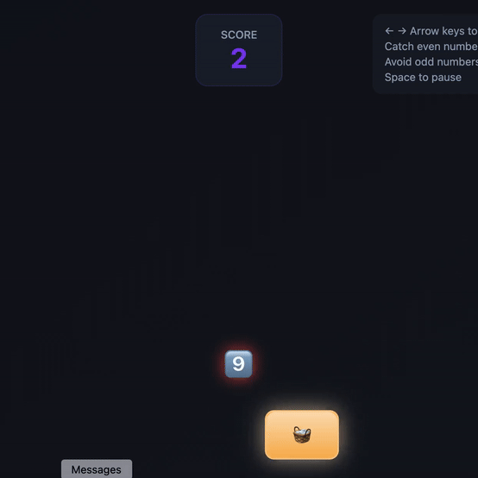
VIBE CODING: BUILD YOUR FIRST GAME USING AI
MATERIALS:
📘 Setup Guide
📕 Lesson Plan
📹 Walkthrough Video
⚙️ Troubleshooting Guide
👉 Teaching Slides
Notes:
Setup Guide is available here: Hour of AI - Vibe Coding: Build your First Game Using AI - Setup Guide
Lesson Plan is available here: Hour of AI - Vibe Coding: Build Your First Game Using AI - Lesson Plan

Slide 2
Learn what vibe coding is and what it can do.
Create and publish an educational catching game!

Slide 3
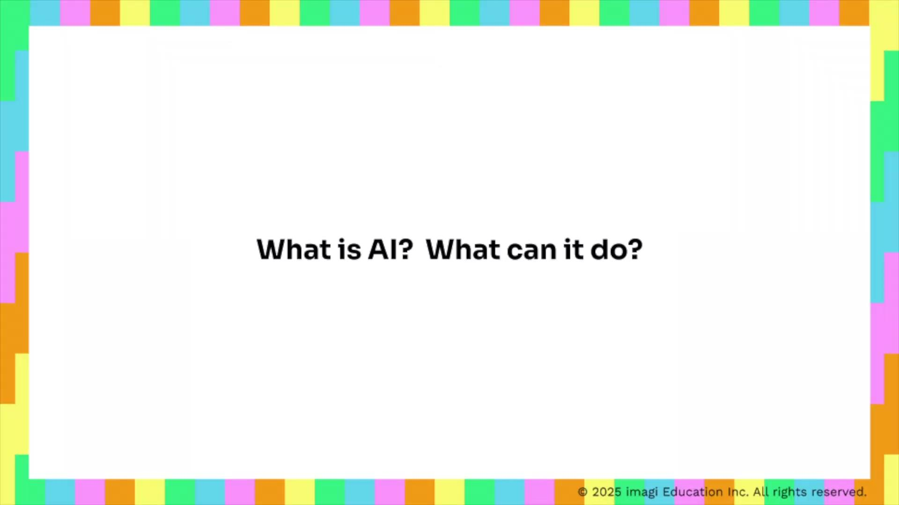
Introduction to AI and Vibe Coding
Notes:
This video covers and can be a substitute for slides 4-10 (up till the discussion).
Below is the video script:
Video 1: Introduction to AI and Vibe Coding + tic tac toe demo + other vibe coding examples demo
What do you know about AI and what it can do?
AI, or Artificial Intelligence, refers to computer systems that can perform complex tasks normally done by humans—things like reasoning, decision-making, or creating. (source) You’ve probably already used some AI tools, like ChatGPT or image generators. But did you know that AI can also write code and build apps for you? That’s called vibe coding.
Vibe coding is a new way of creating with AI. Instead of writing lines of code yourself, you can just tell AI what program you want to make, and it will build it for you.
Let’s try it out together. Imagine you want a tic-tac-toe game. On a vibe coding platform called Lovable, you can type into the chat box: “Please build a tic tac toe game for me.” And just like that—the game is generated! Pretty cool, right?
Now, what if something isn’t quite right or you want to add your own twist? You can simply ask AI to make changes. For example, you could add instructions for players who are new to tic tac toe, or even swap the X’s and O’s for leaves and flowers to give the game a fun new look. [show demo]
Keep in mind, AI’s first try might not be perfect—and that’s completely normal. Working with AI is a bit like working with a person: you need clear communication, patience, and sometimes a few clarifications. Think of it as a back-and-forth process where you improve the game step by step.
Now, you might be wondering: If AI can code for me, do I still need to learn coding?
The answer is yes! Vibe coding is powerful, but it does have limitations:
First: it’s great for small or medium projects, but when things get large and complicated—like apps that handle tons of user data—AI often struggles. That’s where human coders are essential.
Second: it’s hard to vibe code brand-new ideas. Imagine you invent a game mechanic that doesn’t exist yet. Without clear examples, AI won’t always know how to build it.
Third: AI sometimes makes mistakes—even serious ones like security flaws. If your project involves sensitive data, payments, or privacy, you need to understand what the code is really doing.
AI is improving fast, and it’s only going to get better. But here’s the big picture: And the more you learn about coding and computational thinking, the better you can leverage the AI tools, and more powerful your projects can become. Coding isn’t just about writing programs—it builds your confidence in testing, iterating, and understanding what AI creates. Plus, it strengthens problem-solving and logical thinking skills that you’ll use everywhere in life.
So, what can vibe coding do for you right now?
If you already know coding, it can boost your productivity.
If you’re just starting, it gives you a chance to create simple projects quickly and easily—making programming more accessible.
Let’s check out some other projects you could make besides tic tac toe!
This is a memory game where you match codes and the pixel arts they create
You can make A Mario-style platformer for fun,
An inspiring tool that turns your pictures into creative costume ideas
A to-do list app to keep track of your homework
Or even a website to showcase your favorite artists
Some people have even turned their vibe-coded projects into successful businesses!
The possibilities are endless. So here’s the big question: What would you want to build with this tool?

Slide 4
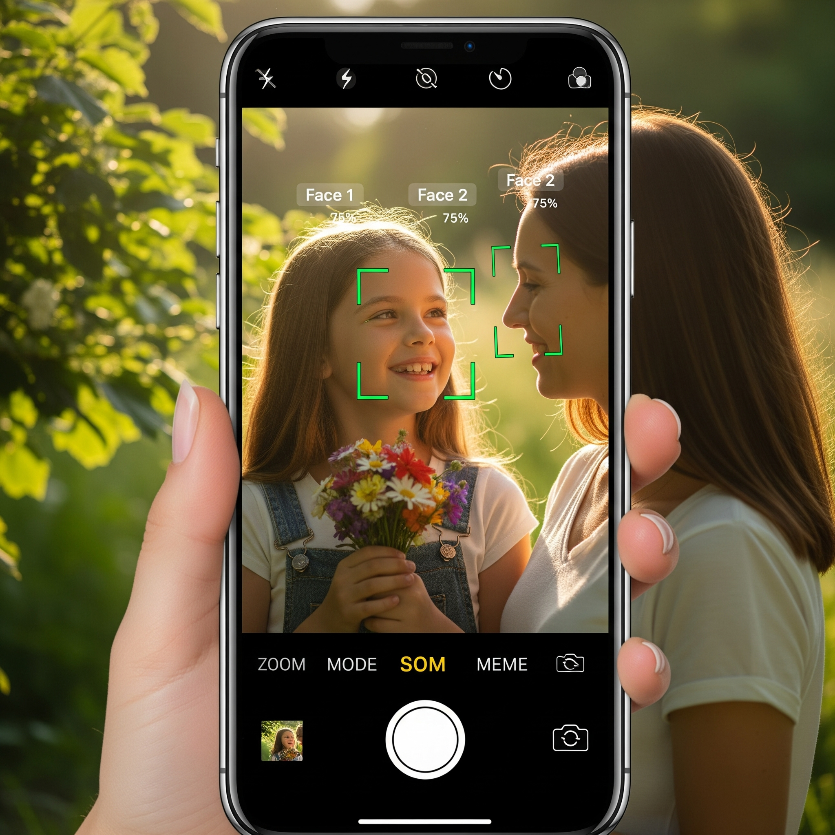
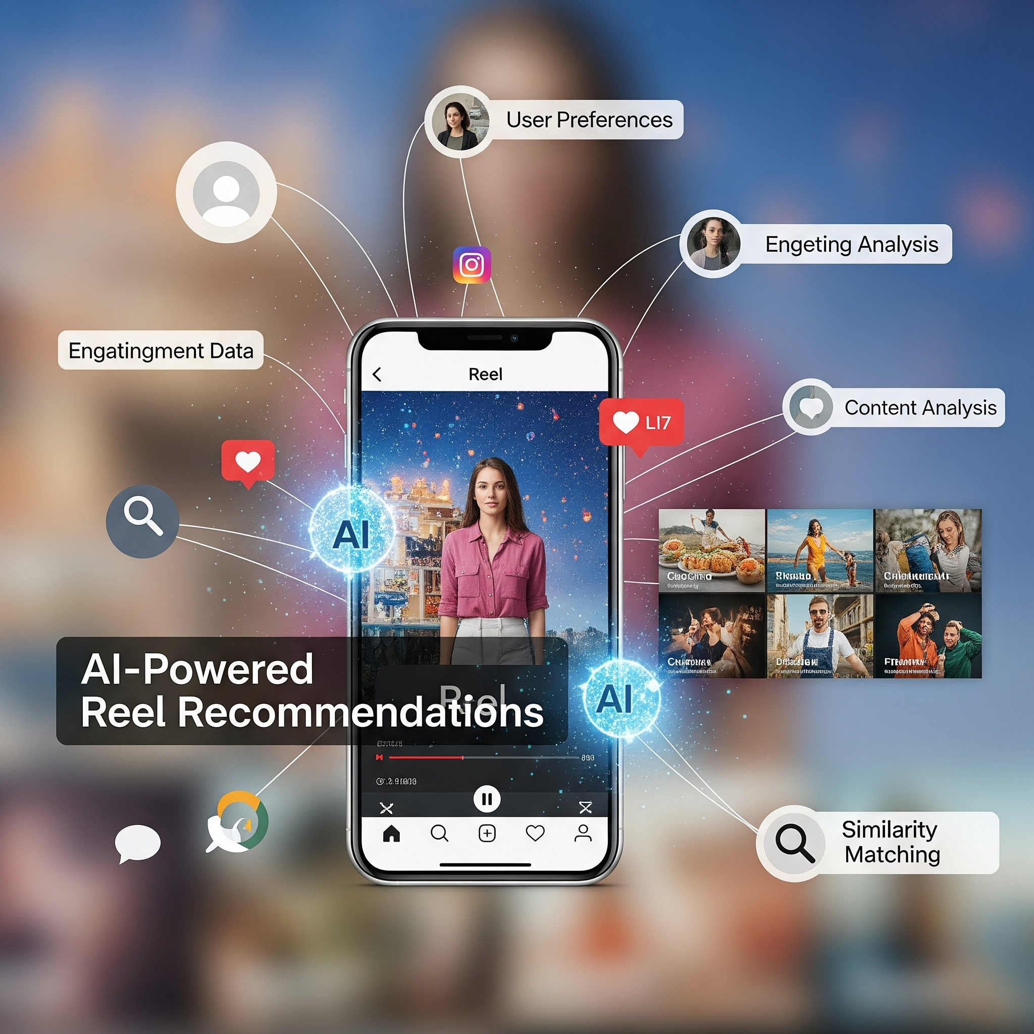
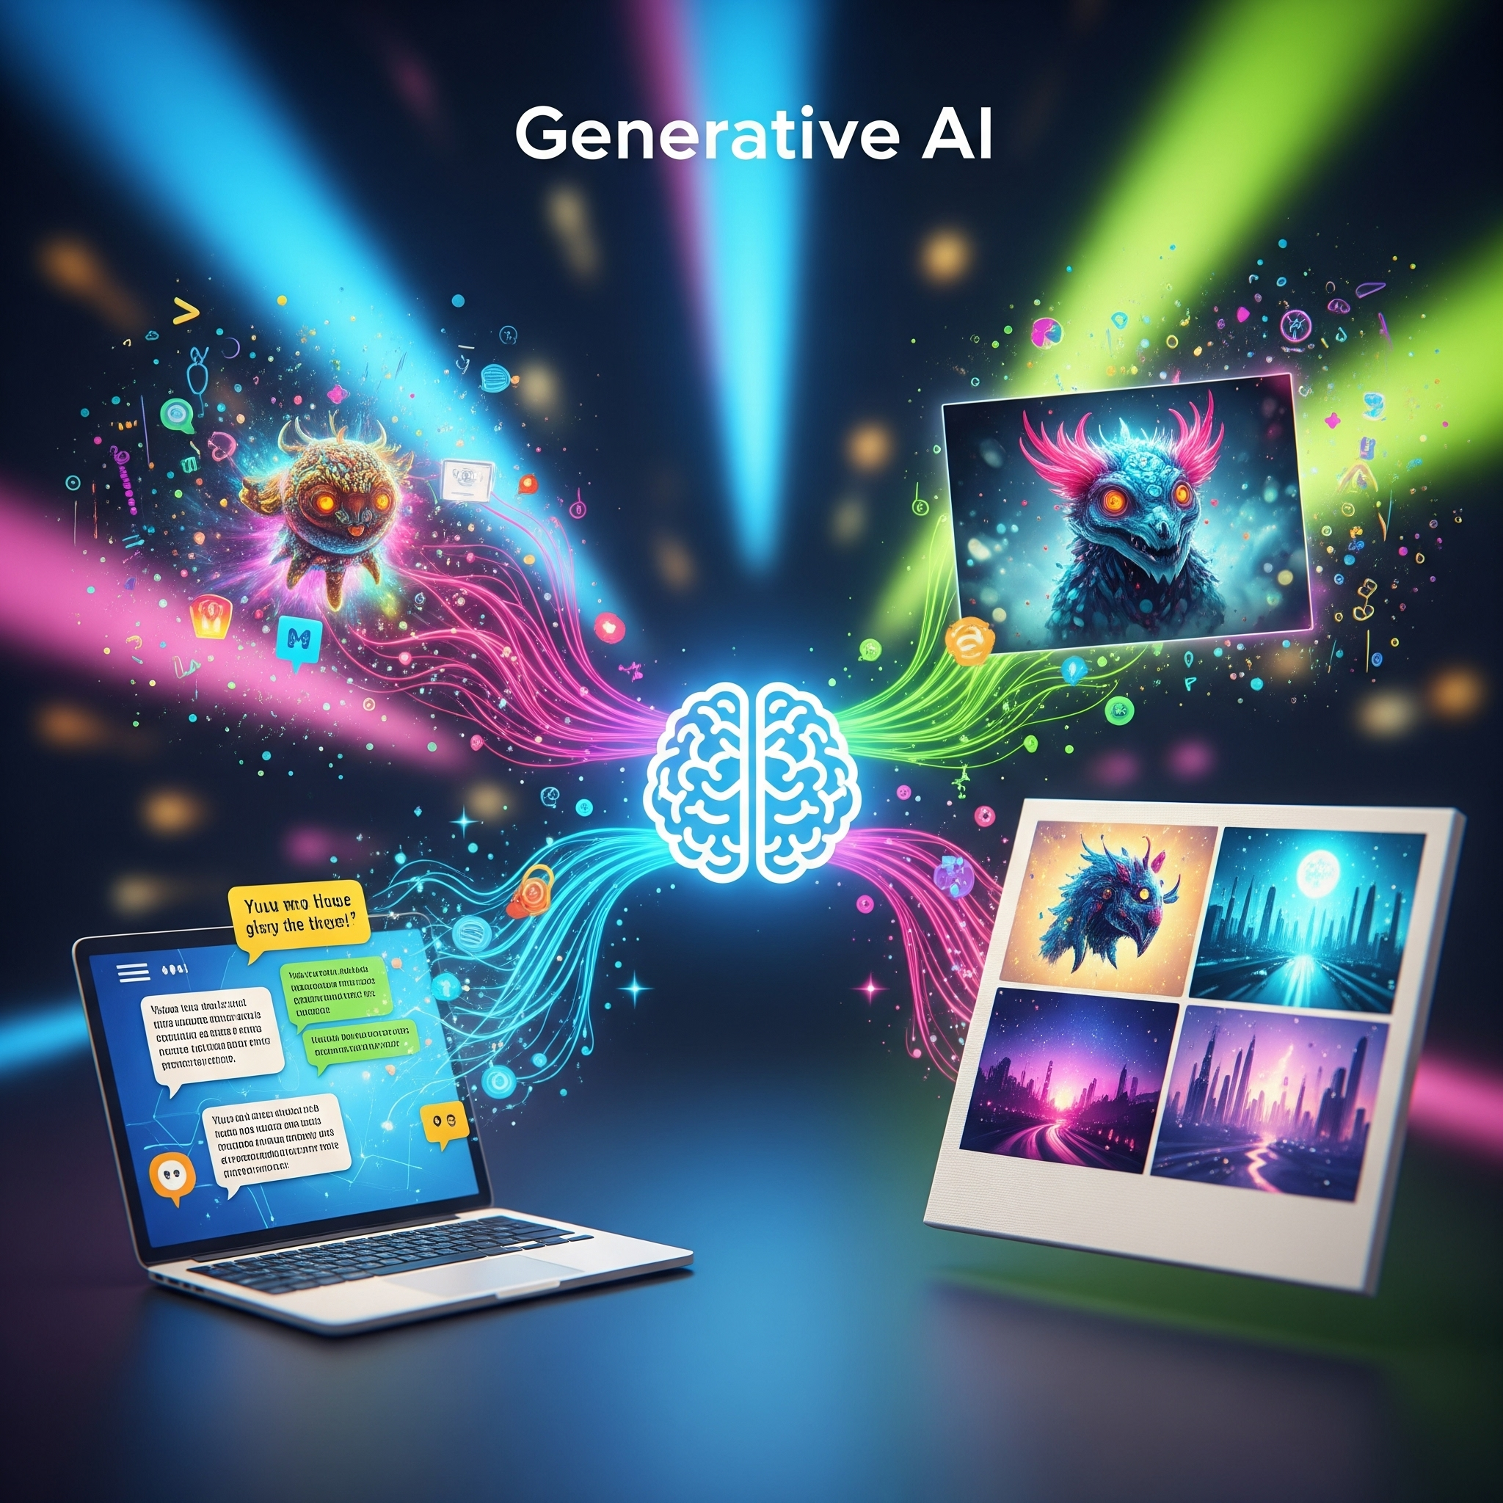
What is AI? What can it do?
Artificial Intelligence (AI)
Computer systems that can perform complex tasks normally done by humans - reasoning, decision making, creating, etc.
Face detection in cameras
Reel recommendations in Instagram
Generative AI, such as ChatGPT and image generators.
Notes:
Potential question prompts:
What do you already know about AI?
What do you think of when speaking about AI?
What do you think AI is?
What can AI do?
AI’s definition cited from NASA: https://www.nasa.gov/what-is-artificial-intelligence/
Images generated by Gemini

Slide 5
Did you know that AI can also write code and create computer programs?
Notes:
Now you know that AI can do all those incredible things - like chatting, face detecting, and generating images… But do you know that, AI can also write code and create computer programs?

Slide 6
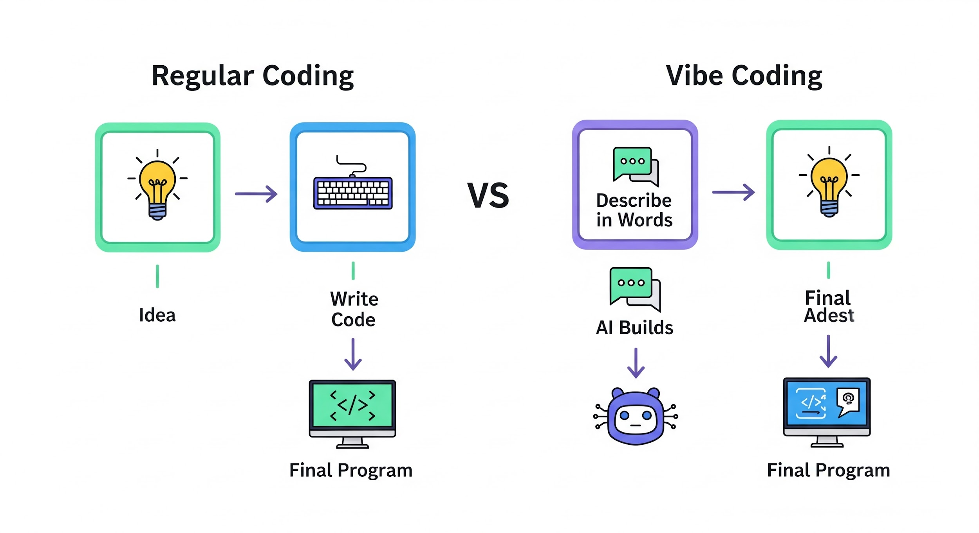
Vibe Coding!
A new way to code: just describe what you want, and the AI turns your words into real code.
Regular Coding
Final Program
Idea
Write Code
Vibe Coding
Describe in Words
Final Program
Idea
AI Builds
Notes:
That’s vibe doing!
Vibe Coding is a new technique to code with AI. Instead of writing codes line by line yourself, you can simply tell AI what program you want to make, and it will create it for you!
—----
Definition of vibe coding cited from IBM: https://www.ibm.com/think/topics/vibe-coding

Slide 7
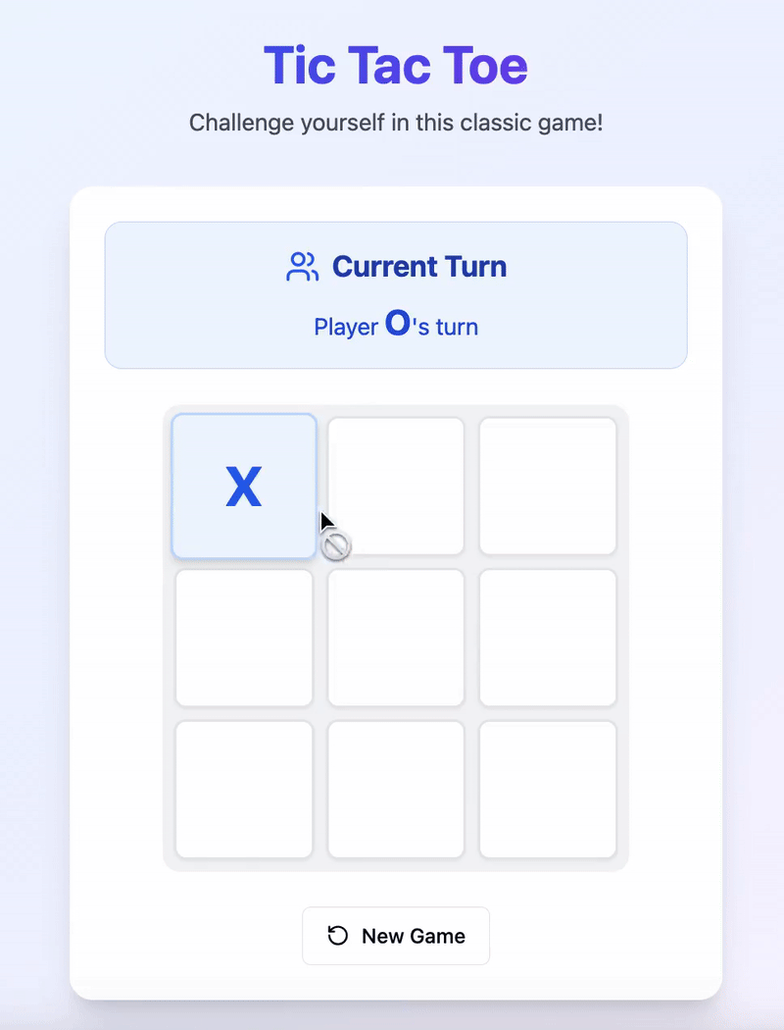
Demo: Build a Tic Tac Toe Game!
https://lovable.dev/
Notes:
[Teacher demonstrates vibe coding a tic tac toe game on Lovable with the following initial and improvement prompts:
Please build a tic tac toe game.
Great job! Please add a 'Rules' button at the bottom of the screen. When players click it, a panel should appear over the game displaying the rules of tic tac toe. The panel should be easy to close so players can return to the game.
Amazing! Now I’d like to change the game’s appearance. Please replace the 'X' symbol with 🌿 and the 'O' symbol with 🌸. Make sure this change is consistent everywhere in the game: the grid itself, the rules panel, turn indicators, and win/draw messages.
]
As demonstrating, mention that coding with AI is an iterative process, you might not get what you want the first time and that’s ok, just tell the AI to make changes.
Note: it can take Lovable about a minute to process the prompt.

Slide 8
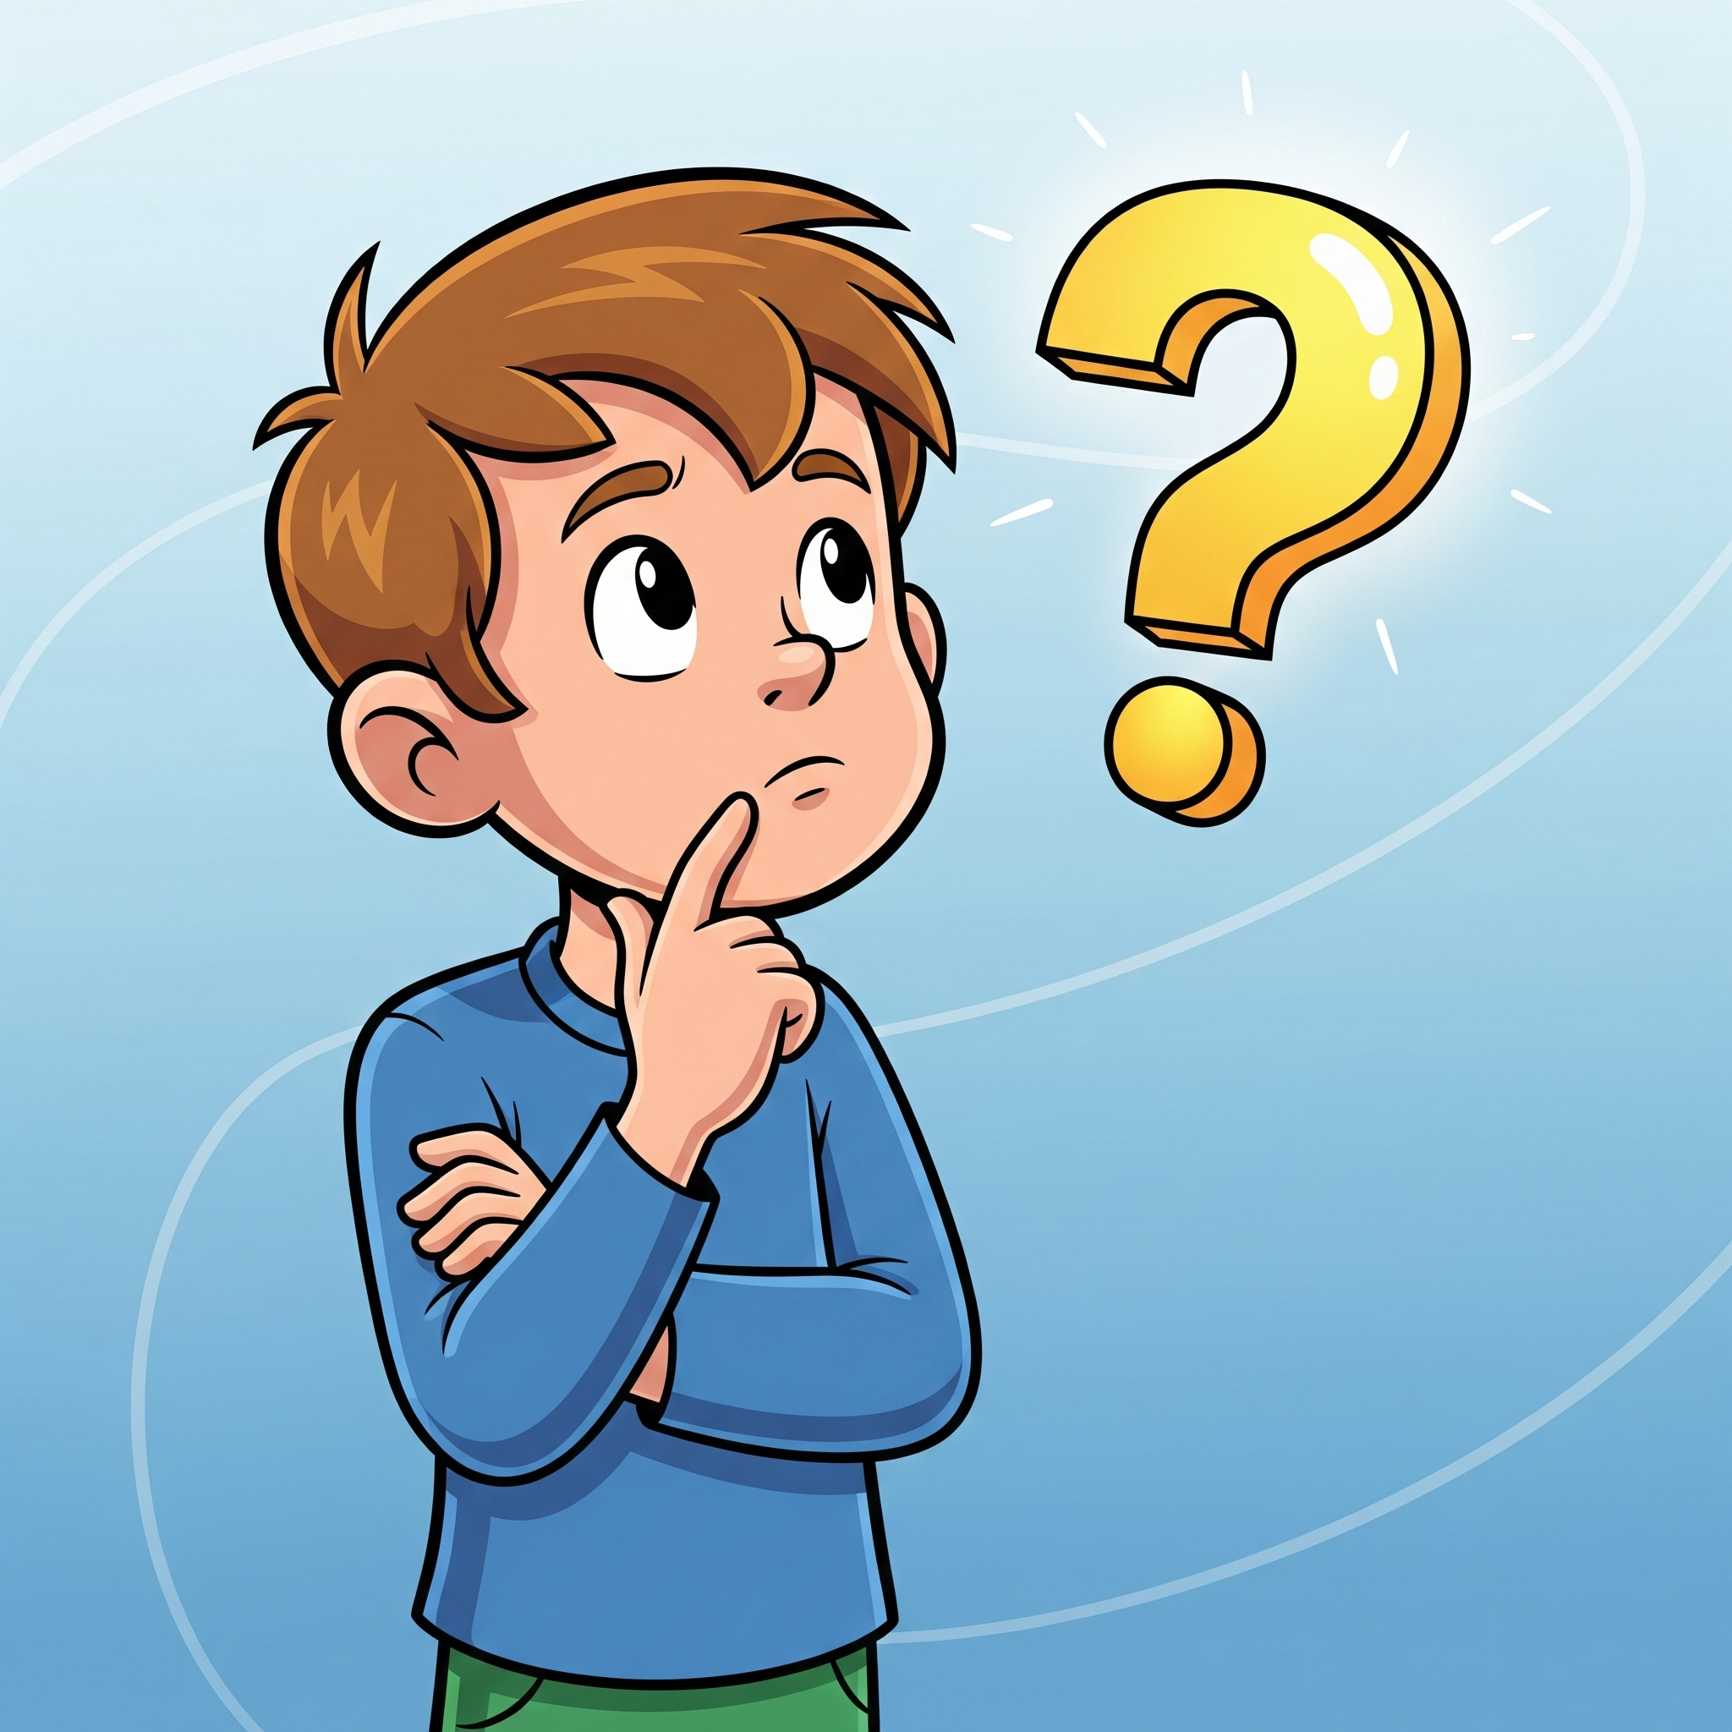
If AI can code for me, do I still need to learn coding?

Slide 9
Yes! Vibe Coding has Limitations
🏗️ AI struggles with large, complex projects.
💡 AI has hard times creating new ideas without examples to learn from.
🔒 AI can make serious security mistakes - so we need to understand what the code does.
🚀 The better we are at coding, the more we feel comfortable and confident with AI, the better we can leverage the tools and build better projects.
Notes:
You might be wondering: If AI can code for me, do I still need to learn coding?
The answer is yes! Vibe coding is powerful, but it does have limitations:
First: it’s great for small or medium projects, but when things get large and complicated—like apps that handle tons of user data—AI often struggles. That’s where human coders are essential.
Second: it’s hard to vibe code brand-new ideas. Imagine you invent a game mechanic that doesn’t exist yet. Without clear examples, AI won’t always know how to build it.
Third: AI sometimes makes mistakes—even serious ones like security flaws. If your project involves sensitive data, payments, or privacy, you need to understand what the code is really doing.
AI is improving fast, and it’s only going to get better. But here’s the big picture: And the more you learn about coding and computational thinking, the better you can leverage the AI tools, and more powerful your projects can become. Coding isn’t just about writing programs—it builds your confidence in testing, iterating, and understanding what AI creates. Plus, it strengthens problem-solving and logical thinking skills that you’ll use everywhere in life.
So, what can vibe coding do for you right now?
If you already know coding, it can boost your productivity.
If you’re just starting, it gives you a chance to create simple projects quickly and easily—making programming more accessible.

Slide 10
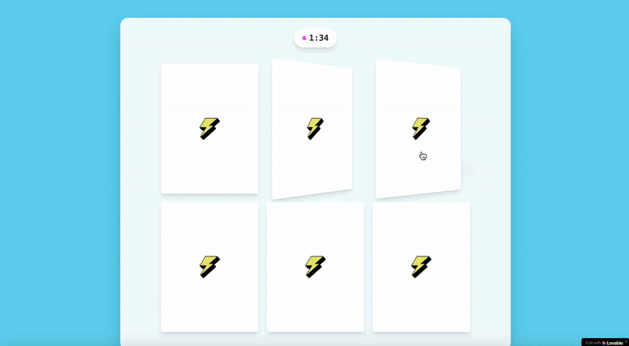
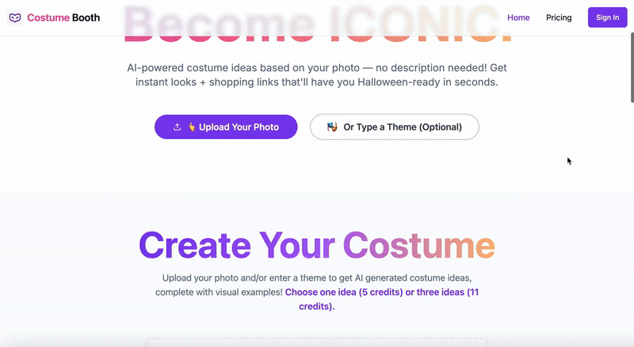
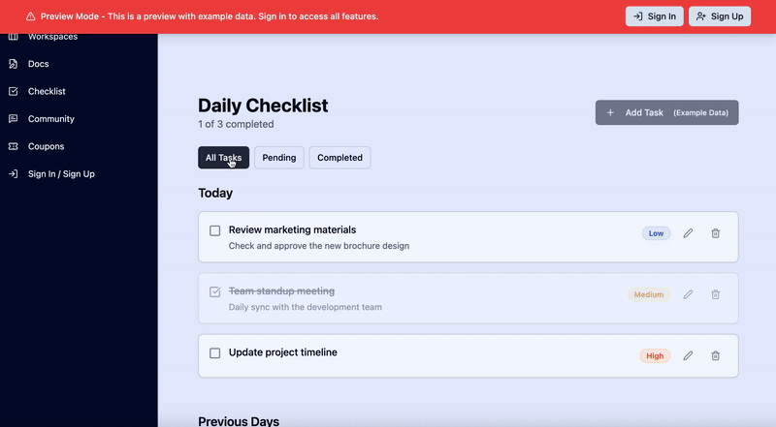
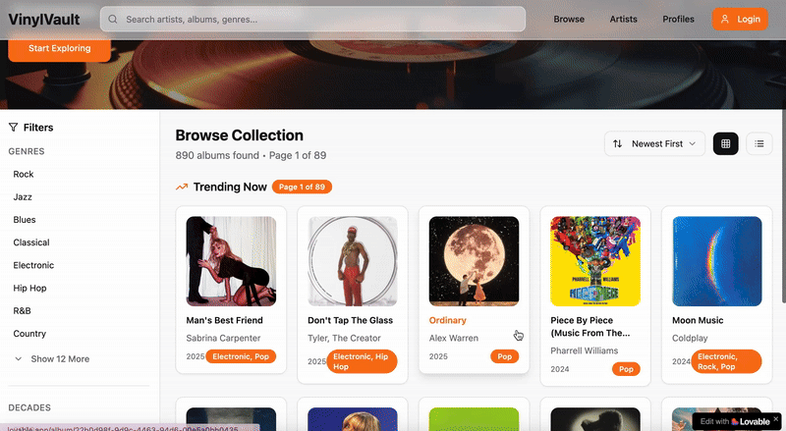
Vibe Coding Examples
A game matching codes and pixel arts
A costume generator based on pictures
A to do list app
A website showcasing music
Notes:
Besides tic tac toe, here are more examples people vibe coded by AI that you can explore. Such as a matching game for coding, a fun inspiring tool that turn pictures into costume ideas. You can create a to-do list app to help manage your homework, and a website showcasing your favorite artists. Some people even made lots of money with their vibe coded sites!
Note on importing images: teacher can remind students that protecting personal information online includes being cautious with the images they upload. Encourage students to think before uploading images and to always ask permission of the image includes other people.
“When using AI tools, it is important to be careful about the images you upload. Pictures can contain a lot of personal information (where you are, who you are with, or what your home looks like). Once shared online, it is hard to control where those images go or how they are used. That’s why we should only upload images we have permission to use and that don’t reveal private details. Being mindful keeps us and other safe while still allowing us to explore the things AI can do.”
[if time allows, teacher can show the site or have students explore them.]
Projects sources:
Memory game matching codes and the pixel arts they create by Dora Palfi from imagi
https://pixel-code-matching-game.lovable.app/
Costume generator by RyFly from Lovable community (not free):
https://costumebooth.com/
To do list app by ciampi 🇧🇷 from Lovable community:
https://notes.21m.space/checklist
VinylVault: a digital archive dedicated to music. Discover albums, bands, and songs from every genre and era. By 𝓯𝓪𝔂 from Lovable community:
https://vinyl-vault-verse.lovable.app/

Slide 11
Discussion: What do you want to create with vibe coding?
Notes:
Potential reflection prompts:
What would you want to create with vibe coding? Are you excited by this new technology? How can this be connected to your own passion?
Is this new technology unlocking your potentials and allowing you to express more that you couldn’t otherwise? Is it making some ideas that you may have had easier to come true?
[Teacher can use the space in this slide to take notes of what students say.]

Slide 12
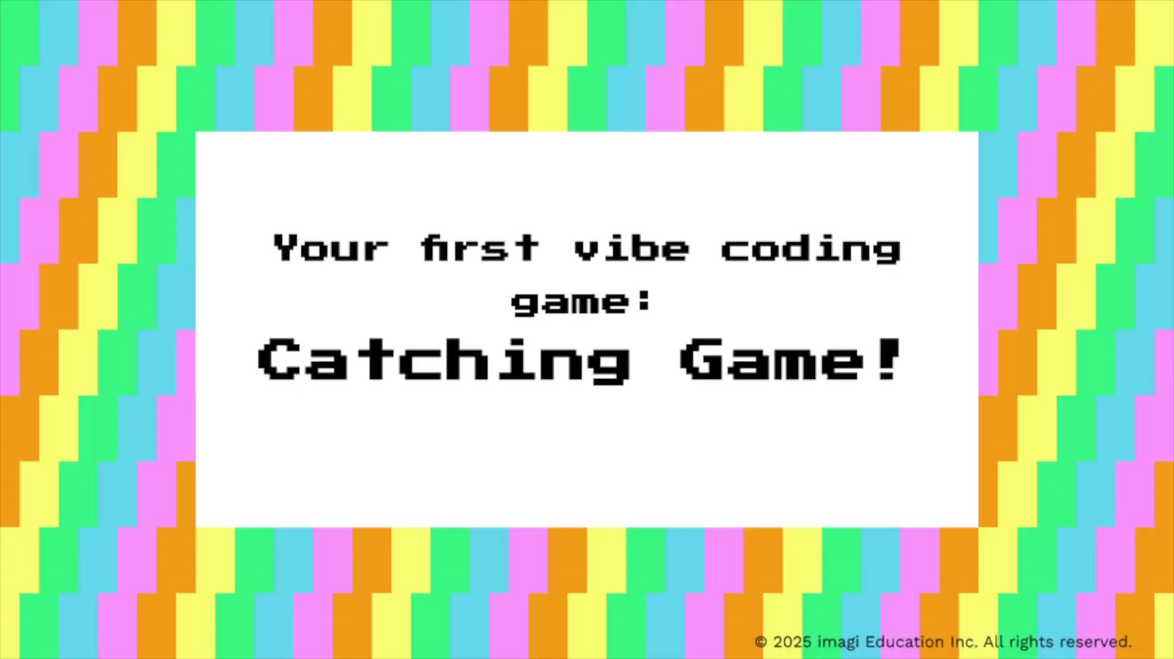
Your First Project: A Catching Game!
Notes:
Video 2: intro to catching game
Video script:
[excited and with passion] Today, you’ll create your very first vibe coding game – a catching game!
In this game, numbers from 0 to 10 will fall from the top of the screen, and you’ll control a basket at the bottom. Your goal is to catch only the even numbers. Each time you catch an even number, you earn 1 point. But if you catch an odd number, you lose 1 point.
Although this mini game is simple, it’s also meaningful. This isn’t just a game – it’s a learning game. It helps solve a real-world problem: making practice more fun. For young kids learning about even and odd numbers, this game turns memorization into play. Instead of boring drills, they get to learn by doing.
Next, I’ll guide you through building your first game in 5 steps:
First, Log into Lovable through imagi.edu.
Second, Use the initial prompt to generate your game.
Third, Make some changes to improve it.
Fourth, Publish your vibe coding project and share your very first published game.
And lastly, Personalize your game to tackle a learning challenge you care about.
For example, you could swap the falling emojis so players catch only recyclable trash to learn about environmental science, or catch only mammals to explore biology. The possibilities are endless!
Now, let’s get started.

Slide 13
5 Steps to Build Your First Game
Log into Lovable (Teachers → follow instructions here)
Create a catching game with your initial prompt
Make a change to your game
Publish your game!
Personalize your game to other subjects
Notes:
Teachers: follow the quick start guide in Hour of AI - Vibe Coding: Build your First Game Using AI - Setup Guide to create anonymous Lovable accounts for you and your students through imagi Edu.

Slide 14
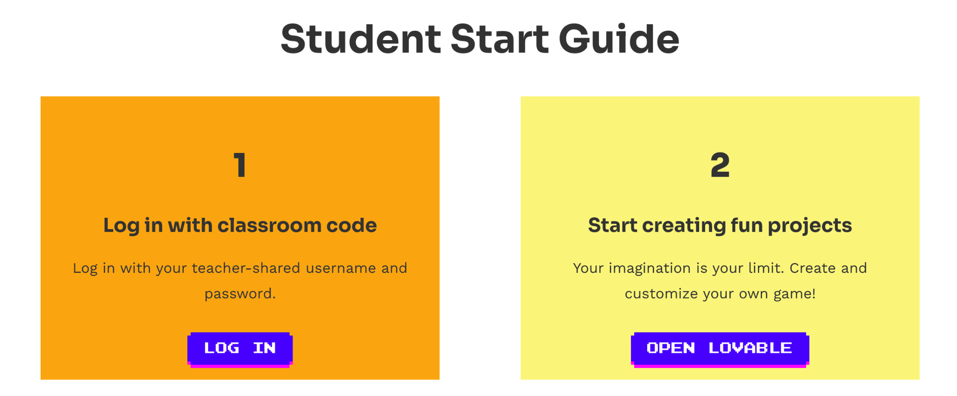
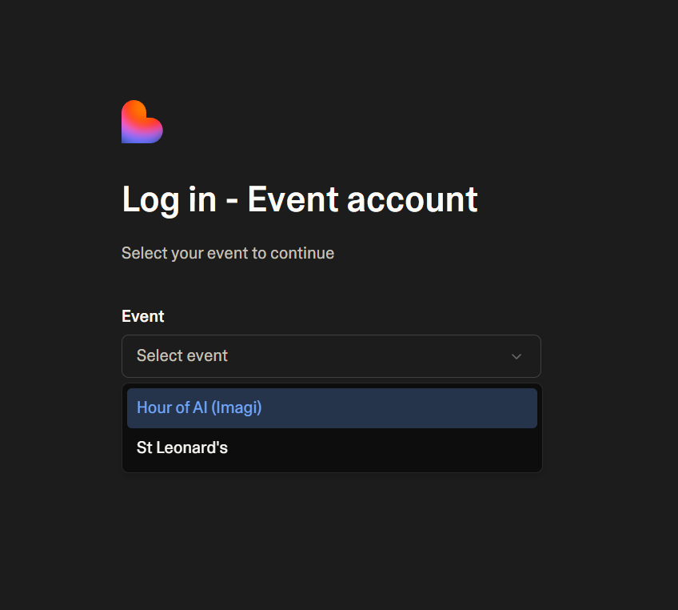
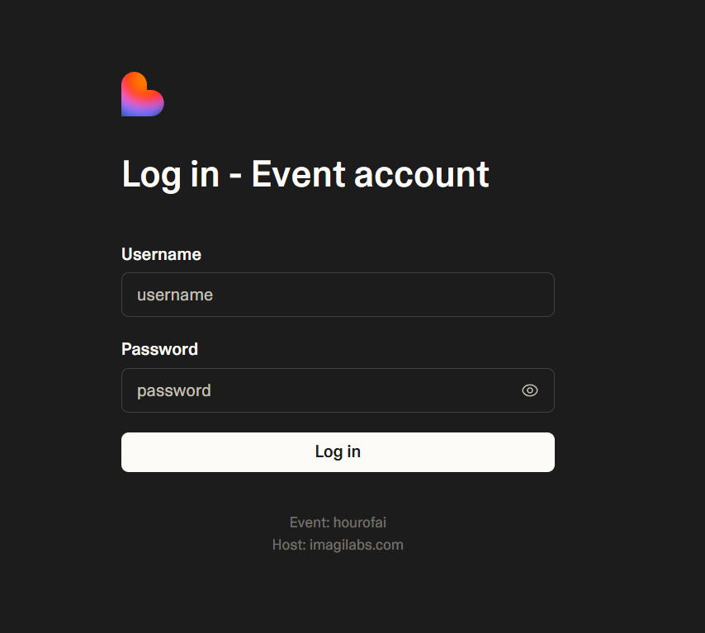
Step 1: Log into Lovable
1
Click “Log In” on the activity page
2
3
Select Hour of AI (imagi) event in the drop down!
Fill in username and password provided by your teacher
Notes:
Students should log in with the teacher-provided anonymous username and password by clicking “Log in” in the Student Start Guide section on the activity page.
Students should not use the standard Lovable login on https://lovable.dev/, which requires an email address.

Slide 15
Step 2: Write a prompt to create your catching game!
Prompt
The input given to an AI model to guide its output.
Example Initial Prompts:
Make a catching game that only catches even numbers.
Make a catching game. Numbers 0-10 will fall from the sky, and the player uses the basket at the bottom to catch them. They should only catch the even numbers. +1 point for even numbers, and -1 point for odd numbers.
Notes:
Now, you’re going to write your first prompt to create the catching game!
So what is a “prompt”? It’s the instruction that you’re sending AI telling it what you want it to do for you.
Writing a good prompt is very important for receiving good result.
But for your first prompt today before we learn any prompting techniques, you can just write it in your natural language and explore the tool freely - whether you want to try a simple prompt, or describe the game with specific details. Here are 2 examples. How would you tell the AI to build this catching game for even numbers?

Slide 16
Step 3: Make one change to your game - to fix bugs
Debugging Prompting Technique: Reality vs Expected
Describe what you expect to see vs. what you see in reality.
Ex. “The play button isn’t working, nothing happens when I click on it. Could you help me to fix it, to make sure that the game starts when I click on start?”
Ex. “The numbers are falling too fast and it’s hard to read them. Could you make them fall slower?”
Notes:
Is your game working well? If so, great! If not, don’t worry, it’s very normal for AI to make mistakes!
If something is not working as expected in your game, or there are some burning changes you want to make, you can ask AI to change it. For small bugs, you can easily fix it with direct command, such as “Make the numbers fall slower”, “change x”.
However, sometimes there might be more difficult bugs that regular prompts have a hard time to solve, then we’ll need a powerful debug technique. A very good one it to describe what you expect to see and what you see in reality. This prompting technique is also very useful when you want to make other changes to your project.
Now, let’s try to apply this technique in our next prompt to make one change: to fix something that isn’t working right.
(If there’s no bug you can notice, and you don’t know what you can change, then you can try to change the color theme. )
[Also, if students are using their own lovable accounts, remind them that they have only 5 free prompts per day, so plan well ahead. After the initial prompt, we can plan to spend 2 prompts for step 3 (one for this slide and one for next), and 2 prompts for step 5 (independent practice). So, if they notice several changes that they want to make, pick only 1~2 most severe ones.]

Slide 17
Step 3: Make one change to your game - make improvements
Usability and User Experience
  Are there bugs? Is the play smooth?
  Can a new player easily figure out how to play?
Game Mechanics and Rules
  Ex. add a timer, add lifes, increasing speed over time…
Aesthetics and Enjoyment
  Try a different appearance or style!
  Anything else you can do to make the game more fun?
Accessibility and Inclusivity
  What can you do make the game accessible to people with disabilities or different needs?
  Ex. increase number size, adding sound indicators for people with vision impairment.
Notes:
Besides fixing obvious bugs, there are some more aspects that I’d encourage you to think about and questions that you can ask yourself:
[go over the slide]

Slide 18
Step 3: Make one change to your game - example prompts
Ex. Try different game mechanics: Now the game might be endless, we can add lives to it to make it stoppable.
Ex. Increase user experience and accessibility: when catching the right emoji, use a positive sound to give players an indicator; and use a negative sound when catching the wrong emoji.

Slide 19
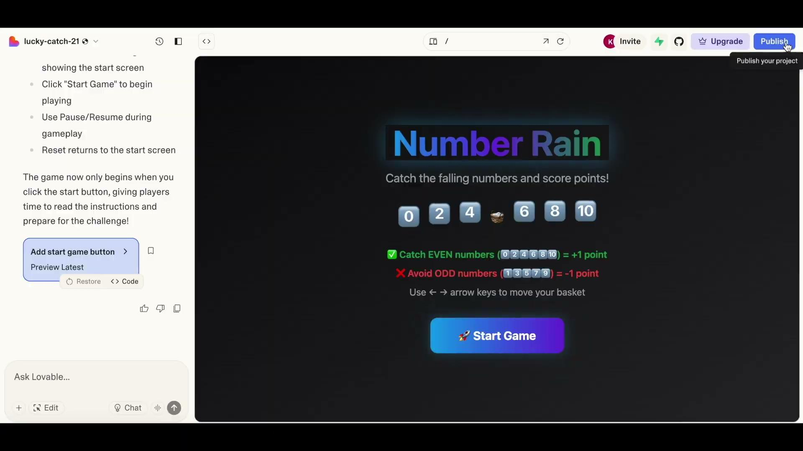
Step 4: Publish your game!
Notes:
Video 3: Publish
Script:
Here is where you can publish your game. This shows your website address, it’s based on your project name. If you don’t like the name, you can re-name your project first.
When you’re ready, click “Publish.” Once it says Published, your game is live, and you can share the link with friends.
If you made any changes to your game — for example, here we changed the color theme — just click “Update.” This will apply the new changes to your published link.
And if you ever want to go back to an earlier version, find the preview of that version, click “Restore,” and then “Update.” Now your link will take players to the older version again.

Slide 20
Step 5: Personalize your game to other subjects! (10 min)
Catch Mammals!
Mammals: 🐯🐭🐷🐮🐼🐻
Non-mammals: 🐥🦉🐸🐌🦋🐛🦑
Catch recyclables!
Recyclable: 🎟️ 🧩 📰 📦 🍾 🥫 🧴 📄
Non-recyclable: 🍰 🍿🍕 🍵 🧃 💡 🧻
Note: “Remix” the project for 2 separate links!
Notes:
Lastly, you’re going to personalize your catching to another subject/ topic that you’re passionate about. For example, let players catch only recyclable trash to learn about environmental science and sustainability; or learn about biology by catching only the mammals among animals.
[Can invite a few students to share ideas if having enough time.]
NOTE: Before you start, go back to the lovable homepage and let’s choose the “Remix” option on the project. This allows you to build a new project based on what you already have, and you will be able to have 2 different versions alive with different links at the same time - since you can create only 1 link for each project.
(If they already started personalization, it’s ok, remix the new version as a new project, and use the old version of the old project will solve the problem.)
This is independent practice; give students about 10 minutes working time. When they’re done, they can update the publication.

Slide 21
SHOWCASE
&
FEEDBACK

Slide 22
Showcase & Feedback
What change did you make for your game in step 3, on what aspect? How did it improve your game?
How did you personalize your game in step 4? What learning problem are you solving with your new game?
Reflections:
Did you get what you hoped to get? Did you find prompting easy or difficult?
Did you enjoy vibe coding? Any more inspirations/ future project ideas that you’d like to share?

Slide 23
What is vibe coding and what we can do with it.
Created an educational game using vibe coding.
How to debug and improve your program with iteration.

Slide 24

Classroom Contest
How to enter:
Bring this Vibe Coding activity to your classroom
Fill out the Classroom Contest form and include links to 3 student projects from this activity
https://tinyurl.com/Vibecodingcontest
Deadline to enter contest: Dec 23rd

Slide 25
Next Steps
An entire unit on vibe coding is in the works!
There, you’ll learn more about:
Deeper understanding of AI and how to use AI responsibly
Different prompting techniques
How to solve real world problems by creating educational games
Project cycle for creating a program
Making sure your app is user friendly
And a lot more!
If you’d like to get early access, email education@imagilabs.com.

