Slide 1
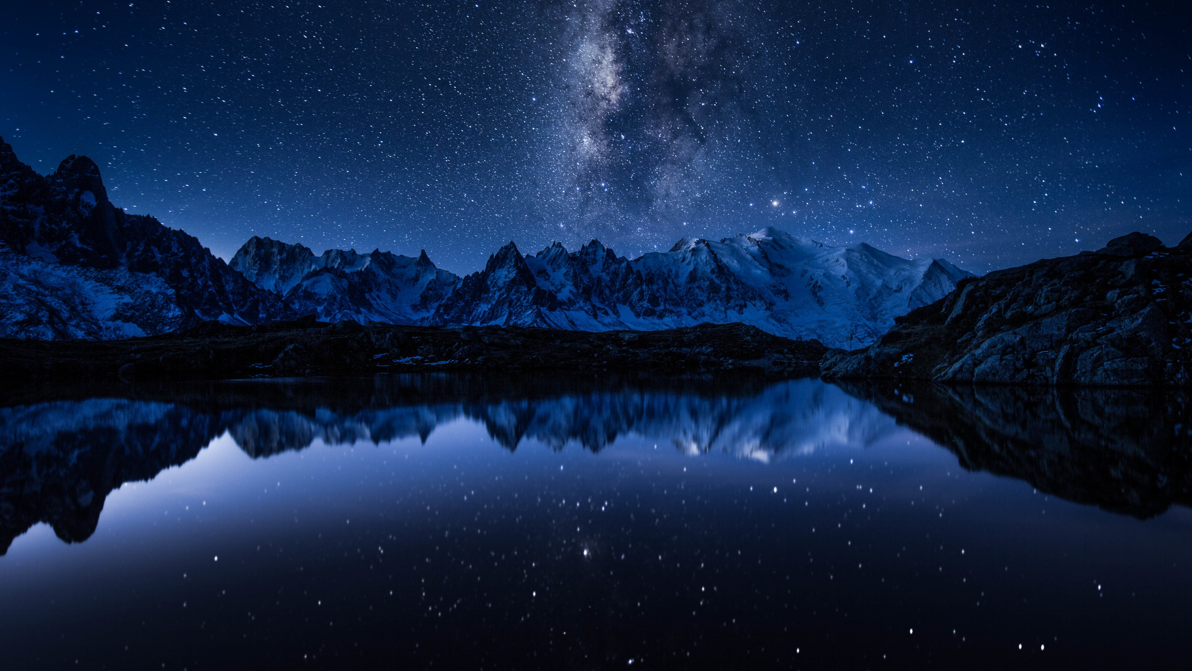
Stardust
Liana Tsigaridi, PhD

Slide 2
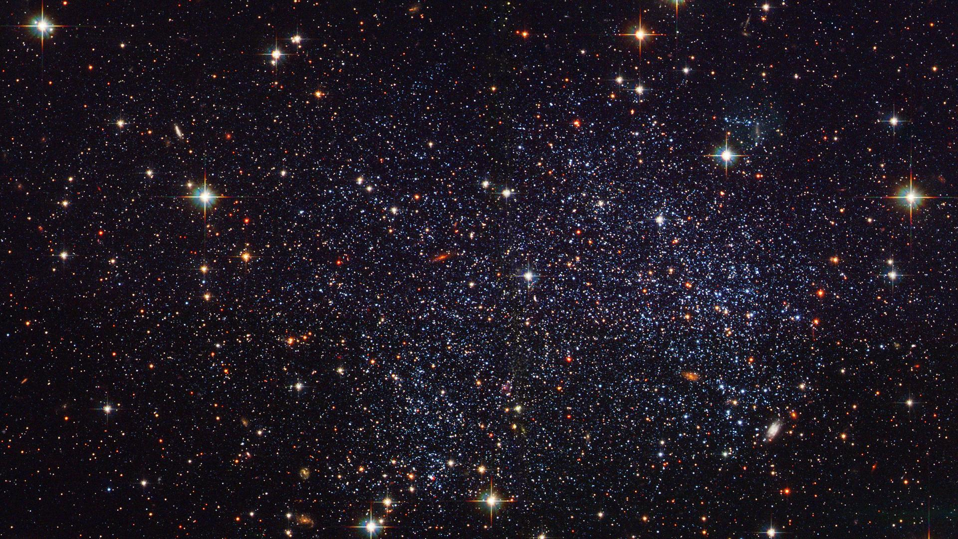
Twinkle, Twinkle Little Star…
Hubble Heritage Image of Sagittarius Star field

Slide 3
How I Wonder What You Are…
Stars have:
Different colors/temperatures
Different sizes
Different masses
Different composition
Hubble Heritage Image of Sagittarius Star field

Slide 4
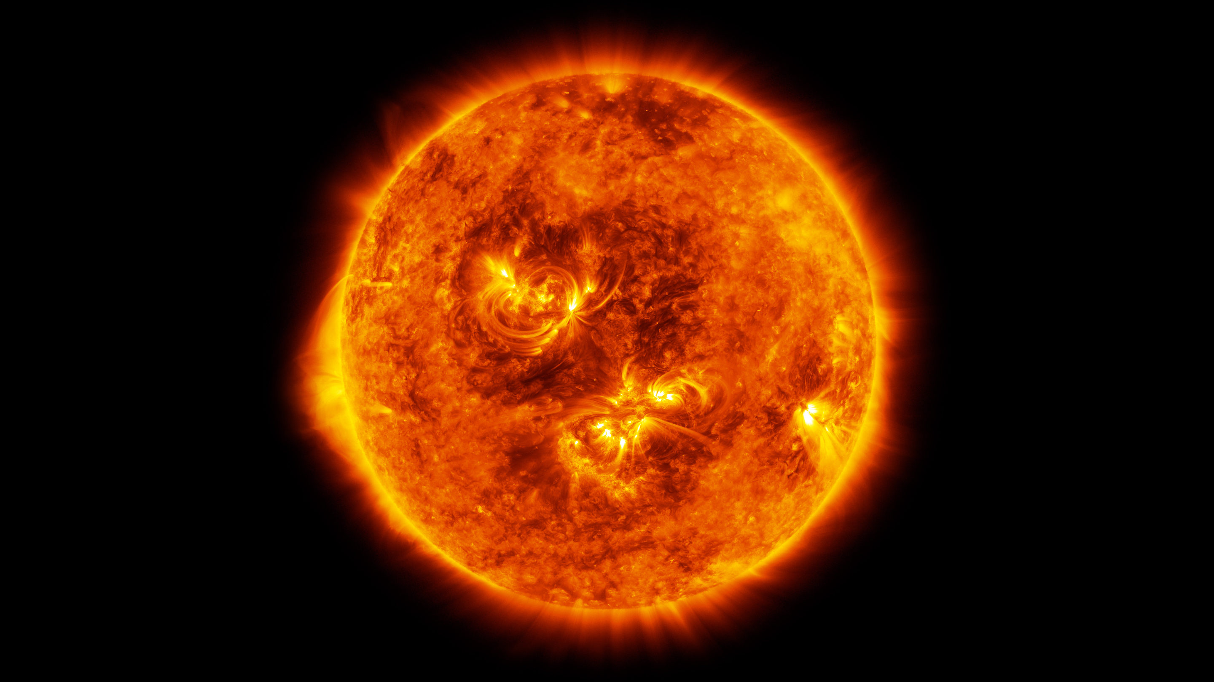
The Sun
Image Credit: NASA’s Solar Dynamics Observatory

Slide 5
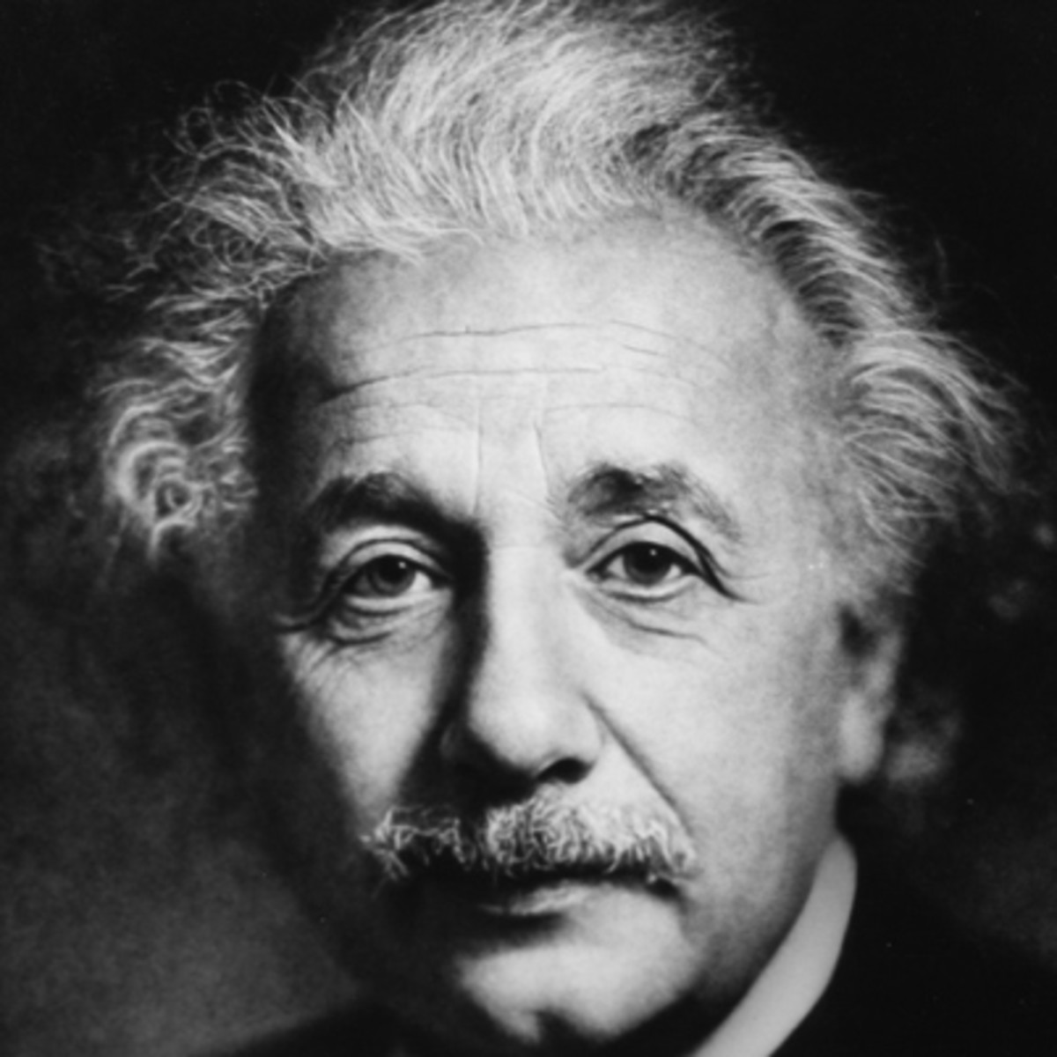
Nuclear Fusion
The combining of light nuclei into heavier ones
Albert Einstein (1879-1955)

Slide 6
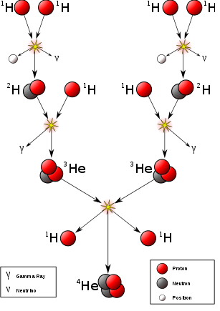
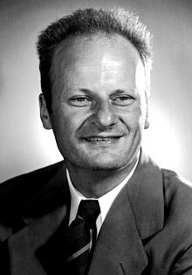
Hydrogen fuses to Helium
Hans Bethe (1906-2005)

Slide 7
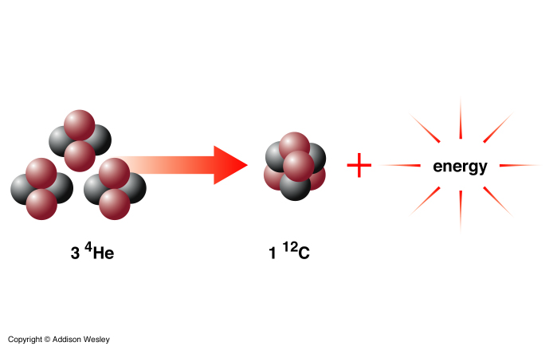
Helium fuses to Carbon
…Until Iron (Fe)

Slide 8
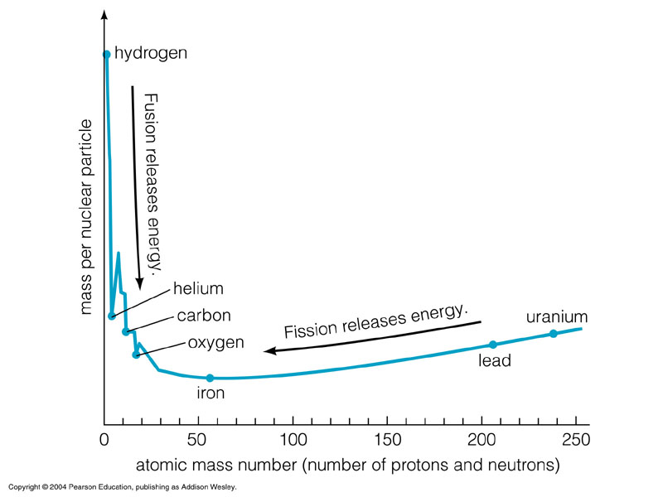

Slide 9
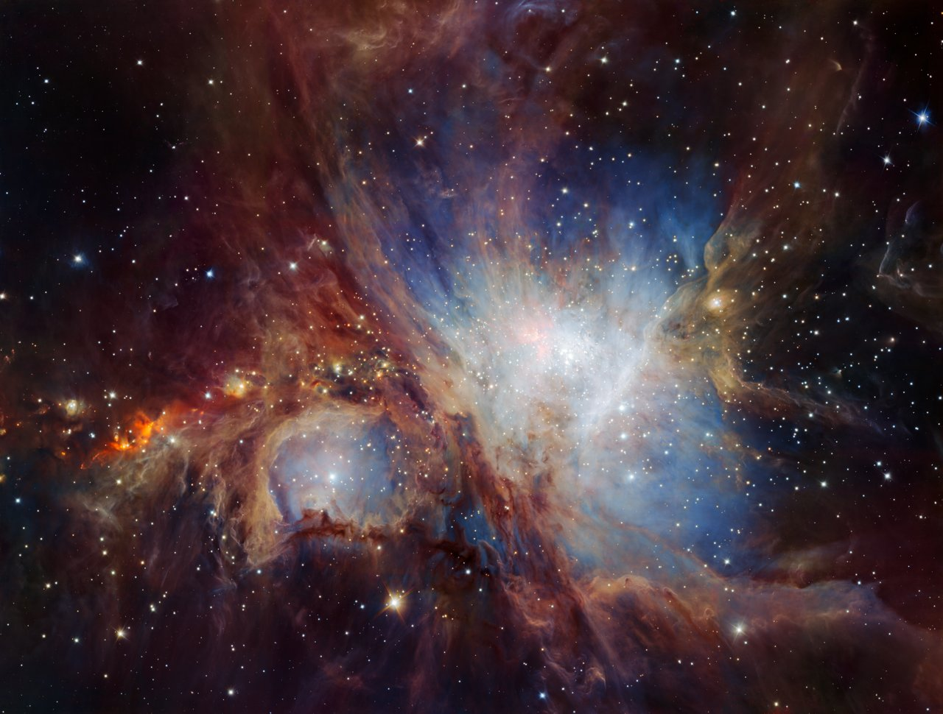
The Orion Nebula
Credit: VLT/ESO

Slide 10
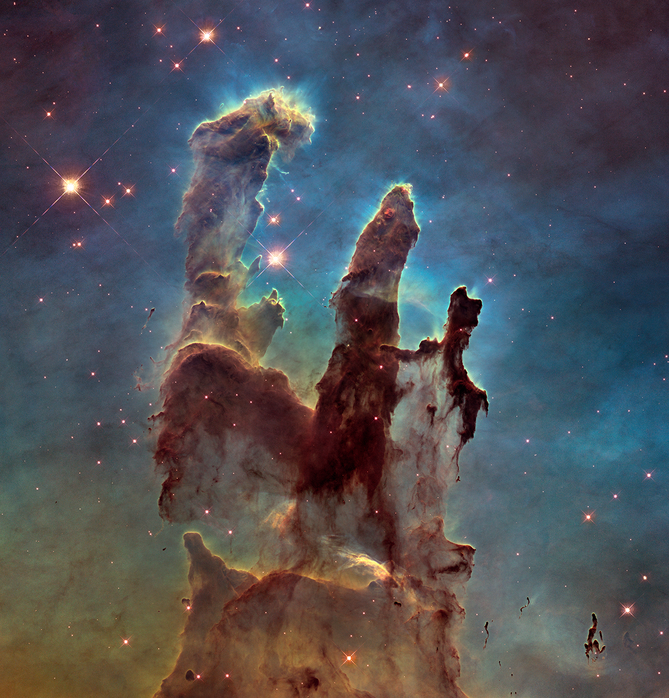
Stellar Nursery
The Eagle Nebula
Credit: NASA, ESA and the Hubble Heritage Team

Slide 11
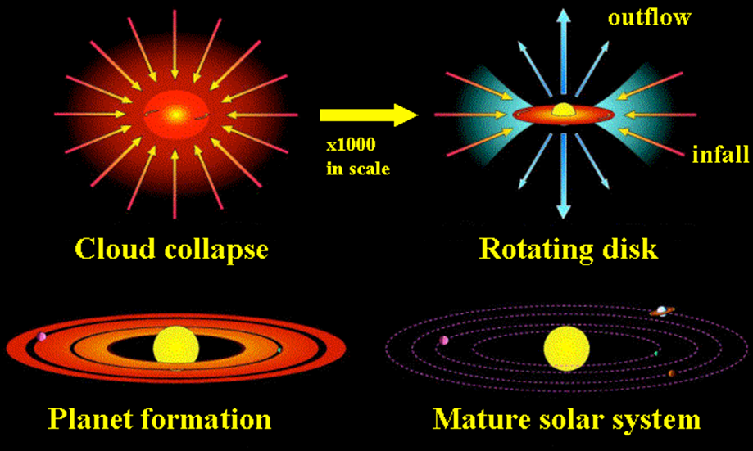
How a single star is born
Stars begin with slow accumulation of dust and gas.
Gravitational attraction of Clumps attracts more material.
Contraction causes Temperature and Thermal Pressure to slowly increase.
At 10 million degrees Celsius fusion ignites!!

Slide 12
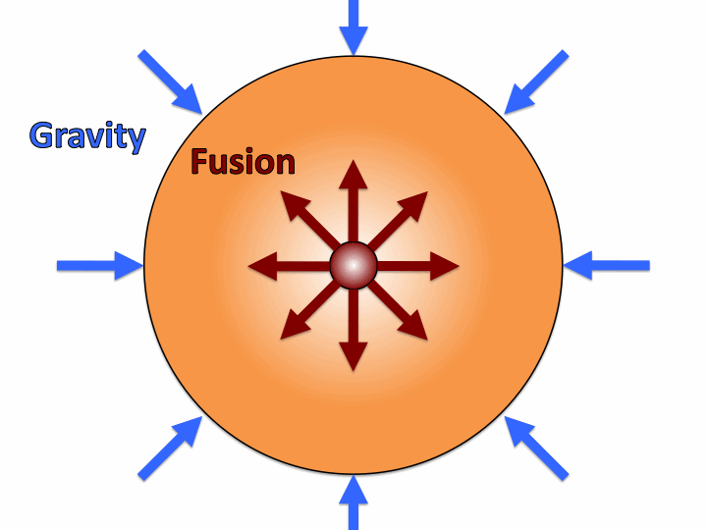
A balancing act
Every star is in a constant balance between 2 forces:
The inward pull of gravity.
The outward push of pressure caused by the heat given off by nuclear fusion.
This balance is called
Hydrostatic Equilibrium

Slide 13
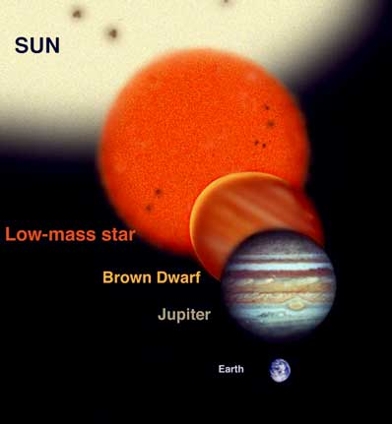
Lower limit
Upper limit

Slide 14
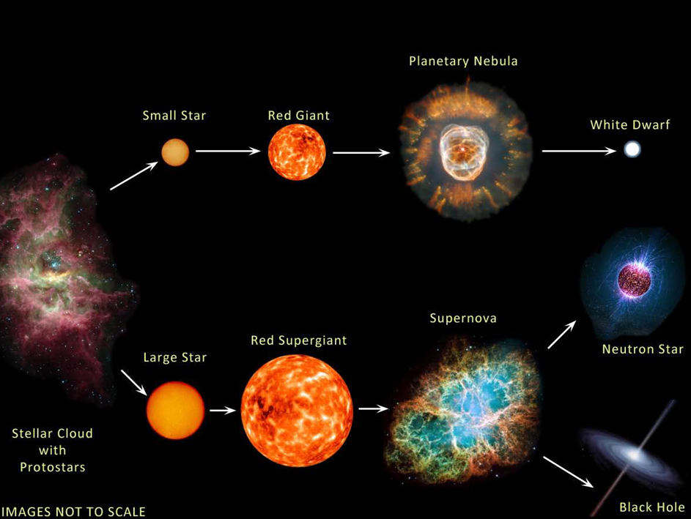
Stellar Evolution

Slide 15
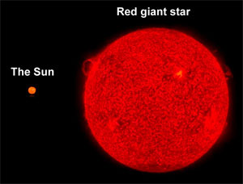
Low-mass stars M<8Ms
The beginning of the end: Red Giants
After Hydrogen is exhausted in the core:
Core collapses releasing energy to the outer layers
The outer layers expand
Temperature and Pressure increase in the core

Slide 16
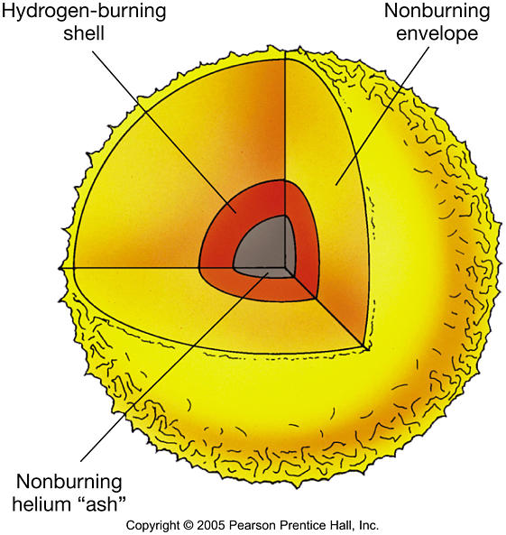
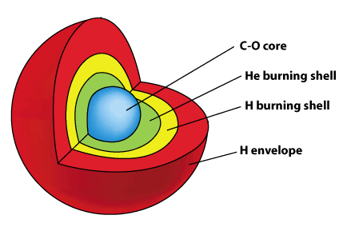
Low-mass stars
More fusion!
At 100 million degrees Celsius, Helium fuses:
Energy sustains the expanded outer layers
of the Red Giant

Slide 17
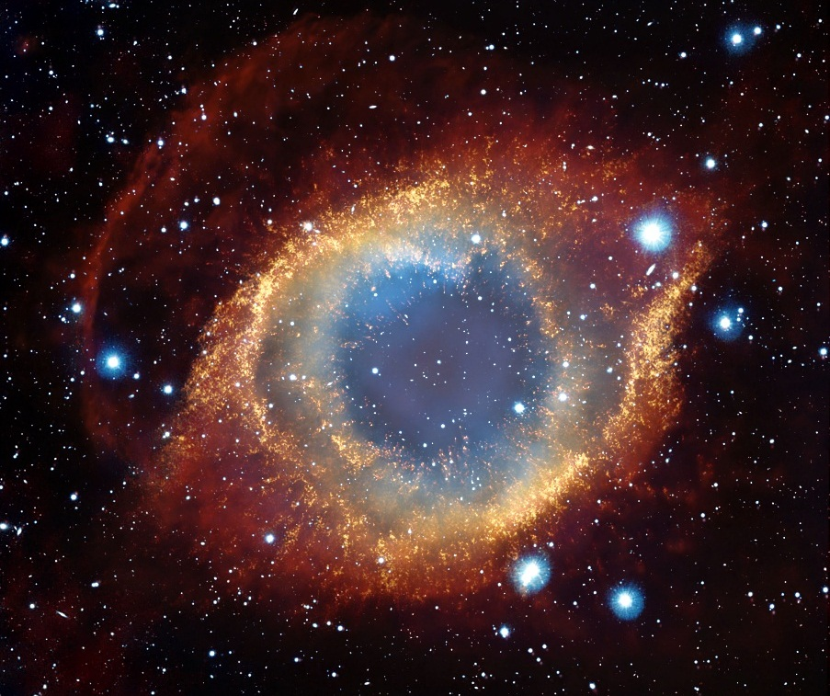
Planetary Nebula
The Helix Nebula
Credit: Hubble Space Telescope

Slide 18
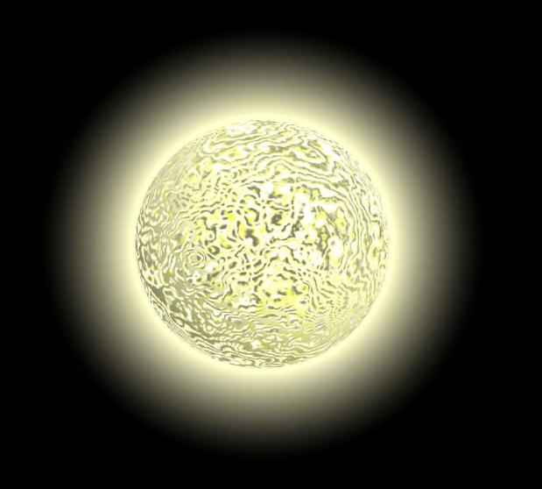
Low-mass stars
The end: White Dwarfs
At the center of the Planetary Nebula lies a White Dwarf
Size of the Earth with mass of the Sun “A ton per teaspoon”
Inward force of gravity balanced by repulsive force of electrons

Slide 19
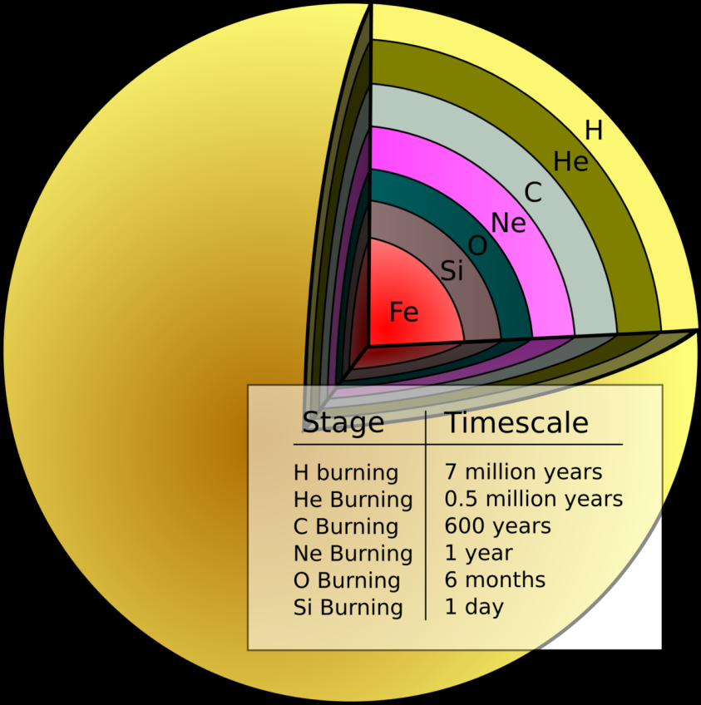
High-mass stars M>8Ms
The beginning of the end: Red Supergiants
After Helium is exhausted, core collapses again until it becomes hot enough to fuse Carbon to Magnesium or Oxygen.
Through a combination of processes, successively heavier elements are formed and burned.

Slide 20
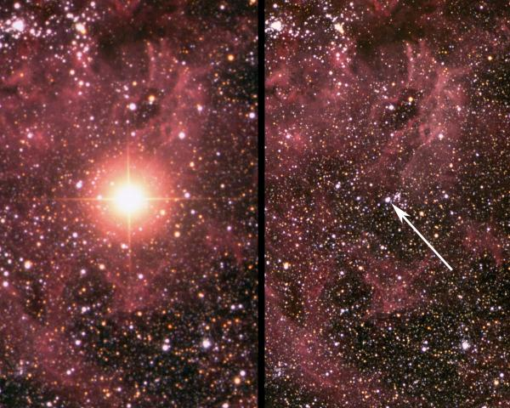
Supernova 1987A in LMC
Credit: Ángel R. López-Sánchez (AAO/MQU), Steve Lee, Robert Patterson, Robert Dean and Jennifer Riding (AAO) & Sarah Martel (UNSW / AAO)

Slide 21
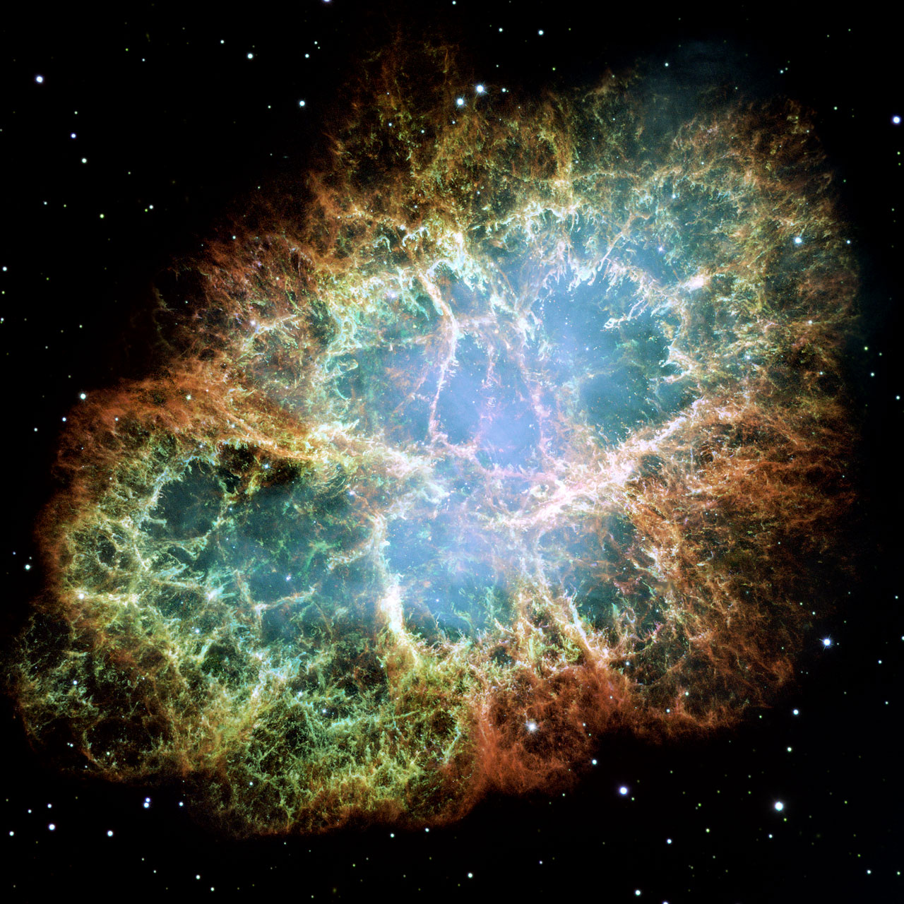
Supernova Remnant
The Crab Nebula
Credit: NASA/ESA Hubble
Space Telescope

Slide 22
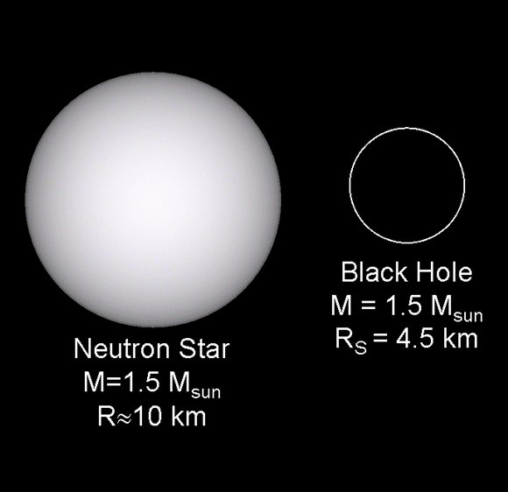
High-mass stars
The end: Neutron Stars or Black Holes

Slide 23
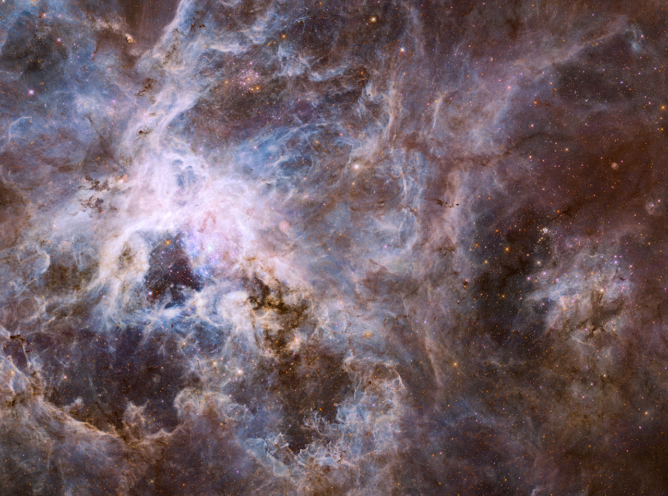
Supernova and ISM
Credit: ESA/Hubble

Slide 24
