Slide 1
Animal Welfare Policy
MAY 2021

Slide 2
Introduction
Animals are an important part of tourism and contribute to the cultural and natural heritage of destinations. At
Club Med, we are aware of this richness and listen to our customers’ wishes to get closer to nature.
However, we also know that tourism can be detrimental to the welfare of the animals involved, and that it is not always easy for consumers and professionals to distinguish between good and bad activities. In parallel, knowledge on animal welfare is developing, thanks to the commitment of various stakeholders, which enables to progressively identify the practices that must be encouraged and the ones that can no longer be tolerated.
Therefore, at Club Med, we have been committed for several years, alongside with specialists, to align our practices with our values. Following an overview of the products we offer to our GMs, we identified three priority groups of animals, elephants, cetaceans and working animals, because of their importance within our offer, but also owing to the existing threats to these species.
We are moving forward with this approach in partnership with our suppliers and experts, convinced that the solution does not lie in removing all animals in tourism, but in selecting and supporting suppliers in the deployment of good practices.
Agnès WEIL, Director of Sustainability

Slide 3
01
05 WORKING
ANIMALS
06
ANIMAL PROPS
07
SEA TURTLES
⁰⁸ OTHER ANIMAL ISSUES
CONTEXT
02
ELEPHANTS
03
CETACEANS
04
WILD CATS

Slide 4
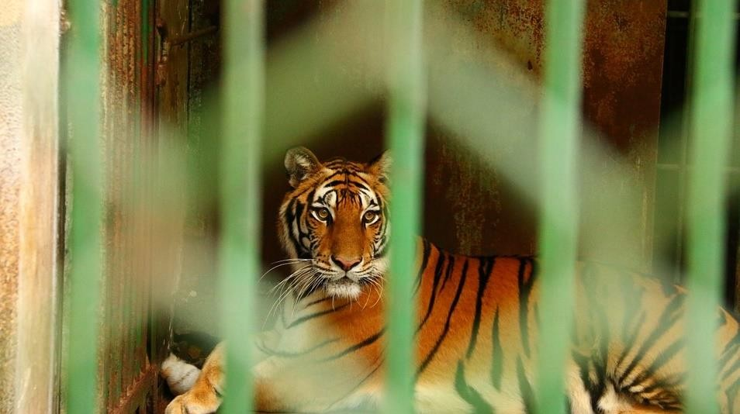
Context
Animal welfare concern & industry reaction

Slide 5
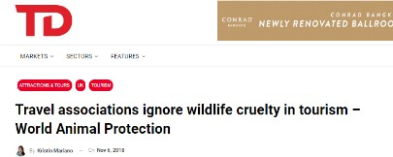
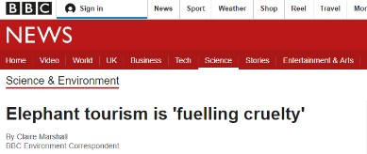
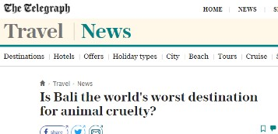
Emergence of animal welfare concerns in tourism
Click on each article to access it

Slide 6
Tourism industry evolution
Commitments from major tourism actors:
ELEPHANTS | CETACEANS | WORKING ANIMALS
No elephant shows and rides sold since 2016 | - | All suppliers must adhere to ABTA’s Global Welfare Guidance for Animals in Tourism All animal excursions suppliers are progressively being audited
- | No new attractions featuring captive whales and dolphins signed since 2017 | -
Kuoni partners must adhere to a code of conduct, they must comply with animal welfare standards (CITES & ABTA Animal Welfare Minimum Requirements)
Legislation on captive cetaceans evolving quickly:
E.g., Cetacean captivity is banned in Canada, California, India, Croatia, Chile, Costa Rica, among other countries

Slide 7
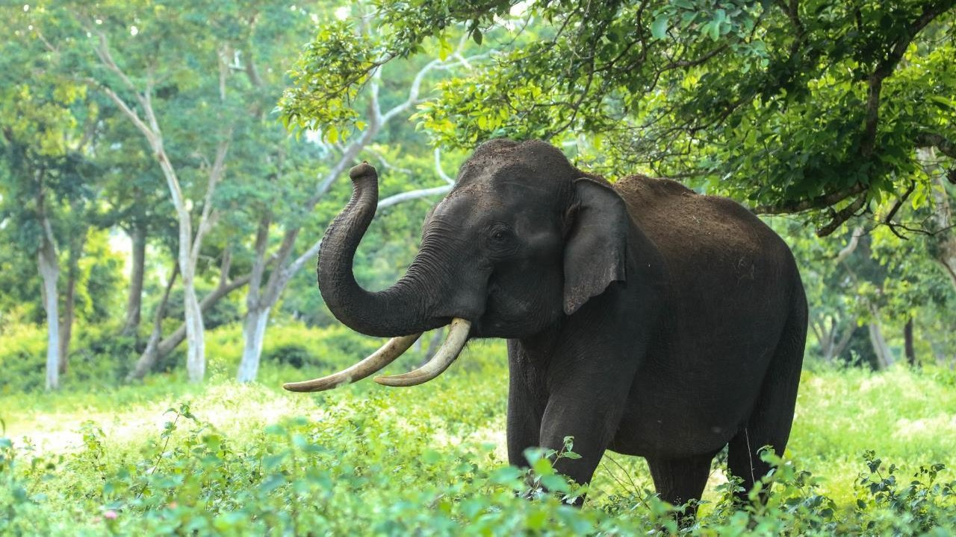
Elephants

Slide 8
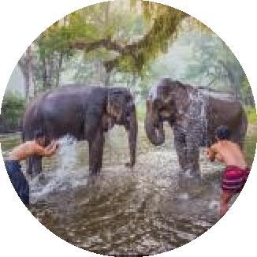
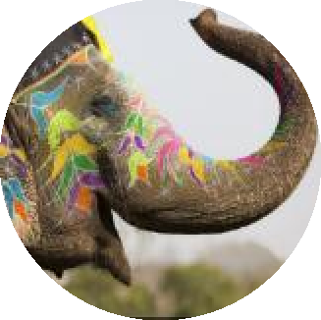
Elephants in tourism
MAIN ACTIVITIES WITH ELEPHANTS
Elephant rides
Elephants shows (circuses)
Feeding and bathing elephants
Viewing elephants in the wild (safari)
Viewing elephants in an enclosure
ISSUES OF ELEPHANT TOURISM
Issues of captivity:
Elephants are very intelligent and social animals who allocate most of their time to foraging and moving
Issues of activities involving contact with elephants:
Elephants are dangerous animals (category 1, like lions)
Activities with human contact require training to make the elephant accept human presence, which very often involve physical and psychological violence to break the animal’s spirit
Additional issues of elephant shows:
Elephants shows force elephants to adopt unnatural postures
o

Slide 9
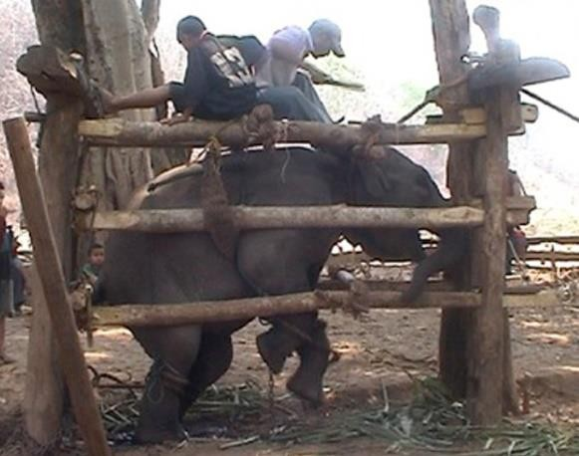
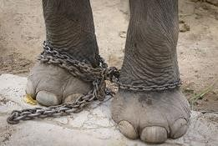
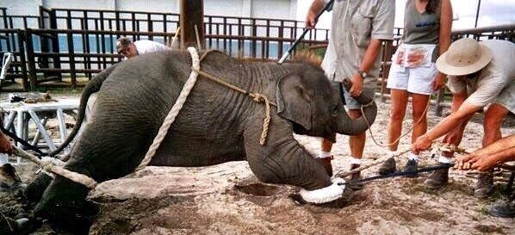
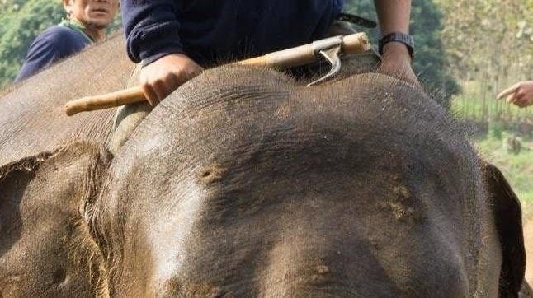
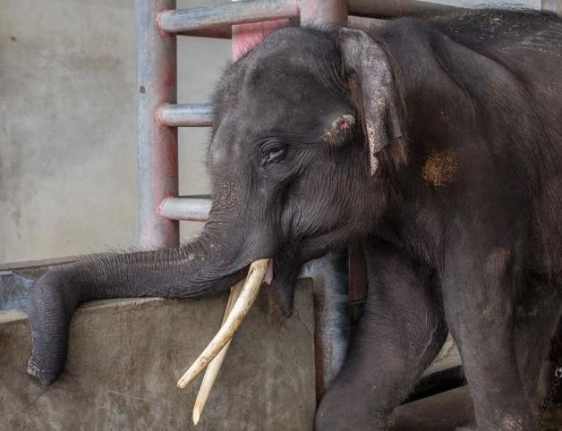
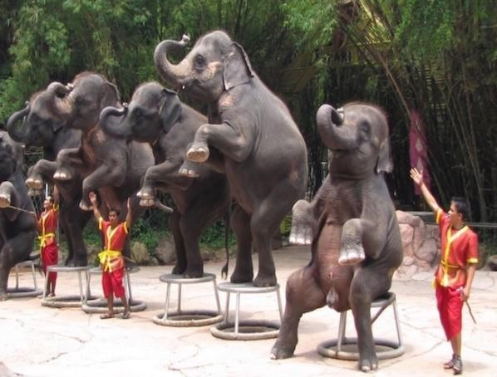
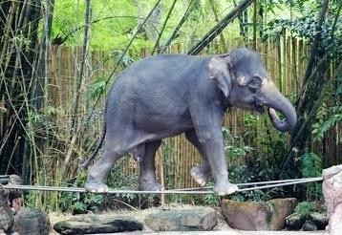
Elephants in tourism – Main welfare risks
Elephants kept in captivity for shows and ride are separated from their mother and trained violently through a practice called « phajaan ». The elephants are isolated, starved and beaten for days to break their wild spirit
Elephants are often chained with very short chains day and night
For activities with contact and shows, elephants are controlled with a
« bullhook ». Right picture: elephant with injuries from bullhook
Elephants are forced to perform unnatural
tricks for shows, under the bullhook threat

Slide 10
Expert support and position
ABTA, 2019:
Any practice involving human-elephant contact is unacceptable.
The ABTA (Association of British Travel Agents) is the reference in terms of animal welfare in tourism
In 2013, they published guidelines overseeing animal welfare in tourism, with a specific focus on elephants
These guidelines were written by 200 experts (NGOs, industry associations, individual experts…) and are
currently being reviewed with the objective to be more demanding.
Club Med has been moving forward in its approach in close collaboration with ABTA for several years,
following ABTA’s recommendations and participating to their animal welfare workshop. The recommendations
included in this chapter are based on all this work and reflection.

Slide 11
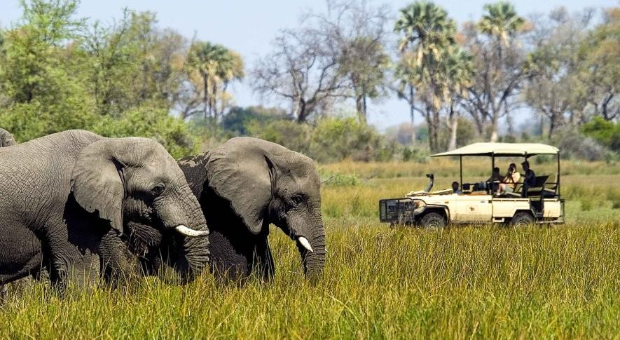
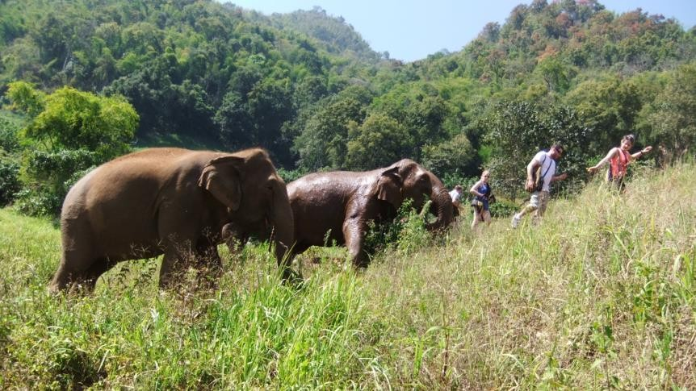
Elephant tourism – Responsible alternatives
Observing elephants being their wild selves is the encouraged elephant tourism activity.
Highest welfare venues allow observational activities only with no direct interaction between humans and elephants. Without contact, the animals are less stressed and thus less dangerous, which allows for less control from the owner, and more peace of mind. Observations activities still enable to provide local people with a vital, sustainable income from wildlife tourism.
Some recognized sanctuaries allow occasional contacts with the elephants and still maintain a high level of
welfare. E.g., the NGO World Animal Protection identified venues with best welfare conditions.

Slide 12
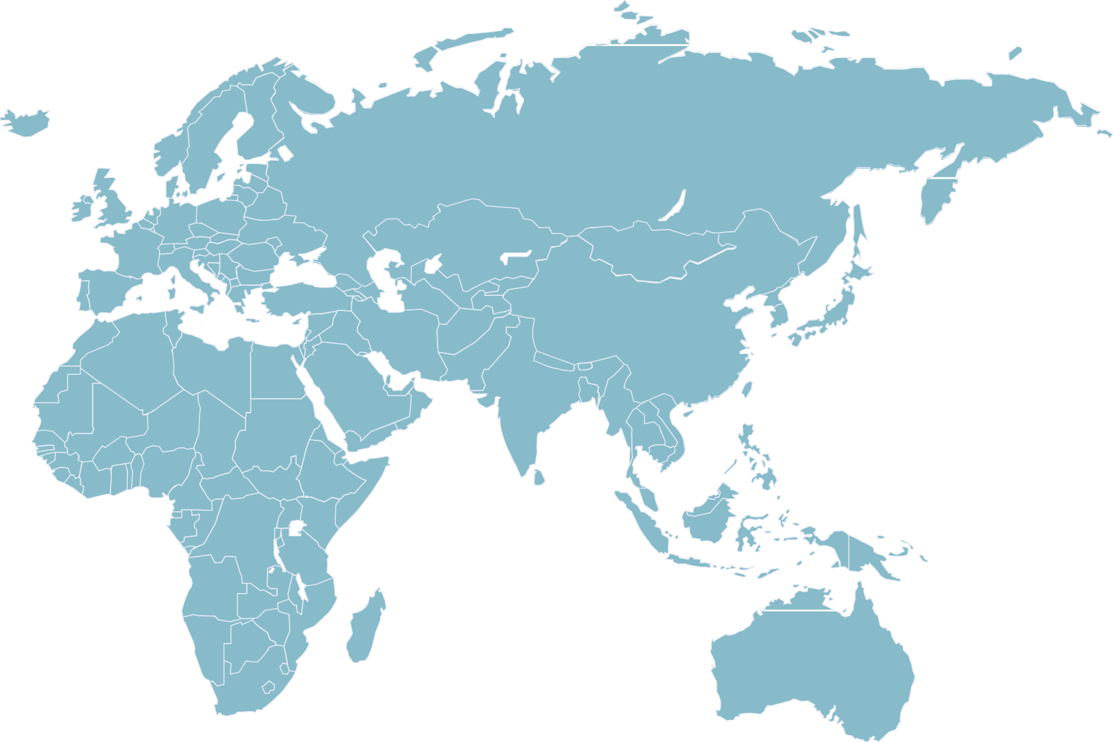
Club Med: 13 elephant activities, 1 resort, 12 circuits
Nepal (1)
Thailand (1)
Excursions: Phuket:
Elephant observation
Sri Lanka (1)
Kenya (1)
Tanzania (1)
Phuket
Circuits:
Elephant observation
Elephant sanctuary
Namibia (3)
South Africa (4)

Slide 13
Elephants
Club Med commitment for
From the end of 2020, Club Med will only offer activities of observation of elephants.
The following activities will be stopped by end of 2020:
Circus shows,
Riding activities,
Bathing activities.

Slide 14
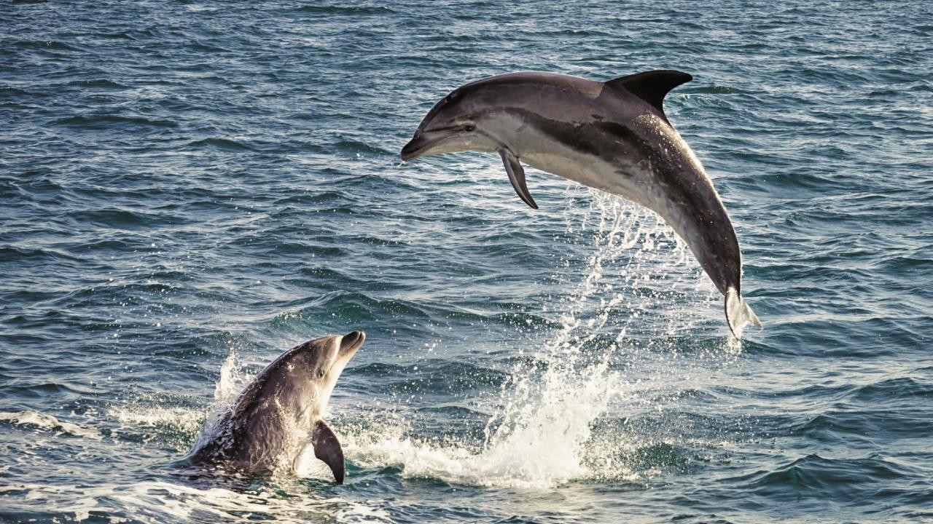
Cetaceans

Slide 15
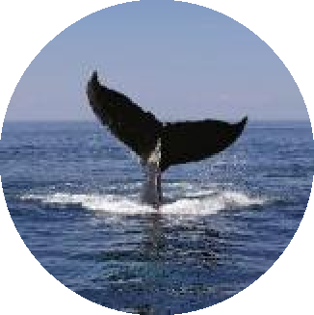
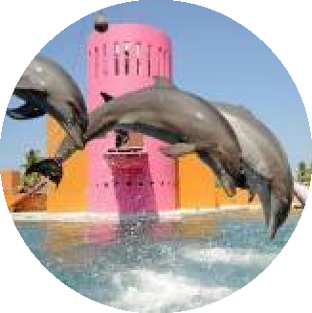
Cetaceans in tourism
MAIN ACTIVITIES WITH CETACEANS
Dolphins and orcas shows in marine parks
« Swim with cetaceans » activities in marine parks
Viewing cetaceans in marine parks
« Swim with cetaceans » activities in the wild
Observing cetaceans in the wild
ISSUES OF CETACEAN TOURISM
Issues of captivity:
Cetaceans naturally live in complex societies and have intelligence comparable to apes and elephants
In captivity, cetaceans are offered a too restrictive space compared to the distances they travel in the wild
They suffer from social and behavioural restrictions
Issues with “in the wild” activities:
Captive and wild cetaceans can be dangerous
Ill-managed boat excursions can make cetaceans unsettled, spending less time feeding, socialising or resting

Slide 16
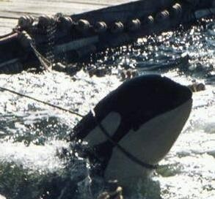
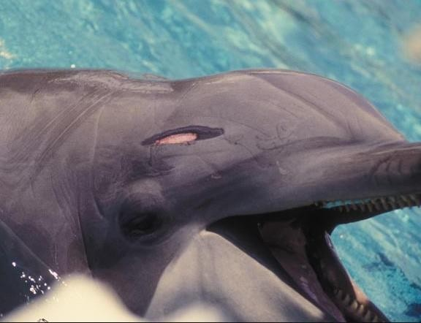
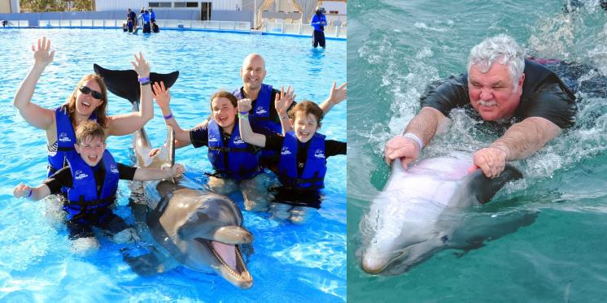
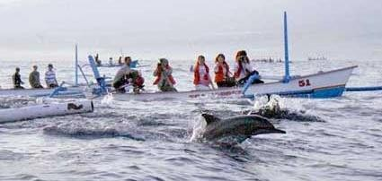
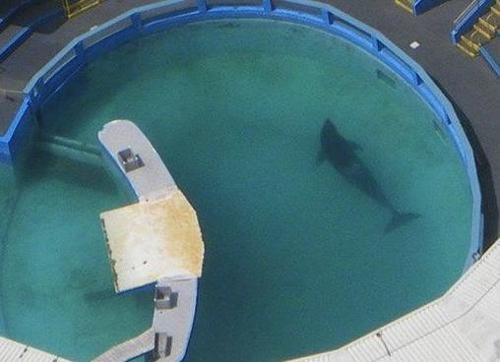
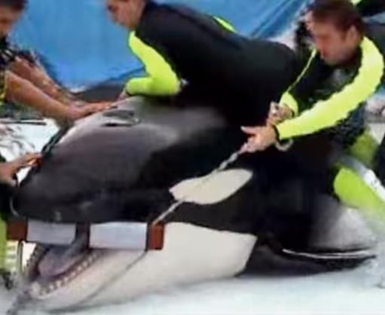
Cetaceans in tourism – Main welfare risks
CAPTIVITY UNETHICAL PRACTICES IN THE WILD UNETHICAL PRACTICES
Animals are often captured violently from the wild
Cetaceans hurt themselves on their tank’s bars, most of them have worn down teeth
« Swim with » activities are stressful to cetaceans since they cannot leave and they can be hurt by human contact
Pressure from numerous boats can disturb cetaceans, especially if boats are chasing the animals
Animals who normally swim more than 100km a day are confined in small tanks
Violent control methods are sometimes used
Almost no captive orca has lived past 30 years old. In the wild, they can live up to 80

Slide 17
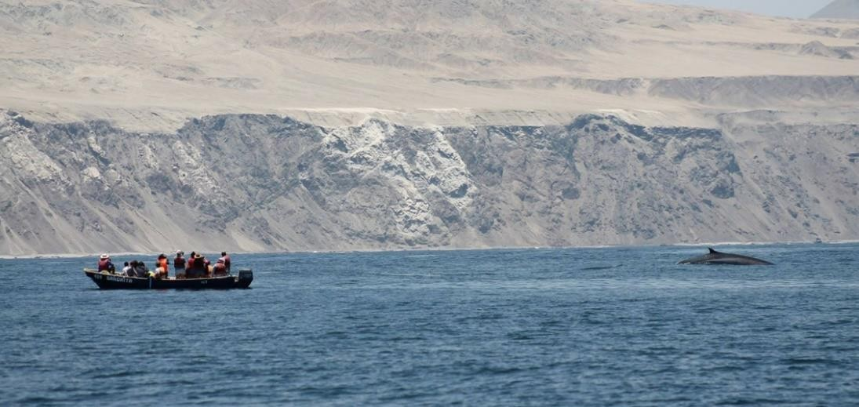
Expert support and position
WCA: Holding cetaceans in captivity is unacceptable.
The WCA (World Cetacean Alliance) is the world's largest partnership working to protect whales, dolphins and porpoises. It gathers non-profit organizations, tour operators and individual experts worldwide to raise awareness on cetaceans.
Protecting cetaceans does not mean stopping all tourist activities, but any activity must be properly designed and supervised, for the safety of animals and humans involved.

Slide 18
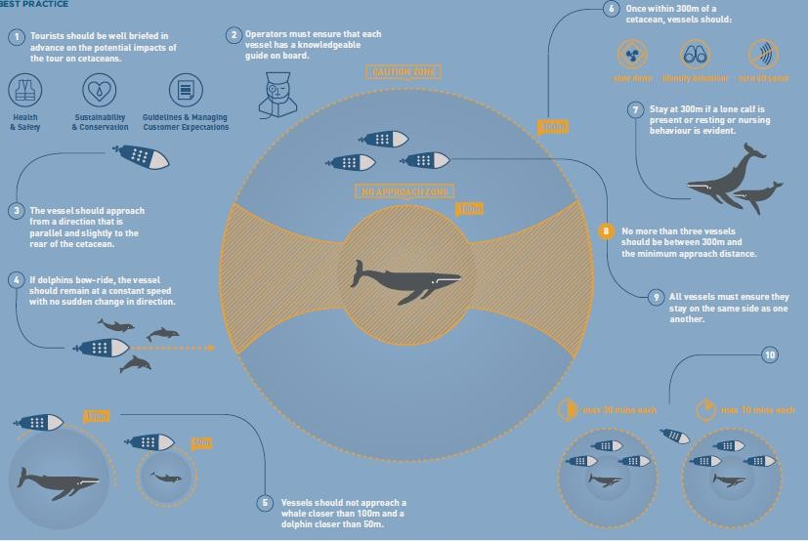
Club Med and the WCA co-created the first international guide on cetaceans observation
In 2018, Club Med sponsored the creation by the World Cetacean Alliance of the first international guidelines on cetaceans observation. This document highlights best practices and unacceptable practices for observation by boat and by swimming.

Slide 19
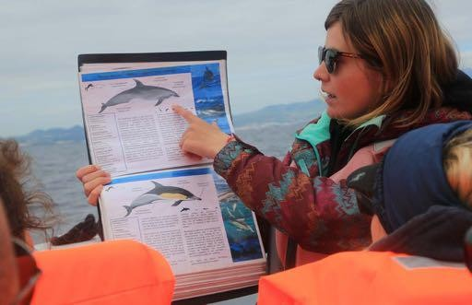
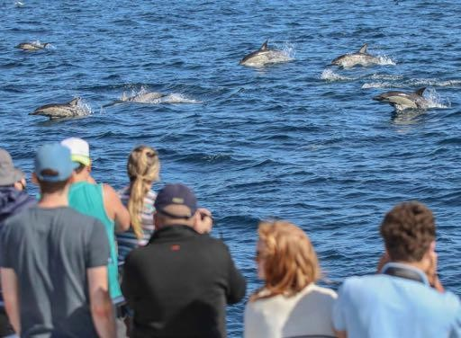
Cetacean tourism – Responsible alternatives
Cetacean watching in the wild is the activity with the most positive impact, provided it is done properly.
Club Med and WCA international cetaceans observation best practices guide provides detailed advice to distinguish between unacceptable and best practices for cetacean watching tours suppliers, including boat tours and swimming tours.
Some examples of best practices:
Each boat must have a knowledgeable guide on board and include a briefing of the customers on the animals and their threats
Cetaceans should always be approached from the side and slightly behind, making sure the animal has a right of way
Boats should not approach a whale closer than 100 metres and should not approach a dolphin or porpoise closer than 50 metres
No more than three boats should be between 300 metres and the cetaceans
There should be no water entry if the cetaceans are feeding, resting or trying to flee
Swimmers should never be placed directly in a cetacean’s line of travel or on top of the animals
See WCA and Club Med guide for more information.
The WCA also assesses and identifies responsible suppliers.

Slide 20
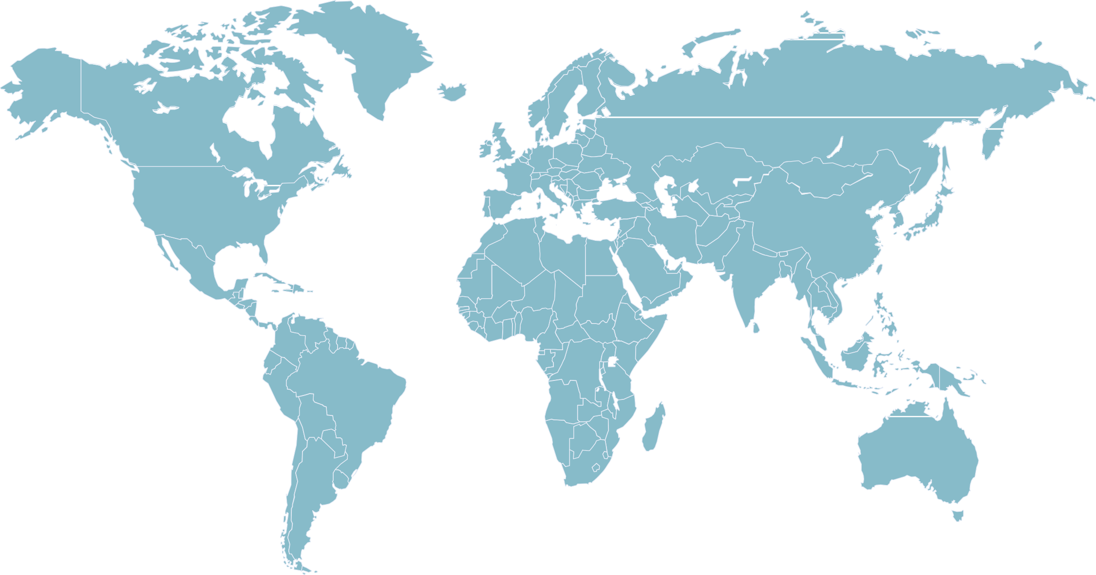
Club Med: 11 cetacean activities, 1 in captivity
Da Balaia
Excursions: Captivity activities
Excursions: In the wild activities
Circuits: In the wild activities
Punta Cana
(2) Captivity + wild
Kani &
Finolhu Villas
Bali
Madagascar (1)
Trancoso
La Pointe & Albion

Slide 21
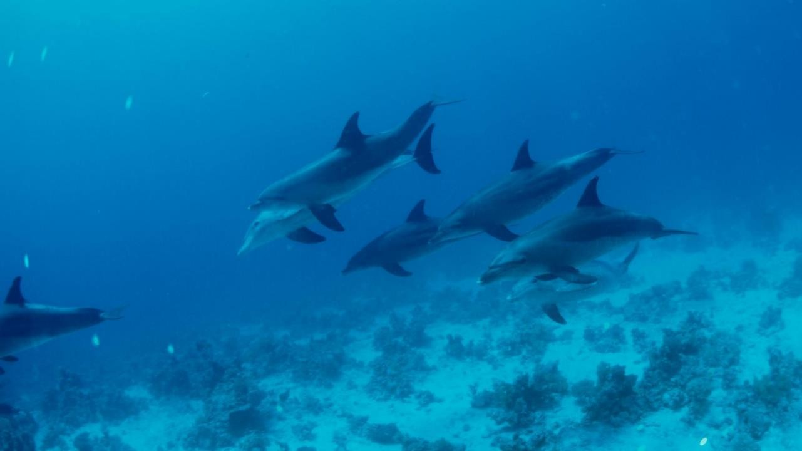
Cetaceans
Club Med commitment for
From the end of 2020, Club Med will only sell activities of observation of cetaceans in the wild.
May 2021 update: last activity will be removed by August 2021.
Since 2019, Club Med works with WCA to train its suppliers on the WCA & Club Med guidelines for wild cetacean observation.

Slide 22
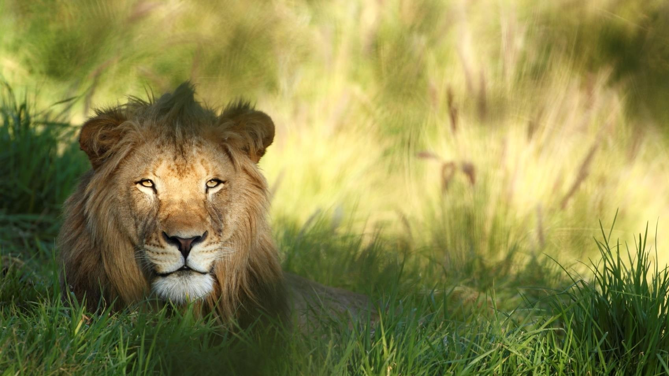
Wild cats
TITLE OF THE PRESENTATION 22

Slide 23
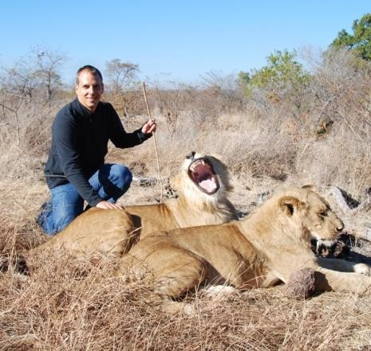
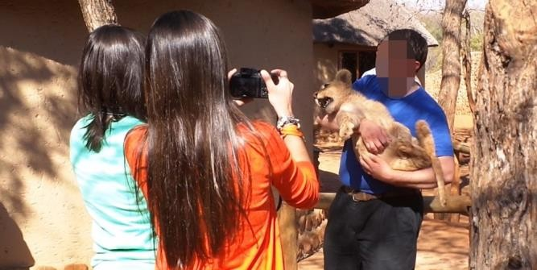
Wild cats tourism – Main welfare risks
Cubs are often separated from their
mothers for pictures with tourists.
They may be chained up or kept in small cages where they are not properly fed.
2
As the lion grows, it may be involved in activities such as Walking with lions.
Interacting with tourists goes against wild cats natural behavior. To avoid any risks, wild cats may be drugged, chained, declawed or have their teeth removed.
1
When the lion grows too dangerous for touristic interactions, they risk ending up in facilities in poor living conditions. Some can be sold for hunting activities.
3
ABTA, 2019
Direct contact between tourists and wild cats like feeding
and ‘walking with’ activites are unacceptable practices.

Slide 24
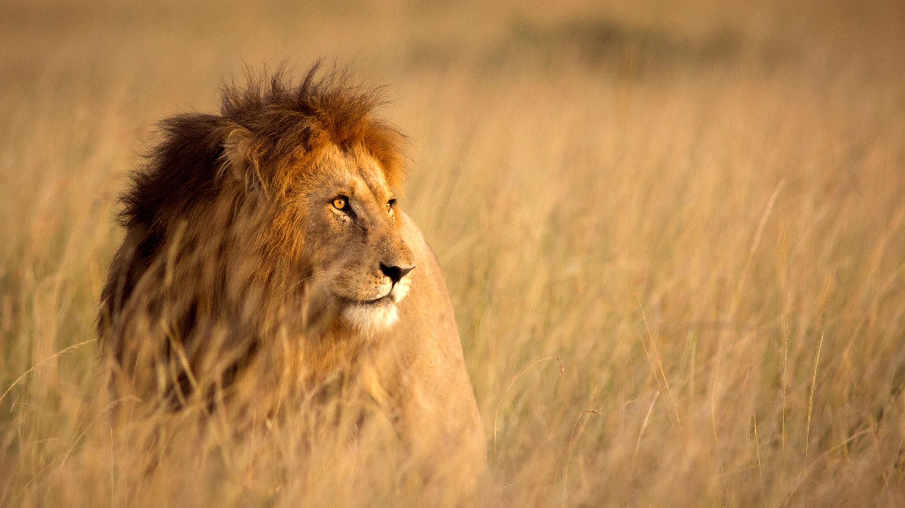
Club Med commitment for
Wild cats
From the end of 2020, Club Med will only offer activities of observation of wild cats.
Activities involving direct interaction with wild cats will be stopped by the end of 2020.

Slide 25
Working animals
TITLE OF THE PRESENTATION 25

Slide 26
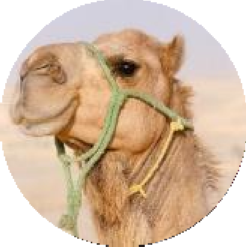
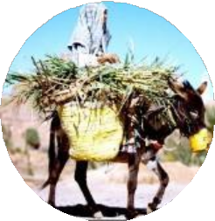
Working animals in tourism
WHAT ARE WORKING ANIMALS?
Animals used for rides (elephants, camels, donkeys…)
Animals used to pull carts, carriages, sleighs
Animals used to carry loads
ISSUES OF WORKING ANIMALS IN TOURISM
Potential impacts on animal welfare:
Animals kept in unsuitable captive conditions
Lack of veterinary care
Problems caused by poorly designed harnesses, saddles
Overloading
Working long hours under hard weather conditions
Cruel training methods
All of these may cause abnormal behaviour, diseases and death
Activities with working animals can be dangerous for humans and must be managed properly
ENSURING MINIMUM WELFARE REQUIREMENTS: THE FIVE FREEDOMS
Freedom from hunger and thirst
Freedom from discomfort
Freedom from pain, injury or disease
Freedom to express normal behaviour
Freedom from fear and distress

Slide 27
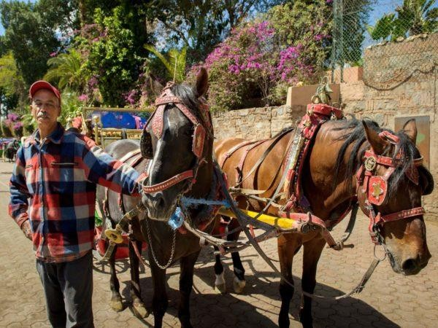
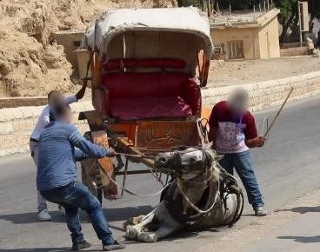
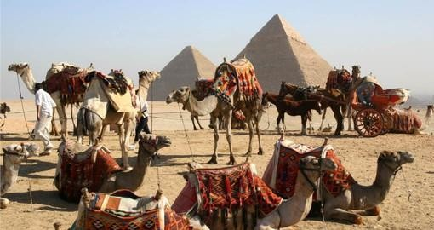
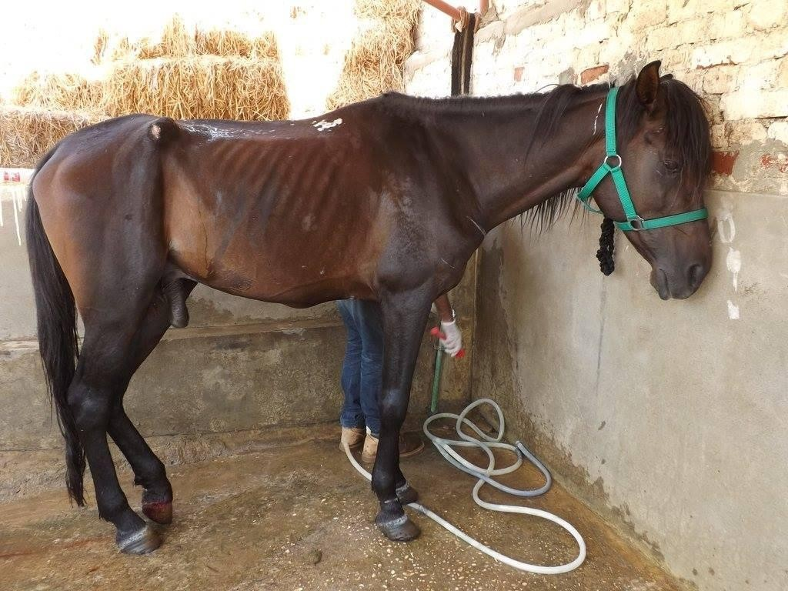
Working animals in tourism – Main welfare risks
Animal can sometimes be forced to work for long hours without rest, carrying too heavy loads or working under severe weather conditions
Working animals are sometimes beaten to do their work
If not adapted, animals can be injured by saddles, harnesses, or ropes. Some owners do not treat the wounds properly before putting the animal back to work
There is a risk that owners do not feed their animals properly in order to save money

Slide 28
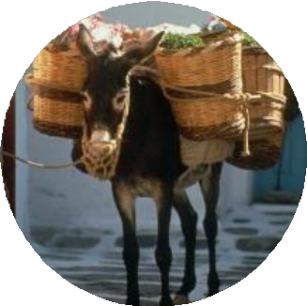
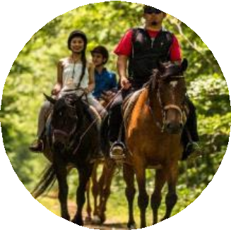
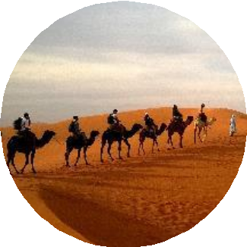
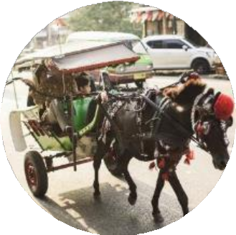
Working Animals at Club Med
XX
Animals carrying loads
E.g., Club Med tour
« Sanctuaires de l’Himalaya »
Working
Animals
XX
Animal rides (horses, camels, donkeys)
E.g., Club Med Agadir, Marrakech, Kemer, Palmiye, Cancun, Punta Cana…
XX
Carriage rides
E.g., Club Med tour « Ramses II »

Slide 29
Working animals
Club Med commitment for
From 2020, Club Med encourages its suppliers to respect working animals welfare through the progressive implementation of its Animal Welfare Charter.
Club Med will be vigilant about suppliers practices and will proceed to animal welfare audit
May 2021 update: due to the ongoing crisis, the implementation of the Animal Welfare
Charter and corresponding audits have been postponed to the industry relaunch

Slide 30
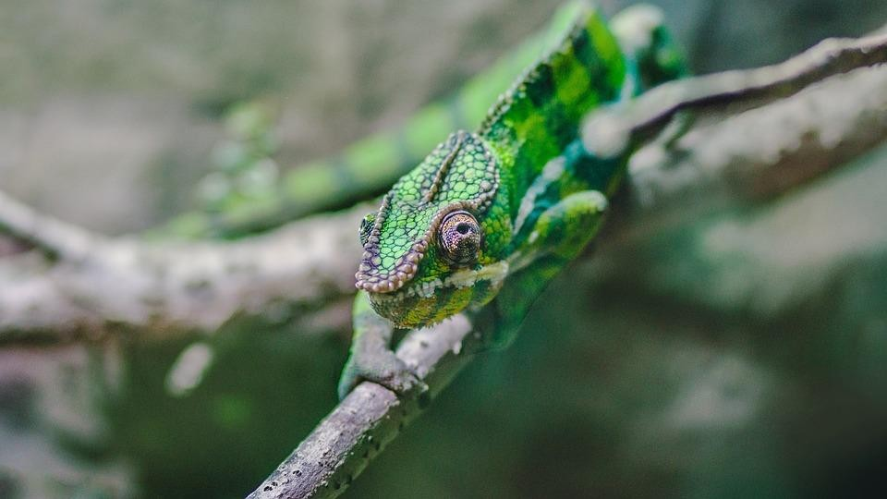
Animals for pictures
TITLE OF THE PRESENTATION
30

Slide 31
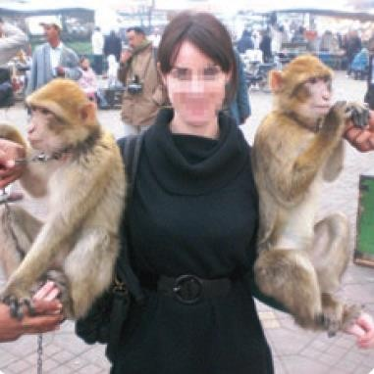
Animal props – Main welfare risks
Animal pictures, also called Animal prom. What is it?
An animal prop is an animal used as an accessory to take a picture with.
What are the risk for wildlife and animal welfare?
Some of the animals used as photo props are directly snatched from their natural habitats, into a noisy and stressful activity.
Animal props are forced to stay for the photo with the tourist. This direct contact goes against natural behaviours and may cause stress and even injuries.
After the show, animal props are often kept in poor living conditions.
ABTA, 2019
Touristic photo involving a wild animal
that is forced to stay is an unacceptable practice.

Slide 32
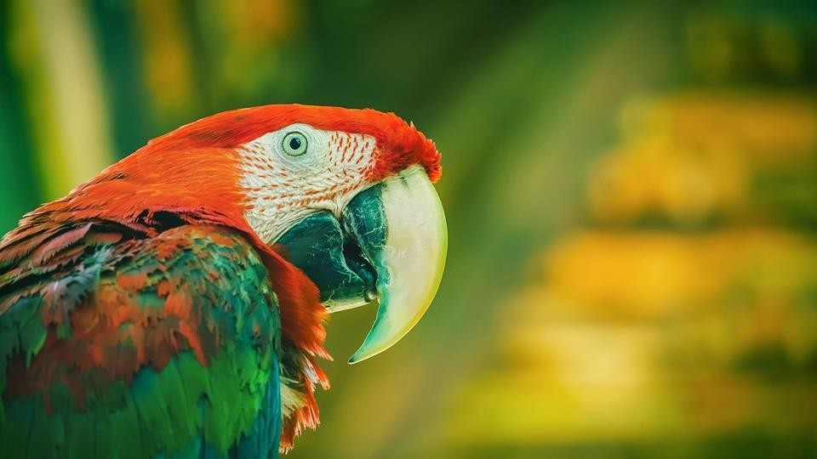
Club Med commitment
for Animal props
By the end of 2020, Club Med will no longer allow the use of wildlife as photographic props.

Slide 33
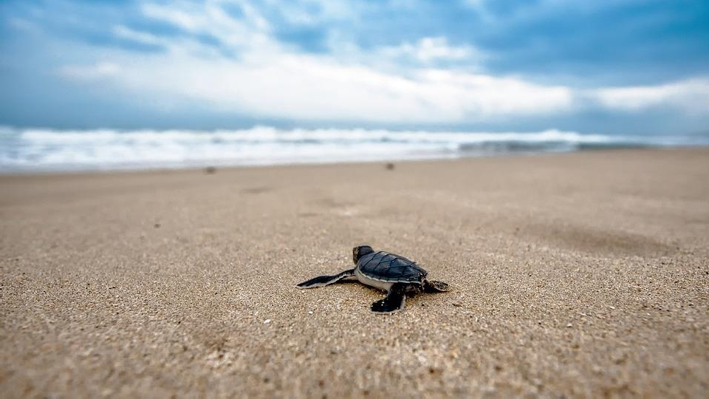
Sea Turtles

Slide 34
Sea turtles - Risks of tourism
Some facts about sea turtles:
Sea turtles are found in all warm and temperate waters throughout the world and migrate hundreds of miles between nesting and feeding grounds.
They spend most of their life in water, but female sea turtles lay their eggs on beaches.
They lay their eggs on the beach were they were born, which means that the resort can disturb them if built on this beach.
Six of the seven species of turtles are threatened or endangered.
Tourism can contribute to endangering marine turtles:
Sea turtles in the water
Sea turtles nesting on beaches
Threats from tourism to sea turtle in water mainly come from watersports and speedboats, especially during breeding season when turtles gather in shallow waters. Very often, turtles are hit by boats without even being noticed
Waste, holes in the sand, sunbeds, parasols and strong lights can all contribute to disturbing the laying turtle, damaging the eggs or preventing the hatches from reaching the sea

Slide 35
Experts support on turtles
Club Med relies on the advice and support of several experts to protect turtles locally at our resorts. Here are some examples :
LA CARAVELLE
IXTAPA BINTAN ISLAND
We work with the Guadeloupe Sea Turtles Network and the protection association « Kap Natirel ». Our partnership was recognized in the France-Antilles newspaper
We partner with « Ixtapa Zihuatanejo », which is a coalition of NGOs and government organisations
The « Bintan Resorts Turtle Conservation Initiative » helps us to protect and collect turtle eggs

Slide 36
In 2013, Club Med created a turtle protection guide
In 2013, we developped an internal guide to raise awareness among our teams and support them in their actions to protect turtles on site.
We were advised by specialists to develop this guide:
Virginie DUVAT, Geography professor and topical environments experts
GAIA DOMO, consulting firm specialized in biodiversity
The guide contains information on marine turtles and their threats, as well as advice on actions that can be implemented by Club Med resorts to help these animals.

Slide 37
Resorts can help protect marine turtles
Example of communication near the beach
Resorts can contribute to raise travelers’ awareness on turtles through:
Conferences and video screenings
Supervised observation of the birth and baby turtles release
Recommendations printed and displayed near the beach
Resorts can help protect turtles and nests from predators by:
Creating a fenced nest area and monitoring the beach every morning for new eggs
Organizing protected release of the baby turtles
Sponsoring local turtle protection associations
Fenced nest area in Club Med Cancun
Protected turtle release at Club Med Bintan Island
Thanks to all these measures, turtles come back to lay their eggs on Club Med’s beaches

Slide 38
Sea turtles nesting sites at Club Med

Slide 39
Sea turtles
Club Med commitment for
In all resorts located in a turtle nesting site, partnering with local experts, Club Med commits to protecting turtles by securing the nests, ensuring non disturbance, and raising awareness.
Club Med will keep the turtle protection guide available to its staff and follow its right application.

Slide 40
Other animal
issues

Slide 41
Club Med commitment
for Cage-free eggs
From 2025 onward, Club Med will only source cage-free eggs*
(shell, liquid and eggs products) for all resorts in Europe, Brazil and the United
States (and from 2027 in the other markets).
In Europe, all eggs served with their shell at the buffet already come from free range hens.
* This commitment is part of our purchasing policy, which implies that all products purchased must meet the company's hygiene and health safety requirements.

Slide 42
Club Med commitment for
Seafood charter
Since 2007, Club Med, through its Sustainable purchasing policy, does not allow the purchase of marine threatened species*.
Our policy is embodied in our Sustainable seafood charter.
*According to IUCN Red List

Slide 43
Club Med commitment for
Animal fur
From the end of 2020, as part of its Animal Welfare policy, Club Med committed to stop buying fur.
By the end of 2021, no more fur will be sold in Club Med’s boutiques.

Slide 44
Additional recommendations for
Stray animals
In case of a group of stray animals on Club Med’s property, Club Med recommends to directly contact local authorities and animal associations to implement a sterilization campaign, and potentially displace them to a suited area.
Introduction of animals on Club Med’s property and their removal by GOs and
GEs should be prohibited (TBD).

Slide 45
Mosquitoes
Additional recommendations for
It is recommended to prefer prevention (limiting stagnant water areas…) and natural methods (larva traps, insect- repellent plants…) but fogging occurs when necessary.
See Kit Mosquitoes – Very unwelcome guest.

Slide 46
CONTACTS
For more information, please contact:
Agnès WEIL, Director of Sustainability
agnes.weil@clubmed.com
Florian DUPRAT, Sustainability manager
Florian.Duprat@clubmed.com

Slide 47
Annexes

Slide 51
Why sterilize stray animals?

