Slide 1
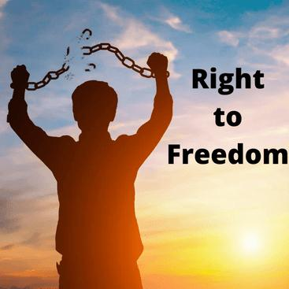
HUMAN RIGHT

Slide 2
THE RIGHT TO FREEDOM
The Right to Freedom of ExpressionThe right to freedom of expression is a cornerstone of democracy and a fundamental human right enshrined in the Universal Declaration of Human Rights. It allows individuals to express their opinions, beliefs, and ideas without fear of censorship or retaliation. This right empowers people to challenge injustices, share knowledge, and participate actively in society. However, it comes with responsibilities and limits, such as avoiding hate speech or incitement to violence. In many parts of the world, freedom of expression is under threat due to authoritarian regimes, misinformation, or censorship. Protecting this right is crucial for fostering open, inclusive, and progressive societies.

Slide 3
ΓΑΒΡΙΉΛ ΝΙΚΟΛΆΟΥ Γ4

