Slide 1
Respect
Aggelos Galanopoulos
Konstantinos Armenakas

Slide 2
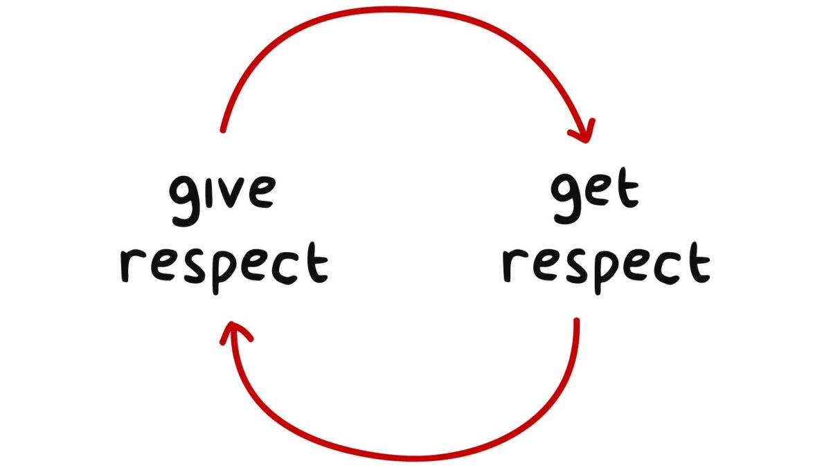
Respect, also called esteem, is a positive feeling or deferential action shown towards someone or something considered important or held in high esteem or regard. It conveys a sense of admiration for good or valuable qualities. It is also the process of honoring someone by exhibiting care, concern, or consideration for their needs or feelings.
In many cultures, people are considered to be worthy of respect until they prove otherwise. Some people may earn special respect through their exemplary actions or social roles. In "honor cultures", respect is more often earned in this way then granted by default.

Slide 3
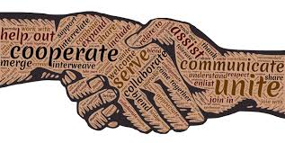
Courtesies that show respect may include simple words and phrases like "thank you" in the West or "namaste" in the Indian subcontinent, or simple physical signs like a slight bow, a smile, direct eye contact, or a handshake. Such acts may have very different interpretations depending on the cultural context. The end goal is for all people to be treated with respect.

Slide 4
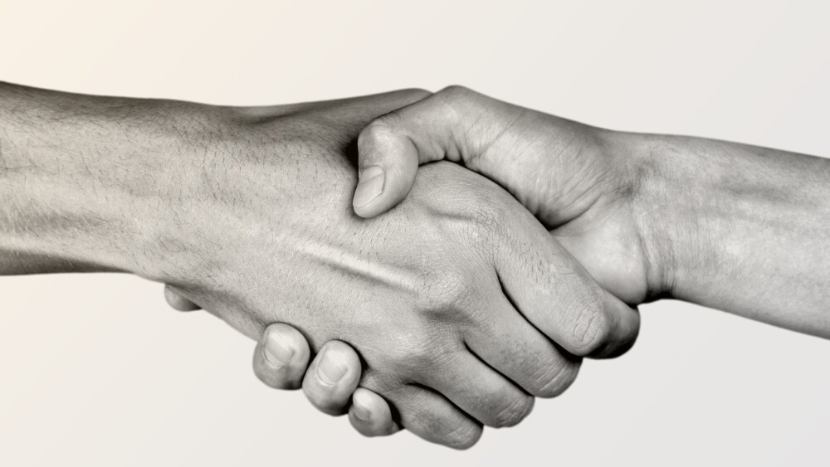
Respect in different cultures
In Islamic cultures, there are many ways to show respect to people. For example, one may kiss the hands of parents, grandparents, or teachers. It is narrated in the sayings of Muhammad "Your smiling in the face of your brother is charity". It is also important for Muslims to treat the Quran with great care, as it's considered the word of God. Actions like placing it on the floor or handling it with unclean hands are forbidden and should be followed by a prayer of forgiveness.
In India, it is customary that, out of respect, when a person's foot accidentally touches a book or any written material (considered to be a manifestations of Saraswati, the goddess of knowledge) or another person's body, it will be followed by an apology in the form of a single hand gesture with the right hand, where the offending person first touches the object with the finger tips and then the forehead or chest.

Slide 5
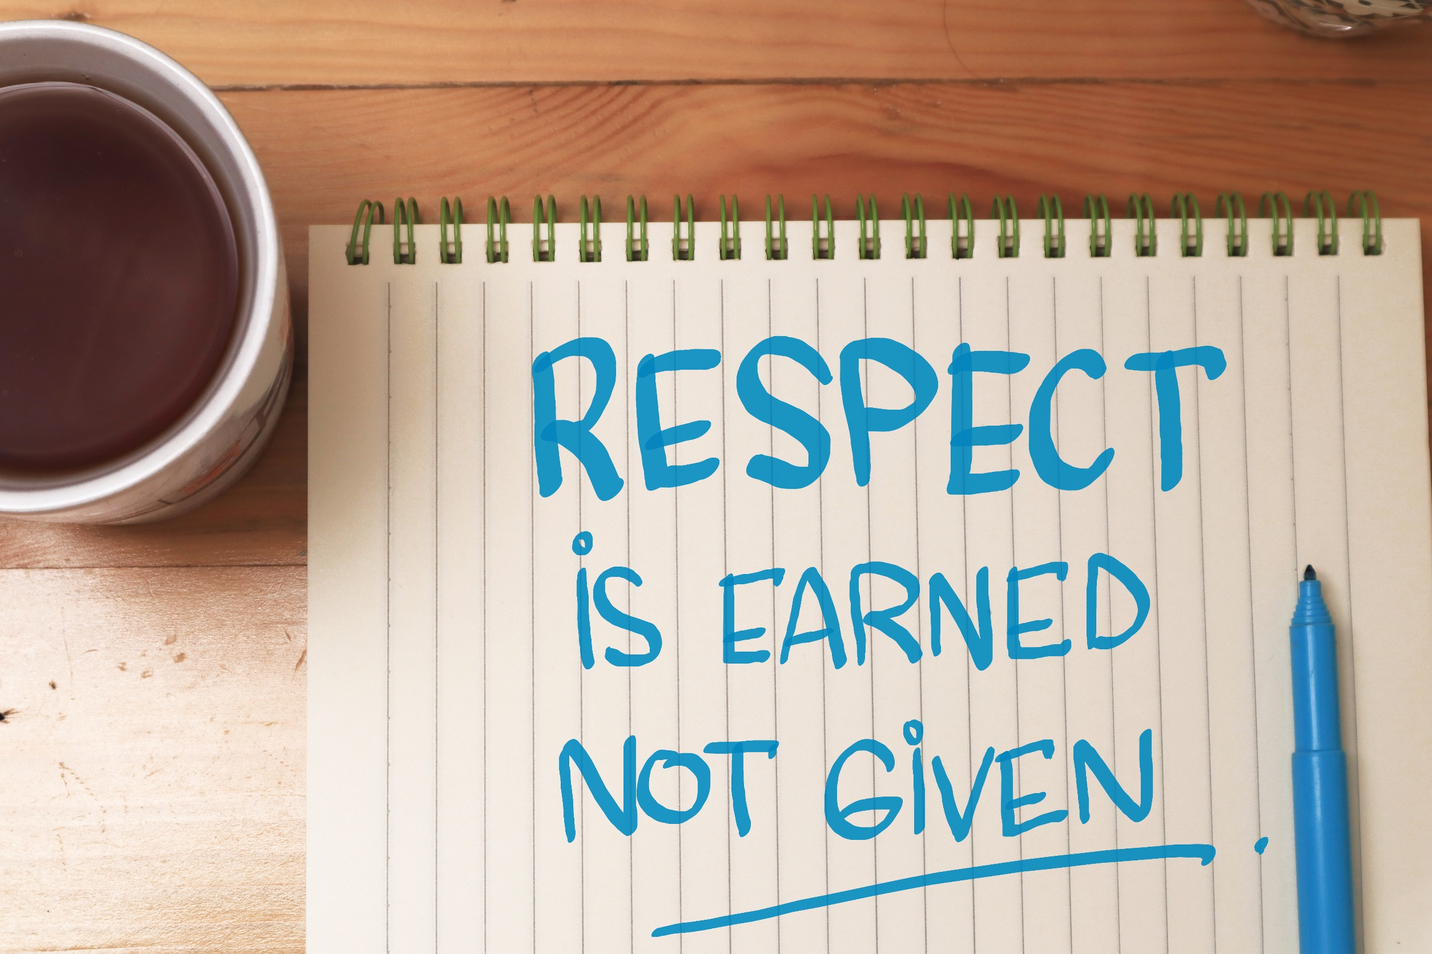
Signs and other ways of showing respect.
One definition of respect is a feeling of admiration for someone or something elicited by their abilities, qualities, and achievements.
In China, it is considered rude to call someone by their first name unless the person is known by the speaker for a long period of time. In work-related situations, people address each other by their titles. At home, people often refer to each other by nicknames or terms of kinship. In Chinese culture, individuals often address their friends as juniors and seniors even if they are just a few months younger or older. When the Chinese ask for someone's age, they often do so to know how to address the person.
An honorific is a word or expression that shows respect when used in addressing or referring to a person.
Typically honorifics are used for second and third persons; use for first person is less common. Some languages have anti-honorific first person form whose effect is to enhance the relative honor accorded a second or third person.
For example, it is disrespectful not to use polite language and honorifics when speaking in Japanese with someone having a higher social status. The Japanese honorific “san” can be used when English is spoken.

Slide 6
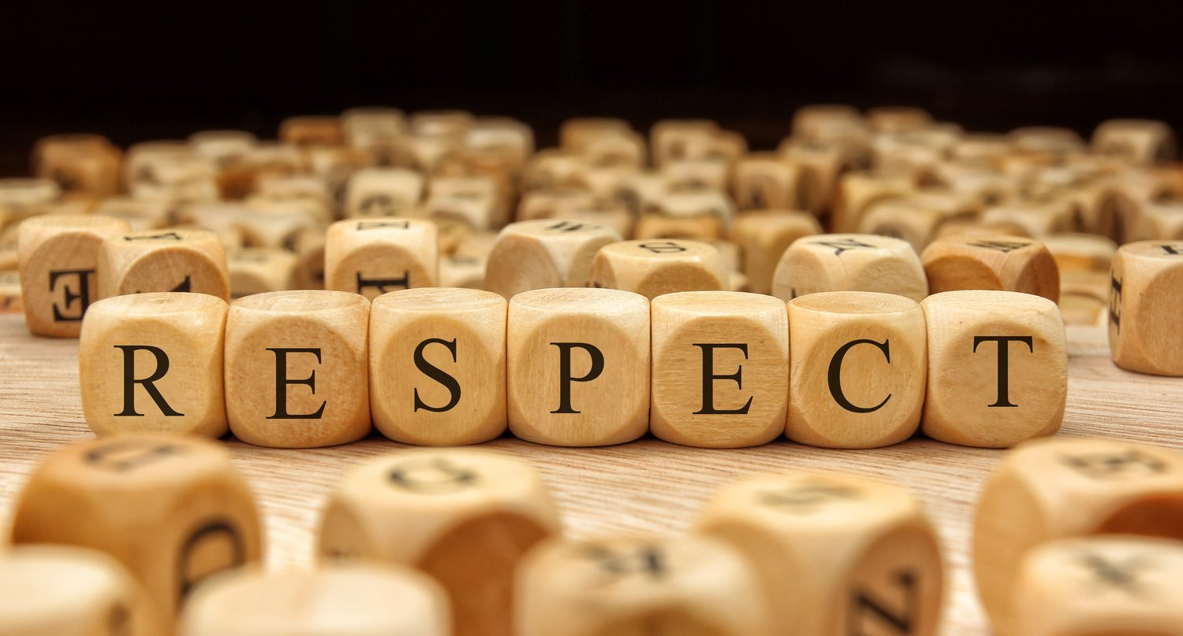
THE END!

