Slide 1
The right to religion
Supervision: Teloni Theodora
Tremouli Kleoniki

Slide 2
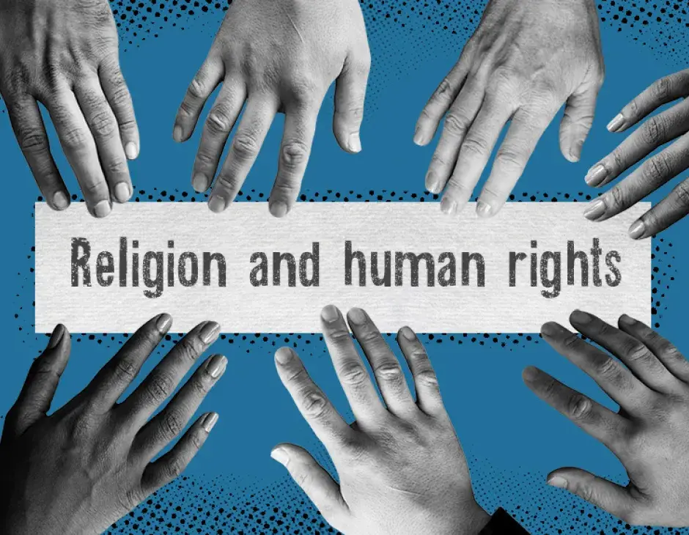
Everyone has the right to freedom of thought, conscience and religion; this right includes freedom to change his religion or belief and freedom, either alone or in community with others and in public or private, to manifest his religion or belief, in worship, teaching, practice and observance.

Slide 3
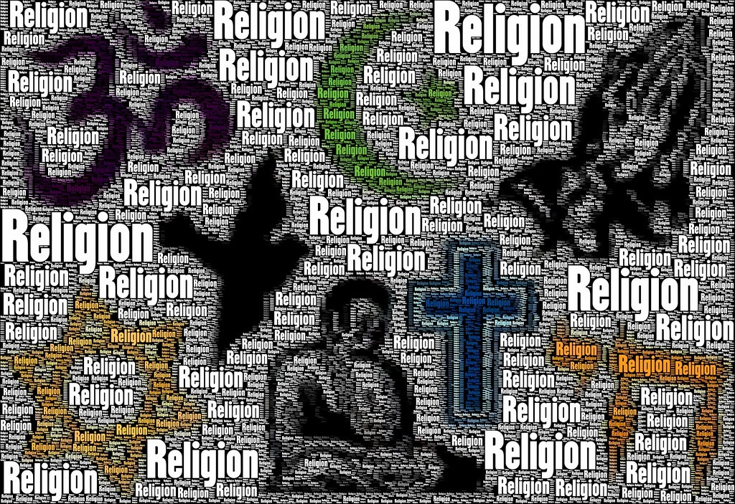
The right to freedom of religion or belief is a fundamental right of every human being, everywhere. However, global religious freedom is under attack, with severe restrictions appearing in all five major parts of the world over the past decade.
Abuses of the right to religious freedom are widespread and affect people around the world. Religious organizations and individuals participating in religious communities must overcome increased repression when expressing their beliefs or demonstrating their religion in public.

Slide 4
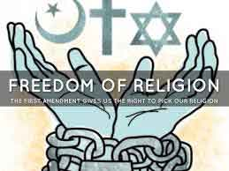
People of good will can do much by working together to reverse the rising tide of religious repression and strengthen the universal right to religious freedom for all.
First, they can understand the nature of the right to religious freedom and take action against threats to that right. Second, they can apply these principles of religious freedom, respecting the rights of all religions and religious beliefs, without discriminating against anyone.
Finally, they can work with people of all faiths to promote and protect religious freedom and tolerance for all nationally and internationally.

