Slide 1
HUMAN RIGHTS
Apostolis Kallergis
Faidonas Theodorou
Γ2

Slide 2
DEFINITION OF HUMAN RIGHTS
Human rights are rights inherent to all human beings, regardless of race, sex, nationality, ethnicity, language, religion, or any other status. Human rights include the right to life and liberty, freedom from slavery and torture, freedom of opinion and expression, the right to work and education, and many more.

Slide 3
HISTORY
Throughout history, concepts of ethical behaviour, justice and human dignity have been important in the development of human societies. These ideas can be traced back to the ancient civilisations of Babylon, China and India. They contributed to the laws of Greek and Roman society and are central to Buddhist, Christian, Confucian, Hindu, Islamic and Jewish teachings.

Slide 4
In 1215, the English barons forced the King of England to sign Magna Carta (which is Latin for ‘the Great Charter’). Magna Carta was the first document to place limits on the absolute power of the king and make him accountable to his subjects. It also laid out some basic rights for the protection of citizens, such as the right to a trial.

Slide 5
17th century English philosopher John Locke discussed natural rights in his work, identifying them as being "life, liberty, and estate (property)", and argued that such fundamental rights could not be surrendered in the social contract. In Britain in 1689, the English Bill of Rights and the Scottish Claim of Right each made a range of oppressive governmental actions, illegal. Two major revolutions occurred during the 18th century, in the United States (1776) and in France (1789), leading to the United States Declaration of Independence and the French Declaration of the Rights of Man and of the Citizen respectively, both of which articulated certain human rights. Additionally, the Virginia Declaration of Rights of 1776 encoded into law a number of fundamental civil rights and civil freedoms.

Slide 6
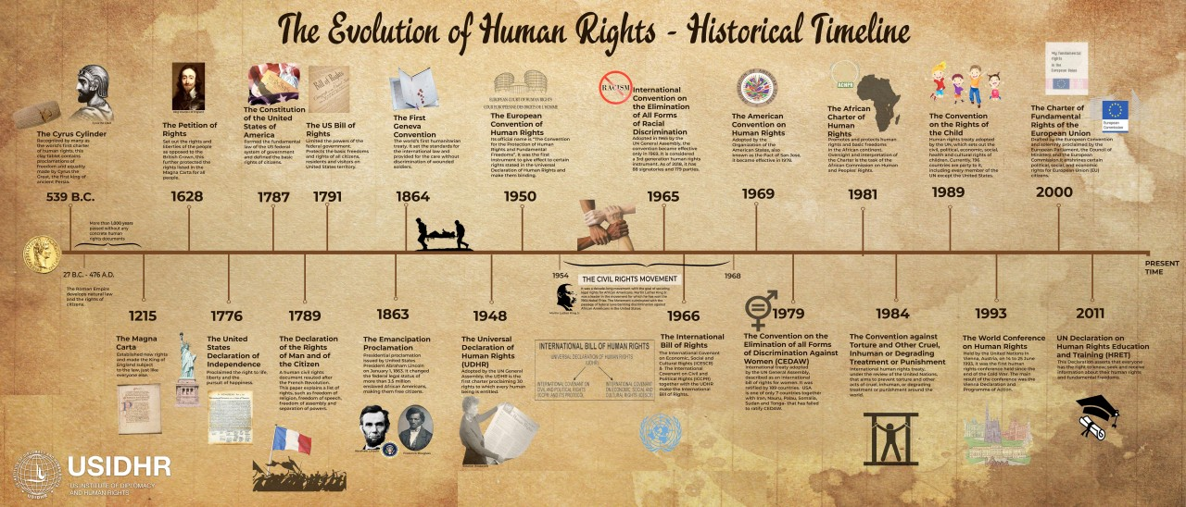

Slide 7
IMPORTANCE
Values of tolerance, equality and respect can help reduce friction within society. Putting human rights ideas into practice can helps us create the kind of society we want to live in. In recent decades, there has been a tremendous growth in how we think about and apply human rights ideas. This has had many positive results - knowledge about human rights can empower individuals and offer solutions for specific problems. Human rights are an important part of how people interact with others at all levels in society - in the family, the community, schools, the workplace, in politics and in international relations. It is vital therefore that people everywhere should strive to understand what human rights are. When people better understand human rights, it is easier for them to promote justice and the well-being of society.

Slide 8
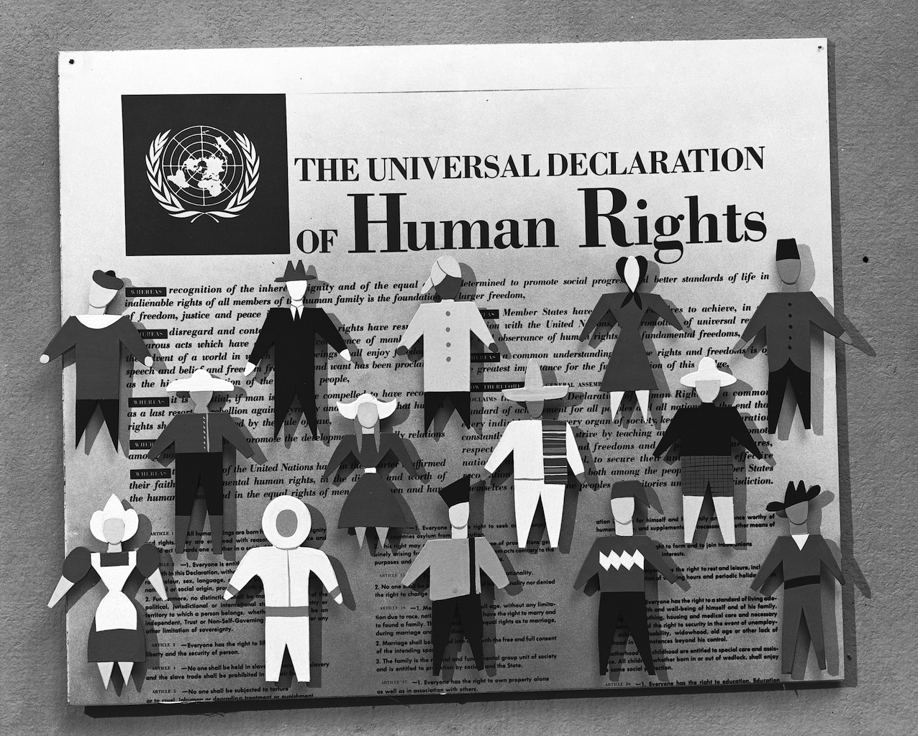

Slide 9
Violation of Human Rights
Human rights violations occur when the inherent freedoms and rights of individuals, as established by international norms, are disregarded or abused. These violations take various forms, including discrimination, unjust imprisonment, torture, and denial of basic necessities such as food, water, and shelter. Often, they are perpetuated by governments, armed groups, or even societal structures.For instance, restrictions on freedom of speech and assembly undermine democratic principles, while practices like forced labor and human trafficking strip individuals of dignity and liberty. Addressing human rights abuses requires robust legal frameworks, global advocacy, and societal commitment to equality and justice. Protecting these rights is essential for fostering peace, fairness, and human development worldwide.

Slide 10
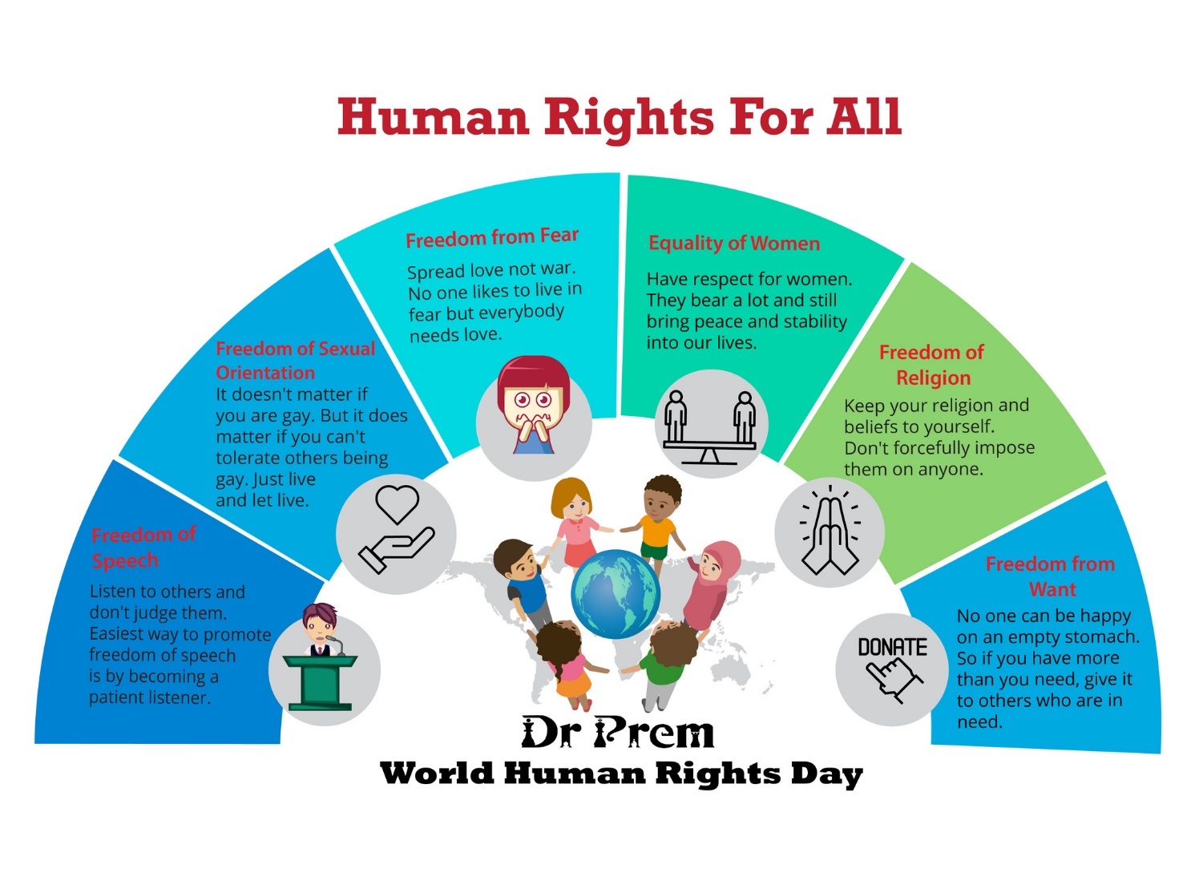

Slide 11
THANKS FOR WATCHING

