Slide 1
FREEDOM Of SPEECH
English Assignment
Teacher: Christine Gogou
Presentation: Lydia Marinopoulou, Theano Manola
Class: Γ3

Slide 2
Freedom of speech is one of the most fundamental pillars of a democratic society. It ensures that individuals can express their thoughts, opinions, and beliefs without fear of censorship or retaliation. However, this right, while crucial, is not absolute and must be balanced against other rights and societal values. At its core, freedom of speech promotes the exchange of ideas, fostering intellectual growth and societal progress. In democratic systems, it empowers citizens to critique governments, advocate for change, and hold power to account.
Without this freedom, societies risk becoming stagnant or, worse, authoritarian, where dissenting voices are silenced, and conformity is enforced.

Slide 3
The principle of freedom of speech is enshrined in numerous legal frameworks, such as the First Amendment of the United States Constitution and Article 10 of the European Convention on Human Rights. These laws underline its universal importance. Nevertheless, even in countries that champion this right, limitations exist. Speech that incites violence, spreads hate, or harms others is typically restricted. These boundaries aim to protect individuals and communities while maintaining the integrity of public discourse.
One of the key debates surrounding freedom of speech today involves its role in the digital age. Social media platforms have revolutionized communication, giving everyone a voice. However, they have also amplified the spread of misinformation, hate speech, and harmful content. Striking a balance between protecting free expression and ensuring a safe online environment remains a pressing challenge.

Slide 4

Another aspect to consider is cultural relativity. While freedom of speech is a cornerstone of Western democracies, not all cultures or political systems view it in the same way. In some nations, restrictions on speech are justified by appeals to tradition, religion, or national security. Critics argue that these restrictions often serve to entrench power and suppress dissent rather than genuinely protect societal values.
Free Speech flag

Slide 5
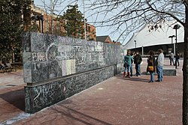
In conclusion, freedom of speech is both a right and a responsibility. It empowers individuals to voice their opinions but also demands that they do so with respect and consideration for others. In an increasingly interconnected and diverse world, fostering open yet respectful dialogue is essential. Only by understanding and navigating its complexities can we uphold this vital freedom while ensuring it serves the greater good of society.
“Permanent freedom of speech wall in Charlottesville, Virginia."

Slide 6
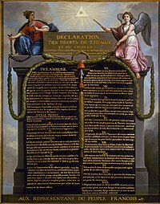
https://en.wikipedia.org/wiki/Freedom_of_speech
https://www.uscourts.gov/about-federal-courts/educational-resources/about-educational-outreach/activity-resources/what-does-free-speech-mean
https://www.amnesty.org/en/what-we-do/freedom-of-expression/
«Declaration of the Rights of Man and of the Citizen» from 1789

