Slide 1

HUMAN RIGHTS OF REFUGEES

Slide 2
THE CAUSES
There are many reasons why people around the globe seek to rebuild their lives in a different country. Some people leave home to get a job or an education. Others are forced to flee persecution or human rights violations such as torture. Millions flee from armed conflicts or other crises or violence. Some no longer feel safe and might have been targeted just because of who they are or what they do or believe – for example, for their ethnicity, religion, or political opinions.

Slide 3
EQUAL RIGHTS
An asylum seeker is a person who has left their country and is seeking protection from persecution and serious human rights violations in another country, but who hasn’t yet been legally recognized as a refugee and is waiting to receive a decision on their asylum claim. Seeking asylum is a human right. This means everyone should be allowed to enter another country to seek asylum. It is important to understand that, just because migrants do not flee persecution, they are still entitled to have all their human rights protected and respected, regardless of the status they have in the country they moved to. Governments must protect all migrants from racist and xenophobic violence. Migrants should never be detained or forced to return to their countries without a legitimate reason. We campaign for a world where human rights can be enjoyed by everyone, no matter what situation they are in. We should make sure governments honour their shared responsibility to protect the rights of refugees, asylum seekers and migrants.

Slide 4
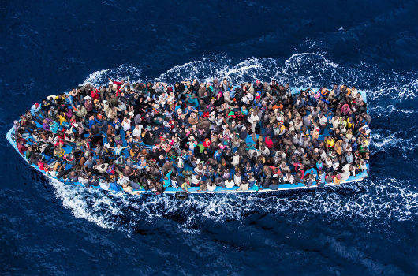
VIOLATION OF BASIC RIGHTS
Unable to prove their citizenship, stateless people may face a lifetime of obstacles trying to access basic rights and services. They often are not allowed to go to school, see a doctor, work legally, open a bank account, buy a house or even get married. This creates and perpetuates generational cycles of poverty. Every human being deserves a life free from persecution and discrimination. But displacement can affect anyone. Hundreds of thousands of people are forced to flee their homes every day – young and old, sick and healthy, sons and daughters.

Slide 5
ACCESS TO HEALTH
Good health is an essential requirement for refugees to be able to rebuild their lives. The right to health exists for all people, including refugees. The right to health means that all of us can access affordable essential health services when and where we need them. Many refugees, however, face tremendous obstacles in meeting their health needs. Fundamentally, all people, including refugees, have the right to access the highest available standard of care without experiencing financial hardship.
Refugee access to national healthcare systems depends on the policies of the host country. In some countries, refugees can access national health systems and services under the same conditions as nationals. This can mean that healthcare costs could be subsidized, reduced, or free (notably during an emergency). In other countries, refugees can only access national health services as foreigners (often meaning at a higher cost). There are also several host countries where refugees are not able to access national healthcare due to national policies or geographical inaccessibility. The costs for private healthcare in these countries are often prohibitive and act as a financial barrier to accessing healthcare. Before displacement, many refugees live in countries experiencing humanitarian crises. During the journey out of their country, refugees may face harsh or dangerous conditions that have severe consequences for their physical and psychological wellbeing. Arriving in their new host country, refugees often do not have access to affordable health services. They may not be able to visit health providers, get medicines and medical supplies, laboratory tests and other life-sustaining health services due to distance, safety, language, policy, or financial barriers. Treatment for ongoing conditions, including noncommunicable diseases and malnutrition, is often interrupted. Refugees may have to live with serious injuries, like broken bones, without medical help.

Slide 6
general
Human rights and refugee law
Human rights are the rights that a person is guaranteed by way of birth. The following are universal human rights that are most relevant to refugees
The right to freedom from torture or degrading treatment
The right to freedom of opinion and expression
The right to freedom of thought, conscience, and religion
The right to life, liberty, and security
Freedom from discrimination
The right to asylum

Slide 7
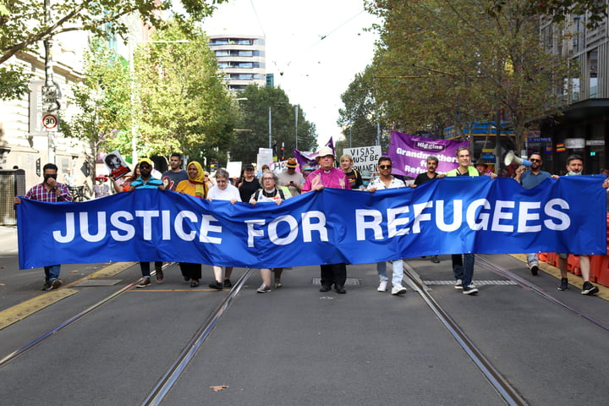
conclusion
Refugee law and international human rights law are closely connected in content but differ in their function. The main difference of their function is the way in which international refugee law considers while international human rights law do not. One of the core principles of international refugee law is the basic idea that a country cannot send back a person to their country of origin if they will face endangerment upon return. In this case, a certain level of sovereignty is taken away from a country.
LOIZOY ALIKI Γ3

