Slide 1
HUMAN RIGHTS
RIGHTS DON’T MAKE EXCEPTIONS:
A PRESENTATION ABOUT DIVERSITY
Barbara Karaviti Γ2

Slide 2
Universal Declaration of Human Rights
ARTICLE 2
According to the Universal Declaration of Human Rights “Everyone is entitled to all the rights and freedoms set forth in this Declaration, without distinction of any kind, such as race, colour, sex, language, religion, political or other opinion, national or social origin, property, birth or other status. Furthermore, no distinction shall be made on the basis of the political, jurisdictional or international status of the country or territory to which a person belongs, whether it be independent, trust, non-self-governing or under any other limitation of sovereignty.’’

Slide 3
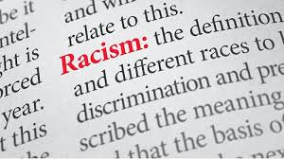
DIVERSITY EXISTS WHEN IT COMES TO HUMAN RIGHTS.
IS THIS DIVERSITY VIOLΑTED?
Sadly, even though people have come a long way, there are numerous forms of racism in today’s world. Racism takes the right from people to have access to facilities, entertainment resources, even housing.

Slide 4
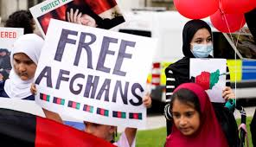
EXAMPLES:
Surely, there are other examples that need to be mentioned from laws that take the right from citizens to have rights without discriminations, but the issue with Talibans and their slavery towards women is without a doubt a shocking topical fact. An important mention is also the marginalization of black people.
We live in serious times that human rights are constantly violated. So, it is important to stay active and in touch with other nations.

Slide 5
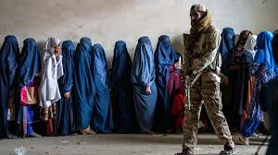
DISCRIMINATION IN GENDER:
We have the strong example of women in Afghanistan:
Talibans have very strict rules towards women. Rules that no one can imagine that people are obligated to follow in the 21st century.
The discrimination of gender is highlighted in this nation. Women have become objects that belong to men. Furthermore, Afghan women are no longer able to study beyond Primary school, go to parks, gyms, nursing homes and leave their homes unaccompanied. Other Islamic laws forbid them to sing or recite poetry.

Slide 6
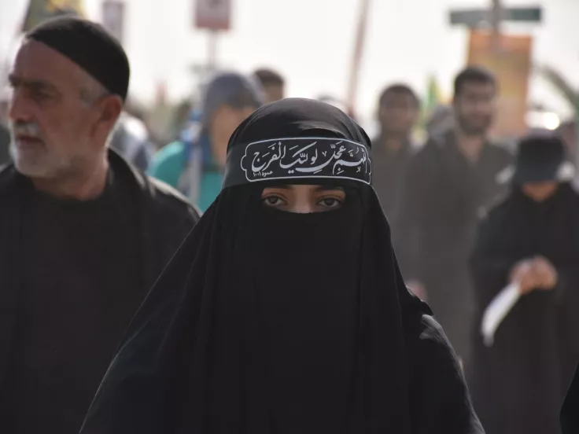
Regarding clothing, females are obligated to wear a clothing named <<burqa>> in public and in front of males that are not a part of their family. More importantly, the supreme leader of the Taliban stated that “Unless they have some important work to do outside the house, it is better to stay inside”.

Slide 7
DISCRIMINATION IN RACE:
Moreover, Black People have faced and still face a lot of difficulties due to the color of their skin. One of the most pressing challenges African states faced at Independence was their lack of infrastructure. Also, they face serious cases of police brutality and economic inequality. Discrimination due to race is one of the most common forms of racism and people are fighting constantly to have unchanged and respected rights.

Slide 8
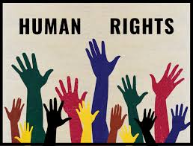
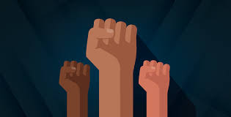
THANK YOU FOR YOUR ATTENTION

Slide 9
SOURCES:
https://www.kathimerini.gr/world/561847102/afganistan-oi-talimpan-epivalloyn-tin-mpoyrka/
https://www.capital.gr/diethni/3883914/talimpan-oi-gunaikes-sto-afganistan-epitrepetai-na-milane-metaxu-tous/
https://www.un.org/en/about-us/universal-declaration-of-human-rights
https://www.pewresearch.org/race-and-ethnicity/2022/08/30/black-americans-have-a-clear-vision-for-reducing-racism-but-little-hope-it-will-happen/

