Slide 1
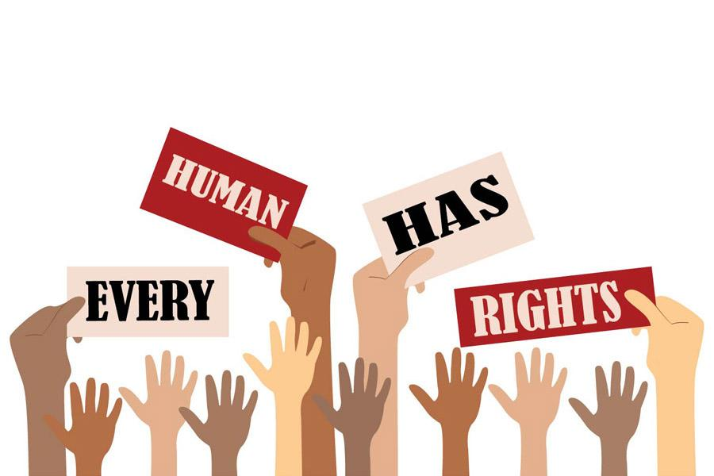
Human Rights: The Right For A Free Life
It is widely known that people all around the world protest, fight or beg for help from socially developed countries in order to regain or win the rights they never had before. However, what is the real meaning of Human Rights exactly? Let’s start with the definition of the term. Human rights are basic rights and freedoms inherent to all human beings. They recognise and protect the dignity of every person in the world, from birth until death. They are documented in the Universal Declaration of Human Rights and in related conventions, declarations and regional instruments. Some examples include freedom of speech, political association, religion, and sexual identity. Moreover, it is necessary for human rights to be protected by the law and the government, although in many countries are clearly violated due to dictators or politicians with dictatorial tendencies who impose their “sick” policies. One of those, is the right to live a free life.

Slide 2
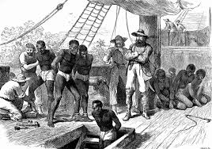
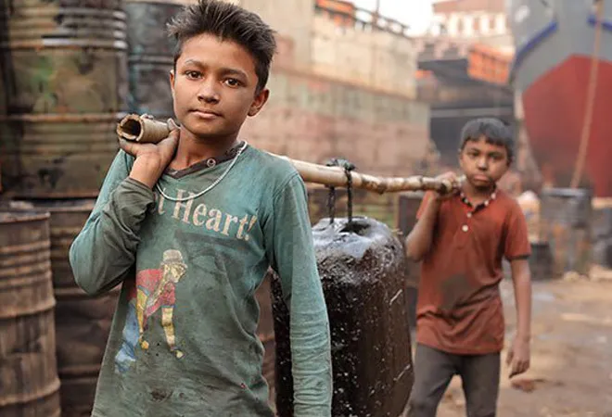
Human Slavery/ Human Trafficking:
First and foremost, a significant example of freedom deprivation is the slavery of black people that took place in the United States during the 19th Century. Although the black people eventually gained equality with the white ones, humanity has still failed to achieve the protection of a significant amount of people that are taken to fulfill the wishes of others. This illegal action is widely known with the term “Human Trafficking”.
Millions of people continue to be trafficked each year, in all regions, and in most countries of the world victims may be trafficked within a country or across a border for various purposes, including forced and exploitative labour in factories, forms and private households, sexual exploitation, forced marriage and organ removal. It is essential to be pointed out that from all of the above types of slavery, many of the victims are children as it is easier to manipulate and handle them with lower or no payment.

Slide 3
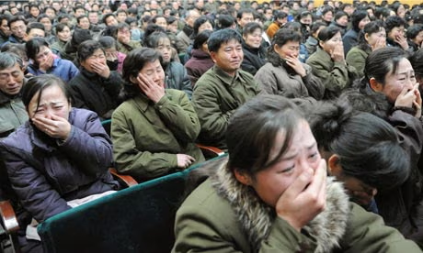
Human Rights violated by tatolitarian regimes:
Even governments violate human rights, such as North Korea, have no right to free speech and movement even within the country. More specifically they are neither aloud to travel abroad nor express their opinion about anything. Furthermore, North Koreans are forced to obey their Leader, Kim Jong Un and those who don’t follow his policy are imprisoned, tortured and eventually executed with the rest of their family. In addition, citizens of North Korea are forced to show their love to their dictator (although it’s fake) and treat him as a god even after his death. Typical example of this behaviour was when people crying for the death of their previous
Leader, Kim Jong Il, in order to survive. Another fact of their mistreatment is that they are not eating properly and at times are led to starvation. Last but not least, religion is forbidden.

Slide 4
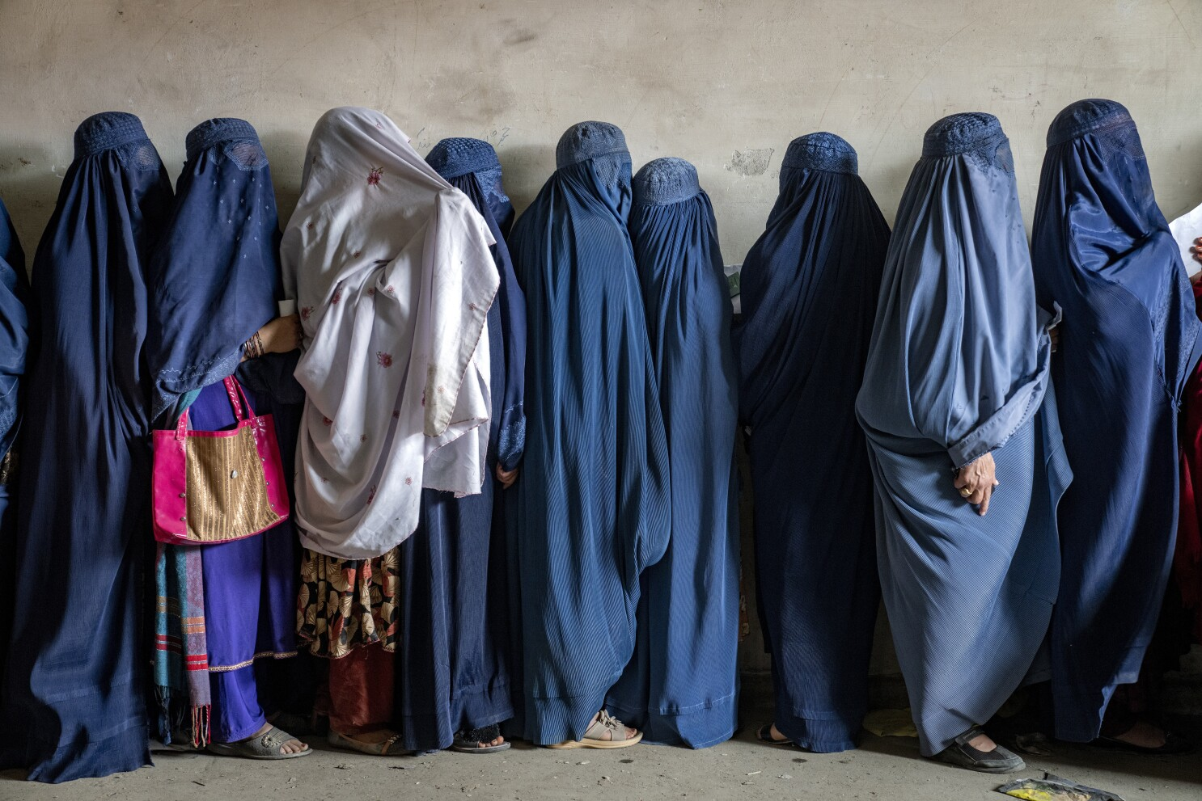
Another example of human rights violation by political regimes is in Afghanistan where the women are mostly affected. They have no right to express their opinions, to go outside alone, to work outside their house attend school beyond primary education. Additionally, Afghan women are mostly treated as objects rather than human beings. To be specific, they are required to cover their entire bodies and are also prohibited from interacting with non muslims, using public transport alone and looking at men to whom they are not related by blood or marriage.

Slide 5

THANK YOU FOR WATCHING!!
Vassilis Karatsikis

