Slide 1
Human Rights The right to education and its violation
Margarita Lytinaki
Γ3

Slide 2
What are Human Rights
Human rights are standards that recognize and protect the dignity of all human beings. Human rights govern how individual human beings live in society and with each other, as well as their relationship with the State and the obligations that the State have towards them. No government, group or individual person has the right to do anything that violates another’s rights.
Human rights are inherent to all human beings and are not granted by any state or country.
They are universal and apply to everyone, regardless of nationality, national or ethnic origin, sex, religion, language or other status.
The rights range from the most fundamental -the right to life-, to those that make life worth living such as the right to food, liberty, freedom from slavery and torture, freedom of expression, education, and more.

Slide 3
Universal Declaration of Human Rights
The Universal Declaration of Human Rights is a milestone document in the history of Human rights. It was drafted by representatives with Legal and Cultural backgrounds from all regions of the world.
The Universal Declaration of Human Rights (UDHR),adopted by the United Nations General Assembly in Paris on December 1948, was the first legal document to set out the fundamental human rights to be universally protected.
It consists of 30 articles (30 human rights) and it has been translated into over 500 languages.

Slide 4
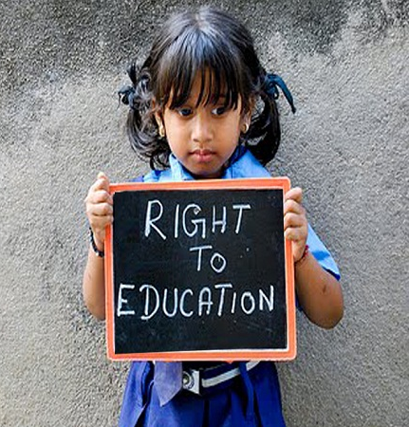
Right to Education
One of the most important rights is the one described in Article 26, the RIGHT to EDUCATION.
Everyone has the right to education. Education shall be free, at least in the elementary and fundamental stages. Elementary education shall be compulsory. Technical and professional education shall be made generally available and higher education shall be equally accessible to all on the basis of merit.
Education shall be directed to the full development of the human personality and to the strengthening of respect for human rights and fundamental freedoms. It shall promote understanding, tolerance and friendship among all nations, racial or religious groups, and shall further the activities of the United Nations for the maintenance of peace.
Parents have a prior right to choose the kind of education that shall be given to their children.

Slide 5
Violation of the Right to education
The violation of the right to education can be met both in the developed and non developed countries in different forms and issues.
Non developed countries violate the right of children to education through the poor conditions in which people leave, but also due to the discrimination that women and little girls face in every aspect of their lives.
On the other hand, on the developed countries, the right of equal education between children is violated mostly due to the different social and economic statuses and discrimination in races, religions and gender.
Conflicts and War also restrict the access of children and Individuals to Education.
More specifically, violation of educational rights include issues such as:

Slide 6
Violation of the Right to education
Discrimination:
Excluding certain groups of people based on gender, race, ethnicity, disability or socioeconomic status.
Due to Racial discrimination students or certain racial backgrounds may face lower expectations from teachers or isolation from other students.
Gender discrimination discourage girls from seeking education and that leads to gender gap in literacy and opportunities.
In addition, socioeconomic discrimination makes students, from lower income families, face barriers such as lack in technology resources, or even sport and entertainment events at school.

Slide 7
Violation of the Right to education
Lack of Resources:
Insufficient Materials, underqualified teachers, or poor infrastructure due to Inadequate Funding by the Government.
When educational institutions are underfunded, they may lack basic resources such as textbooks, qualified teachers, and safe learning environments leading to poor educational outcomes.

Slide 8
Violation of the Right to education
Prohibited Access:
Preventing Children and Individuals receiving school education due to
various barriers:
In areas affected by Conflicts and War, schools may be destroyed making it impossible for children to access education.
Religious restrictions implemented by some groups of people restrict access to education for specific population as a mean of control.
Lack of accessible infrastructure prevent children with disabilities from attending school.

Slide 9
Violation of the Right to education
Safety Concerns:
Schools that are not safe due to violence, bullying, or hazardous conditions deter students from attending and undermine their right to a secure education.

Slide 10
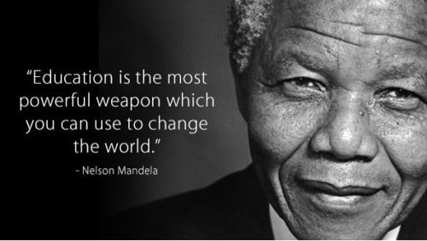
Let’s all Respect the Right to Education
Nelson Mandela firmly believed that Education is the most powerful weapon which we can use to change the world.
He recognized that true freedom and equality could only be achieved by investing in the minds of the youth.
If we want to make this world a better one, we should all do our best to educate children of all races, genders, religions, social and economical status.
By this way we will help them open their minds and make this ugly world a better one.

Slide 11
Sources
https://unicef.org
https://un.org
https://www.ohchr.org/en
https://unesdoc.unesco.org/
https://educatetogrow.com/
https://www.nelsonmandela.org/news/entry/the-importance-of-education-to-madiba

Slide 12
Thank You!!

