Slide 1
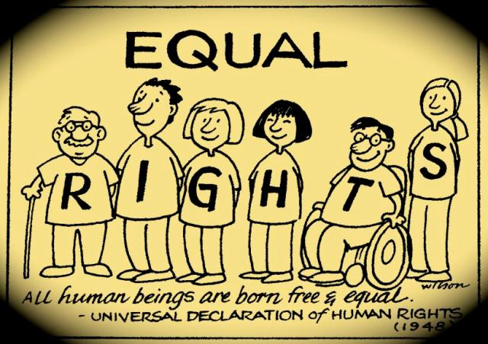
International Declaration of Human Rights 1948
EQUALITY
Nino Kefaloudis
Ilianna Klouvatou

Slide 2
Article 2 of Universal Declaration of Human Rights
Everyone is entitled to all the rights and freedoms set forth in this Declaration, without distinction of any kind, such as race, colour, sex, language, religion, political or other opinion, national or social origin, property, birth or other status. Furthermore, no distinction shall be made on the basis of the political, jurisdictional or international status of the country or territory to which a person belongs, whether it be independent, trust, non-self-governing or under any other limitation of sovereignty.

Slide 3
What Does Equality Mean?
Equality is the state of being equal, especially in status, rights and opportunities. Equality means each individual or group of people is given the same resources and opportunities, regardless of their circumstances. In social and racial justice movements, equality can actually increase inequities in communities as not every group of people needs the same resources or opportunities allocated to them in order to thrive.

Slide 4
Examples of Equality
1) Equality in Language
Leaders in the National Capital Area host an information meeting for all community members on the COVID-19 pandemic, testing, vaccinations and more. They only host the meeting once, and it is only held in the English language. There are no translators or separate meetings for residents who do not speak English or speak English as a second language, isolating a large population of the National Capital Area from receiving important and potentially life-saving health information. An equitable meeting would have included different languages, including English, Spanish and Korean to serve all major populations. This way, everyone hears the same information in their native or primary language.

Slide 5
2) Equality and the Digital Divide
Low-income students in a Prince George’s County neighborhood do not have access to the internet and do not own computers, making it difficult for them to complete lessons and homework assignments through their school’s virtual, at-home school year during the pandemic. On the other hand, other students throughout the county have affordable access to Wi-Fi, laptops and other needed digital tools to succeed in school. A local nonprofit allocates funds to give each student in the county a laptop, but because they do not have enough funds to supply both laptops and hotspots to every student, they are unable to provide any student with a Wi-Fi hotspot. The students that did not previously have internet access in their homes, now have a laptop but still cannot access their school’s virtual classrooms and therefore miss lessons and homework assignments throughout the school year. In the equitable version of this example, funds would be allocated to only give students in need a laptop and a hotspot, instead of every student as not every student needed the technology they already had access to.

