Slide 1
Rights of Equality ΦΩΤΕΙΝΗ ΓΑΛΑΝΟΠΟΥΛΟΥ ΧΡΥΣΑ ΓΚΟΥΦΑ

Slide 2
Rights of Equality
Equality affirms that all human beings are born free and equal. Equality presupposes that all individuals have the same rights and deserve the same level of respect. All people have the right to be treated equally.
When do I need to consider the rights of equality and non-discrimination?
race
sex
age
disability
colour
religion
nationality
language
Equality demands that no one faces discrimination based on traits like race, gender, age, sexuality, or disability. Everyone can access equal opportunities and the resources they need to thrive.

Slide 3
Rights of Equality
Legal recognition
What are the 3 rules of equality
According to some articles that protects the right to be recognised everywhere as a person before the law,this means that they cannot be limited or qualified under any circumstances.
What are the equal rights in the EU?
Every EU citizen enjoys the same fundamental rights based on the values of equality, non-discrimination, inclusion, human dignity, freedom and democracy.
Reflexive Property | a = a
Symmetric Property | If a = b then b = a.
Transitive Property | If a = b and b = c then a = c.

Slide 4
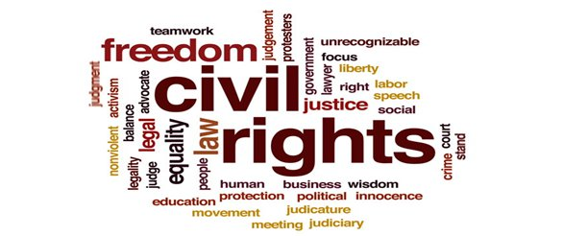
Rights of Equality
What is an example of equal rights?
We are all entitled to human rights. These include the right to live free from violence and discrimination, to enjoy the highest attainable standard of physical and mental health , to do whatever we want with our life and body, to love whoever we want to love and be ourselves, to be educated, to own property, to vote, to work and earn an equal wage.
How to show equality?
Treating everyone equally and fairly.
Creating an inclusive culture that has respect for all cultures and religions.
Ensuring equal access to opportunities for all the citizens.
Enabling people to develop their full potential.
Educating people and making them understand the importance of Equality.
Making more laws and policies to promote Equality

Slide 5
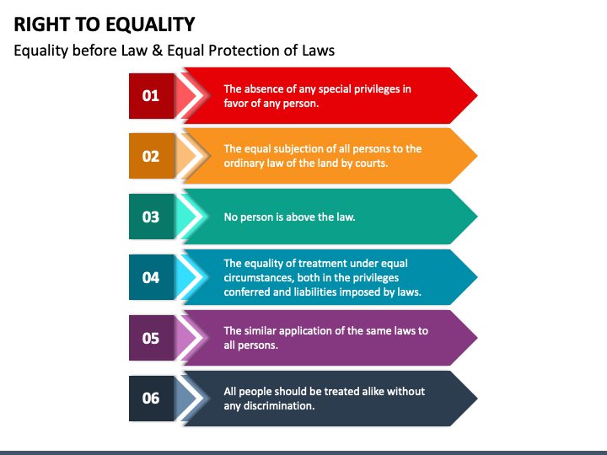
Rights of Equality
Who is ultimately responsible for ensuring human rights violations don’t happen?
In human rights treaties, states bear the primary burden of responsibility for protecting and encouraging human rights. When a government ratifies a treaty, they have a three-fold obligation. They must respect, protect, and fulfill human rights. When violations occur, the police, the judges, prosecutors but also the government are to intervene and prosecute those responsible. The government must hold everyone and itself accountable.

