Slide 1
Rights to freedom of speech
Athanasiou ilias & Atsalakis xaris

Slide 2
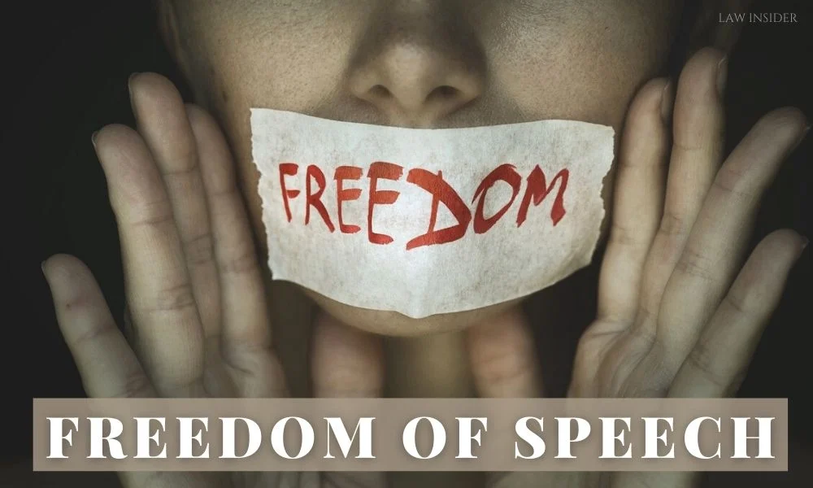
Freedom of speech is a principle that supports the freedom of an individual or a community to articulate their opinions and ideas without fear of retaliation, censorship, or legal sanction. The right to freedom of expression has been recognised as a human right in the Universal Declaration of Human Rights and international human rights law by the United Nations. Many countries have constitutional law that protects free speech. Terms like free speech, freedom of speech, and freedom of expression are used interchangeably in political discourse. However, in a legal sense, the freedom of expression includes any activity of seeking, receiving, and imparting information or ideas, regardless of the medium used.

Slide 3
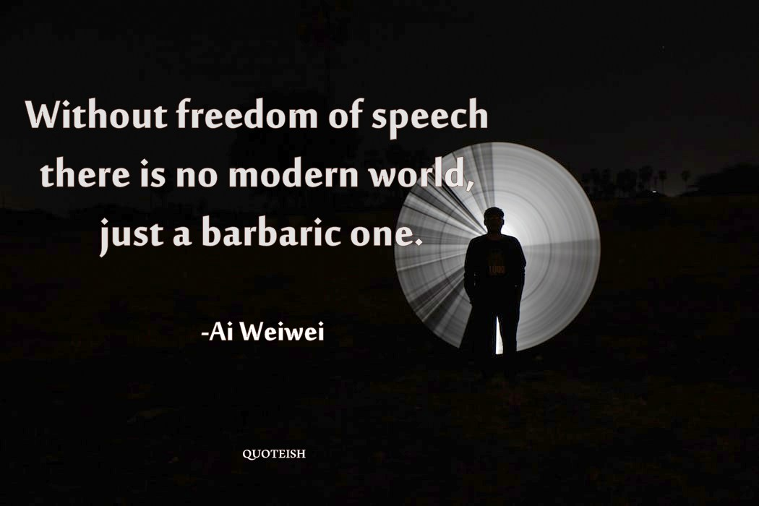
The idea of the "offense principle" is also used to justify speech limitations, describing the restriction on forms of expression deemed offensive to society, considering factors such as extent, duration, motives of the speaker, and ease with which it could be avoided. With the evolution of the digital age, application of freedom of speech becomes more controversial as new means of communication and restrictions arise, for example, the Golden Shield Project, an initiative by Chinese government's Ministry of Public Security that filters potentially unfavourable data from foreign countries. Facebook routinely and automatically eliminates what it perceives as hate speech, even if such words are used ironically or poetically with no intent to insult others.

Slide 4
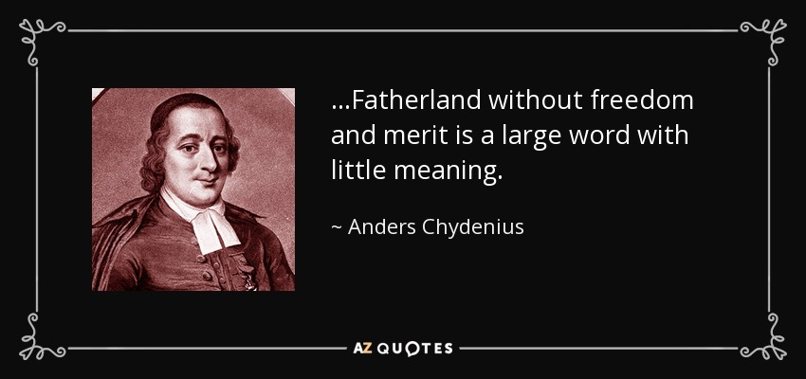
.
One of the world's first freedom of the press acts was introduced in Sweden in 1766 (Swedish Freedom of the Press Act), mainly due to the classical liberal member of parliament and Ostrobothnian priest Anders Chydenius. In a report published in 1776, he wrote:
No evidence should be needed that a certain freedom of writing and printing is one of the strongest bulwarks of a free organization of the state, as, without it, the estates would not have sufficient information for the drafting of good laws, and those dispensing justice would not be monitored, nor would the subjects know the requirements of the law, the limits of the rights of government, and their responsibilities. Education and ethical conduct would be crushed; coarseness in thought, speech, and manners would prevail, and dimness would darken the entire sky of our freedom in a few years.

Slide 5
Relationship to other rights
The right to freedom of speech and expression is closely related to other rights. It may be limited when conflicting with other rights (see limitations on freedom of speech). The right to freedom of expression is also related to the right to a fair trial and court proceeding which may limit access to the search for information, or determine the opportunity and means in which freedom of expression is manifested within court proceedings. As a general principle freedom of expression may not limit the right to privacy, as well as the honor and reputation of others. However, greater latitude is given when criticism of public figures is involved.
The right to freedom of expression is particularly important for media, which play a special role as the bearer of the general right to freedom of expression for all. However, freedom of the press does not necessarily enable freedom of speech. Judith Lichtenberg has outlined conditions in which freedom of the press may constrain freedom of speech. For example, if all the people who control the various mediums of publication suppress information or stifle the diversity of voices inherent in freedom of speech. This limitation was famously summarised as "Freedom of the press is guaranteed only to those who own one". Lichtenberg argues that freedom of the press is simply a form of property right summed up by the principle "no money, no voice".

Slide 6
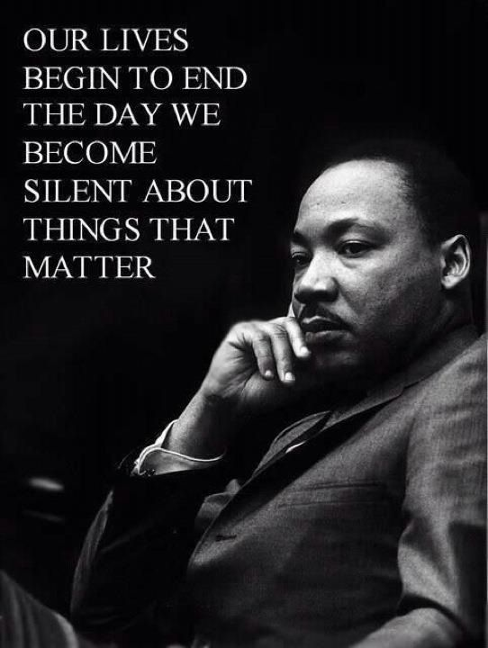
THANKS YOU FOR YOUR ATTENTION

