Slide 1
Freedom of Speech ΔΕΛΗΓΙΩΡΓΗΣ ΧΡΙΣΤΟΦΟΡΟΣ ΓΙΑΝΝΟΥΛΗΣ ΒΑΣΙΛΗΣ

Slide 2
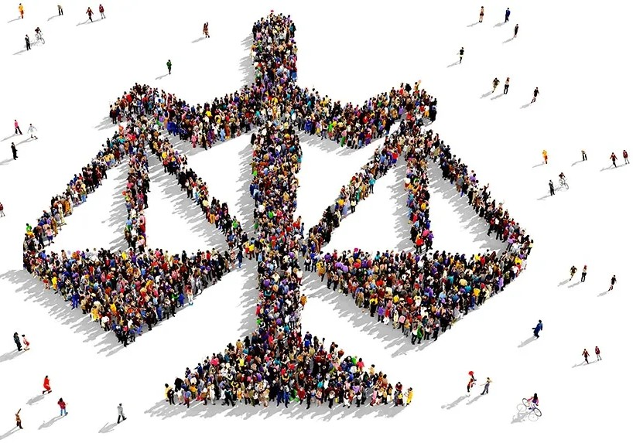
Welcome to Freedom of Speech
Freedom of Speech is a cornerstone of democracy, allowing individuals to express their thoughts and opinions without fear. In this presentation we will explore its signiﬁcance, limitations, and the ongoing debates surrounding it. Let’s dive into what it truly means to speak freely!

Slide 3
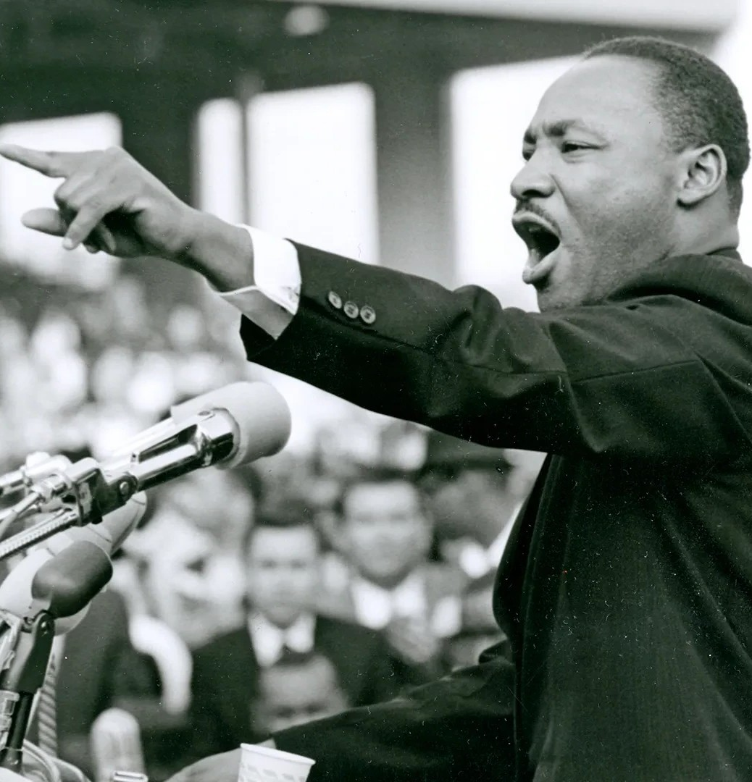
The Importance of Freedom
Freedom of Speech empowers individuals to share ideas, challenge norms, and advocate for change. It plays a crucial role in shaping societies and fostering innovation. Without it, many movements and advancements we cherish today might not exist.

Slide 4
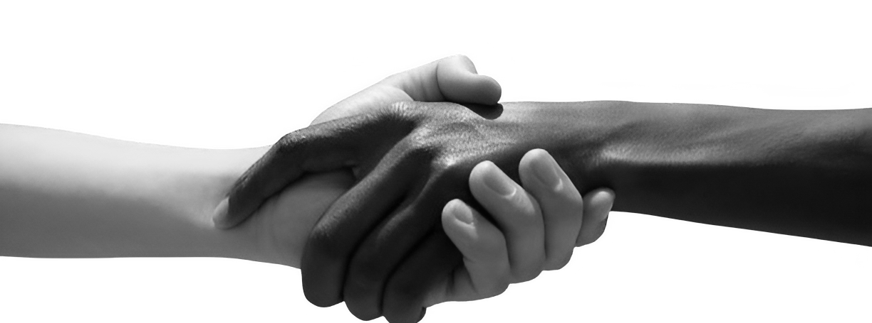
Limitations and Responsibilities
While Freedom of Speech is vital, it comes with responsibilities. Hate speech, incitement to violence, and misinformation can harm society. Understanding the balance between expression and responsibility is essential for a healthy dialogue.

Slide 5
Wrapping It Up
In conclusion, Freedom of Speech is a powerful tool that shapes our world. It’s essential to protect this right while being aware of its limitations. Let’s continue to have open conversations and respect diverse viewpoints as we navigate this complex topic.

Slide 6
Thank you!
Do you have any questions?
ΔΕΛΗΓΙΩΡΓΗΣ ΧΡΙΣΤΟΦΟΡΟΣ ΓΙΑΝΝΟΥΛΗΣ ΒΑΣΙΛΗΣ

