Slide 1
UNIT 6 Leaders born or made? (Definition of leader noun from the Oxford Advanced American Dictionary)
Leader: a person who leads a group of people, especially the head of a country, an organization, etc
a political/spiritual, etc. leader
the leader of the movement
union leaders
He was not a natural leader.
She's a born leader.
a person or thing that is the best, or in first place in a race, business, etc. She was among the leaders of the race from the start.
The company is a world leader in electrical goods.

Slide 2
Match the leader to his portrait
1. Winston Churchill
2. Abraham Lincoln
4. Nelson Mandela
5. Napoleon Bonaparte
6. Alexander the Great
3. Mohanda Gandhi
7. Julius Caesar
8. Martin Luther King Jr.

Slide 3
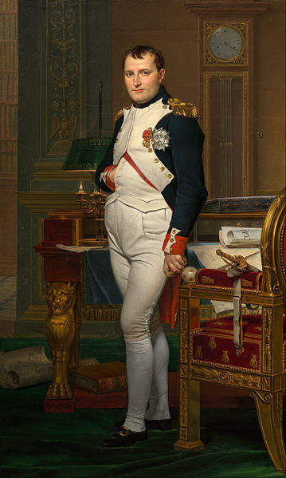
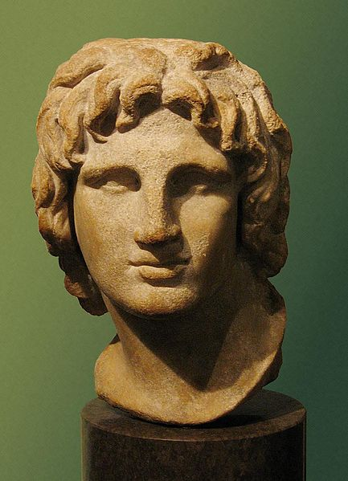
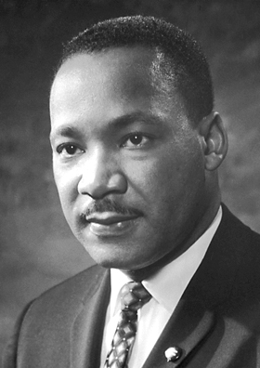
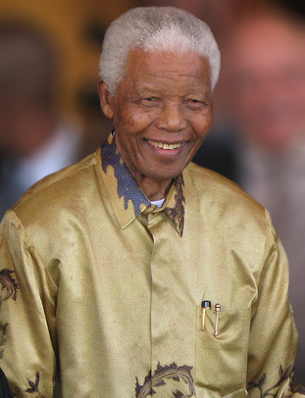
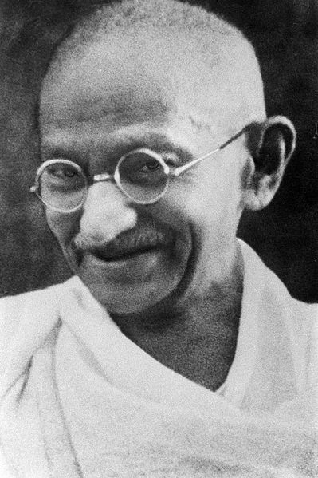
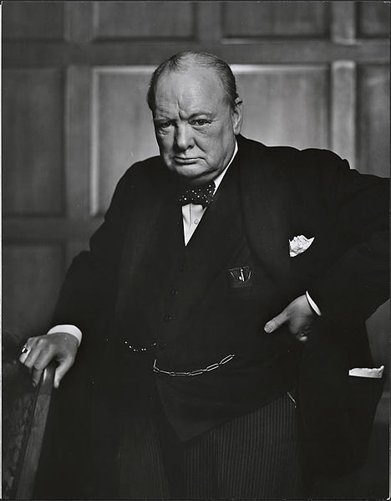
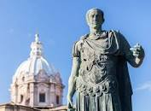
A
B
C
D
F
E
G
H

Slide 4
What are 10 characteristics of a good leader?
Honesty
Ability to delegate
Communication
Sense of humor
Confidence
Commitment
Positive attitude
Creativity

Slide 5
What is an adjective to describe a leader? https://www.wordreference.com/
confident
charismatic
collaborative
uplifting
encouraging
approachable
attentive
inspiring
trustworthy
transparent
focused
inclusive
honest
communicative

Slide 6
My leader

Slide 7
Martin Luther King
https://www.youtube.com/watch?v=_IB0i6bJIjw
Watch this video and jot down one of Martin Luther King’s dream.
Did it become true?
Study the vocabulary of the unit
and
Turn to page 83 of your book and do task 2.

Slide 8
Nelson Mandela
Turn to page 84 of your book and skim the text to find out if these statements about Nelson Mandela are true or false.
He was president of South Africa
He was a doctor.
He was in favour of apartheid.
He stayed in prison for 27 years.
He was awarded the Nobel Peace Prize in 1993.

Slide 9
Persuasive Techniques

