Slide 1
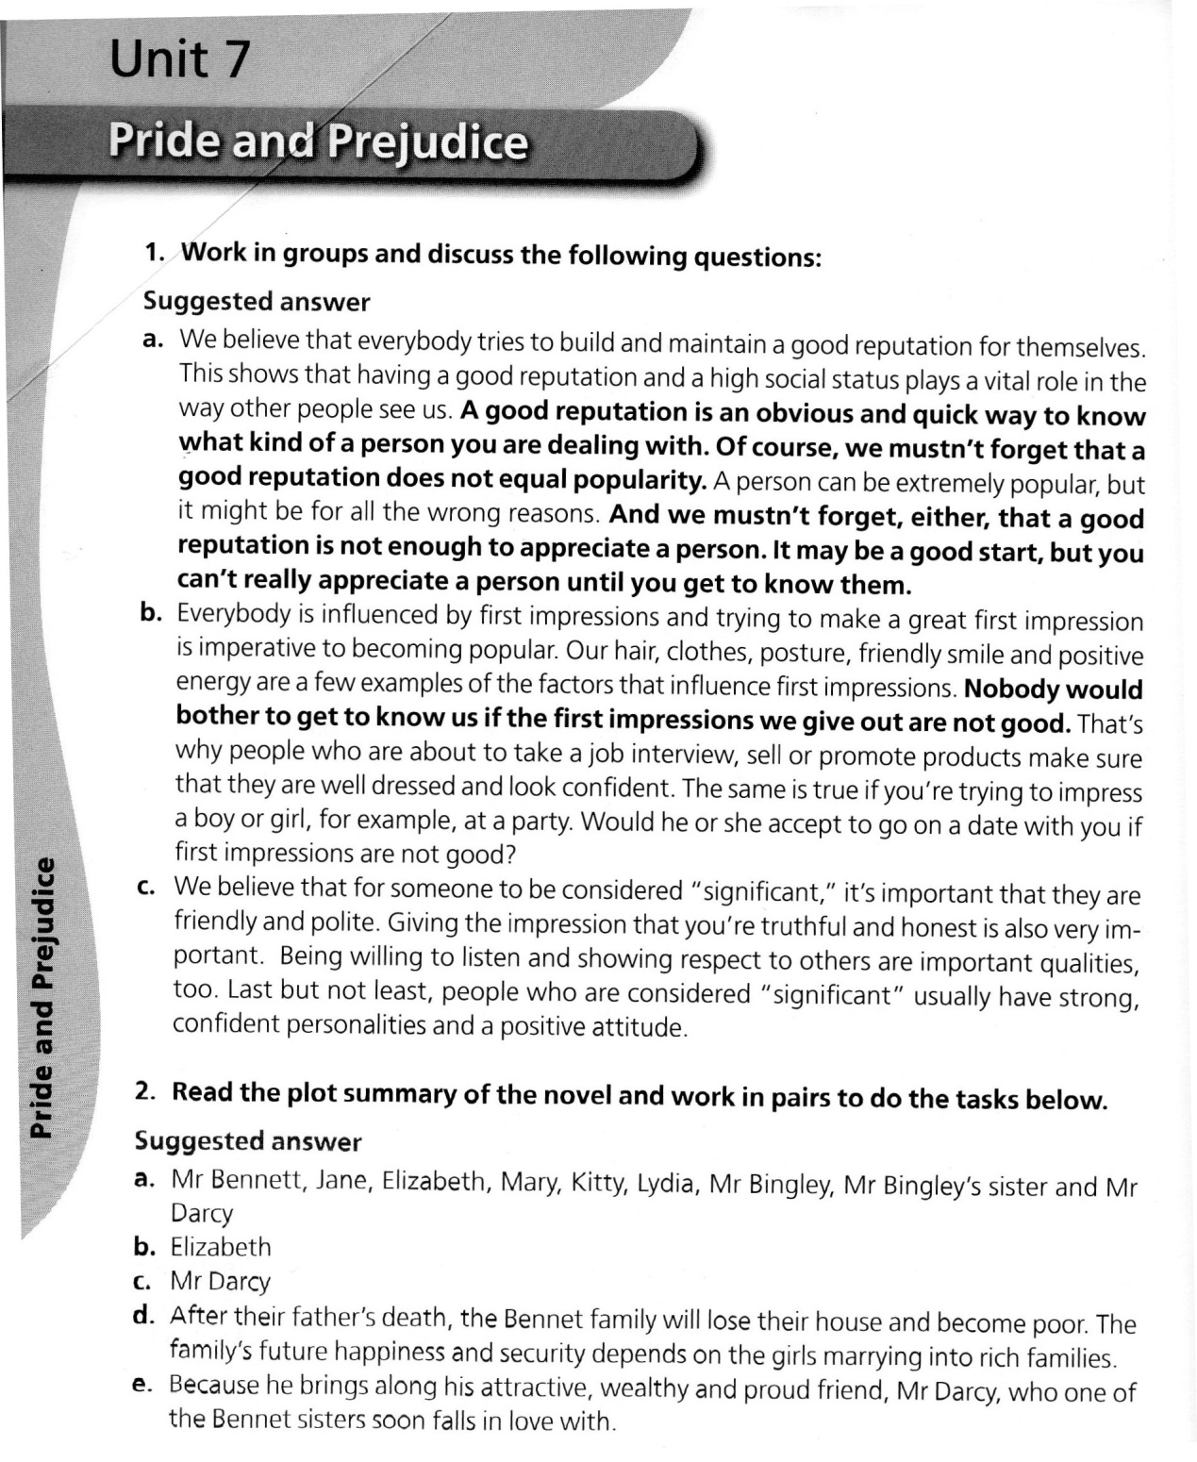

Slide 2
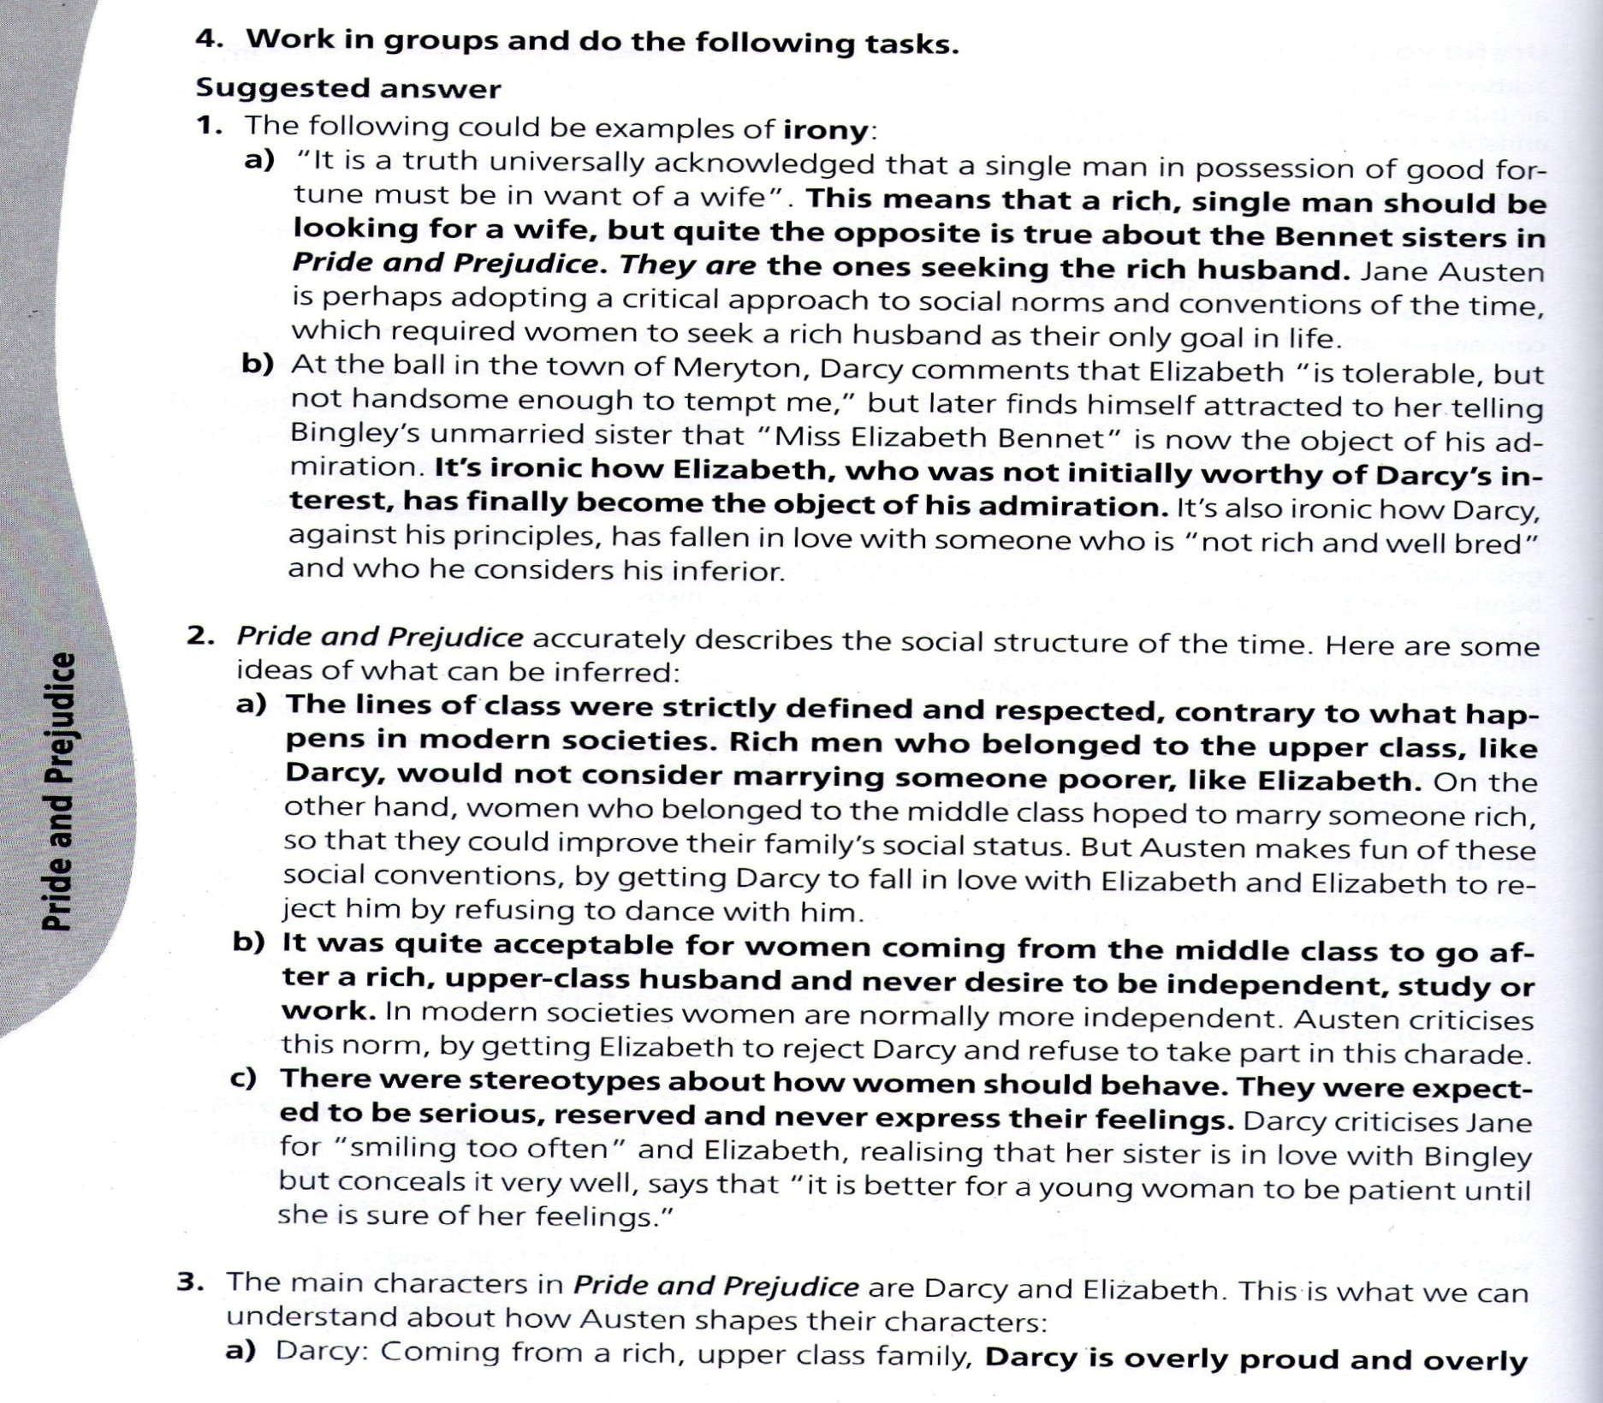

Slide 3
3) The main characters in Pride and Prejudice are Darcy and Elizabeth. This is what we can understand about
how Austen shapes their characters:
Darcy: coming from a rich, upper class family, Darcy
is overly proud and overly conscious of his social status.
He looks down on other people who come from a
humbler background, like Elizabeth, stating that he has
no interest in women who are “slighted by other men.”

Slide 4
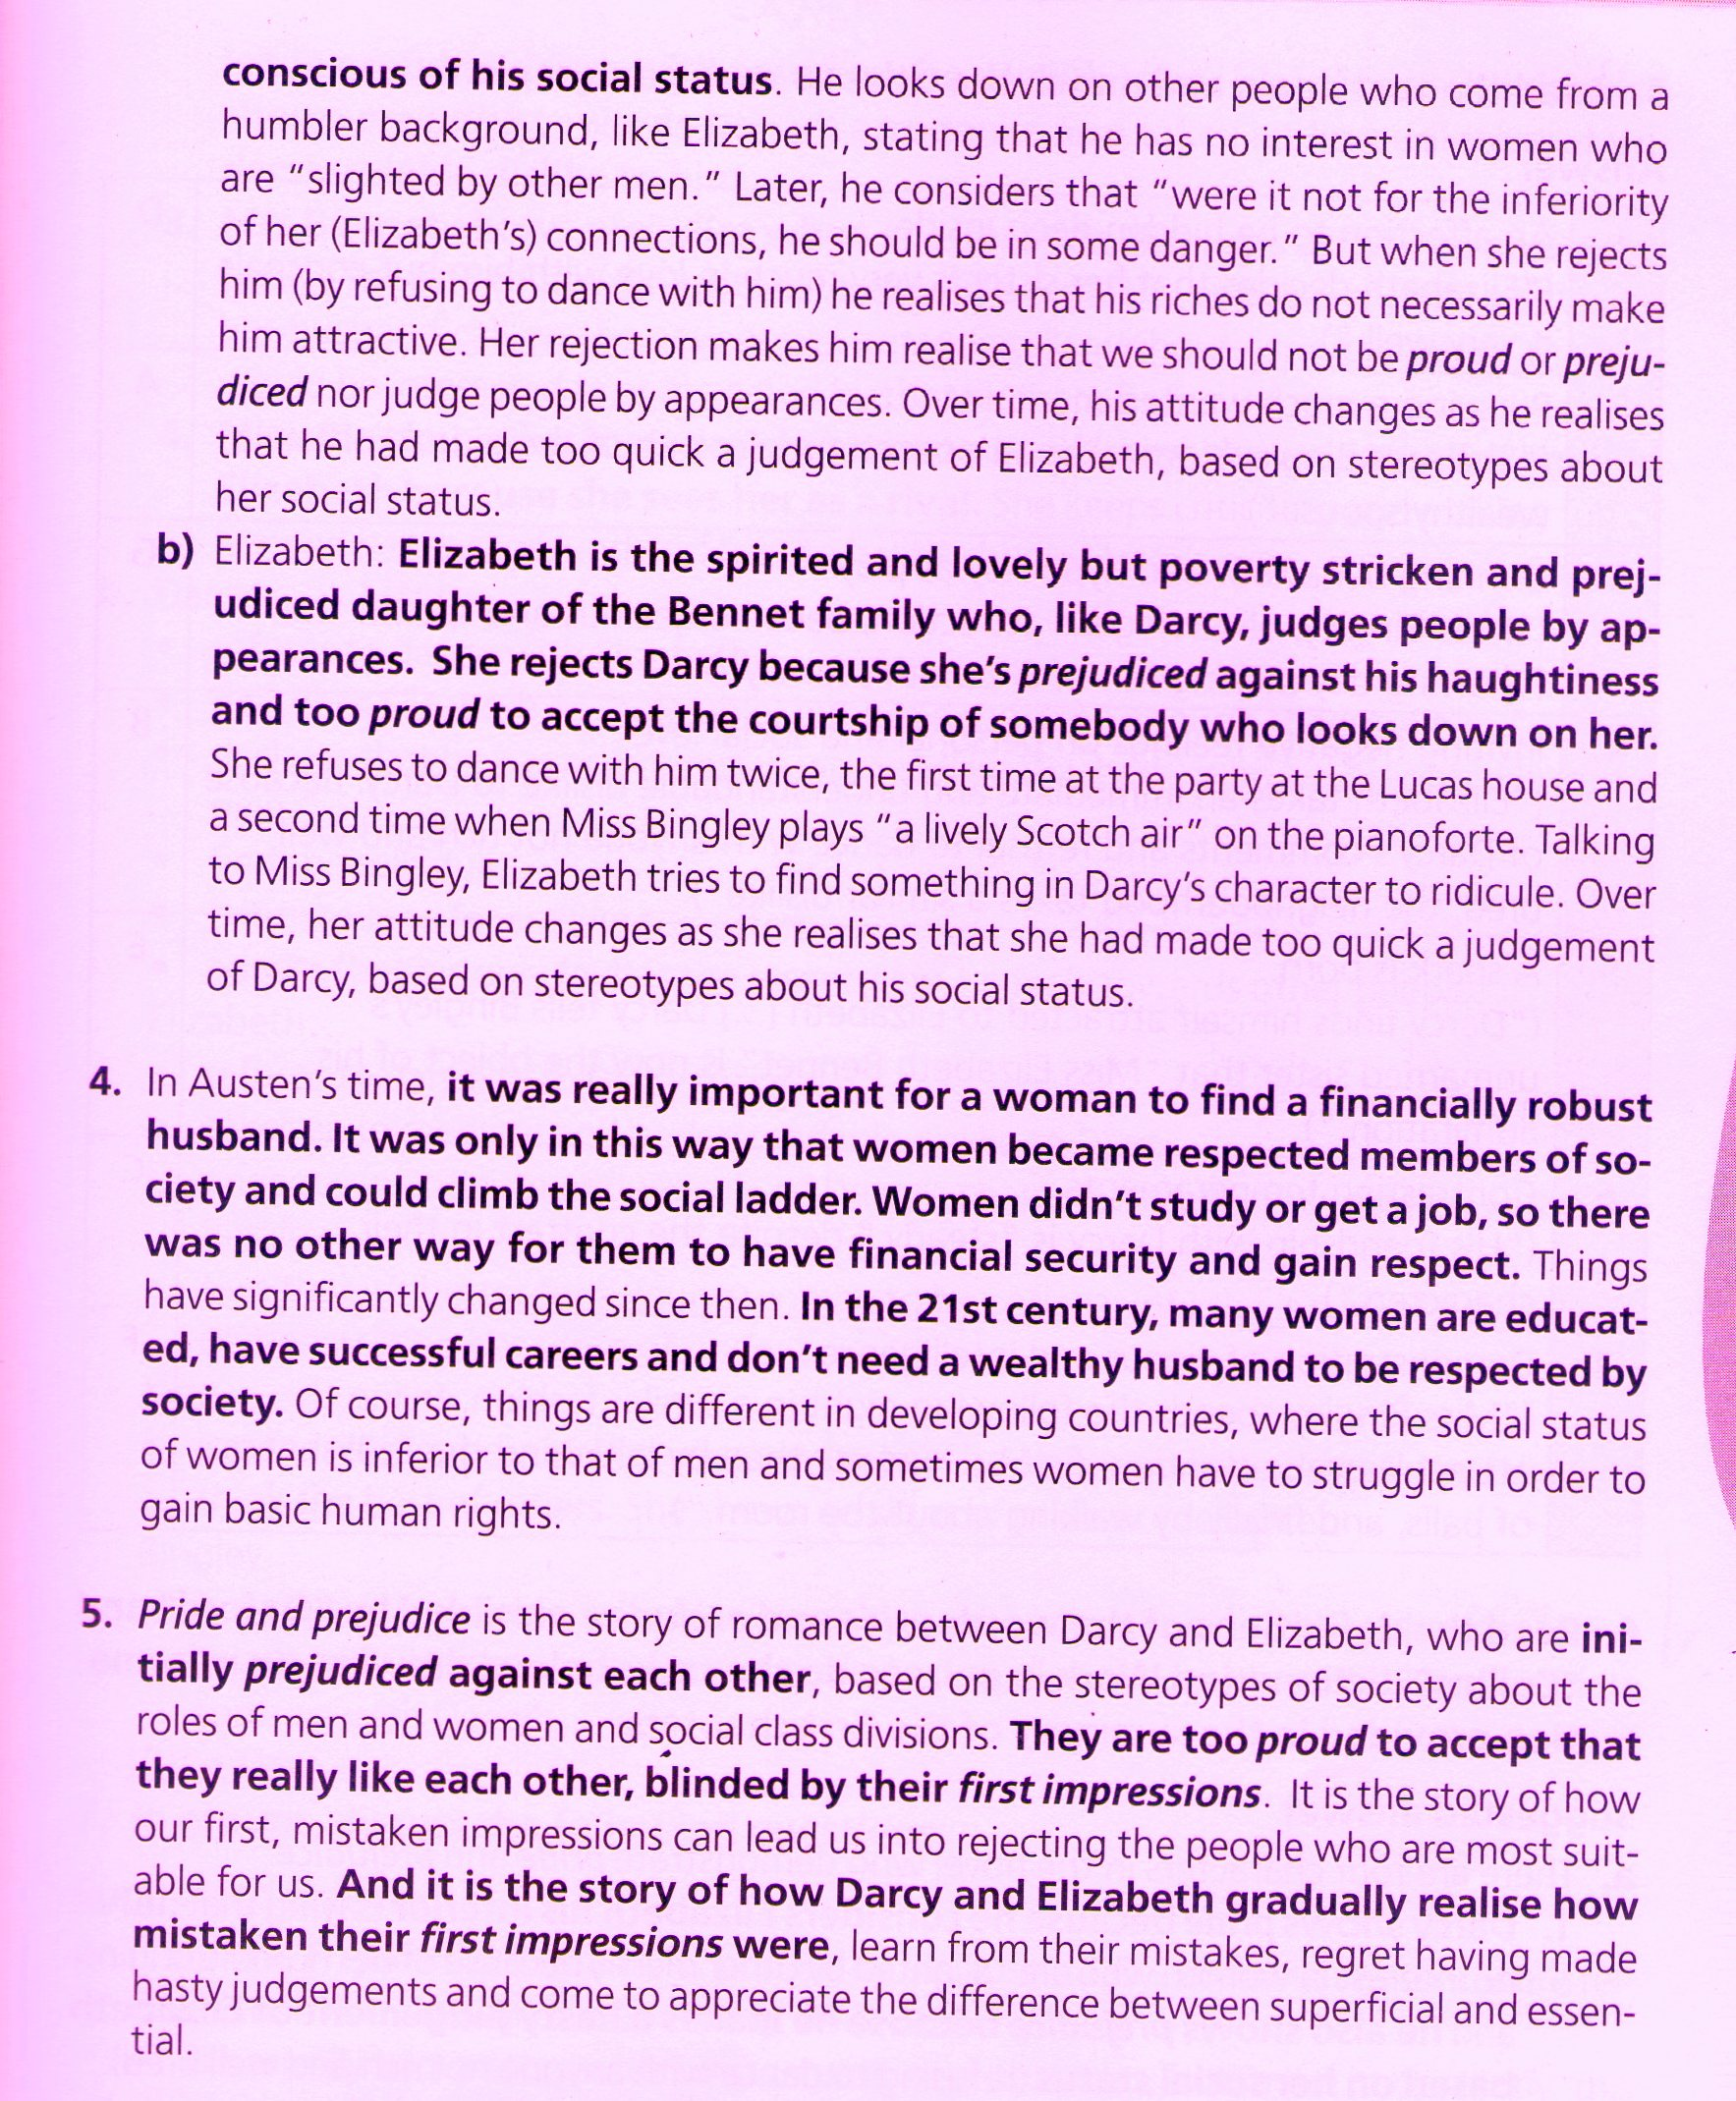

Slide 5
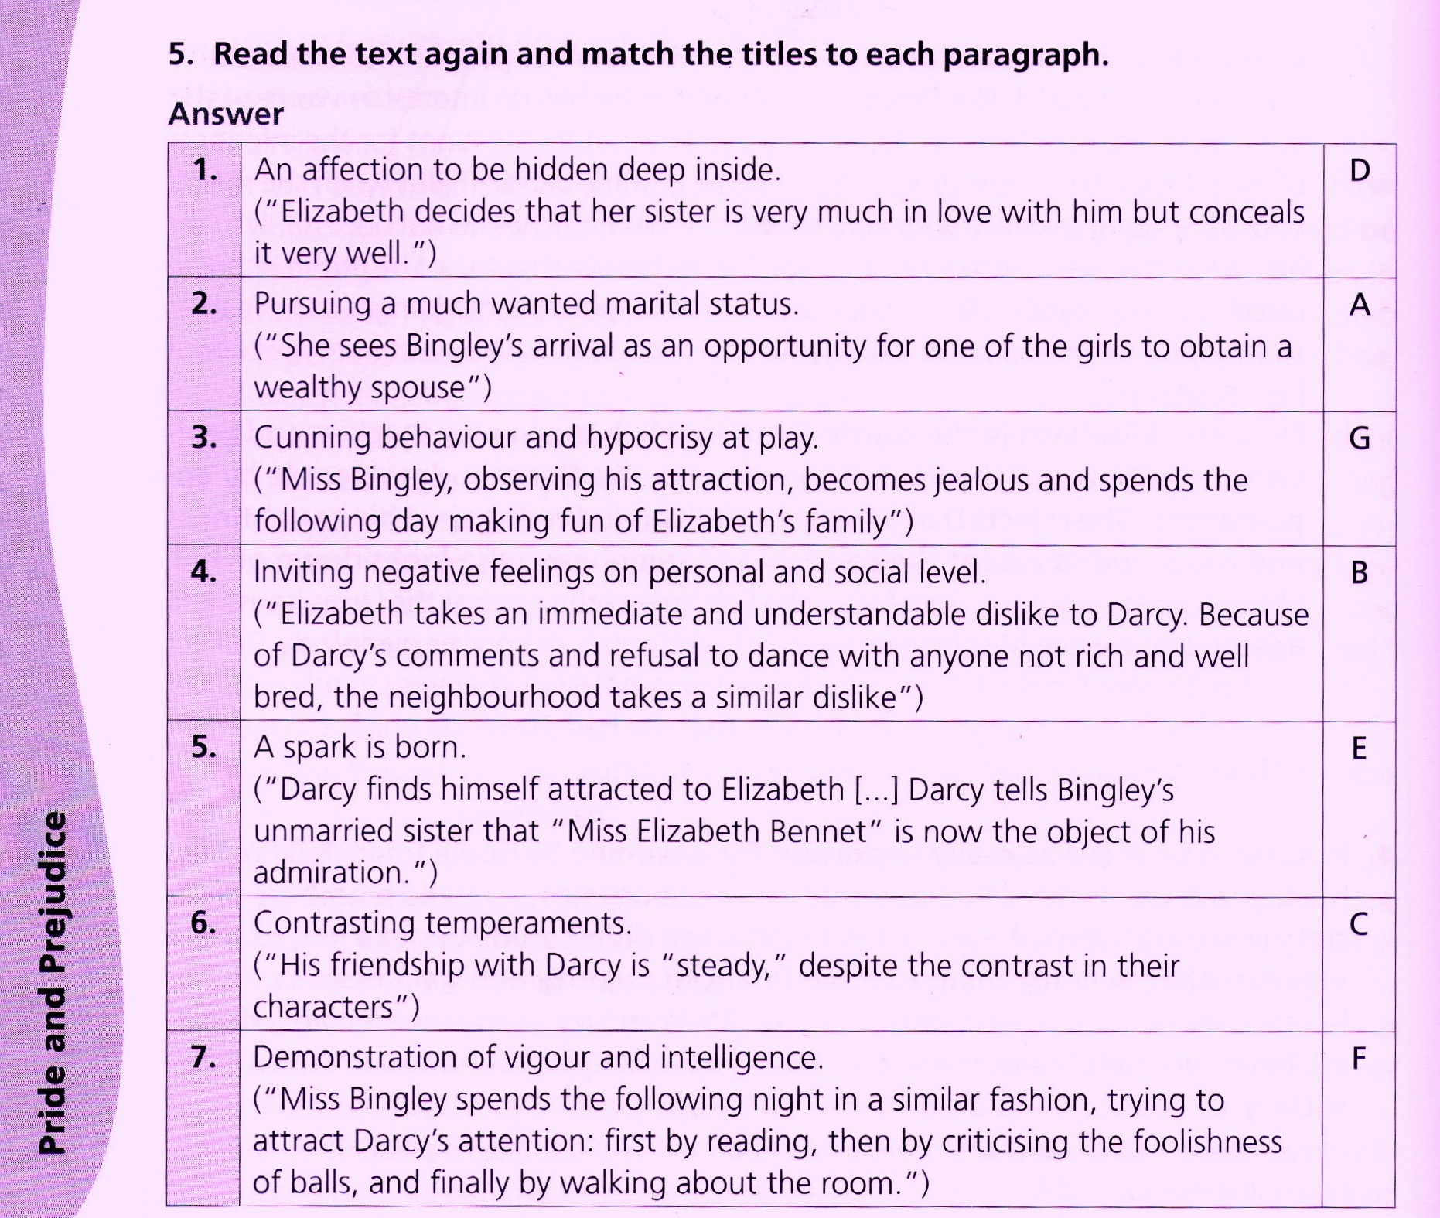

Slide 6
6.
There are four characters in the novel who demonstrate pride and prejudice.
Darcy shows pride because he considers Elizabeth his inferior because of her
humble origins. He shows prejudice because he makes a hasty judgment of Elizabeth
Based on her social status, refusing to dance with anyone not rich and well bred.
2. Elizabeth shows pride and prejudice in rejecting Darcy’s proposal twice, because she
is too proud to dance with anyone who considers her his inferior. She also shows
prejudice towards Darcy’s arrogance and takes an immediate and understandable dislike
to him.
3. Mrs. Bennet shows prejudice when she sees Mr Bingley’s arrival as an opportunity for one
of her daughters to obtain a wealthy spouse. She insists that her husband call on the new
arrival immediately, without caring whether the girls would be interested in or attracted to
that man.
4. Miss Bingley, who is obviously attracted to Darcy, shows prejudice against Elizabeth because she sees her as a rival. She keeps criticizing and making fun of her and her background and tries to belittle her in Darcy’s eyes.

Slide 7
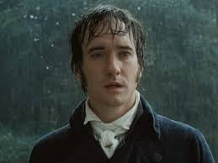
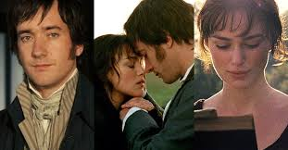
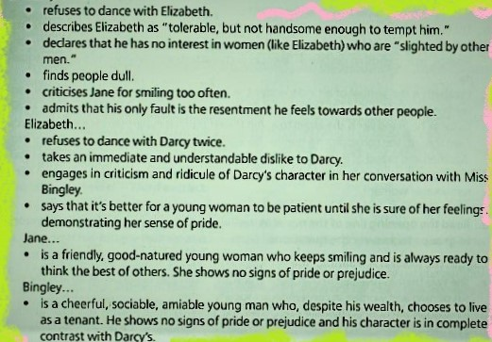
Darcy

Slide 8
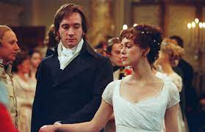
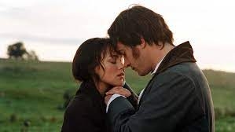
Pride and prejudice still retains its popularity because it talks about issues that were
Relevant then and are still relevant today.
Pride and prejudice is basically about a love story with twists, turns and obstacles; but, most importantly, this romance has a happy end.
The novel focuses on human relationships and feelings, which are universal and timeless. The characters experience feelings of love, jealousy, resentment, pride and regret.
It is interesting because it provides an accurate description of the 19th century society, and zooms in the status of women in it. It is the story of a strong woman who goes against conventions of society and does not settle for anything less than she wants.
A story of how our pride and prejudice can often blind us and lead us into forming mistaken first impressions. The characters come to realize how wrongful they were, and appreciate the difference between superficial and essential.

Slide 9
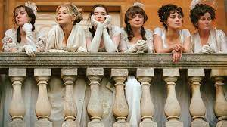
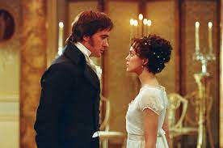
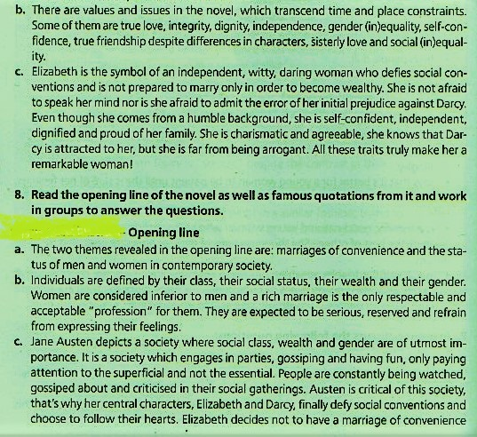
Task 8.

Slide 10
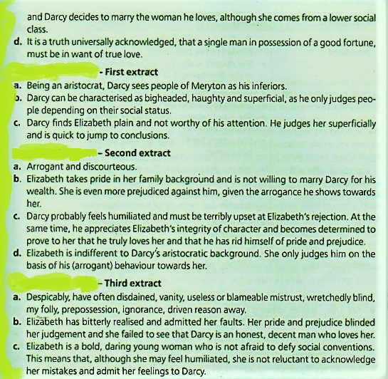
Task 8.

Slide 11
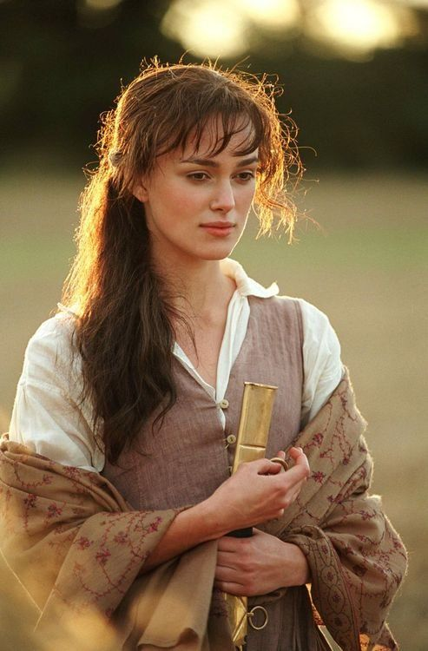
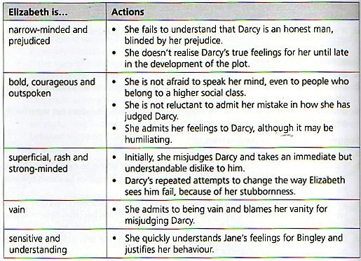
Third extract – d)

